Slide 1
Heat – Orchestration for OpenStack
Overview, AutoScaling & Ceilometer
Steven Hardy (shardy@redhat.com)
4th October 2013

Slide 2
Heat Overview
Horizon
Dashboard
Heat
Orchestration
Keystone
Identity
Service
Nova
Compute
Node
Glance
Image
Service
Swift
Object
Store
Neutron
Networking
Cinder
Volume
Service
Provides AWS Cloudformation and native ReST API
Abstract configuration of services to single-template (CFN/HOT)
HA/Autoscaling features
Openstack integrated project
Notes:
KEY POINTS
Heat provides a way of defining all your openstack resources / services from a single template
Ties together the underlying IAAS services, so you can provide a consolidated infrastructure service, single integration point
Compatible with AWS Cloudformation (templates and API)
Has Autoscaling and HA features
Recently became an incubated project

Slide 3
Heat Stack Lifecycle
User Portal (Horizon)
Stack/Resource
Templates
Orchestration (Heat)
REST
REST
REST
REST
REST
REST
REST
Compute
(Nova)
Identity
(Keystone)
REST
Network
(Neutron)
Glance
(Image Store)
Instance
- cloud-init
- cfn-init
- cfn-hup
-cfn-push-stats
Block Storage
(Cinder)
Object Storage
(Swift)
Metrics/Alarms
(Ceilometer)
Notes:
KEY POINTS

Slide 4
AutoScaling Example
Openshift Users
Metrics
Heat
Heat Stack
Openshift Broker
Orchestrate
Scaling Actions
LaunchConfig
(Openshift Node)
AutoScalingGroup
Notes:
KEY POINTS

Slide 5
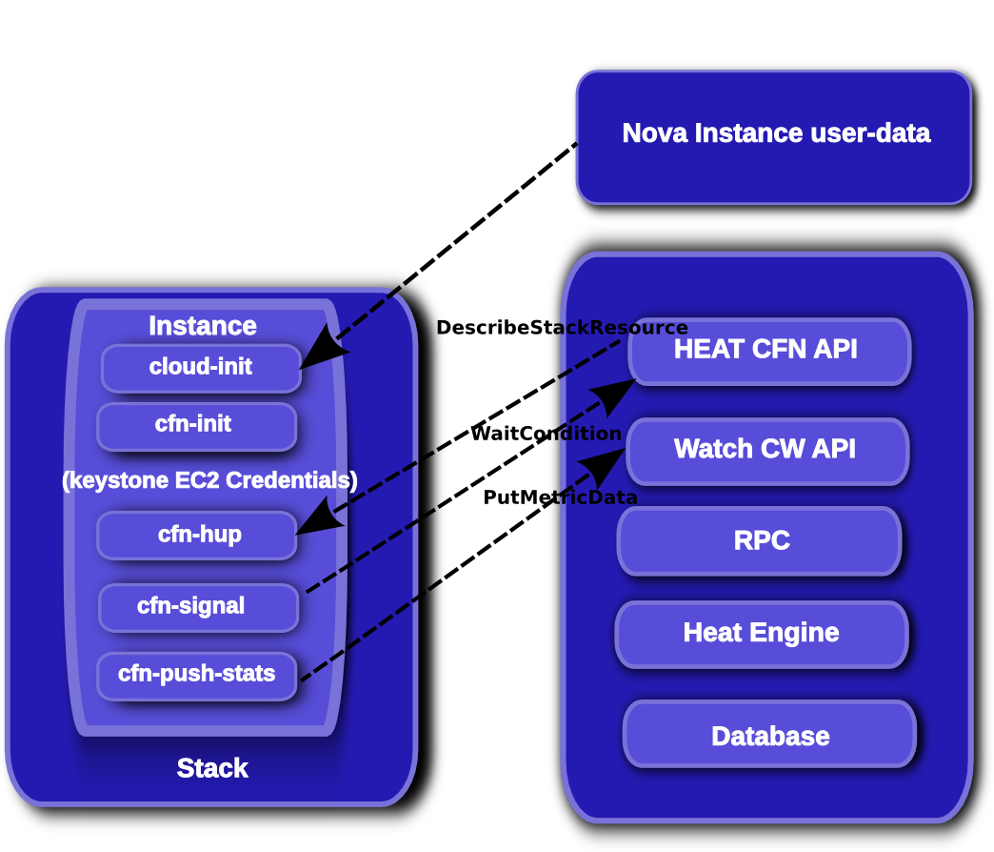
Heat Stack Management
Notes:
KEY POINTS

Slide 6
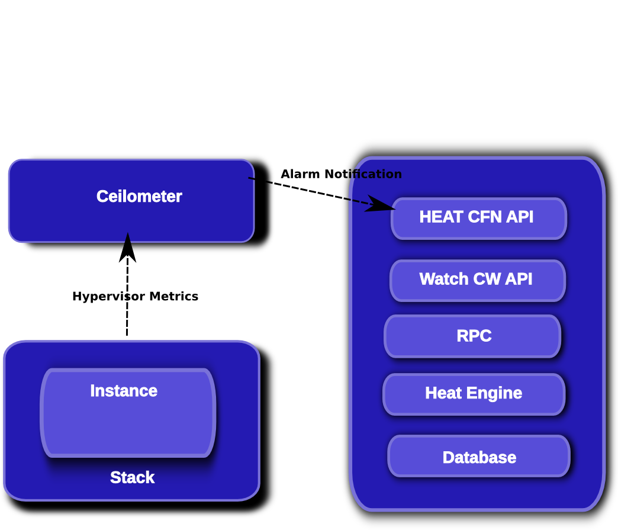
Heat Stack Management (Ceilometer)
Notes:
KEY POINTS

Slide 7
Heat Resource Types
AWS::AutoScaling::AutoScalingGroup
AWS::AutoScaling::LaunchConfiguration
AWS::AutoScaling::ScalingPolicy
AWS::CloudFormation::Stack
AWS::CloudFormation::WaitCondition
AWS::CloudFormation::WaitConditionHandle
AWS::CloudWatch::Alarm
AWS::EC2::EIP
AWS::EC2::EIPAssociation
AWS::EC2::Instance
AWS::EC2::InternetGateway
AWS::EC2::NetworkInterface
AWS::EC2::RouteTable
AWS::EC2::SecurityGroup
AWS::EC2::Subnet
AWS::EC2::SubnetRouteTableAssocation
AWS::EC2::Volume
AWS::EC2::VolumeAttachment
AWS::EC2::VPC
AWS::EC2::VPCGatewayAttachment
AWS::ElasticLoadBalancing::LoadBalancer
AWS::IAM::AccessKey
AWS::IAM::User
AWS::RDS::DBInstance
AWS::S3::Bucket
OS::Ceilometer::Alarm
OS::Cinder::Volume
OS::Cinder::VolumeAttachment
OS::Heat::AccessPolicy
OS::Heat::CWLiteAlarm
OS::Heat::HARestarter
OS::Heat::InstanceGroup
OS::Neutron::Firewall
OS::Neutron::FirewallPolicy
OS::Neutron::FirewallRule
OS::Neutron::FloatingIP
OS::Neutron::FloatingIPAssociation
OS::Neutron::HealthMonitor
OS::Neutron::IKEPolicy
OS::Neutron::IPsecPolicy
OS::Neutron::IPsecSiteConnection
OS::Neutron::LoadBalancer
OS::Neutron::Net
OS::Neutron::Pool
OS::Neutron::Port
OS::Neutron::Router
OS::Neutron::RouterGateway
OS::Neutron::RouterInterface
OS::Neutron::Subnet
OS::Neutron::VPNService
OS::Nova::Server
OS::Swift::Container
Notes:
KEY POINTS
Heat implements most functionality
Heat upstream has more work to do on network functionality

Slide 8
Icehouse Roadmap
More flexible AutoScaling (API, Resource Scaling, ...)
Developing HOT DSL
Engine scale-out
Rolling Updates (UpdatePolicy, Metadata update)
Native in-instance tools
Template-function plugins
Software configuration resources
More native resource types
Stack snapshot/restore
Notes:
KEY POINTS
Heat implements most functionality
Heat upstream has more work to do on network functionality

Slide 9
In Closing
Flexible and rapidly evolving orchestration system
Version your infrastructure like code
Define custom resources
Single-template interface to all of openstack

Slide 10
Thank you!
http://docs.openstack.org/developer/heat/
http://openstack.redhat.com/Docs
http://github.com/openstack/heat
https://launchpad.net/heat
http://wiki.openstack.org/wiki/Heat
http://hardysteven.blogspot.co.uk
https://github.com/hardys/presentations

