Slide 1
Heat – Orchestration for OpenStack
Icehouse project update
Steven Hardy (shardy@redhat.com)
1st April 2014

Slide 2
Heat Overview
User Portal (Horizon)
Stack/Resource
Templates
Orchestration (Heat)
REST
REST
REST
REST
REST
REST
REST
Compute
(Nova)
Identity
(Keystone)
REST
Network
(Neutron)
Glance
(Image Store)
Instance
- cloud-init
- cfn-init
- cfn-hup
-cfn-push-stats
Block Storage
(Cinder)
Object Storage
(Swift)
Metrics/Alarms
(Ceilometer)
Notes:
KEY POINTS

Slide 3
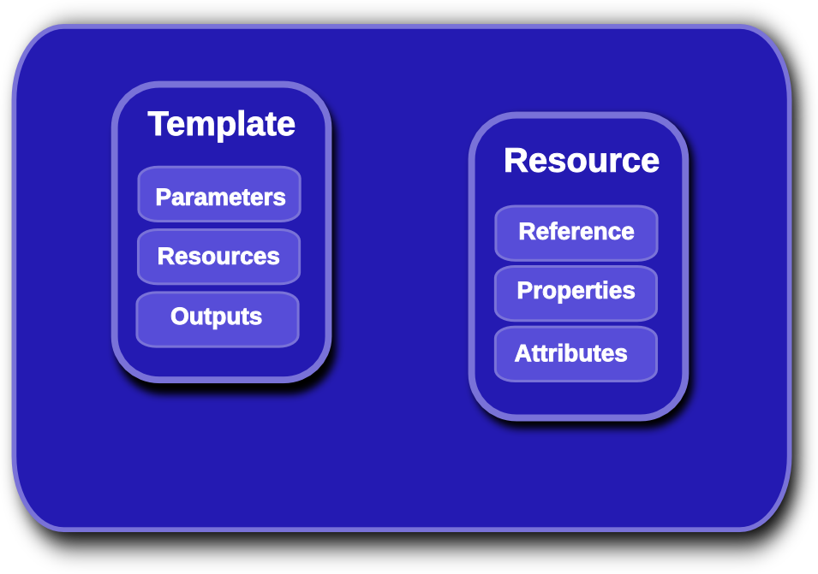
Heat Template Overview
Notes:
KEY POINTS
Lifecycle operations
Create creates a stack from a template
Delete deletes an existing instantiated stack
Update updates an existing instantiated stack
Introspection operations
List obtains a list of existing stacks
Describe obtains details of existing stacks
Events List obtains events that have occurred for a stack
List resources lists resources associated with a stack
Template describes a stack

Slide 4
Heat Orchestration Template
heat_template_version: 2013-05-23
parameters:
image:
type: string
constraints:
- custom_constraint: glance.image
resources:
my_instance:
type: OS::Nova::Server
properties:
flavor: m1.small
image: {get_param: image}
outputs:
networks:
description: my_instance network details
value: {get_attr : [my_instance, networks]}
Notes:
KEY POINTS
Lifecycle operations
Create creates a stack from a template
Delete deletes an existing instantiated stack
Update updates an existing instantiated stack
Introspection operations
List obtains a list of existing stacks
Describe obtains details of existing stacks
Events List obtains events that have occurred for a stack
List resources lists resources associated with a stack
Template describes a stack

Slide 5
Heat Template Links
docs.openstack.org/developer/heat/template_guide
github.com/openstack/heat-templates
heat resource-type-list
heat resource-type-show OS::Nova::Server
docs.openstack.org/developer/heat/template_guide/hot_spec.html
Notes:
KEY POINTS
Lifecycle operations
Create creates a stack from a template
Delete deletes an existing instantiated stack
Update updates an existing instantiated stack
Introspection operations
List obtains a list of existing stacks
Describe obtains details of existing stacks
Events List obtains events that have occurred for a stack
List resources lists resources associated with a stack
Template describes a stack

Slide 6
Havana features
Concurrent resource operations
Much improved networking/Neutron support
Initial support for native template language (HOT)
“Provider/Environment” abstractions (template-defined resources)
Ceilometer integration for metrics/monitoring/alarms
UpdateStack improvements
Integration with keystone trusts
Many more native resource types
Horizon (UI) integration
Stack “actions” (suspend/resume)
Notes:
KEY POINTS
Heat implements most functionality
Heat upstream has more work to do on network functionality

Slide 7
Icehouse key new features
HOT DSL feature-complete and declared stable
Software-config initial implementation complete
“stack domain users” (no more admin requirement)
Native auto-scaling resources
Pluggable parameter constraints
Pluggable template parser/functions
Scalable heat-engine
“management API” additions
Notes:
KEY POINTS
Provides orchestration service for openstack
Integrates all openstack core projects
Converts either a JSON or YAML template into an openstack cloud application

Slide 8
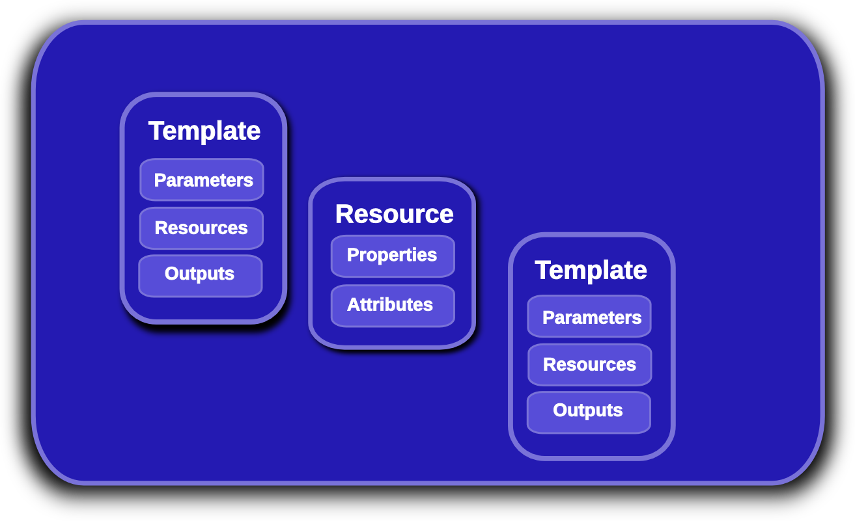
Heat Nested Stack Templates
Notes:
KEY POINTS
Lifecycle operations
Create creates a stack from a template
Delete deletes an existing instantiated stack
Update updates an existing instantiated stack
Introspection operations
List obtains a list of existing stacks
Describe obtains details of existing stacks
Events List obtains events that have occurred for a stack
List resources lists resources associated with a stack
Template describes a stack

Slide 9
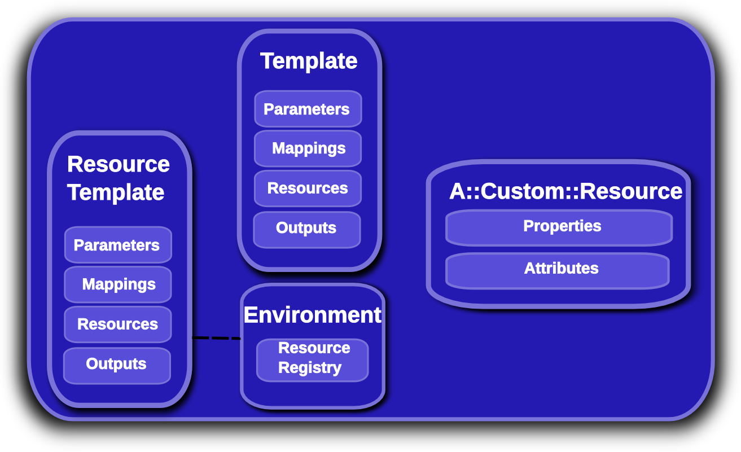
Provider Resources
Notes:
KEY POINTS
Lifecycle operations
Create creates a stack from a template
Delete deletes an existing instantiated stack
Update updates an existing instantiated stack
Introspection operations
List obtains a list of existing stacks
Describe obtains details of existing stacks
Events List obtains events that have occurred for a stack
List resources lists resources associated with a stack
Template describes a stack

Slide 10
Provider Resources
Heat native interface to nested stacks
No hard-coded URLs (in the template)
Staging workflow/testing much simplified
Allows deployer or user to define custom resources
  /etc/heat/environment.d
  /etc/heat/templates
  Users heat stack-create –environment-file=foo.yaml
    Users can override default deployer resources!
resource_registry:
"My::Custom::Server": server.yaml
Notes:
KEY POINTS
Lifecycle operations
Create creates a stack from a template
Delete deletes an existing instantiated stack
Update updates an existing instantiated stack
Introspection operations
List obtains a list of existing stacks
Describe obtains details of existing stacks
Events List obtains events that have occurred for a stack
List resources lists resources associated with a stack
Template describes a stack

Slide 11
Provider Resource environment
parameters:
key_name: mykey
resource_registry:
My::Custom::Server : my_server.yaml
OS::Nova::Server : override_nova.yaml
python-heatclient resolves local files and URLs
Files associated with environment are passed along with the stack-create/update API request
heat stack-create mystack -f template.yaml -e environment.yaml
Notes:
KEY POINTS
Lifecycle operations
Create creates a stack from a template
Delete deletes an existing instantiated stack
Update updates an existing instantiated stack
Introspection operations
List obtains a list of existing stacks
Describe obtains details of existing stacks
Events List obtains events that have occurred for a stack
List resources lists resources associated with a stack
Template describes a stack

Slide 12
Software Config
Much better integration with cloud-init
  OS::Heat::CloudConfig
  OS::Heat::MultipartMime
  Removes hard requirement for additional agents
Initial software config resources implemented
  OS::Heat::SoftwareConfig
  OS::Heat::SoftwareDeployment
  OS::Heat::StructuredConfig
  OS::Heat::StructuredDeployment
Notes:
KEY POINTS
Lifecycle operations
Create creates a stack from a template
Delete deletes an existing instantiated stack
Update updates an existing instantiated stack
Introspection operations
List obtains a list of existing stacks
Describe obtains details of existing stacks
Events List obtains events that have occurred for a stack
List resources lists resources associated with a stack
Template describes a stack

Slide 13
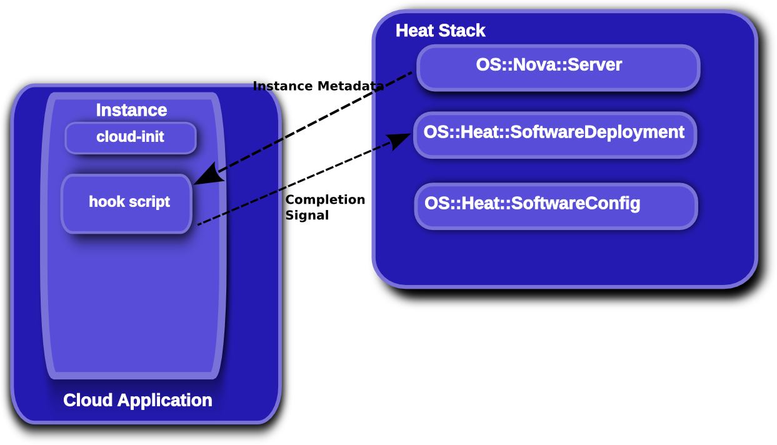
Software Config
Notes:
KEY POINTS
Lifecycle operations
Create creates a stack from a template
Delete deletes an existing instantiated stack
Update updates an existing instantiated stack
Introspection operations
List obtains a list of existing stacks
Describe obtains details of existing stacks
Events List obtains events that have occurred for a stack
List resources lists resources associated with a stack
Template describes a stack

Slide 14
Software Config
SoftwareConfig resource defines the config to be applied
  CM tool agnostic
SoftwareDeployment resource applies the config to a specified
  Apply config to server
  Takes inputs to allow parameterization of configs
  CM tool agnostic
Hook scripts are deployed in instance
  Via cloud-init or pre-built image
  Handle mapping the SoftwareConfig to the CM tool/agent
    Heat-cfntools (cfn-init)
    Tripleo agents (os-refresh-config/os-config-applier)
    Puppet
    Chef
    ... (definable by the user/deployer)
Notes:
KEY POINTS
Lifecycle operations
Create creates a stack from a template
Delete deletes an existing instantiated stack
Update updates an existing instantiated stack
Introspection operations
List obtains a list of existing stacks
Describe obtains details of existing stacks
Events List obtains events that have occurred for a stack
List resources lists resources associated with a stack
Template describes a stack

Slide 15
Roadmap (incomplete & tbc!)
Autoscaling hooks (scale-down cleanup)
Autoscaling parameters (choose victims)
Enable retry from failed states
Rolling updates
Stack check
Stack preview
Cancel stack update
Update preview
... Will be driven by users and downstream projects :)
Notes:
KEY POINTS
Heat implements most functionality
Heat upstream has more work to do on network functionality

Slide 16
Questions?
https://wiki.openstack.org/wiki/Heat
http://docs.openstack.org/developer/heat/
https://github.com/hardys/presentations

