Slide 1
Heat – Orchestration for OpenStack
Overview, Status, Roadmap
Steven Hardy (shardy@redhat.com)
Openstack Meetup, London – 23rd May 2013

Slide 2
Heat Overview
Started in March 2012
Incubated for Grizzly, Integrated for Havana
25 contributors (9 core)
~1900 commits
~34,000 lines of code
37 different resource types (and counting!)
We do much more than launch instances :)
Notes:
KEY POINTS
Provides orchestration service for openstack
Integrates all openstack core projects
Converts either a JSON or YAML template into an openstack cloud application

Slide 3
Heat Overview
Horizon
Dashboard
Heat
Orchestration
Keystone
Identity
Service
Nova
Compute
Node
Glance
Image
Service
Swift
Object
Store
Quantum
Networking
Cinder
Volume
Service
Provides AWS Cloudformation and native ReST API
Abstract configuration of services to single-template
HA/Autoscaling/Monitoring features
Openstack integrated project
Notes:
KEY POINTS
Heat provides a way of defining all your openstack resources / services from a single template
Ties together the underlying IAAS services, so you can provide a consolidated infrastructure service, single integration point
Compatible with AWS Cloudformation (templates and API)
Has Autoscaling and HA features
Recently became an incubated project

Slide 4
Heat Overview
Orchestration of Openstack deployments
Integrates with all Openstack core projects
  Ceilometer integration for Havana release
Converts a JSON template into a cloud application
  Templates can be nested for better modularity
Implements well known template and API (AWS Cloudformation, also YAML, openstack ReST)
  Native template syntax discussions ongoing
Version your cloud applications like your software
Repeatable deployments, fully automated
Notes:
KEY POINTS
Provides orchestration service for openstack
Integrates all openstack core projects
Converts either a JSON or YAML template into an openstack cloud application

Slide 5
Heat API : Key features
Compatibility with AWS Cloudformation (template/API)
Also superset of OS native resources & ReST API
Fully open community project
Distro-agnostic, integrated openstack project
Implements HA (service/instance/stack)
Implements Instance AutoScaling/InstanceGroups
Cloudwatch/Monitoring API (will move to Ceilometer)
Pluggable resource implementations
Watch this space!
Notes:
KEY POINTS

Slide 6
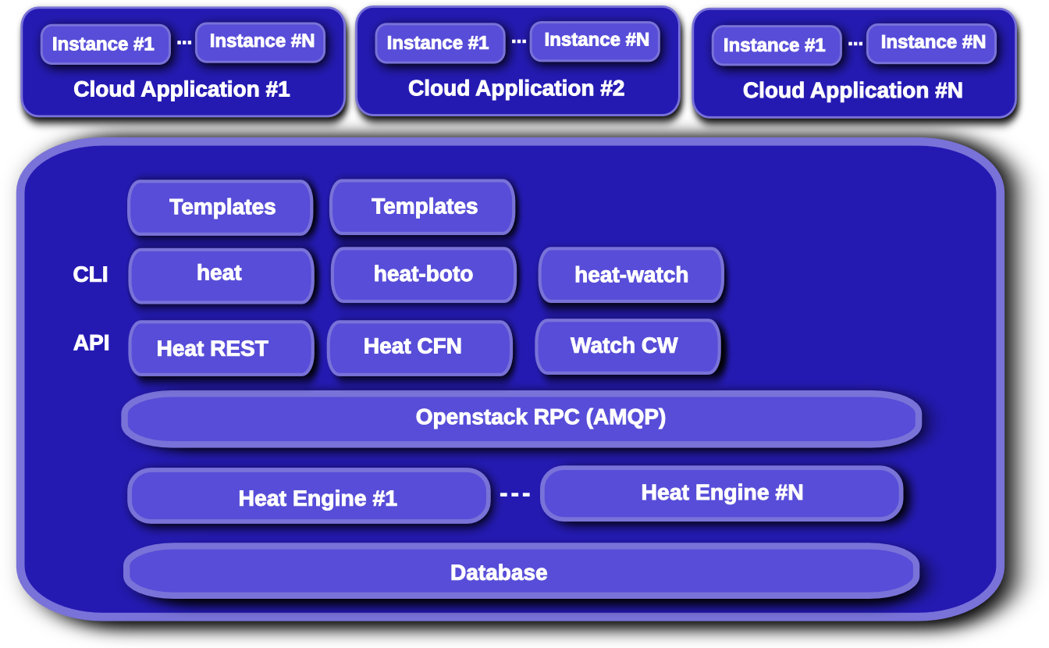
Heat Overview
Notes:
KEY POINTS
API module that services user API operations
Engine module that services API module rpc operations
Cloudwatch API for metric collection

Slide 7
Nova Instance Lifecycle
Image
REST
Nova
Glance
(Image Store)
Keystone
REST
Nova-network
/quantum
Nova-volume
/cinder
Instance
- cloud-init
- ???
Instance
- cloud-init
Instance
- cloud-init
Instances
- cloud-init
- ???
Swift
Ceilometer
Notes:
KEY POINTS

Slide 8
Heat Stack Lifecycle
Stack
Template
Heat
REST
REST
REST
REST
REST
Heat-jeos
(oz)
Nova
REST
REST
Nova-network
/quantum
Glance
(Image Store)
Nova-volume
/cinder
Instance
- cloud-init
- cfn-init
- cfn-hup
-cfn-push-stats
Swift
Ceilometer
Notes:
KEY POINTS

Slide 9
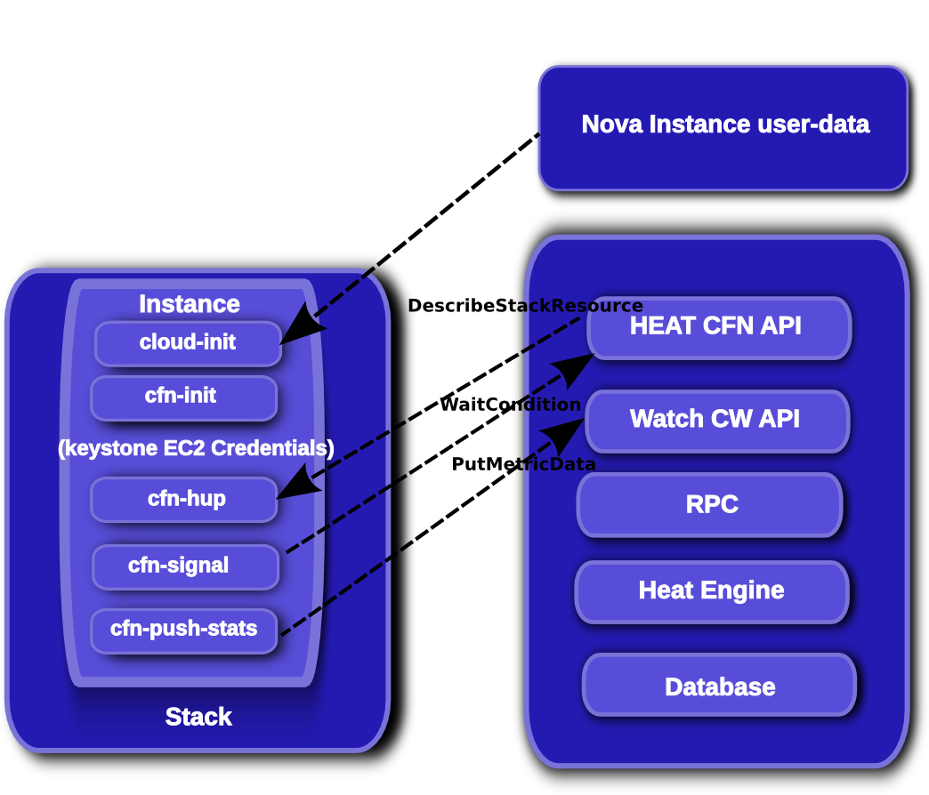
Heat Stack lifecycle
Notes:
KEY POINTS

Slide 10
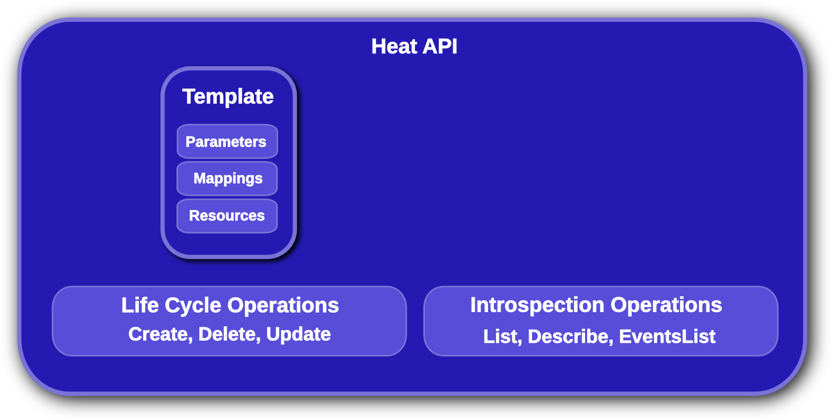
Heat API
“Providers” abstraction coming
Other new abstractions being discussed
Transient stack “actions” being discussed/implemented
Notes:
KEY POINTS
Lifecycle operations
Create creates a stack from a template
Delete deletes an existing instantiated stack
Update updates an existing instantiated stack
Introspection operations
List obtains a list of existing stacks
Describe obtains details of existing stacks
Events List obtains events that have occurred for a stack
List resources lists resources associated with a stack
Template describes a stack

Slide 11
Heat Resource Types
AWS::AutoScaling::AutoScalingGroup
AWS::AutoScaling::LaunchConfiguration
AWS::AutoScaling::ScalingPolicy
AWS::CloudFormation::Stack
AWS::CloudFormation::WaitCondition
AWS::CloudFormation::WaitConditionHandle
AWS::CloudWatch::Alarm
AWS::EC2::EIP
AWS::EC2::EIPAssociation
AWS::EC2::Instance
AWS::EC2::InternetGateway
AWS::EC2::NetworkInterface
AWS::EC2::RouteTable
AWS::EC2::SecurityGroup
AWS::EC2::Subnet
AWS::EC2::SubnetRouteTableAssocation
AWS::EC2::Volume
AWS::EC2::VolumeAttachment
AWS::EC2::VPC
AWS::EC2::VPCGatewayAttachment
AWS::ElasticLoadBalancing::LoadBalancer
AWS::IAM::AccessKey
AWS::IAM::User
AWS::RDS::DBInstance
AWS::S3::Bucket
OS::Heat::AccessPolicy
OS::Heat::HARestarter
OS::Heat::InstanceGroup
OS::Quantum::FloatingIP
OS::Quantum::FloatingIPAssociation
OS::Quantum::Net
OS::Quantum::Port
OS::Quantum::Router
OS::Quantum::RouterGateway
OS::Quantum::RouterInterface
OS::Quantum::Subnet
OS::Swift::Container
Notes:
KEY POINTS
Heat implements most functionality
Heat upstream has more work to do on network functionality

Slide 12
Grizzly Features
144 bugs fixed
19 blueprints implemented
  New ReST API
  Quantum Resources
  YAML templates
  Python-heatclient
  Better networking & VPC resource support
  Improved UpdateStack support
  Stack Rollback
  Swift Resource type
  Improved security (metadata/WaitCondition events)
Notes:
KEY POINTS
Heat implements most functionality
Heat upstream has more work to do on network functionality

Slide 13
Havana Roadmap
Parallel resource creation (nearly done)
Further improve networking/Quantum support
Rolling Updates (Metadata/UpdatePolicy)
Support for extended template language (HOT)
“Provider” abstraction (template-defined resources)
Add AutoScaling API (maybe)
Move to Ceilometer for metrics/monitoring/alarms
More UpdateStack Improvements
Further improved security (PKI/trusts/in-instance credentials)
Native resource types
Horizon (UI) integration
Stack “actions” (suspend/resume)
Configurable LoadBalancer (LBAAS)
Notes:
KEY POINTS
Heat implements most functionality
Heat upstream has more work to do on network functionality

Slide 14
Future Roadmap
Will be driven by users & downstream projects
  Triple-O
  Openstack CI Infra
  ...
User-base and community participation is increasing
We need more users and use-case data to shape direction/priority of feature development
We welcome new contributors (and reviewers! :)
Notes:
KEY POINTS
Heat implements most functionality
Heat upstream has more work to do on network functionality

Slide 15
In Closing
Users, testers and developers wanted!
  Connect via IRC on #heat@freenode
  Check out the repositories:
    https://github.com/openstack/heat
    https://github.com/openstack/heat-templates
    https://github.com/openstack/heat-cfntools
    https://github.com/openstack/python-heatclient
  Read the Documentation:
    http://docs.openstack.org/developer/heat
    http://wiki.openstack.org/Heat/
  Packages Available (RDO, Debian)

Slide 16
Questions?

