Slide 1

Deploying OpenStack at Scale
...with TripleO, Ansible and Containers
OpenStack Summit, Sydney
6th November 2017
Steve Hardy (shardy@redhat.com)

Slide 2


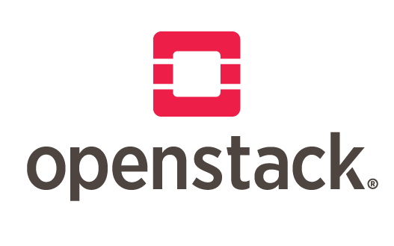
Who am I
Software Engineer at Red Hat
Working on OpenStack since 2012
Heat & TripleO Core reviewer
Former Heat & TripleO PTL

Slide 3
What is this talk about?

Slide 4













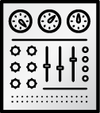
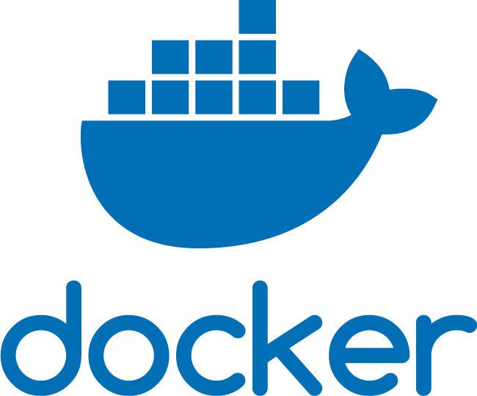
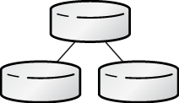



What this talk IS about.
Deploying/managing the OpenStack services
The services that make OpenStack run.
DEPLOYMENT
and
MANAGEMENT
TELEMETRY
DATA
PROCESSING
SHARED FILESYSTEM
ORCHESTRATION
SHARED SERVICES
IDENTITY
IaaS+
CEILOMETER
SAHARA
MANILA
HEAT
KEYSTONE
COMPUTE
STORAGE
NETWORKING
BARE-METAL
PROVISIONING
DASHBOARD
BLOCK
IMAGE
OBJECT
IaaS
NOVA
CINDER
GLANCE
SWIFT
NEUTRON
IRONIC
HORIZON
TRIPLEO

Slide 5
What this talk IS NOT about.
Containerizing workloads RUNNING ON OpenStack.
The services that make OpenStack run.
DEPLOYMENT
and
MANAGEMENT
TELEMETRY
DATA
PROCESSING
SHARED FILESYSTEM
ORCHESTRATION
SHARED SERVICES
IDENTITY
IaaS+
CEILOMETER
SAHARA
MANILA
HEAT
KEYSTONE
COMPUTE
STORAGE
NETWORKING
BARE-METAL
PROVISIONING
DASHBOARD
BLOCK
IMAGE
OBJECT
IaaS
NOVA
CINDER
GLANCE
SWIFT
NEUTRON
IRONIC
HORIZON
TRIPLEO

Slide 6
Introduction to TripleO

Slide 7



PLANNING
DEPLOYMENT
OPERATIONS
Network topology
Service parameters
Resource capacity
Pre-flight checks/validations
Deployment orchestration
Service configuration
Major version upgrades
Applying minor updates
Scaling up and down

Slide 8
Planning
Manage hardware inventory, capacity planning
Node Discovery & Introspection
Register Bare Metal Nodes
Profile Matching (node assignment)
Controller Nodes
Compute Nodes
Networker Nodes

Slide 9
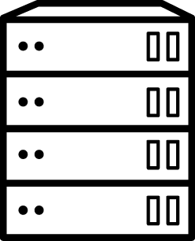

Planning
Composable roles, customize enabled services and placement
Controller Role
Controller Role
Custom Ceilometer Role
Custom Networker Role
Note TripleO role !=
ansible role...
Keystone
Keystone
Ceilometer
Ceilometer
Neutron
Neutron
RabbitMQ
RabbitMQ
Glance
Glance
...
...

Slide 10
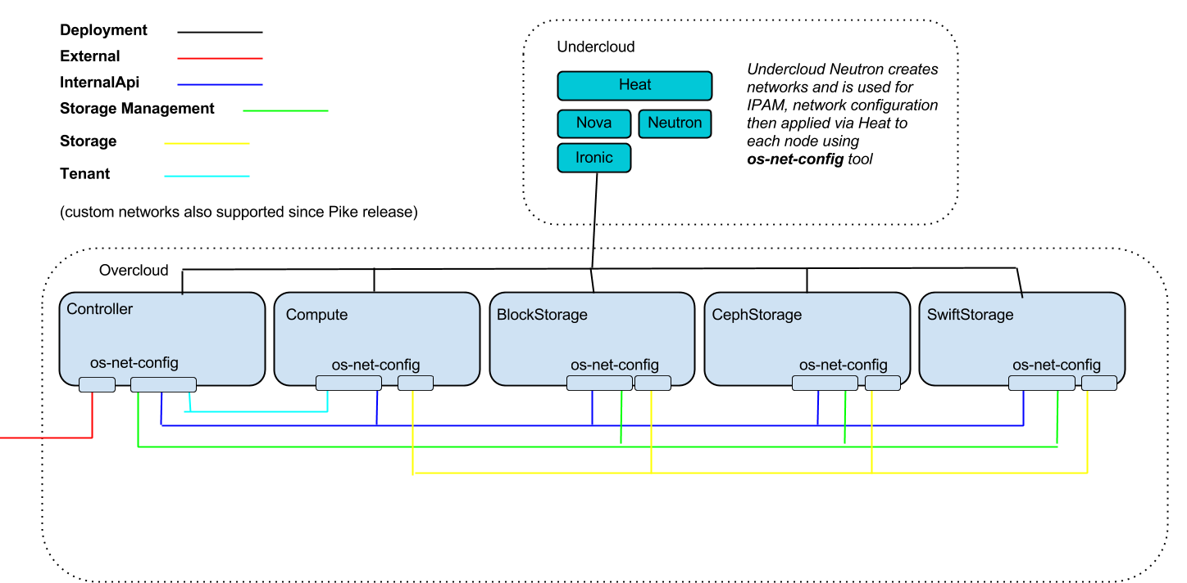
Planning
Customizable network isolation, declarative nic configuration

Slide 11
TripleO - Planning
Node discovery, introspection & grouping (Ironic)
Customizable “roles” (group of nodes)
Pluggable “composable services” (Heat templates)
Per-service network isolation (Neutron/os-net-config)
HA support (Pacemaker)
Predictable placement & preassigned IPs (Ironic/Nova)
Flexible service configuration (Heat parameters)
Version control your infrastructure “as code” (yaml)

Slide 12
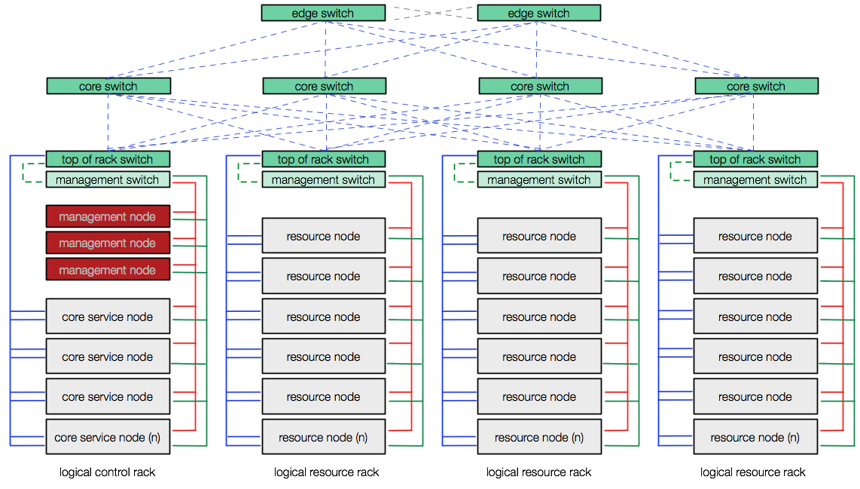


TripleO - Deployment
Deployment & Management App
OpenStack Production Cloud
OpenStack
OpenStack

Slide 13
TripleO - Deployment
Deployment & Management App
OpenStack Production Cloud
Undercloud
Overcloud

Slide 14
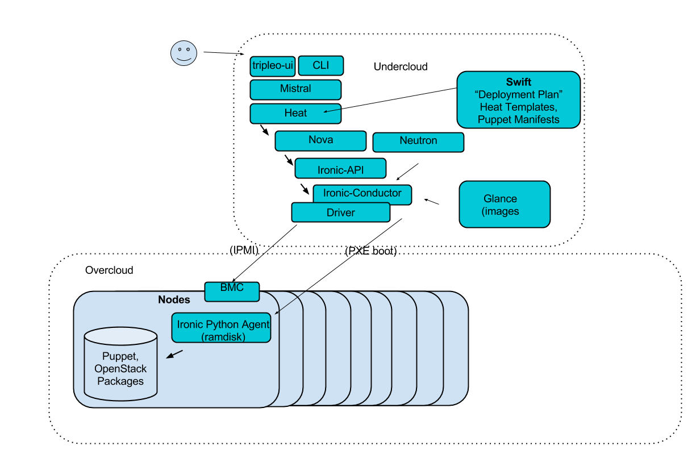
Deployment
Architecture Overview

Slide 15
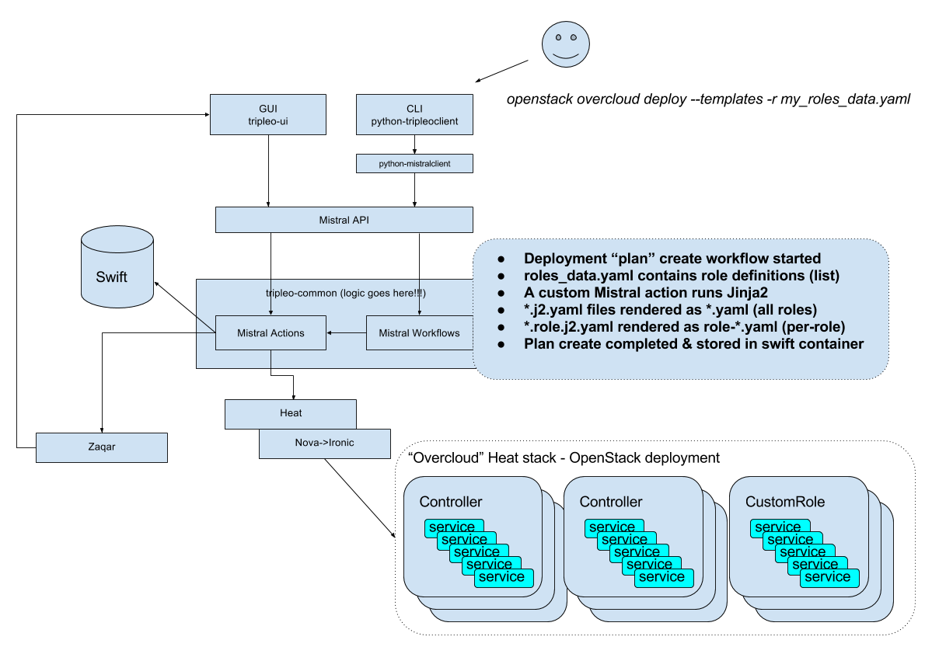
Deployment
Architecture Overview

Slide 16
TripleO - Deployment
Pre-flight validations (Ansible based)
Disk image based deployment (Glance)
Baremetal provisioning (Ironic)
Baremetal service configuration (Puppet)
Heat templates define each service & configuration
Mistral workflow API provides pluggable interface for UX
Increasingly using Ansible “under the hood”

Slide 17
TripleO - Operations
Automated configuration of monitoring clients (Sensu)
Support for centralized logging
Major version upgrades, orchestrated by Heat+Ansible
Minor version updates - rolling no downtime
Automated scale up to add capacity
Orchestrated scale down and node removal

Slide 18
TripleO + Ansible

Slide 19
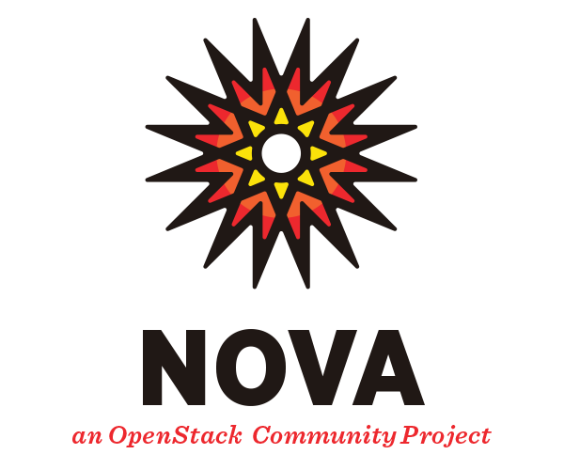
Heat+Puppet Architecture
How we used to do it...
tripleo-heat-templates
heat-config-puppet
puppet
puppet-tripleo
puppet-$service
openstack-service
Overcloud (RHEL/CentOS)
baremetal (rpms)

Slide 20
Heat+Ansible Architecture
From Pike release
CLI/UI (unchanged)
tripleo-heat-templates
Service templates (unchanged)
(Debug direct ansible interaction)
heat-config-ansible
Ansible
openstack overcloud config download
cd <tmpdir>
ansible-playbook -i /usr/bin/tripleo-ansible-inventory deploy_steps_playbook.yaml
puppet
puppet-$service
host_prep_tasks
baremetal (rpms)
openstack-service
Overcloud (RHEL/CentOS)

Slide 21
Deployment
Ansible + puppet deploy workflow
Hiera step 1/2/3/4/5 (ansible loop)
Host preparation
(host_prep_tasks)
Puppet
Service Configuration
(step_config)

Slide 22
Deployment with Containers

Slide 23
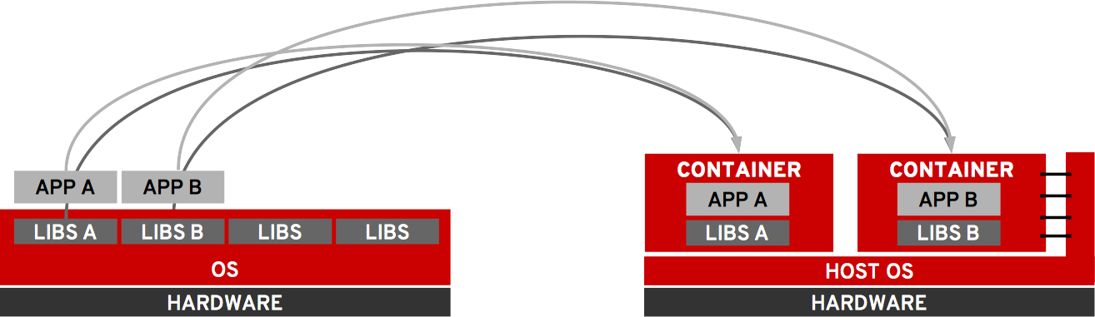
Containers for apps ...
TRADITIONAL OS
CONTAINERS

Slide 24
Containers for OpenStack services
TRADITIONAL OPENSTACK
CONTAINERIZED OPENSTACK
SERVICE A
SERVICE B
SERVICE A
SERVICE B

Slide 25
TripleO - Containers
Pike release supports most services in containers
A hybrid baremetal/container model is possible
Assists with migration of vendor plugins e.g Neutron
Includes upgrade support (from baremetal)
Most state e.g DB is left on the host filesystem
Reuses the same “composable services” architecture
Some new interfaces specific to containers added
HA support (Pacemaker managed container bundles)
Host networking used to retain network isolation
Backwards compatibility (Heat parameters & puppet)

Slide 26
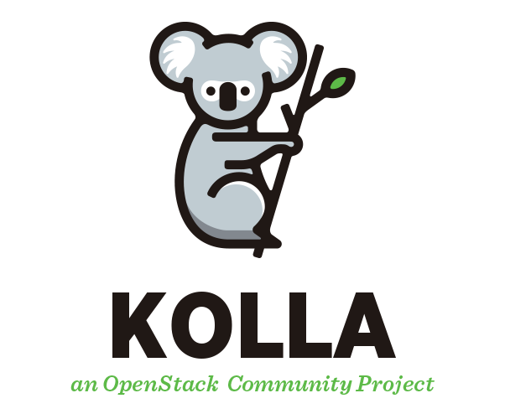


How does it all come together?
Sort of like this ...
openstack-service
tripleo-heat-templates
openstack-base
heat-config-ansible
base
ansible
paunch
docker-puppet.py
puppet
Overcloud (RHEL/CentOS)
docker
baremetal (rpms)
networks

Slide 27
Deployment
Ansible + puppet + containers deploy workflow
Host preparation
(host_prep_tasks),
Write json for paunch
Puppet
Baremetal Configuration
(step_config)
puppet/docker steps
1/2/3/4/5
(ansible loop)
Container config generation
(docker_puppet.py)
Container deployment
(paunch)
Container bootstrap tasks
(docker-puppet.py)

Slide 28
How does it all come together?
Multi step deployments
Baremetal configuration (still via puppet)
Tool to generate config via puppet (docker-puppet.py).
Ansible playbook runs paunch via command module
Paunch takes that config and starts up the containers
Docker-puppet.py runs again to perform bootstrapping via puppet
ansible deploy tasks applied with an incrementing step
- name: Start containers for step {{step}}
command: >-
paunch --debug apply
--file /var/lib/tripleo-config/hashed-docker-container-startup-config-step_{{step}}.json
--config-id tripleo_step{{step}} --managed-by tripleo-{{role_name}}

Slide 29
Paunch 101
Container orchestration
Paunch is a …
Utility to launch and manage containers using the configuration data found in the TripleO service template. (It’s an orchestrator of sorts)
It’s a wrapper for the docker-cli.
Supports standalone use outside of heat/TripleO (derived from the heat docker-cmd hook initially).

Slide 30
Paunch 101
http://git.openstack.org/cgit/openstack/paunch/
Single host only, operations are performed via the docker client on the currently configured docker service.
Zero external state, only labels on running containers are used when determining which containers an operation will perform on.
Single threaded and blocking, containers which are not configured to detach will halt further configuration until they exit (config generation & bootstrap containers)
Co-exists with other container configuration tools - only containers tagged as being managed by paunch are modified
Idempotent - leave containers running when their config has not changed, but replace containers which have modified config (minimise minor update downtime)

Slide 31

How does it all come together?
Container Images
TripleO uses Kolla containers recipes to build OCI-compliant container images - some additional packages are added to the default kolla build to support TripleO.
openstack-service
openstack-base
base

Slide 32
How does it all come together?
Container image management using openstack CLI plugins
Create a yaml file to set the image, location, namespace, etc:
$ openstack overcloud container image prepare
Consume the image file generated by prepare:
$ openstack overcloud container image upload
These steps generate an environment file that is then consumed by heat on deployment/update.
$ openstack overcloud deploy --templates $templates -e $templates/environments/docker.yaml
This command is used to deploy a (minimal) container enabled overcloud - only one additional environment file is needed to enable containerized deployment.

Slide 33


Slide 34
Other talks this week...
TripleO Project Update - Monday 3.10-3.50pm C3.2
TripleO Project onboarding - Monday 4.20 - 5.00pm C4.7
Putting OpenStack on Kubernetes - Monday 4.20 - 5.00pm Pyrmont Theatre
Automated NFV deployment with TripleO - Tuesday 09.00 - 09.40am C3.3
OpenStack in containers (lightning talk) - Wednesday 2.40-2.50pm - Parkside 2 foyer

Slide 35
Links & where to find out more
IRC (Freenode) #tripleo
openstack-dev mailing list [tripleo]
https://docs.openstack.org/developer/tripleo-docs/
https://docs.openstack.org/tripleo-quickstart/
http://tripleo.org/planet.html (has links to blogs)
https://hardysteven.blogspot.co.uk/
https://etherpad.openstack.org/p/tripleo-deep-dive-topics
  Has links to previous talks, we can do more if you request specific topics!

