Slide 1
Heat – Orchestration for OpenStack
Overview, Intro to Provider Resources
Steven Hardy (shardy@redhat.com)
3rd October 2013

Slide 2
Heat Overview
User Portal (Horizon)
Stack/Resource
Templates
Orchestration (Heat)
REST
REST
REST
REST
REST
REST
REST
Compute
(Nova)
Identity
(Keystone)
REST
Network
(Neutron)
Glance
(Image Store)
Instance
- cloud-init
- cfn-init
- cfn-hup
-cfn-push-stats
Block Storage
(Cinder)
Object Storage
(Swift)
Metrics/Alarms
(Ceilometer)
Notes:
KEY POINTS

Slide 3
Havana Features
Concurrent resource operations
Much improved networking/Neutron support
Initial support for native template language (HOT)
“Provider/Environments” abstractions (template-defined resources)
Ceilometer integration for metrics/monitoring/alarms
UpdateStack improvements
Initial integration with keystone trusts functionality
Many more native resource types
Horizon (UI) integration
Stack “actions” (suspend/resume)
Notes:
KEY POINTS
Heat implements most functionality
Heat upstream has more work to do on network functionality

Slide 4
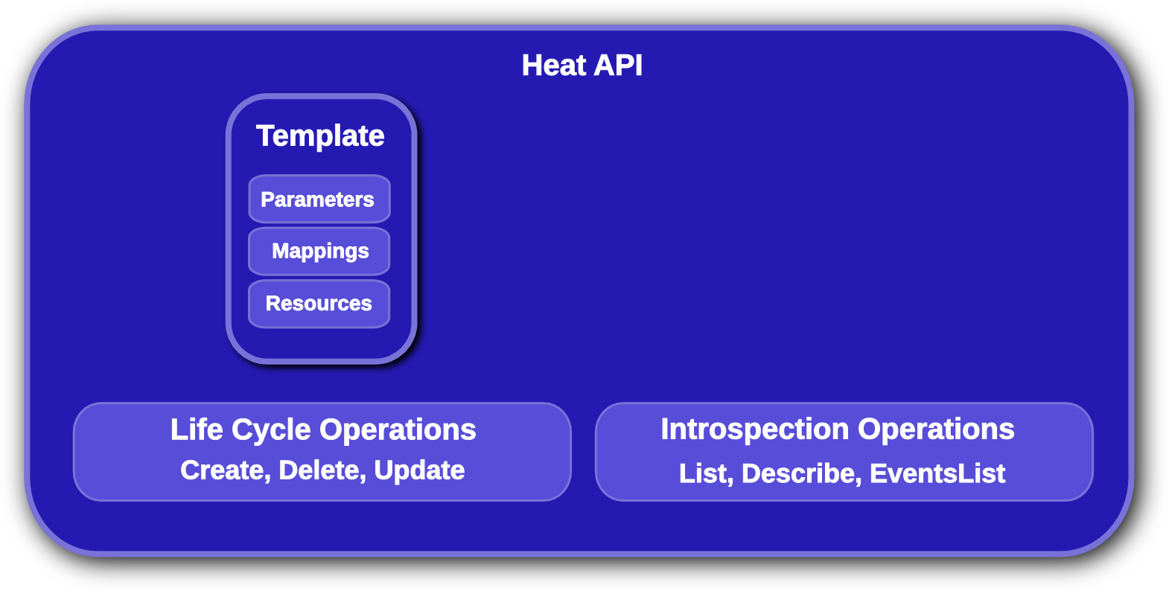
Heat Template Overview
Notes:
KEY POINTS
Lifecycle operations
Create creates a stack from a template
Delete deletes an existing instantiated stack
Update updates an existing instantiated stack
Introspection operations
List obtains a list of existing stacks
Describe obtains details of existing stacks
Events List obtains events that have occurred for a stack
List resources lists resources associated with a stack
Template describes a stack

Slide 5
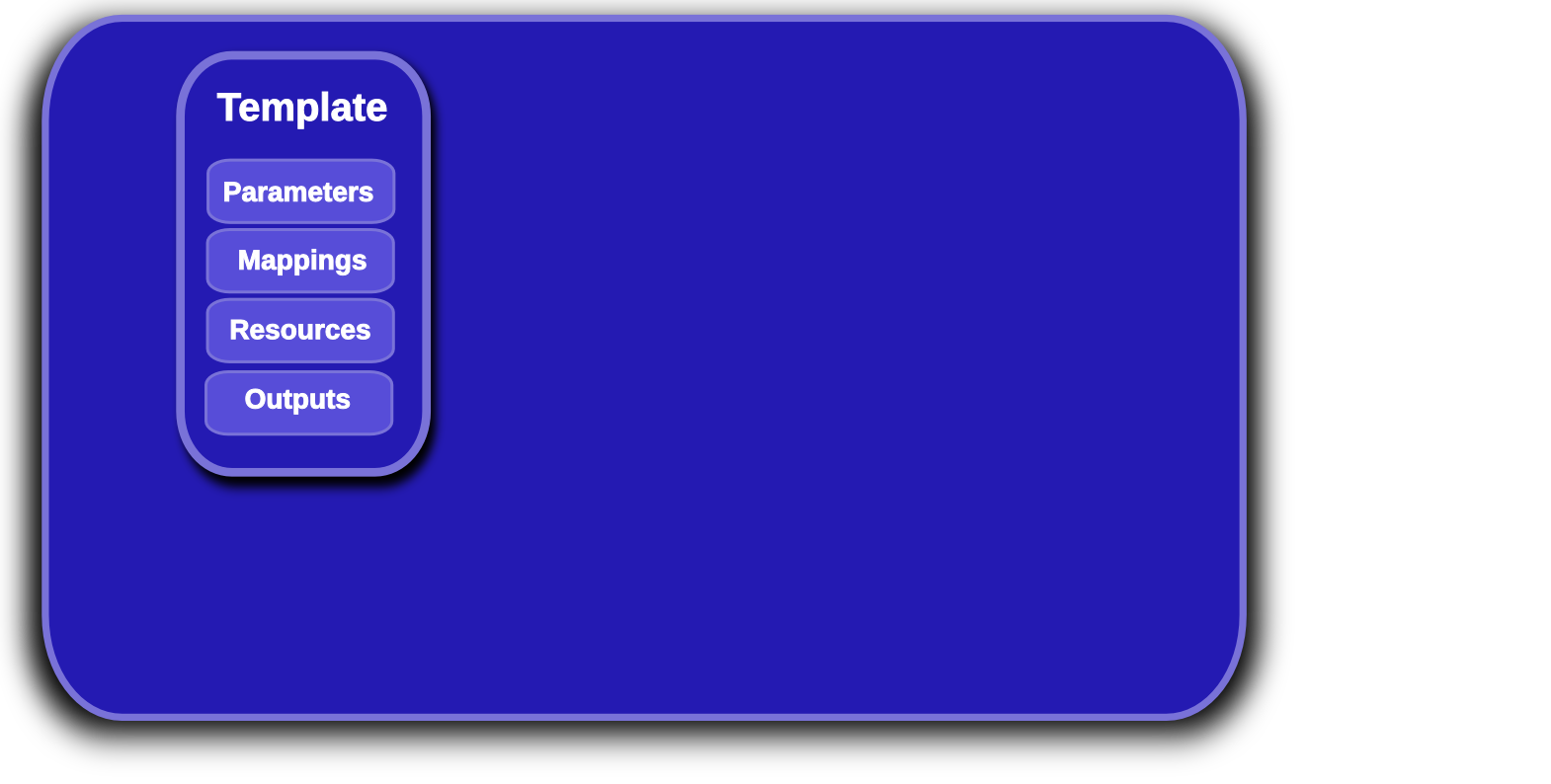
Heat Template Overview
Notes:
KEY POINTS
Lifecycle operations
Create creates a stack from a template
Delete deletes an existing instantiated stack
Update updates an existing instantiated stack
Introspection operations
List obtains a list of existing stacks
Describe obtains details of existing stacks
Events List obtains events that have occurred for a stack
List resources lists resources associated with a stack
Template describes a stack

Slide 6
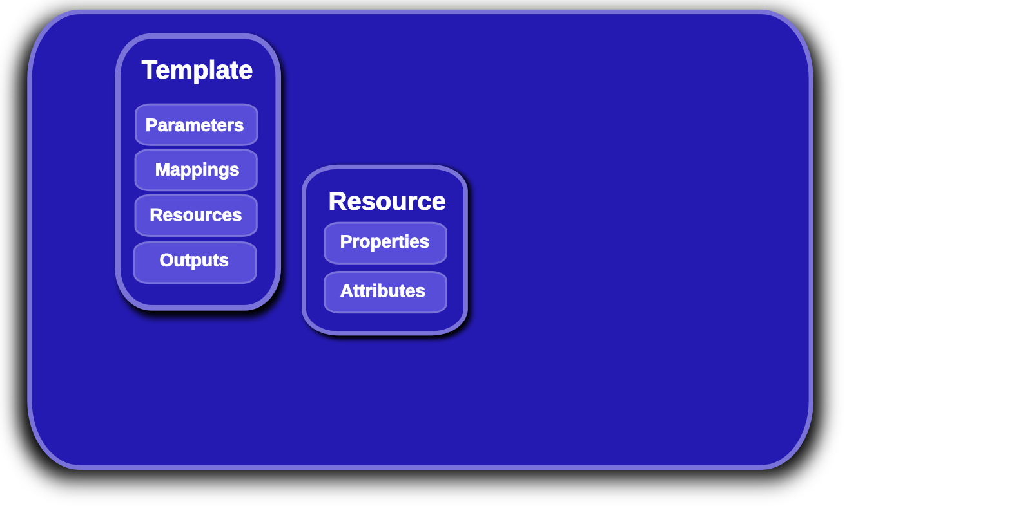
Heat Template Overview
Notes:
KEY POINTS
Lifecycle operations
Create creates a stack from a template
Delete deletes an existing instantiated stack
Update updates an existing instantiated stack
Introspection operations
List obtains a list of existing stacks
Describe obtains details of existing stacks
Events List obtains events that have occurred for a stack
List resources lists resources associated with a stack
Template describes a stack

Slide 7
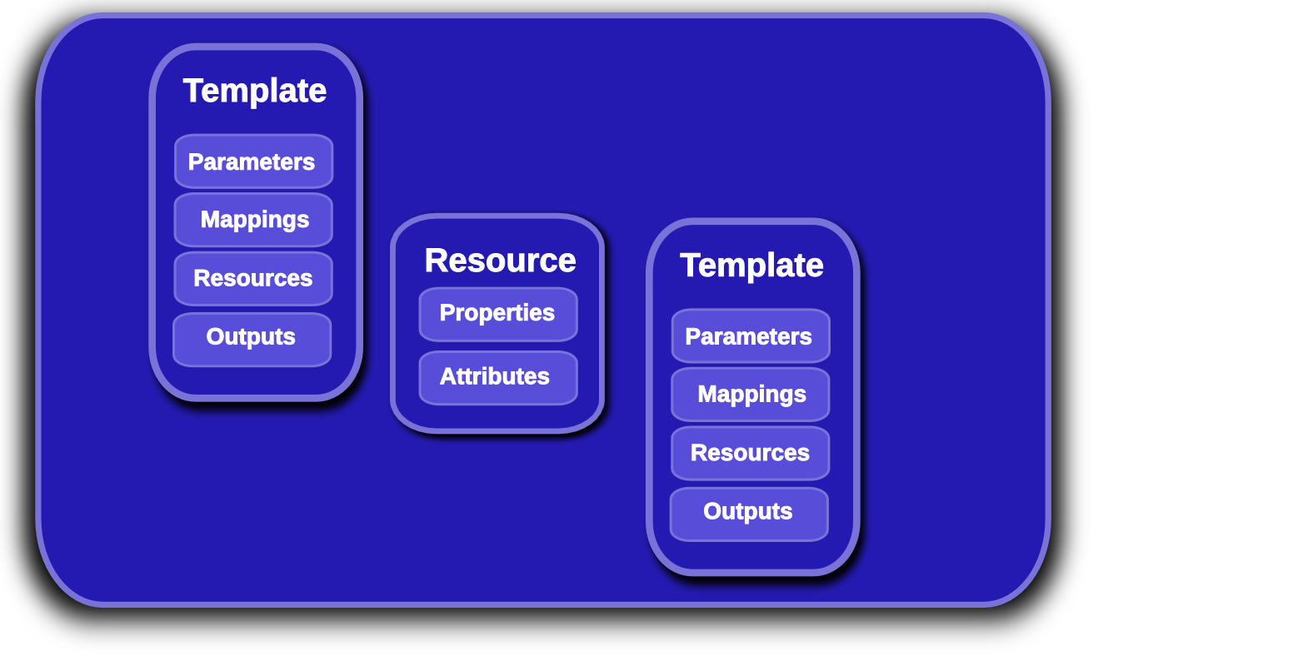
Heat Nested Stack Templates
Notes:
KEY POINTS
Lifecycle operations
Create creates a stack from a template
Delete deletes an existing instantiated stack
Update updates an existing instantiated stack
Introspection operations
List obtains a list of existing stacks
Describe obtains details of existing stacks
Events List obtains events that have occurred for a stack
List resources lists resources associated with a stack
Template describes a stack

Slide 8
Openshift Example
Openshift Users
Heat Stack
Openshift Broker
LaunchConfig
(Openshift Node)
AutoScalingGroup
Notes:
KEY POINTS

Slide 9
Openshift Example
Openshift Users
Heat Stack
Openshift Broker
AWS::CloudFormation::Stack
Broker Instance
Heat Stack
LaunchConfig
(Openshift Node)
AutoScalingGroup
Notes:
KEY POINTS

Slide 10
Heat Nested Stack Templates
"Resources" : {
"OpenshiftBroker": {
"Type": "AWS::CloudFormation::Stack",
"Properties": {
"TemplateURL": "https://somewhere/something.template",
“Parameters”: <map containing stack parameters>
}
},
Available in Grizzly Heat
AWS compatible interface to nested stacks
Allows user to compose layered/reusable deployments
Hard-coded URL's is inconvenient
Notes:
KEY POINTS
Lifecycle operations
Create creates a stack from a template
Delete deletes an existing instantiated stack
Update updates an existing instantiated stack
Introspection operations
List obtains a list of existing stacks
Describe obtains details of existing stacks
Events List obtains events that have occurred for a stack
List resources lists resources associated with a stack
Template describes a stack

Slide 11
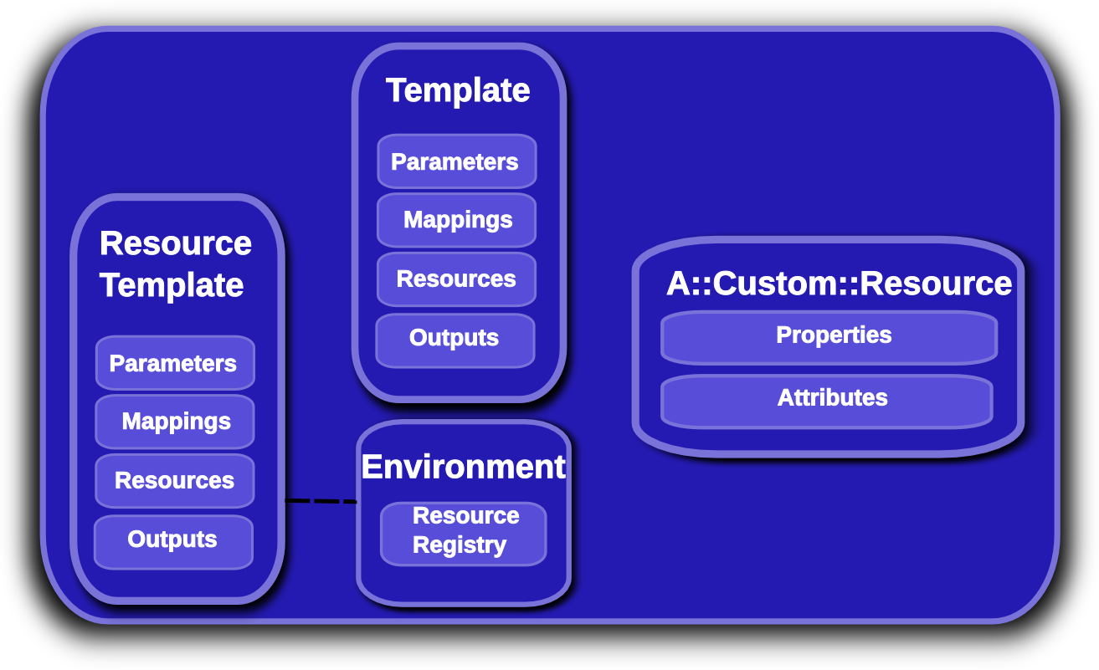
Provider Resources
Notes:
KEY POINTS
Lifecycle operations
Create creates a stack from a template
Delete deletes an existing instantiated stack
Update updates an existing instantiated stack
Introspection operations
List obtains a list of existing stacks
Describe obtains details of existing stacks
Events List obtains events that have occurred for a stack
List resources lists resources associated with a stack
Template describes a stack

Slide 12
Provider Resources
Heat native interface to nested stacks
No hard-coded URLs (in the template)
Staging workflow/testing much simplified
Allows deployer and user to define custom resources
  /etc/heat/environment.d
  /etc/heat/templates
  Users heat stack-create –environment-file=foo.yaml
    Users can override default deployer resources!
resource_registry:
"My::Custom::Server": file:///foo/bar.yaml
Notes:
KEY POINTS
Lifecycle operations
Create creates a stack from a template
Delete deletes an existing instantiated stack
Update updates an existing instantiated stack
Introspection operations
List obtains a list of existing stacks
Describe obtains details of existing stacks
Events List obtains events that have occurred for a stack
List resources lists resources associated with a stack
Template describes a stack

Slide 13
Heat Resource Types
AWS::AutoScaling::AutoScalingGroup
AWS::AutoScaling::LaunchConfiguration
AWS::AutoScaling::ScalingPolicy
AWS::CloudFormation::Stack
AWS::CloudFormation::WaitCondition
AWS::CloudFormation::WaitConditionHandle
AWS::EC2::EIP
AWS::EC2::EIPAssociation
AWS::EC2::Instance
AWS::EC2::InternetGateway
AWS::EC2::NetworkInterface
AWS::EC2::RouteTable
AWS::EC2::SecurityGroup
AWS::EC2::Subnet
AWS::EC2::SubnetRouteTableAssocation
AWS::EC2::Volume
AWS::EC2::VolumeAttachment
AWS::EC2::VPC
AWS::EC2::VPCGatewayAttachment
AWS::ElasticLoadBalancing::LoadBalancer
AWS::IAM::AccessKey
AWS::IAM::User
AWS::RDS::DBInstance
AWS::S3::Bucket
OS::Ceilometer::Alarm
OS::Cinder::Volume
OS::Cinder::VolumeAttachment
OS::Heat::AccessPolicy
OS::Heat::CWLiteAlarm
OS::Heat::HARestarter
OS::Heat::InstanceGroup
OS::Neutron::Firewall
OS::Neutron::FirewallPolicy
OS::Neutron::FirewallRule
OS::Neutron::FloatingIP
OS::Neutron::FloatingIPAssociation
OS::Neutron::HealthMonitor
OS::Neutron::IKEPolicy
OS::Neutron::IPsecPolicy
OS::Neutron::IPsecSiteConnection
OS::Neutron::LoadBalancer
OS::Neutron::Net
OS::Neutron::Pool
OS::Neutron::Port
OS::Neutron::Router
OS::Neutron::RouterGateway
OS::Neutron::RouterInterface
OS::Neutron::Subnet
OS::Neutron::VPNService
OS::Nova::Server
OS::Swift::Container
Notes:
KEY POINTS
Heat implements most functionality
Heat upstream has more work to do on network functionality

Slide 14
Icehouse Roadmap
Developing HOT DSL
Engine scale-out
Rolling Updates (UpdatePolicy, Metadata update)
Native in-instance tools
Template-function plugins
Software configuration resources (Puppet/Chef/...)
More native resource types
Stack snapshot/restore
Per-resource suspend/resume
Better cloud-init integration
...
Notes:
KEY POINTS
Heat implements most functionality
Heat upstream has more work to do on network functionality

Slide 15
Links, any Questions?
http://docs.openstack.org/developer/heat/
http://openstack.redhat.com/Docs
http://github.com/openstack/heat
https://launchpad.net/heat
http://wiki.openstack.org/wiki/Heat
http://hardysteven.blogspot.co.uk
https://github.com/hardys/presentations

