Slide 1
Heat – Orchestration for OpenStack
Introduction to OpenStack Orchestration
Steven Hardy (shardy@redhat.com)
4th June 2014

Slide 2
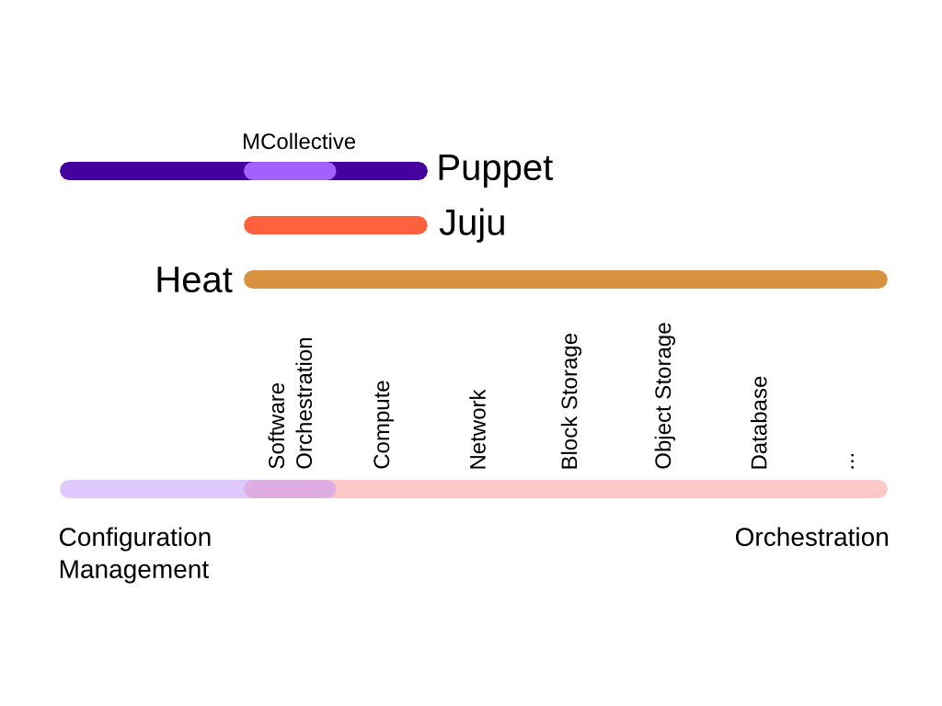
Orchestration Overview
Notes:
KEY POINTS

Slide 3
Heat Overview
Fully repeatable deployments
Integrated OpenStack project
Declarative, template driven model
Version your infrastructure like code!
Implicit dependency management
Abstract details of underlying API's
Compose complex deployments, modularity, reuse
Simplify management of grouped resources
Plugin model, fully extensible
Notes:
KEY POINTS
Provides orchestration service for openstack
Integrates all openstack core projects
Converts either a JSON or YAML template into an openstack cloud application

Slide 4
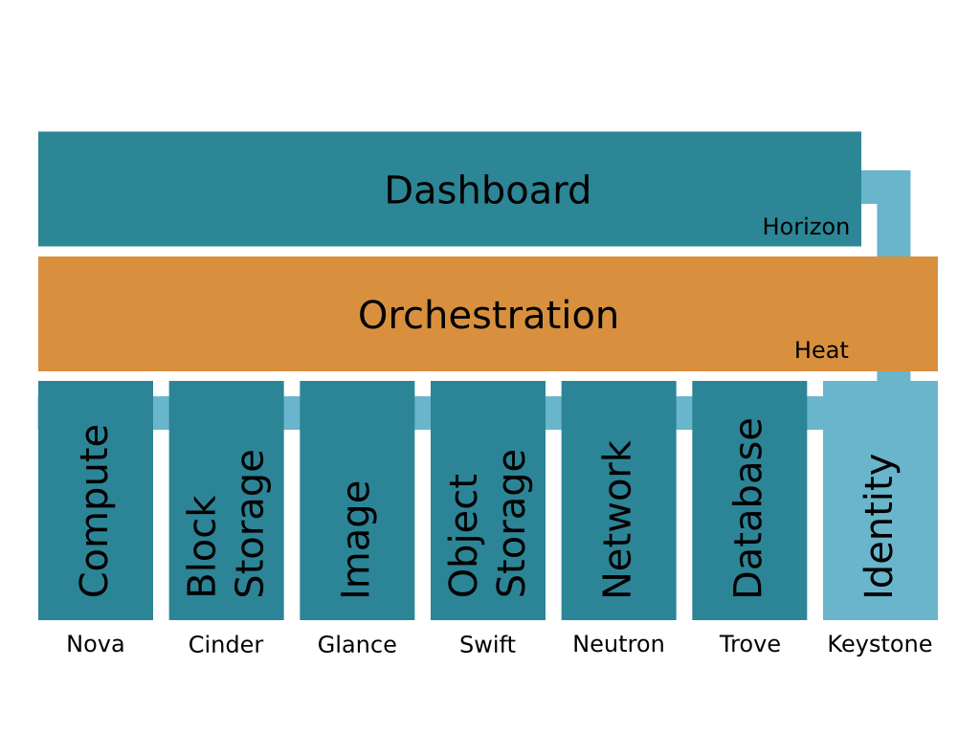
Heat Overview
Notes:
KEY POINTS

Slide 5
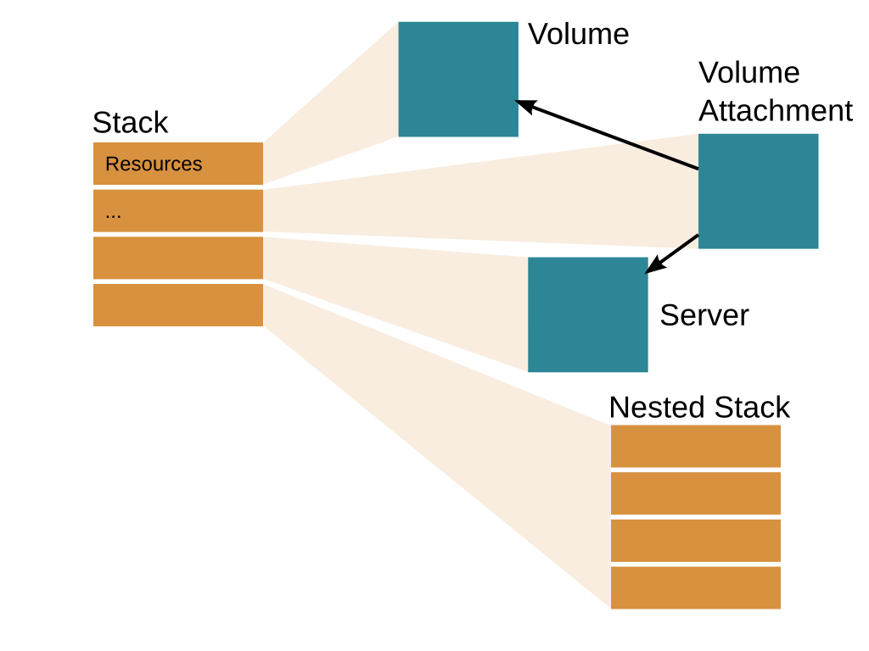
Notes:
KEY POINTS

Slide 6
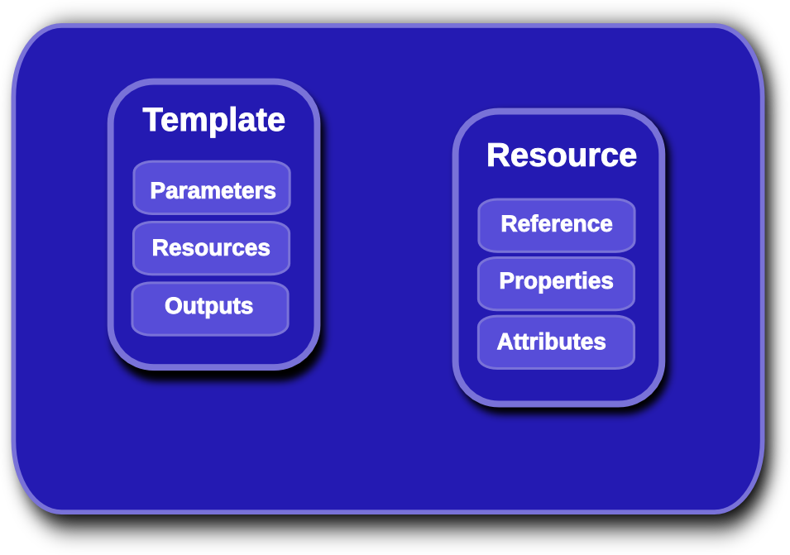
Heat Template Overview
Notes:
KEY POINTS
Lifecycle operations
Create creates a stack from a template
Delete deletes an existing instantiated stack
Update updates an existing instantiated stack
Introspection operations
List obtains a list of existing stacks
Describe obtains details of existing stacks
Events List obtains events that have occurred for a stack
List resources lists resources associated with a stack
Template describes a stack

Slide 7
Heat Orchestration Template
heat_template_version: 2013-05-23
parameters:
image:
type: string
resources:
my_instance:
type: OS::Nova::Server
properties:
flavor: m1.small
image: {get_param: image}
outputs:
networks:
description: my_instance network details
value: {get_attr : [my_instance, networks]}
Notes:
KEY POINTS
Lifecycle operations
Create creates a stack from a template
Delete deletes an existing instantiated stack
Update updates an existing instantiated stack
Introspection operations
List obtains a list of existing stacks
Describe obtains details of existing stacks
Events List obtains events that have occurred for a stack
List resources lists resources associated with a stack
Template describes a stack

Slide 8
Parameters/Constraints
heat_template_version: 2013-05-23
parameters:
image:
type: string
description: Image to use for the instance to be created.
default: cirros-0.3.2-x86_64-disk
constraints:
- allowed_values: ['cirros-0.3.2-x86_64-disk', 'fedora-20.x86_64']
volume_size:
type: number
description: Size of volume to attach to instance
default: 1
constraints:
- range: {min: 1, max: 10}
Notes:
KEY POINTS
Lifecycle operations
Create creates a stack from a template
Delete deletes an existing instantiated stack
Update updates an existing instantiated stack
Introspection operations
List obtains a list of existing stacks
Describe obtains details of existing stacks
Events List obtains events that have occurred for a stack
List resources lists resources associated with a stack
Template describes a stack

Slide 9
Heat Template Links
docs.openstack.org/developer/heat/template_guide
docs.openstack.org/developer/heat/template_guide/hot_spec.html
github.com/openstack/heat-templates
heat resource-type-list
heat resource-type-show OS::Nova::Server
Notes:
KEY POINTS
Lifecycle operations
Create creates a stack from a template
Delete deletes an existing instantiated stack
Update updates an existing instantiated stack
Introspection operations
List obtains a list of existing stacks
Describe obtains details of existing stacks
Events List obtains events that have occurred for a stack
List resources lists resources associated with a stack
Template describes a stack

Slide 10
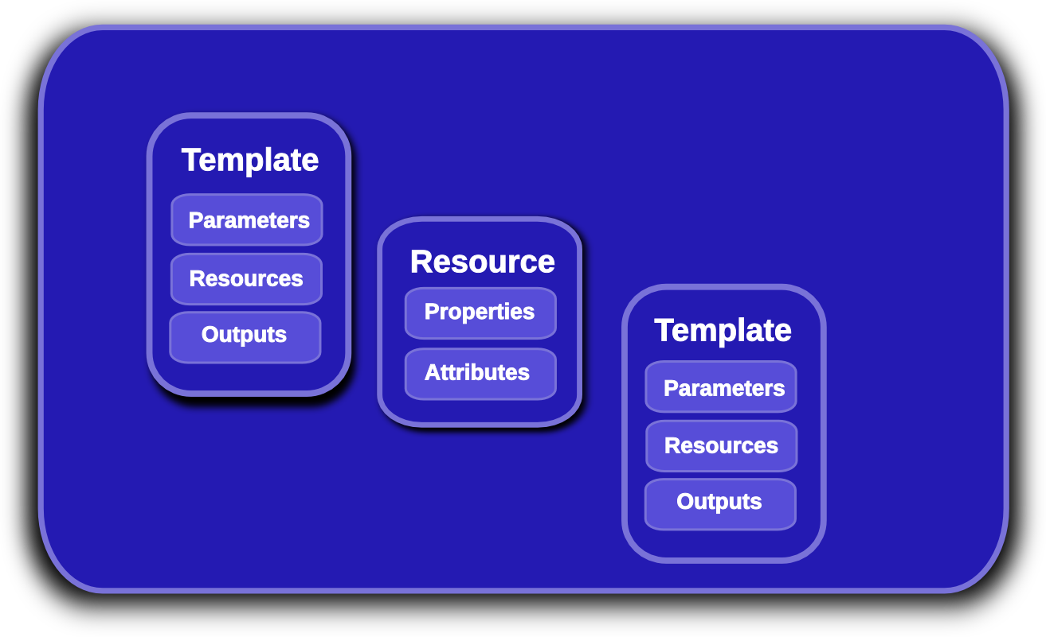
Heat Nested Stack Templates
Notes:
KEY POINTS
Lifecycle operations
Create creates a stack from a template
Delete deletes an existing instantiated stack
Update updates an existing instantiated stack
Introspection operations
List obtains a list of existing stacks
Describe obtains details of existing stacks
Events List obtains events that have occurred for a stack
List resources lists resources associated with a stack
Template describes a stack

Slide 11
Nested Stack Example
heat_template_version: 2013-05-23
resources:
my_nested:
type: my_nested.yaml
Notes:
KEY POINTS
Lifecycle operations
Create creates a stack from a template
Delete deletes an existing instantiated stack
Update updates an existing instantiated stack
Introspection operations
List obtains a list of existing stacks
Describe obtains details of existing stacks
Events List obtains events that have occurred for a stack
List resources lists resources associated with a stack
Template describes a stack

Slide 12
Nested Stack Example
heat_template_version: 2013-05-23
resources:
my_nested:
type: my_nested.yaml
Notes:
KEY POINTS
Lifecycle operations
Create creates a stack from a template
Delete deletes an existing instantiated stack
Update updates an existing instantiated stack
Introspection operations
List obtains a list of existing stacks
Describe obtains details of existing stacks
Events List obtains events that have occurred for a stack
List resources lists resources associated with a stack
Template describes a stack

Slide 13
Grouped Resources
heat_template_version: 2013-05-23
resources:
my_group:
type: OS::Heat::ResourceGroup
properties:
count: 50
resource_def: {type: my_nested.yaml}
Notes:
KEY POINTS
Lifecycle operations
Create creates a stack from a template
Delete deletes an existing instantiated stack
Update updates an existing instantiated stack
Introspection operations
List obtains a list of existing stacks
Describe obtains details of existing stacks
Events List obtains events that have occurred for a stack
List resources lists resources associated with a stack
Template describes a stack

Slide 14
Environments
parameters:
key_name: mykey
resource_registry:
My::Custom::Server : my_server.yaml
OS::Nova::Server : override_nova.yaml
python-heatclient resolves local files and URLs
Files associated with environment are passed along with the stack-create/update API request
heat stack-create mystack -f template.yaml -e environment.yaml
Notes:
KEY POINTS
Lifecycle operations
Create creates a stack from a template
Delete deletes an existing instantiated stack
Update updates an existing instantiated stack
Introspection operations
List obtains a list of existing stacks
Describe obtains details of existing stacks
Events List obtains events that have occurred for a stack
List resources lists resources associated with a stack
Template describes a stack

Slide 15
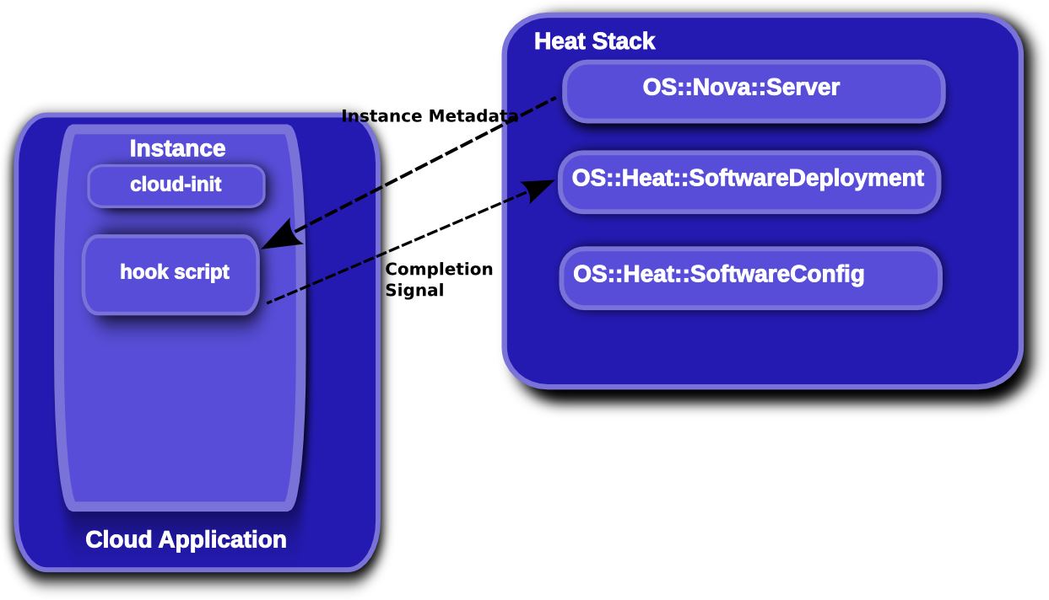
Software Config
Notes:
KEY POINTS
Lifecycle operations
Create creates a stack from a template
Delete deletes an existing instantiated stack
Update updates an existing instantiated stack
Introspection operations
List obtains a list of existing stacks
Describe obtains details of existing stacks
Events List obtains events that have occurred for a stack
List resources lists resources associated with a stack
Template describes a stack

Slide 16
Getting Started
Devstack (Fedora/Ubuntu)
RDO/RHOS (Fedora/CentOS/RHEL)
Debian/Ubuntu Packages
Rackspace Orchestration Service
...
Notes:
KEY POINTS
Provides orchestration service for openstack
Integrates all openstack core projects
Converts either a JSON or YAML template into an openstack cloud application

Slide 17
Icehouse key new features
HOT DSL feature-complete and declared stable
Software-config initial implementation complete
“stack domain users” (no more admin requirement)
Native auto-scaling resources
Pluggable parameter constraints
Pluggable template parser/functions
Scalable heat-engine
“management API” additions
Notes:
KEY POINTS
Provides orchestration service for openstack
Integrates all openstack core projects
Converts either a JSON or YAML template into an openstack cloud application

Slide 18
Juno Roadmap
Recovery from failed states/convergence
Further scalability improvements
Autoscaling enhancements
Auth model updates
Stack preview
Quota support
Improved functional/upgrade testing
...
Notes:
KEY POINTS
Heat implements most functionality
Heat upstream has more work to do on network functionality

Slide 19
Questions?
wiki.openstack.org/wiki/Heat
docs.openstack.org/developer/heat/
github.com/hardys/presentations
docs.openstack.org/developer/heat/template_guide
docs.openstack.org/developer/heat/template_guide/hot_spec.html
github.com/openstack/heat-templates

