Slide 1
Heat - Status Update
Orchestration for Openstack
Steven Hardy (shardy@redhat.com)
Openstack Summit – 18th April 2013

Slide 2
Heat Overview
Started in March 2012
25 contributors (9 core)
~1900 commits
~34,000 lines of code
37 different resource types (and counting!)
We do much more than launch instances :)
Notes:
KEY POINTS

Slide 3
Heat Overview
Horizon
Dashboard
Heat
Orchestration
Keystone
Identity
Service
Nova
Compute
Node
Glance
Image
Service
Swift
Object
Store
Quantum
Networking
Cinder
Volume
Service
Provides CFN-compatible and native ReST API
Abstract configuration of core services to single-template
HA/Autoscaling features
Notes:
KEY POINTS

Slide 4
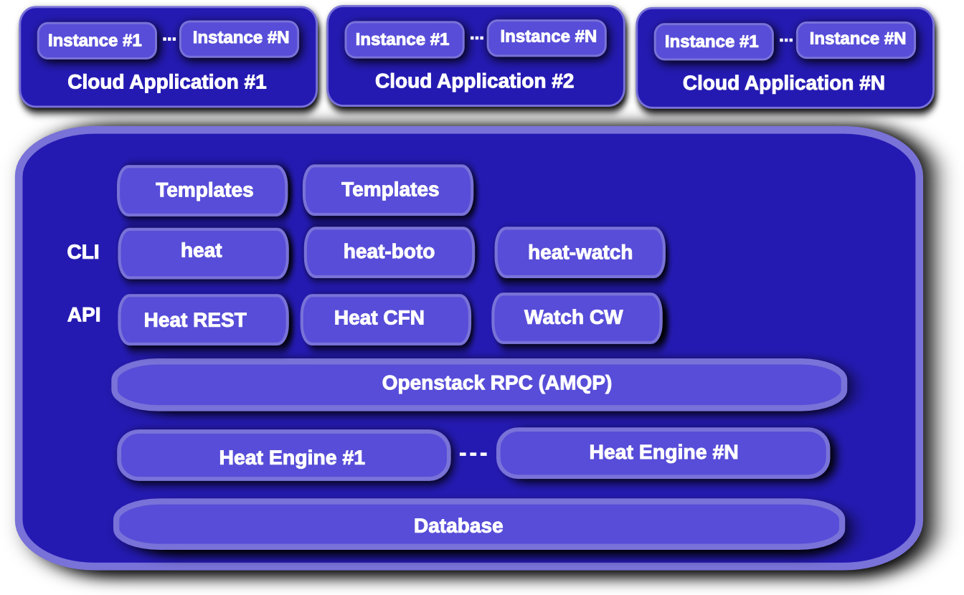
Heat Overview
Notes:
KEY POINTS

Slide 5
Heat Overview
Stack
Template
Heat
REST
REST
REST
REST
REST
Heat-jeos
(oz)
Nova
REST
REST
Nova-network
/quantum
Glance
(Image Store)
Nova-volume
/cinder
Instance
- cloud-init
- cfn-init
- cfn-hup
-cfn-push-stats
Swift
Ceilometer
Notes:
KEY POINTS

Slide 6
Heat Resource Types
AWS::AutoScaling::AutoScalingGroup
AWS::AutoScaling::LaunchConfiguration
AWS::AutoScaling::ScalingPolicy
AWS::CloudFormation::Stack
AWS::CloudFormation::WaitCondition
AWS::CloudFormation::WaitConditionHandle
AWS::CloudWatch::Alarm
AWS::EC2::EIP
AWS::EC2::EIPAssociation
AWS::EC2::Instance
AWS::EC2::InternetGateway
AWS::EC2::NetworkInterface
AWS::EC2::RouteTable
AWS::EC2::SecurityGroup
AWS::EC2::Subnet
AWS::EC2::SubnetRouteTableAssocation
AWS::EC2::Volume
AWS::EC2::VolumeAttachment
AWS::EC2::VPC
AWS::EC2::VPCGatewayAttachment
AWS::ElasticLoadBalancing::LoadBalancer
AWS::IAM::AccessKey
AWS::IAM::User
AWS::RDS::DBInstance
AWS::S3::Bucket
OS::Heat::AccessPolicy
OS::Heat::HARestarter
OS::Heat::InstanceGroup
OS::Quantum::FloatingIP
OS::Quantum::FloatingIPAssociation
OS::Quantum::Net
OS::Quantum::Port
OS::Quantum::Router
OS::Quantum::RouterGateway
OS::Quantum::RouterInterface
OS::Quantum::Subnet
OS::Swift::Container
Notes:
KEY POINTS

Slide 7
Grizzly Features
144 bugs fixed
19 blueprints implemented
  New ReST API
  Quantum Resources
  YAML templates
  Python-heatclient
  Better networking & VPC resource support
  Improved UpdateStack support
  Stack Rollback
  Swift Resource type
  Improved security (metadata/WaitCondition events)
Notes:
KEY POINTS

Slide 8
Havana Roadmap
Parallel resource creation
Further improve networking/Quantum support
Rolling Updates
Support for new/extended template language
Add AutoScaling API actions
Move to Ceilometer for metrics/monitoring/alarms
More UpdateStack Improvements
Further improved security (trusts/in-instance credentials)
Native resource types
Stack suspend resume
Configurable LoadBalancer (use LBAAS)
Notes:
KEY POINTS

Slide 9
In Closing
Get involved!
  Connect with the community via IRC on #heat@freenode
  Check out the repository:
    https://github.com/openstack/heat
  Read the Documentation:
    http://wiki.openstack.org/Heat/
Heat simple but powerful method for orchestrating OpenStack environments

Slide 10
Questions?

