Slide 1
Introduction to Heat API
Orchestration for Openstack
Steven Hardy (shardy@redhat.com)
EMEA Openstack Day – 5th December 2012

Slide 2
Heat Overview
Horizon
Dashboard
Heat
Orchestration
Keystone
Identity
Service
Nova
Compute
Node
Glance
Image
Service
Swift
Object
Store
Quantum
Networking
Cinder
Volume
Service
Provides AWS Cloudformation and native ReST API
Abstract configuration of services to single-template
HA/Autoscaling/Monitoring features
Openstack incubated project
Notes:
KEY POINTS
Heat provides a way of defining all your openstack resources / services from a single template
Ties together the underlying IAAS services, so you can provide a consolidated infrastructure service, single integration point
Compatible with AWS Cloudformation (templates and API)
Has Autoscaling and HA features
Recently became an incubated project

Slide 3
Heat Overview
Orchestration of Openstack deployments
Integrates with all Openstack core projects
Converts a JSON template into a cloud application
Implements well known template and API (AWS Cloudformation, also YAML, ReST)
Version your cloud applications like your software
Repeatable deployments, fully automated
Notes:
KEY POINTS
Provides orchestration service for openstack
Integrates all openstack core projects
Converts either a JSON or YAML template into an openstack cloud application

Slide 4
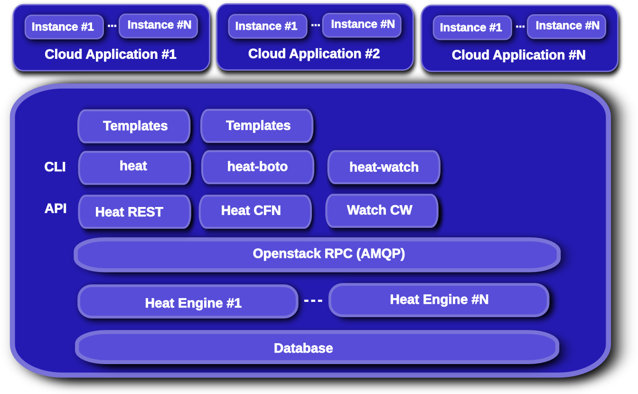
Heat Overview
Notes:
KEY POINTS
API module that services user API operations
Engine module that services API module rpc operations
watch API for metric collection

Slide 5
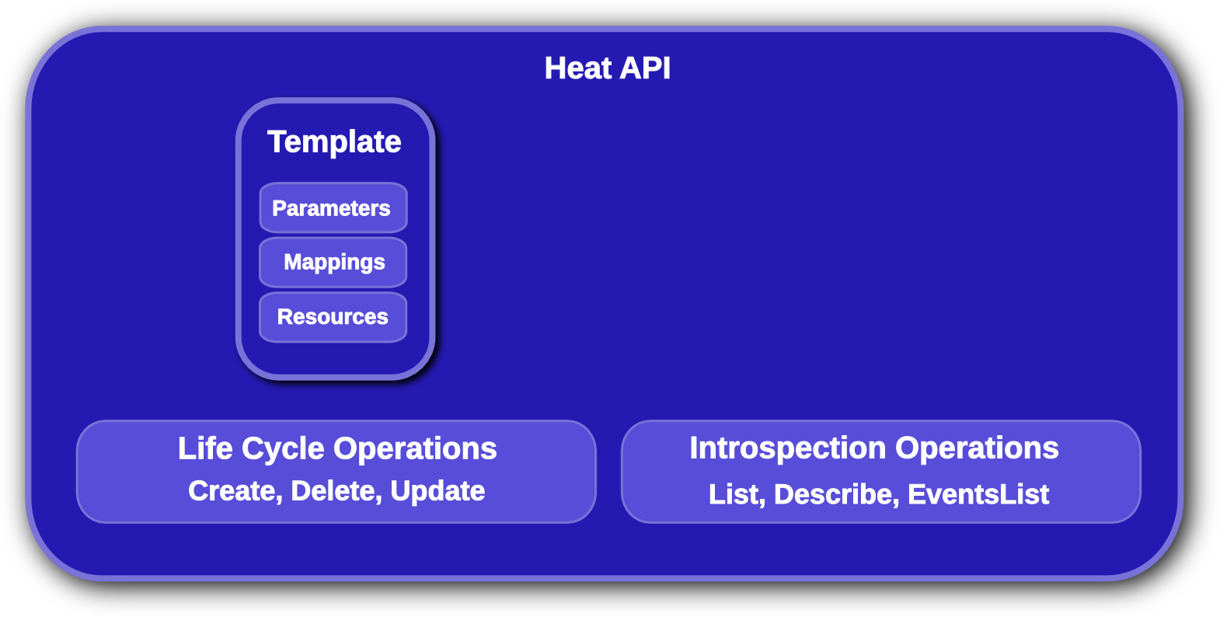
Heat API
Notes:
KEY POINTS
Lifecycle operations
Create creates a stack from a template
Delete deletes an existing instantiated stack
Update updates an existing instantiated stack
Introspection operations
List obtains a list of existing stacks
Describe obtains details of existing stacks
Events List obtains events that have occurred for a stack
List resources lists resources associated with a stack
Template describes a stack

Slide 6
Heat API : Key features
Compatibility with AWS Cloudformation (template/API)
Also superset of OS native resources & ReST API
Fully open community project (come get involved!)
Incubated project, aiming for $core
Implements HA (service/instance/stack)
Implements Instance Autoscaling
Watch/Monitoring API (will move to Ceilometer)
Pluggable resource implementations
Watch this space!
Notes:
KEY POINTS

Slide 7
Nova Instance Lifecycle
Base OS image stored in glance
Deployment-time configuration/customization
Cloud-init (nova user/metadata)
Puppet/Chef/Scripts/???
Potentially complex
Everyone rolling-their-own solutions
High maintenance overhead
Notes:
KEY POINTS

Slide 8
Nova Instance Lifecycle
Image
REST
Nova
Glance
(Image Store)
Keystone
REST
Nova-network
/quantum
Nova-volume
/cinder
Instance
- cloud-init
- ???
Instance
- cloud-init
Instance
- cloud-init
Instances
- cloud-init
- ???
Swift
Ceilometer
Notes:
KEY POINTS

Slide 9
Heat Stack lifecycle
Base OS image stored in glance
Deploy instances & configure services based on template contents (resources)
Deployment-time configuration/customization
Very flexible, but much reduced complexity
Cloud-init (nova user/metadata), plus cfn-init
Puppet/Chef can still be used if you want!
Fully integrated single-service solution
Notes:
KEY POINTS

Slide 10
Heat Stack lifecycle
Stack
Template
Heat
REST
REST
REST
REST
REST
Heat-jeos
(oz)
Nova
REST
REST
Nova-network
/quantum
Glance
(Image Store)
Nova-volume
/cinder
Instance
- cloud-init
- cfn-init
- cfn-hup
-cfn-push-stats
Swift
Ceilometer
Notes:
KEY POINTS

Slide 11
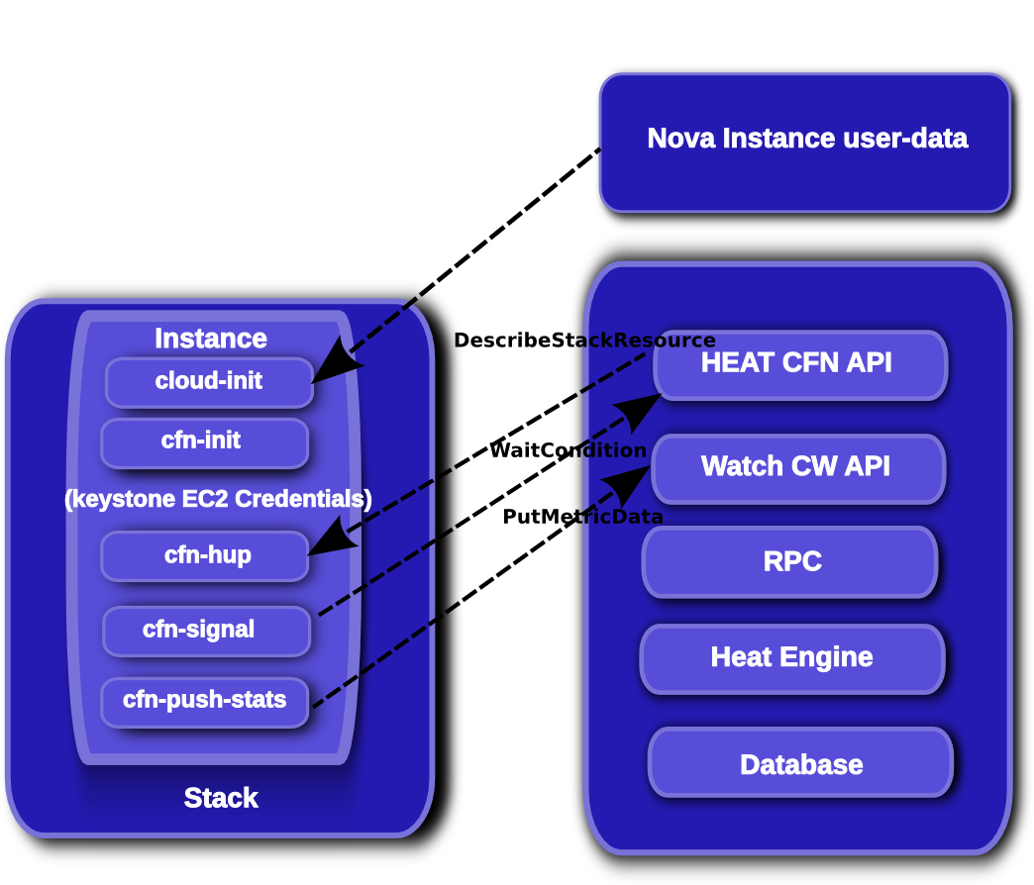
Heat Stack lifecycle
Notes:
KEY POINTS

Slide 12
Why Heat/orchestration?
Orchestration makes things repeatable
Much easier to provide “on demand” infrastructure
Much less scripting, single template system
Leverage the power of openstack without learning fine detail of every service (learn one set of APIs/tools)
Portability/migration
Version/tag/branch your infrastructure like code!
Composed templates/modularity
Pluggable, user-modifiable resource implementations
Open(stack) community project :)
Notes:
KEY POINTS

Slide 13
Template Parameters
Definition:
"Parameters" : {
"InstanceType" : {
"Description" : "WebServer EC2 instance type",
"Type" : "String",
"Default" : "m1.large",
"AllowedValues" : [ "t1.micro", "m1.small", "m1.large",
"m1.xlarge", "m2.xlarge","m2.2xlarge", "m2.4xlarge",
"c1.medium", "c1.xlarge", "cc1.4xlarge" ],
"ConstraintDescription" : "must be a valid instance type."
},
}
Using the Parameter:
{ “Ref” : “InstanceType” }
Notes:
KEY POINTS
Description field describes parameter
Type field describes parameter type
Rest of body contrains input

Slide 14
Template Mappings
Definition:
“Mappings”: {
"DistroArch2Inst": {
"F16" : { "32" : "F16-i386-cfntools", "64" : "F16-x86_64-cfntools" },
"F17" : { "32" : "F17-i386-cfntools", "64" : "F17-x86_64-cfntools" },
"U10" : { "32" : "U10-i386-cfntools", "64" : "U10-x86_64-cfntools" }
}
}
Using the Mapping:
“ImageId”: {
"Fn::FindInMap" : [
"DistroArch2Inst", { "Ref" : "Distribution" }, { “Ref” : “Arch” }
]
}
Notes:
KEY POINTS
Key maps to a value
One map can be used as input into another map

Slide 15
Template Resources
Resources {
“WikiDatabase”: {
"Type" : "AWS::EC2::Instance",
.. bunch of stuff ...
},
"DatabaseIPAddress" : {
"Type" : "AWS::EC2::EIP"
},
"DatabaseIPAssoc" : {
"Type" : "AWS::EC2::EIPAssociation",
"Properties" : {
"InstanceId" : { "Ref" : "WikiDatabase" },
"EIP" : { "Ref" : "DatabaseIPAddress" }
}
}
}
Notes:
KEY POINTS
Type describes type of resource
Properties describe properties of resource
Metadata describes resource metadata typically passed into a resource on instantiatioin

Slide 16
Template Resources (YAML)
Resources:
WebServer:
Type: AWS::EC2::Instance
..bunch of stuff..
IPAddress: {Type: 'AWS::EC2::EIP'}
IPAssoc:
Type: AWS::EC2::EIPAssociation
Properties:
InstanceId: {Ref: WebServer}
EIP: {Ref: IPAddress}
Notes:
KEY POINTS
Type describes type of resource
Properties describe properties of resource
Metadata describes resource metadata typically passed into a resource on instantiatioin

Slide 17
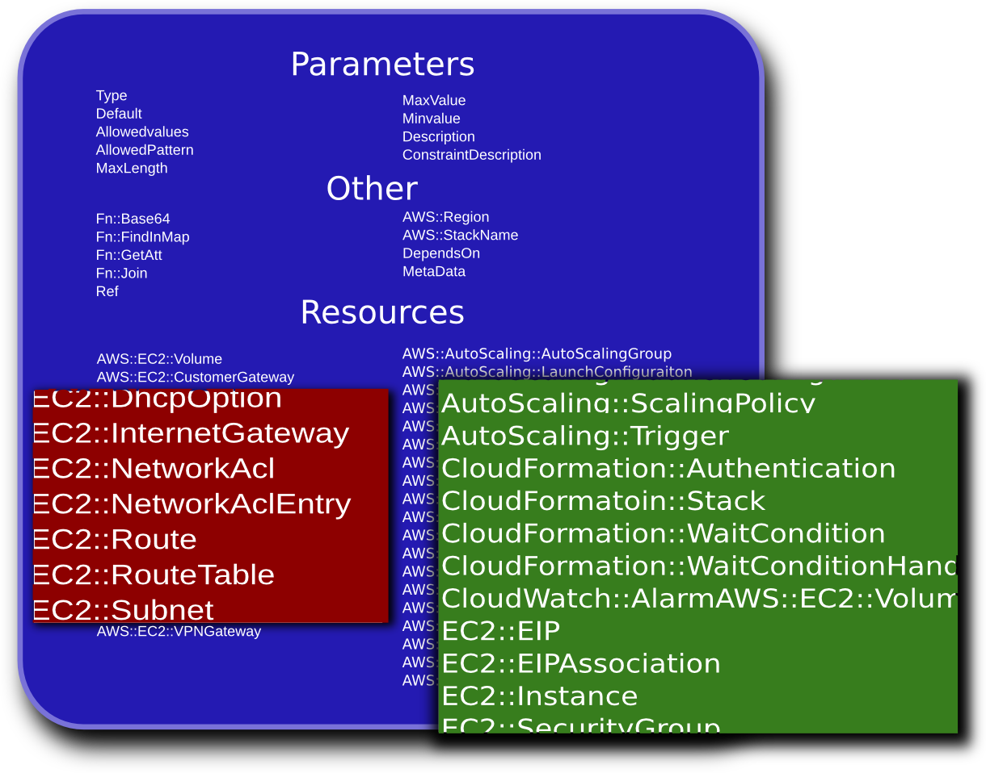
Heat Resource Types
Notes:
KEY POINTS
Heat implements most functionality
Heat upstream has more work to do on network functionality

Slide 18
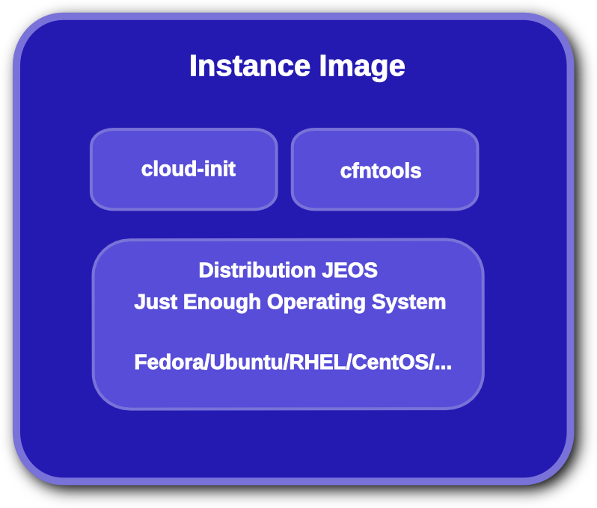
Heat Image Contents
Notes:
KEY POINTS
JEOS operating system
Could optimize JEOS for specific applications
cfn tools provide:
Orderly instance initialization
Signaling of events to heat
Metadata retrieval
Monitor metadata for updates
Cloud-init which acts on:
part handler
config data
retrives metadata server IP
contains VM initialization data
initialization script

Slide 19
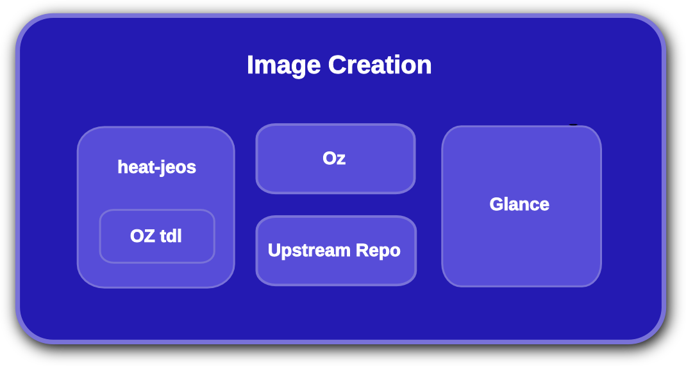
Heat Image Creation
Notes:
KEY POINTS
Oz used to generate JEOS images using native OS tools
Growing library of supported distributions
Do not require prebuilt images but lose some functionality

Slide 20
Demonstration of High Availability
“Resources”: {
"WebServerRestartPolicy" : {
  "Type" : "HEAT::HA::Restarter"
  "Properties" : {
  “InstanceId" : { "Ref" :"WikiServer" }
  }
  },
  "HttpFailureAlarm": {
  "Type": "AWS::CloudWatch::Alarm",
  "Properties": {
  "AlarmDescription": "Restart the
  WikiDatabase if httpd fails > 3 times
  In 5 minutes",
  "MetricName": "ServiceFailure",
  "Namespace": "system/linux",
  "Statistic": "SampleCount",
  "Period": "300",
  "EvaluationPeriods": "1",
  "Threshold": "2",
  "AlarmActions": [ { "Ref": "WebServerRestartPolicy" } ],
  "ComparisonOperator": "GreaterThanThreshold"
  }
  },
  “WebServer”: {
  "Type": "AWS::EC2::Instance",]
  "Metadata" : {
  "AWS::CloudFormation::Init" : {
  "config" : {
  "files" : {
  "/etc/cfn/notify-on-httpd-restarted" : {
  "content" : { "Fn::Join" : ["", [
  "#!/bin/sh\n",
  "/opt/aws/bin/cfn-push-stats --watch ",
  { "Ref" : "HttpFailureAlarm" },
  " --service-failure\n"
  ]]},
  },
  "/tmp/cfn-hup-crontab.txt" : {
  "content" : { "Fn::Join" : ["", [
  "MAIL=\"\"\n",
  "\n",
  "* * * * * /opt/aws/bin/cfn-hup -f\n"
  ]]},
  },
  "/etc/cfn/hooks.conf" : {
  "content": { "Fn::Join" : ["", [
  "[cfn-http-restarted]\n",
  "triggers=service.restarted\n",
  "path=Resources.WebServer.Metadata\n",
  "action=/etc/cfn/notify-on-httpd-restarted\n",
  "runas=root\n"
  ]]},
  }
  }}}}
  ... more instance stuff ...
  }}
Notes:
KEY POINTS:
A custom restarter type is used to restart the VM to achieve escalation after 3 failures of httpd
crontab scripts watch httpd for failures and indicate when a failure has occurred and restart http
Template contents not shown healthchecks the VM and the application restarters
The example colors:
Green is a custom resource for heat
Yellow is a cloudwatch alarm type
Blue is the instance name
Red is the command to run

Slide 21
Demonstration of Autoscaling
  “Resources”: {
  "WebServerGroup" : {
  "Type" :"AWS::AutoScaling::AutoScalingGroup",
  "Properties" : {
  "AvailabilityZones" : { "Fn::GetAZs" : ""},
  "LaunchConfigurationName" : { "Ref" : "LaunchConfig" },
  "MinSize" : "1",
  "MaxSize" : "3",
  "LoadBalancerNames" : [ { "Ref" : "ElasticLoadBalancer" } ]
  }
  },
  "WebServerScaleUpPolicy" : {
  "Type" : "AWS::AutoScaling::ScalingPolicy",
  "Properties" : {
  "AdjustmentType" : "ChangeInCapacity",
  "AutoScalingGroupName" : { "Ref" : "WebServerGroup" },
  "Cooldown" : "60",
  "ScalingAdjustment" : "1"
  }
  },
  "WebServerScaleDownPolicy" : {
  "Type" : "AWS::AutoScaling::ScalingPolicy",
  "Properties" : {
  "AdjustmentType" : "ChangeInCapacity",
  "AutoScalingGroupName" : { "Ref" : "WebServerGroup" },
  "Cooldown" : "60",
  "ScalingAdjustment" : "-1"
  }
  },
"MEMAlarmHigh": {
"Type": "AWS::CloudWatch::Alarm",
"Properties": {
"AlarmDescription": "Scale-up",
"MetricName": "MemoryUtilization",
"Namespace": "system/linux",
"Statistic": "Average",
"Period": "60",
"EvaluationPeriods": "1",
"Threshold": "50",
"AlarmActions": [ { "Ref":
"WebServerScaleUpPolicy" } ],
"Dimensions": [
{
"Name": "AutoScalingGroupName",
"Value": { "Ref": "WebServerGroup" }
}
],
"ComparisonOperator": "GreaterThanThreshold"
}
},
Notes:
KEY POINTS:
Monitoring of the VM for a high memory usage condition occurs via the MemAlarmHigh much as shown in the HA example
When the MemAlarmHigh alarm occurs, the WebServerScaleUpPolicy is executed
Scale constraints are available via MinSize and MaxSize
Example Colors:
Green is the autoscaling group
Blue is the scale up policy

Slide 22
In Closing
Users and developers wanted!
  Connect with the community via IRC on #heat@freenode
  Check out the repository:
    https://github.com/openstack/heat
  Read the Documentation:
    http://wiki.openstack.org/Heat/
Heat simple but powerful method for orchestrating OpenStack environments

Slide 23
Questions?

