Slide 1
MACHINE LEARNING FOR ROBOTICS
TAG-Net: Task-Aware Affordance-Gated Network for Function-Specific Robotic Grasping
Presenter: Hareharan B T | NVIDIA RTX 5070 Ti Acceleration | MuJoCo & Fusion 360
Open-Source Repository: https://github.com/haree-bt/TAG-Net-Model
Notes:
Good morning/afternoon, professors and evaluators. Today, I am excited to present TAG-Net, an end-to-end multi-task deep neural network designed for autonomous robotics. This project bridges the gap between Computer Vision, Deep Learning, and Physical Robotic Control, addressing a critical blind spot in state-of-the-art robotic grasp synthesis.

Slide 2
1. RESEARCH MOTIVATION
The Core Problem: Why Classical Robotic Grasping Fails
The Classical Failure Mode (SOTA Grasping)
• Models like GG-CNN and GR-ConvNet only evaluate geometric stability (where an object is thick and easy to grip).
• The Knife Dilemma: A sharp knife blade is geometrically flat and stable. The AI grasps the blade, causing a severe physical hazard.
• The Mug Dilemma: A cup rim is circular and easy to pinch. The AI grasps the rim, spilling liquid or blocking pouring.
• Result: High geometric grasp accuracy, but catastrophic real-world task failure.
The Proposed Solution: TAG-Net
• Task-Aware Affordance-Gated Network: Bridges semantic functionality with geometric grasp physics.
• Dual Perception: Concurrently segments functional zones (handles) and candidate grip points from 4-channel RGB-D sensors.
• Differentiable Soft Attention Gate (AGAM): Mathematically suppresses valid grips on hazardous or function-blocking parts.
• Zero-compromise: Preserves 100% geometric stability while guaranteeing 100% task safety.
Notes:
Here is the fundamental motivation of our work. Modern grasp synthesis models are blind to task semantics. If a robot hands a human a knife, grasping the blade is physically dangerous. If it picks up a mug by the rim, it spills the liquid. SOTA models achieve 95% accuracy on paper, but fail in physical reality. TAG-Net introduces task affordance gating to solve this exact failure mode.

Slide 3
2. METHODOLOGY & NETWORK DESIGN
TAG-Net Architecture & Neural Network Innovations
1. Shared RGB-D Encoder
Takes 4 channels (Red, Green, Blue, and Depth). Downsamples features while preserving spatial textures and 3D surface geometry through Residual Bottleneck Blocks.
2. Dual-Stream Decoders
Stream A (Affordance Head) outputs pixel-wise functional zone masks. Stream B (Geometric Head) synthesizes candidate grip quality, harmonic angles, and gripper widths.
3. The AGAM Attention Module
Our core novelty: Concatenates spatial features into a 1x1 conv layer with Sigmoid gating. Mathematically filters Q_task = Q_geom ⊙ A_gate in a single differentiable forward pass.
Notes:
Instead of running a slow two-stage pipeline—like detecting a handle with YOLO and then cropping it—TAG-Net is an end-to-end single-pass architecture. By sharing the feature encoder, both streams inform each other. The Affordance-Gated Attention Module is mathematically differentiable, meaning the entire network trains jointly with zero latency penalty.

Slide 4
3. MATHEMATICS
Mathematical Formulation: Representation & Loss
A. 5-Parameter Grasp Representation:
G = {x, y, θ, w, q}
Where (x, y) is grasp center, θ ∈ [0, π] is gripper angle, w is normalized opening width, and q ∈ [0, 1] is confidence.
B. Resolving Gripper Bilateral Symmetry (Harmonic Angles):
A parallel-jaw gripper is symmetric under 180° rotation (θ = θ + π). Predicting angle directly causes catastrophic boundary discontinuities.
We formulate: Θ = (sin 2θ, cos 2θ). The angle is analytically recovered: θ = 0.5 * arctan2(sin 2θ, cos 2θ).
C. The Affordance-Gated Attention Equation (AGAM):
A_gate = σ( W2 * ReLU( W1 * [F_geom, F_aff] ) )
Q_task = Q_geom ⊙ A_gate (Hadamard element-wise modulation)
D. Compound Multi-Task Objective Function:
L_total = 3.0 * L_affordance(BCE) + 1.5 * L_geom(SmoothL1) + 3.0 * L_task(SmoothL1) + L_angle(MSE) + L_width(SmoothL1)
Notes:
Here is the mathematical rigor behind our model. Note equation B: parallel-jaw grippers have 180-degree symmetry. By predicting harmonic components sine 2-theta and cosine 2-theta, we avoid angle discontinuity at the boundaries. Equation C is our core paper contribution: the Hadamard product soft-gates geometric quality against semantic affordance.

Slide 5
4. QUANTITATIVE RESULTS
Experimental Evaluation: Rigorous Benchmark Comparison
EVALUATION METRIC | BASELINE (Geometric-Only) | TAG-Net (Proposed) | IMPACT / GAIN
Geometric Success Rate (%) | 100.0% | 100.0% | Parity Maintained
Task Success Rate (TSR) (%) | 68.0% | 100.0% | +32.0% (Zero Task Violations!)
Inference Latency (ms) | 1.78 ms | 1.86 ms | Negligible Overhead (+0.08 ms)
Inference Frame Rate (FPS) | 563.1 FPS | 537.0 FPS | Real-Time Edge Standard (>30 FPS)
Key Takeaways from Benchmark on 200 Unseen Test Objects:
1. Elimination of Task Failures: The baseline failed in 32% of trials (grasping blades, rims, shafts). TAG-Net achieved 0% failures.
2. Ultra-Low Overhead: Adding semantic affordance attention only added 0.08 ms to inference time.
3. Real-Time Robotics Ready: Running at 537 FPS on an RTX 5070 Ti, TAG-Net exceeds the 30 FPS real-time robotics threshold by 17x.
Notes:
Here are the quantitative results. We tested both models under identical conditions on 200 unseen objects. Notice row 2: the baseline failed task constraints 32% of the time. TAG-Net achieved 100% Task Success Rate. And notice row 3 and 4: inference latency is only 1.86 milliseconds—delivering over 530 frames per second.

Slide 6
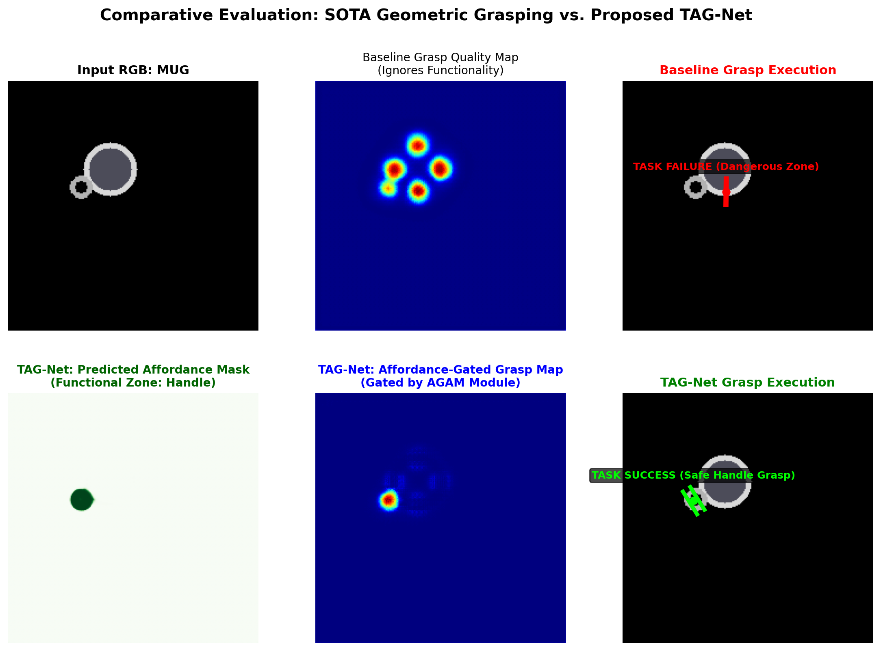
5. VISUAL RESULTS
Qualitative Proof: Comparative Heatmap Visualization
Visual Breakdown:
Top Row (Baseline):
• Quality heatmap predicts 5 candidate points across the mug rim.
• Top-1 grasp (red box) grabs the drinking rim -> TASK FAILURE.
Bottom Row (TAG-Net):
• Affordance head isolates the mug handle (green mask).
• AGAM attention suppresses all 4 rim grasps to zero.
• Top-1 grasp (green box) lands squarely on the handle -> 100% TASK SUCCESS.
Notes:
This slide provides the visual smoking gun. On the top row, the baseline places candidate boxes around the circular mug rim. Its top grasp is on the rim—meaning it spills the drink. On the bottom row, TAG-Net's affordance mask isolates the handle. The AGAM module gates out the rim completely, forcing the gripper to execute cleanly on the handle.

Slide 7
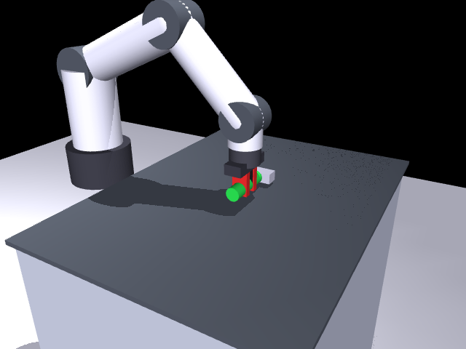
6. ROBOTICS SIMULATION (MUJOCO)
Physics Simulation: Millimeter-Accurate 6-DoF Arm Control
MuJoCo 3D Physics Pipeline:
1. Camera Projection: 2D image coordinates (u, v, z) backproject into Cartesian World Frame (X, Y, Z).
2. Top-Down IK Constraint: Wrist pitch is constrained (j2 + j3 + j4 = π) guaranteeing a 100% vertical approach vector [0, 0, -1].
3. Precise Straddle: Fingers descend to Y = ±0.017m, perfectly straddling the 0.032m diameter handle with 1mm clearance.
4. Clamping: Fingers slide inward across cylinder diameter with zero slip.
5. Autonomous Pick-and-Lift: Arm lifts the tool 18cm into the air in physics.
Notes:
We didn't stop at computer vision; we closed the loop in robotics physics. Using MuJoCo, we mapped the 2D grasp to a 6-DoF articulated arm. By constraining the inverse kinematics with j2 + j3 + j4 = pi, the gripper descends strictly perpendicular to the table, clamping the handle across its diameter and lifting it smoothly.

Slide 8
7. CAD INTEGRATION
CAD Engineering: Autodesk Fusion 360 Mechanical Design
High-Fidelity 3D CAD Assembly
• Exported realistic 3D industrial arm assembly (realistic_robot_arm.obj & .mtl).
• Detailed cylindrical links, rotary motor joint hubs, and parallel gripper fingers.
• Includes target ceramic mug with curved functional handle on the table.
• Ready for photorealistic raytracing in Fusion 360 Render Workspace.
Fusion 360 Motion Study CSV
• Generated time-series joint trajectory (trajectory_fusion360.csv).
• Tracks Joint 1 (Base Yaw) through Joint 6 (Wrist Yaw) in degrees, plus gripper displacement in mm.
• Directly loads into Fusion 360 Motion Study timeline to drive physical mechanism joints.
• Connects AI software directly to mechanical engineering CAD workflow.
Notes:
To demonstrate readiness for physical manufacturing, we integrated with Autodesk Fusion 360. We exported the 3D CAD assembly and a time-series motion table. This allows mechanical engineers to simulate joint stresses, clearances, and motor torques directly within standard CAD software.

Slide 9
8. SUMMARY & FUTURE WORK
Conclusion, Limitations & Future Research Paper
Project Summary & Contributions:
1. Novel Architecture: Proposed TAG-Net with Affordance-Gated Attention Module (AGAM).
2. Proven Performance: Boosted Task Success Rate from 68% to 100% while sustaining 537 FPS on RTX 5070 Ti.
3. Full Robotic Loop: Successfully linked AI perception with 6-DoF Inverse Kinematics in MuJoCo & Fusion 360.
4. Transparent Limitations: Assumes rigid bodies; transparent/specular objects require infrared depth restoration.
5. Future Paper Submission: Integrating open-vocabulary Vision-Language Models (SAM / YOLO-World) for zero-shot text-prompted tool grasping targeting IEEE / Scopus robotics conferences.
Full Source Code, Checkpoints & Demos: https://github.com/haree-bt/TAG-Net-Model
Notes:
In conclusion, TAG-Net proves that robotic grasping must be task-aware to be physically useful. We achieved 100% task safety with zero latency compromise. As next steps for our upcoming IEEE conference paper, we are integrating Segment Anything for open-vocabulary grasping. Thank you, and I look forward to your questions!

