Slide 1
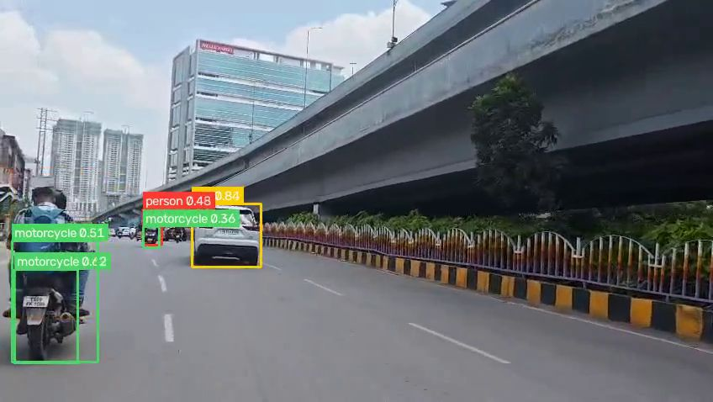
VisionIQ · NH5 Highway AI
Automatic traffic monitoring from highway video: vehicles, number plates and incidents in one web platform
A processed frame: every road user is detected, classified and tracked
Project review · 5 October 2026
Notes:
VisionIQ combines our NH5 Highway detection model with a web platform. Upload highway footage or use a live camera; the system detects and tracks every vehicle, reads Indian number plates, raises incident alerts, and links all results together. This review covers the model, the platform and what we learned.

Slide 2





What the project set out to do
Count and classify traffic
Read Indian number plates
Raise incident alerts
Connect the results
Cars, motorcycles, autos, buses, trucks, bicycles and pedestrians, each counted once.
Plates are cleaned, read and accepted only in a valid Indian format.
Accidents, vehicle fires, road work and potholes, with snapshots.
Every video gets an Excel report, linked into one knowledge graph.
Two targets: the VisionIQ website for uploaded videos and a live camera, and the Rubik Pi edge board (compressed INT8 model).
Notes:
Four goals: count and classify all traffic, read Indian plates, raise alerts for incidents and road hazards, and connect everything into reports and a knowledge graph. The system runs as a website, and the model is also converted for the Rubik Pi edge board.

Slide 3




From video to answers in six steps
1. Input
2. Detect
3. Track
4. Plates
5. Alert
6. Report
Uploaded video, photo or live camera
YOLOv8n finds 12 classes in every frame
ByteTrack keeps one ID per object
PaddleOCR, Indian format, 5 matching reads
Event rules: accident, fire, road work
Excel report, dashboard and ontology
Every finished video lands in the library, the vehicle database, the dashboard and the ontology automatically, within about 10 seconds.
Notes:
The pipeline: input from an upload or live camera; YOLOv8n detection; ByteTrack tracking so each vehicle is counted once; plate reading with PaddleOCR, accepted only after five identical valid readings; rule-based alerts; and an Excel report per video that feeds the dashboard and the ontology automatically.

Slide 4
The detection model
PART 1
Notes:
First, the YOLOv8 detection model behind the platform.

Slide 5



One model detects 12 classes
Vehicles
car · motorcycle · auto · bus · truck · bicycle
Traffic counts per type
People
person
Pedestrian counts and roadside events
Number plates
license_plate
Indian plate reading
Road hazards
pothole · road_construction
Maintenance and work-zone alerts
Incidents
accident_scene · fire_accident
Accident and fire alerts
YOLOv8n (nano, 3.0 M parameters) · trained 100 epochs at 960 px on 88,083 images (105k-image dataset)
Notes:
One small YOLOv8n model handles all 12 classes: six vehicle types, people, number plates, two road hazards, and two incident classes. It was trained for 100 epochs at 960 pixels on about 88 thousand training images from a 105 thousand image dataset.

Slide 6
Accuracy beats the 0.75 target
0.805
mAP50 on the leak-free test set (target 0.75)
0.818
on the full test set
3.7 MB
INT8 model for the Rubik Pi, same 0.805
Notes:
Overall mAP50 is 0.805 on the leak-free test set, which only contains images with no near-copy in training, so it is the honest number. The target was 0.75. Plates, autos, cars, motorcycles and buses are strongest; potholes are the weakest class at 0.56. The INT8 version for the edge board keeps the same 0.805 at only 3.7 MB.

Slide 7

v8 is the best model so far
Measured on 14 test videos | v5 | v6 | v8
Vehicles detected | 104,630 | 43,023 | 133,439
Correct number plates read | 10 | 31 | 31
Accident detection | not possible | misses vehicles | yes
Fire detection | not possible | not possible | yes
Count stability (lower is better) | 12.1% | 24.0% | 8.3%
Test videos: real crashes and vehicle fires were all detected; busy traffic with no incidents raised no false alerts; foreign plates were correctly ignored.
Notes:
Compared with v5 and v6 on the same 14 test videos, v8 detects the most vehicles, reads as many correct plates as v6, is the first to detect fires, and has the most stable counts. On scenario tests it caught all crashes and fires without false alarms on normal traffic.

Slide 8
Rules that keep the output trustworthy
Counted once
No single-frame alarms
Each vehicle keeps one track ID across frames, so it appears once in the counts and the report.
An accident or fire must be seen steadily for about a second before an alert is raised.
No guessed plates
Fire must look like fire
A plate is accepted only in a valid Indian format, after 5 matching readings at 85%+ OCR confidence.
A fire box needs real flame colour, so grey dust after a crash is not reported as fire.
Notes:
Four rules make the results reliable: tracking means each vehicle is counted once; alerts need about a second of steady detection; plates are never guessed; and a fire detection must actually contain flame colour.

Slide 9
The VisionIQ platform
PART 2
Notes:
Second, the VisionIQ website that runs the model and presents the results.

Slide 10
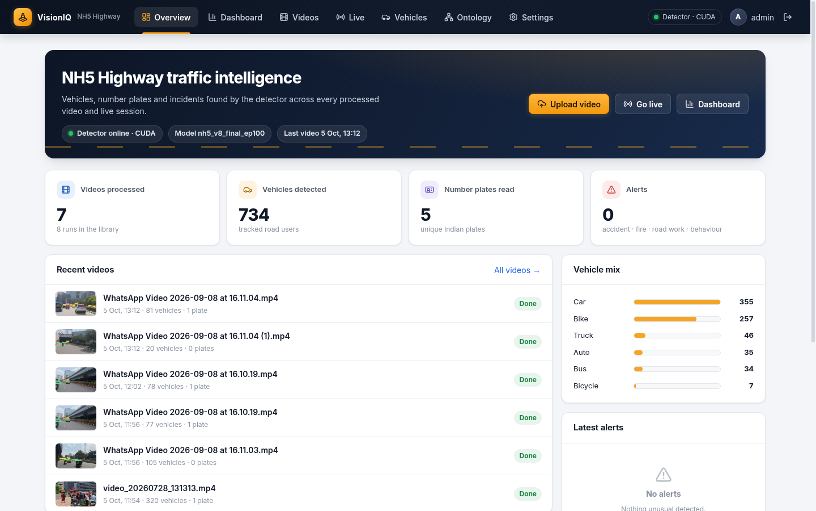
One website, seven clear tabs
1
Overview
Totals, recent videos, plates and alerts
2
Dashboard
Charts by time range and video
3
Videos
Upload, library and per-video results
4
Live
Detection on a device camera
5
Vehicles
Plate search and sightings history
6
Ontology
Knowledge graph from the Excel reports
7
Settings
Road maps, model info, account
Notes:
The website is one application with seven tabs. It replaced an earlier version with fifteen sidebar entries, several of which showed demo data. Every tab now shows real detection results.

Slide 11
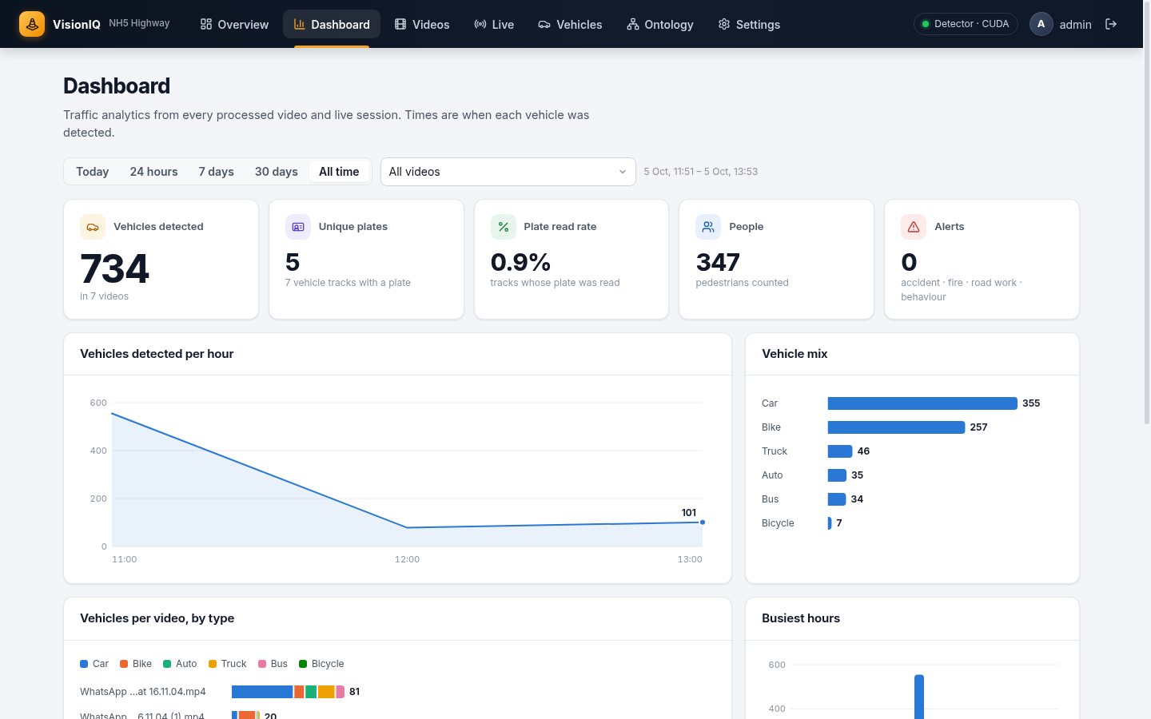



Dashboard: traffic analytics at a glance
One filter row
Today, 24 hours, 7 or 30 days, or all time, for one video or all of them.
Key numbers
Vehicles, unique plates, plate read rate, people and alerts.
Charts
Vehicles over time, vehicle mix, per-video mix by type, busiest hours.
Notes:
The dashboard has one filter row: time range and video. All numbers and charts follow it. A video processed twice is counted once everywhere, so the numbers on every page agree.

Slide 12
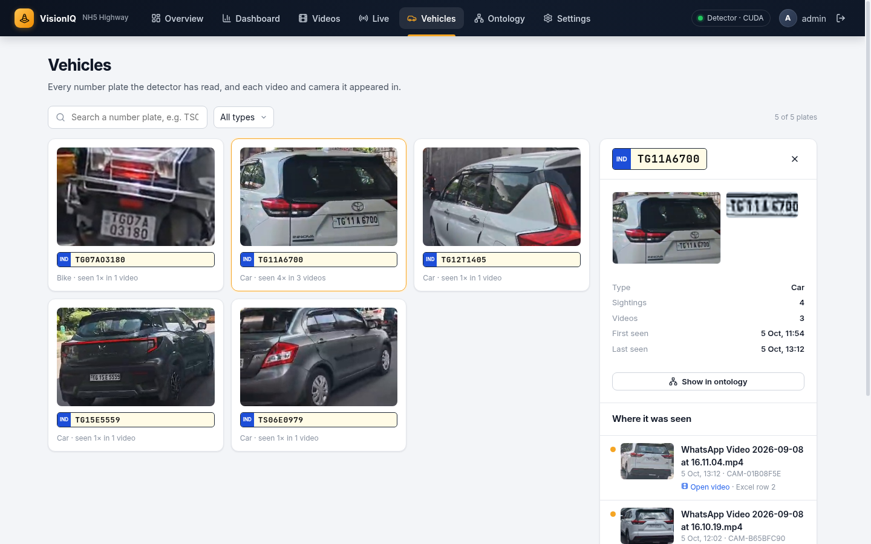
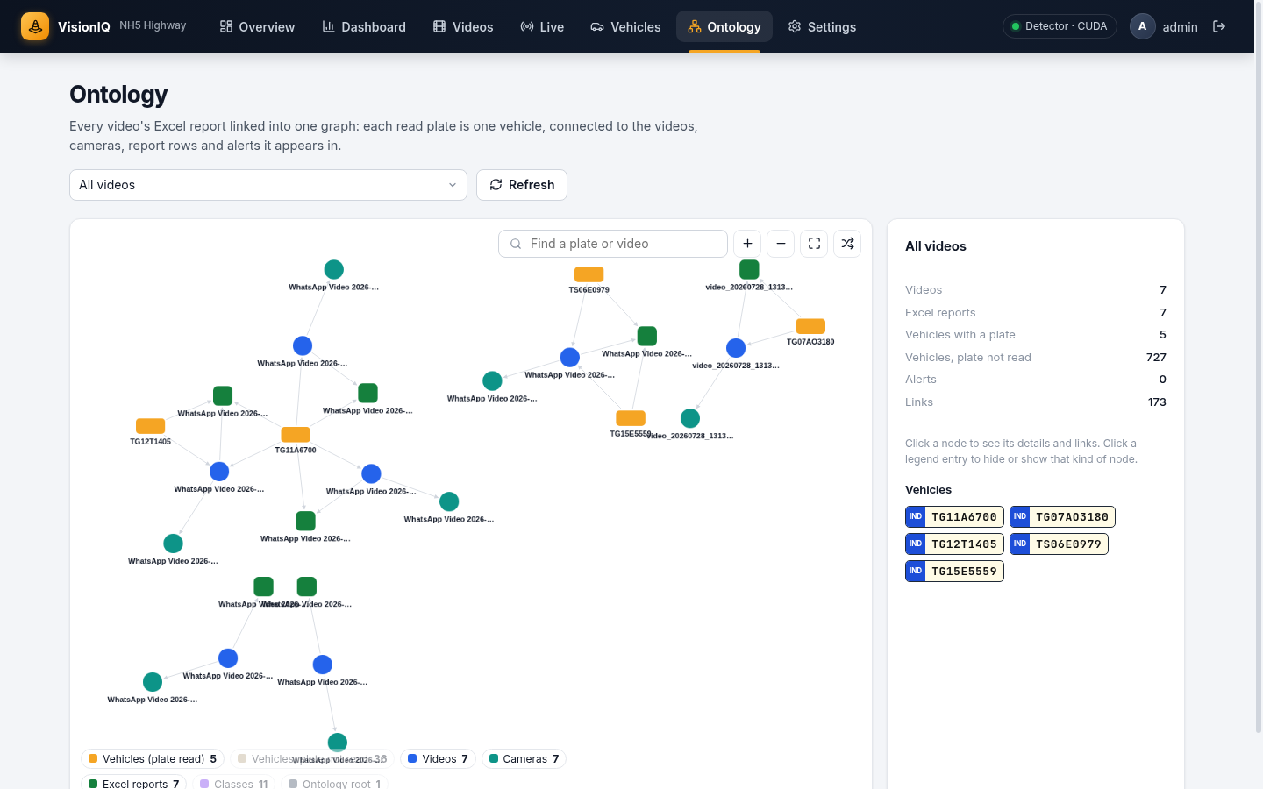
Every vehicle traced back to its source
Vehicles: search a plate and see each video and camera it was seen in, with photos and the Excel row.
Ontology: each Excel report becomes a graph: one node per plate, linked to its videos, cameras, report rows and alerts.
Notes:
Two ways to follow a vehicle. The Vehicles tab tracks one plate across all videos. The Ontology turns every Excel report into a knowledge graph, so any vehicle, video, camera or alert can be traced back to the exact spreadsheet row it came from.

Slide 13
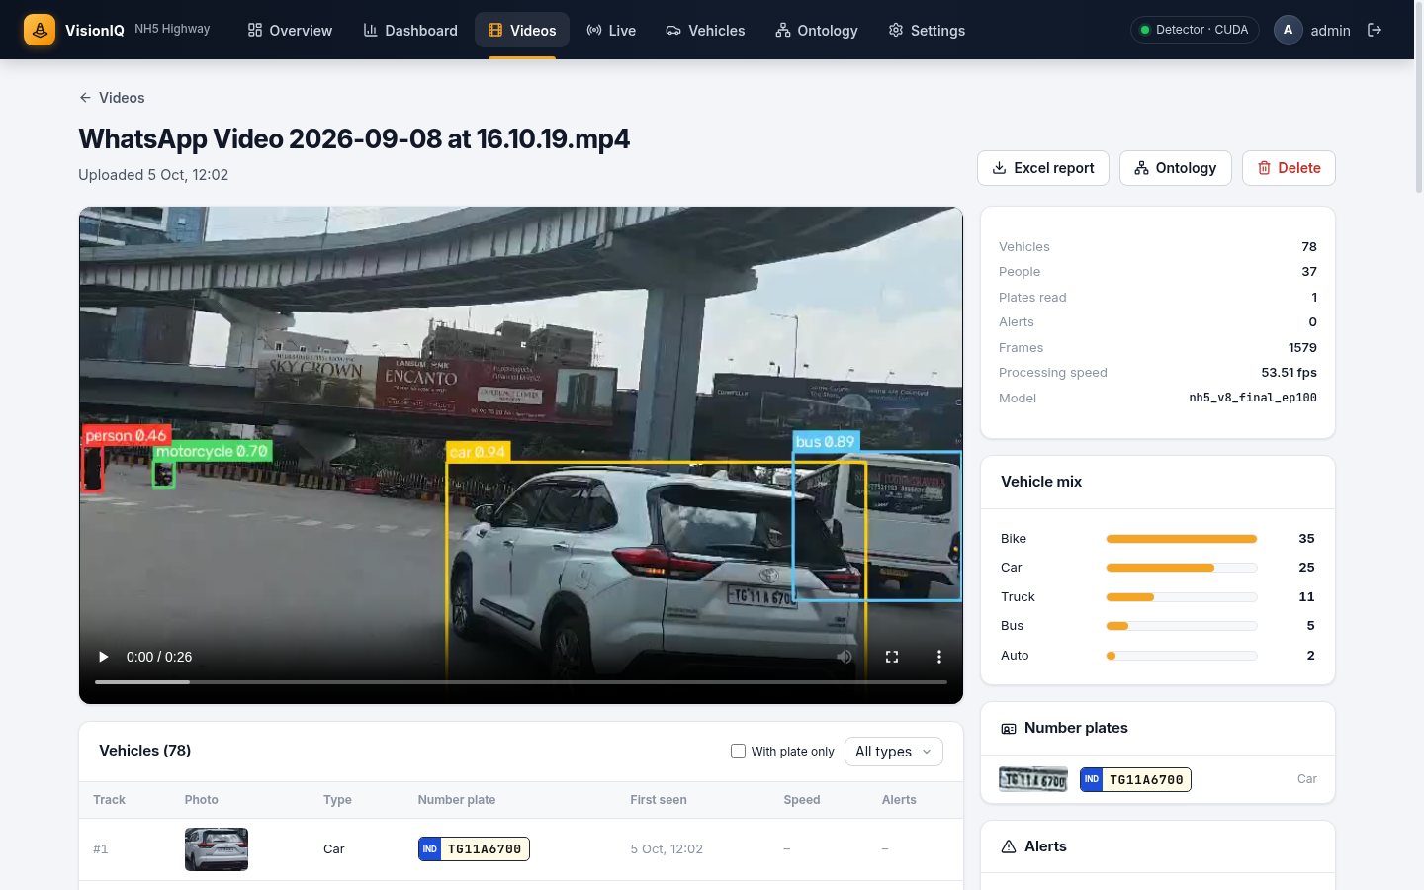


Each video: annotated, counted and reported
Annotated video with every detection drawn on it
Table of every tracked vehicle with photo, type and plate
Excel report download: Vehicles and Events sheets
About 53 frames per second on the GPU (RTX 4090)
Re-uploading the same file shows the earlier result instead of processing it twice
Notes:
Opening a video shows the annotated video, every tracked vehicle with its photo and plate, the alerts, and the Excel report. Processing runs at about 53 frames per second on the GPU. Uploading the exact same file again returns the earlier result rather than double counting.

Slide 14





Built to run reliably on the team network
One server
Login required
Automatic import
Python backend serves the website, the API and the GPU models on one port (gunicorn).
Every page, API call, video, photo and Excel report needs a signed-in user.
Finished videos flow into the database, dashboard and ontology within about 10 seconds.
No duplicates
Consistent look
Edge ready
Identical files are detected by SHA-256 hash and counted once everywhere.
Bundled fonts and a fixed theme, so every computer shows the same interface.
INT8 ONNX model (3.7 MB) for the Rubik Pi board, same accuracy.
Notes:
Engineering highlights: a single server for the site, API and models; login protection on everything; automatic import of results; duplicate detection so a re-uploaded video is never counted twice; a consistent interface on every computer; and an edge-ready INT8 model.

Slide 15



What limits plate reading, and what does not
Reading is accurate
0.9%
When a plate is detected, OCR and the Indian-format check confirm nearly every real plate.
of tracked vehicles have a confirmed plate in the current videos
Detection is the limit
Most vehicles never show a detectable plate: too far, at an angle, or too small in the frame.
7 plates, 333 vehicles
in one Indian-plate test video
Loosening rules adds errors
Fewer votes, lower confidence or a larger image size added misreads, not new plates.
Fix at the source
Closer or overhead NH5 cameras, higher resolution, and more plate training data.
Notes:
We measured where plates are lost on four videos. Reading is not the problem: detected plates are read correctly, and loosening the acceptance rules only produced misreads. The real limit is that most vehicles never show a detectable plate in this footage. A test video with UK plates gives zero by design. The fix is better camera placement and more plate training data.

Slide 16


Known limitations and next steps
Limitations today
Next steps
Potholes: about half are missed (mAP50 0.56)
Road construction: false detections on bollards and lone signs
Few plates from high or overhead cameras
Smoke-only fires and wreck photos not always recognised
Some CCTV accidents flagged 1 to 3 seconds early
Train road construction as a separate model
Relabel potholes and CCTV accidents; add more data
Collect real NH5 camera footage, including night and overhead views
Fix camera positions, then enable lane-change and wrong-side rules
Deploy the INT8 model on the Rubik Pi board
Notes:
Main limitations: potholes, road-construction false positives, plates from high cameras, smoke-only fires, and some early accident flags. The next steps focus on data: separate road-construction training, relabelling, and footage from the real NH5 cameras, then enabling the camera-specific rules and deploying on the edge board.

Slide 17
Summary
0.805
mAP50, above the 0.75 target
12
classes from one small model
~53 fps
processing on the GPU
A working platform that turns highway video into counted vehicles, verified plates, alerts and linked reports
7
clear tabs in one website
Thank you · Questions
Notes:
To summarise: the v8 model beats its accuracy target with 12 classes in a small network, the platform processes video at about 53 frames per second, and the results are available in one clear website with a dashboard and a knowledge graph. Thank you; happy to take questions.

