Slide 1
R-DB V2 Red Discord Bot
SW ENG 3XA3 2018

Slide 2

Our Team
Jason Tsui, Hareem Arif, Abdul Elrahwan

Slide 3


ABOUT US
Reimplementation of a Discord Bot
What is a discord bot you may ask?
Discord is a proprietary freeware designed for video gaming communities that specializes in text, image, video, and audio communication.
So we have used this freeware to create a community of our own, for users to join in on, and communicate on various topics in various ways.

Slide 4


What does it do?
Connect. Communicate. Discuss.
Allows users to connect on server. On the server they can connect to channels.
Different channels for different topics.
Discuss:
Music, News, Movies.

Slide 5

Qualities
Installability
Portability
Learnability
ADD SOMETHING HERE

Slide 6
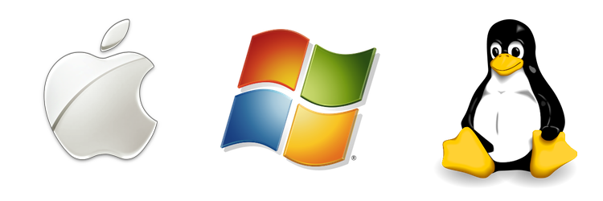


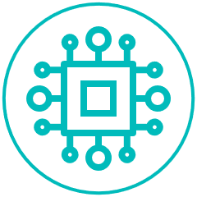

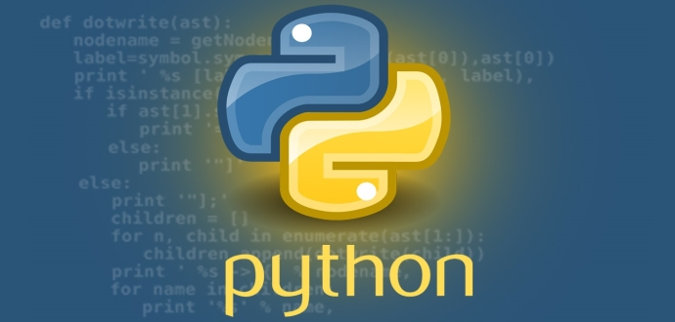
R-DB V2
Installability
Discord is available as a browser, Windows, macOS, Linux, OS and Android application.
Portability
The project itself is programmed through Python, coupled with the accessibility of the server, the product is portable on many systems
Learnability
Describe how we have this
Quality 4
Describe how we have this

Slide 7

The Design.
Why it is the way it is
The layout is one that is bridged from the freeware
The topics hosted for discussion are taken from the original implementation

Slide 8
Current Features
Connect – Communicate – Discuss
1
2
3
Feature 1
Feature 2
Feature 3
Details on it
Details on it
Details on it

Slide 9

DEMO

Slide 10
Future Features
3
2
Feature 3
1
Section 3 Subtitle
Building on what’s there
Feature 2
Section 2 Subtitle
Feature 1
Section 1 Subtitle

Slide 11

SUMMARY
Do we need this slide?
DETAILS

Slide 12
THANK YOU!

Slide 13
APPENDIX
This section is for the references for the pictures, I have all the links, making the proper reference formatted version

