Slide 1
Program Flow Control- Conditionals
DR. HAREEM NISAR
Hareem.nisar94@gmail

Slide 2
Learning Objectives
1. Understand conditional statements and their usage
2. Practice programming tasks using conditions
3. Get familiar with using built-in functions for Strings
Notes:
https://answergarden.ch/2214334

Slide 3
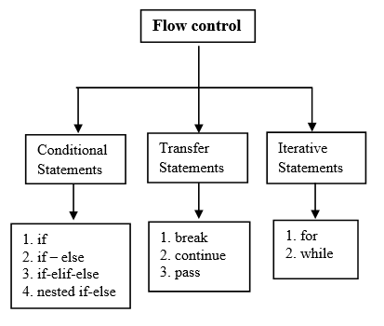
Python control flow statements
© PyNative

Slide 4
if
if (condition here is True):
code line 1
code line 2
code line …

Slide 5
If else
if (condition here is True):
code line 1
code line 2
code line …
else:
code line 1

Slide 6
If – elif - else
if condition-1:
statement 1
elif condition-2:
statement 2
elif condition-3:
statement 3
else:
statement 4

Slide 7
Nesting
if conditon_outer:
if condition_inner:
statement of inner if
else:
statement of inner else:
statement of outer if
else:
Outer else
statement outside if block

Slide 8
Resources
For syntax and learning commands: https://www.w3schools.com/python/default.asp
For practice questions with solutions:
https://pynative.com/python-exercises-with-solutions/
https://www.codesdope.com/practice/practice_python/

Slide 9
Strings - assignment
X = ‘Hey’
Y = “Hello Pumpkin”
Z = “““ My dearly and utterly beloved,
the love of my life,
the fire inside my heart”””

Slide 10
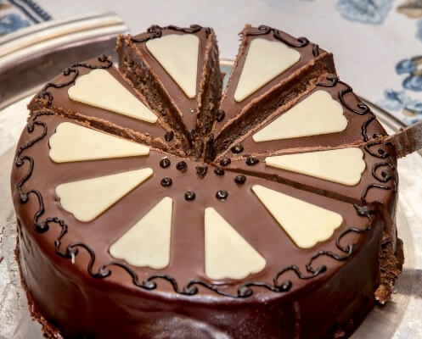
Strings are an Array
a = “KABOOM”
# indexing = location = each character has a number/index associated with it.
# slicing = getting a part of the original string.
What is “K” ?? a[0] or a[1]
what’s “M” ?
length_a = len(a)

Slide 11
Loop through a string
for x in “kaboom": print(x)

Slide 12
Check if a word exists
txt = “Kitty cats are the best!" print(“cats" in txt)

Slide 13
Check if a word exists
txt = “Kitty cats are the best!" print(“cats" in txt)
if “cats" in txt: print("Yes, cats are the best.")

Slide 14
Check if a word exists
txt = “Kitty cats are the best!" print(“cats" in txt)
if “cats" in txt: print("Yes, cats are the best.")
What if not?

Slide 15
Modify Strings
.upper()
.lower()
.split()
.reverse()
.replace()
.strip()

