Slide 1



Image Processing
Module 7 – Libraries
Instructor: Dr. Hareem Nisar
Contact: hareem.nisar94@gmail.com

Slide 2






Introduction to Digital Image Processing

Slide 3
Learning Objectives
By the end of this lesson, students should be able to
Recognize the importance of image processing in the real world.
Identify and distinguish between different types of images.
Notes:
1 min

Slide 4

Where is Image Processing?
Art
Robots
Multimedia
Business?
Social media
On the road?
In your home?
Your work or office?
Space!
Medicine
Security systems
Forensics
Factories!
Notes:
Where do you see Image processing?

Slide 5
I spy with my eye…
Give examples where images or image processing is taking place around you.
Hints:
- Images may be modified
- Something might be read / scanned
- Actions taken based on images
- Images taken based on actions
- Consider your work or workspace
Notes:
https://jamboard.google.com/d/1vOgfdp7mjzv_KnOV7S-scFQVeM_8BGZJ_5FLB6h3e9A/edit?usp=sharing

Slide 6
Image Processing
Art
Robots
Multimedia
Business?
Social media
On the road?
In your home?
Your work or office?
Space!
Medicine
Security systems
Forensics
Factories!

Slide 7
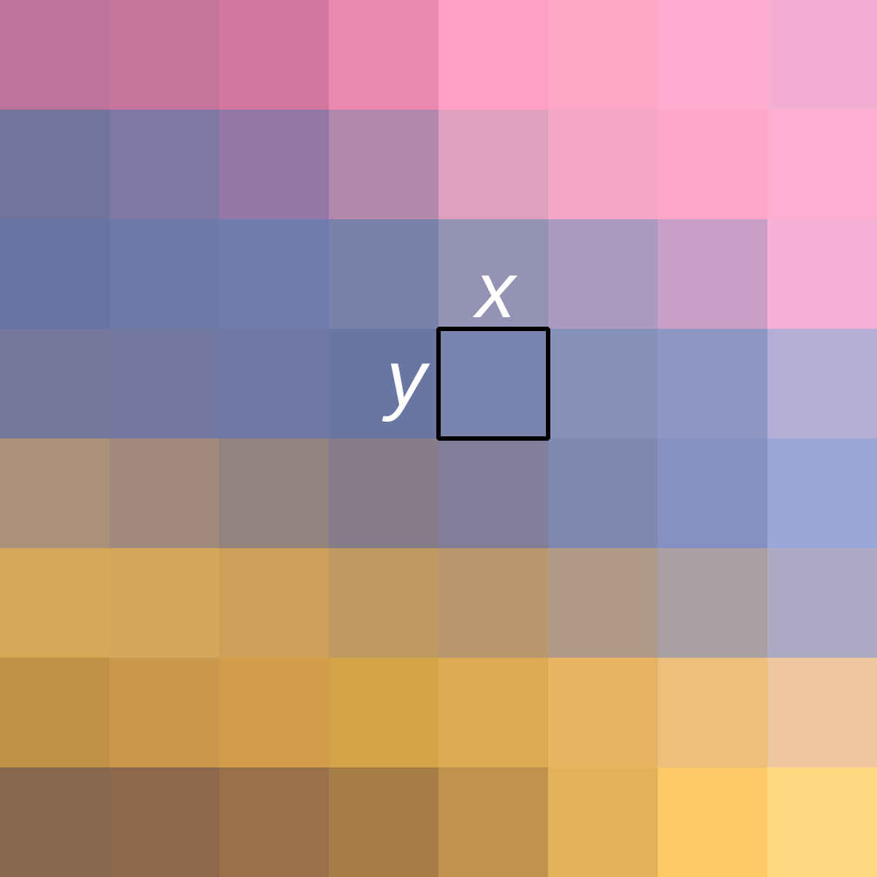
What is an image?
0,0
x
Image is a form 2D data with
a) Spatial information
b) Intensity information
Each pixel has (x,y) coordinate to define location
And an intensity value I
i
y

Slide 8
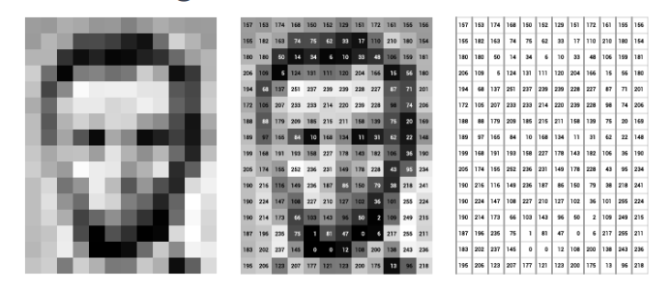
Pixel Intensity
Notes:
Ra

Slide 9
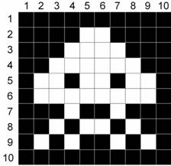
Binary
1s and 0s
0 = black
1 = white
First white pixel location
(5,2)

Slide 10
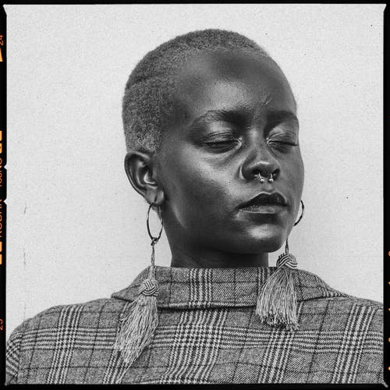
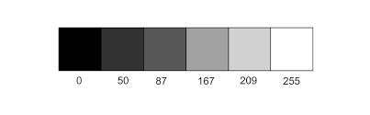
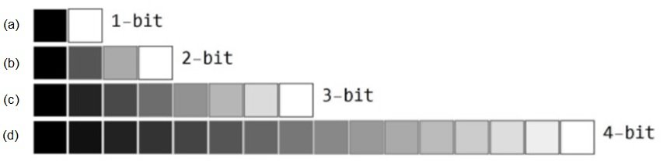
GrayScale
Intensity Range: 0-255
Notes:
Where does that number come from? 8 bits

Slide 11
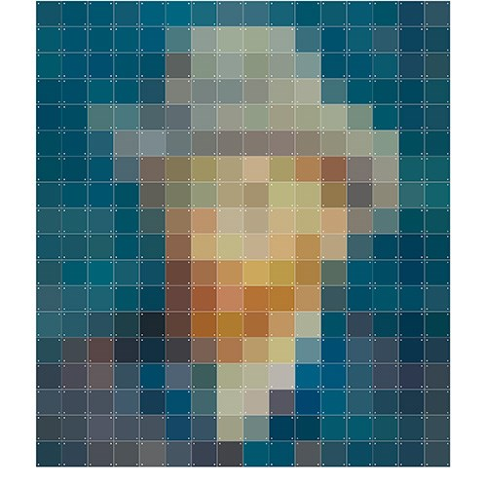
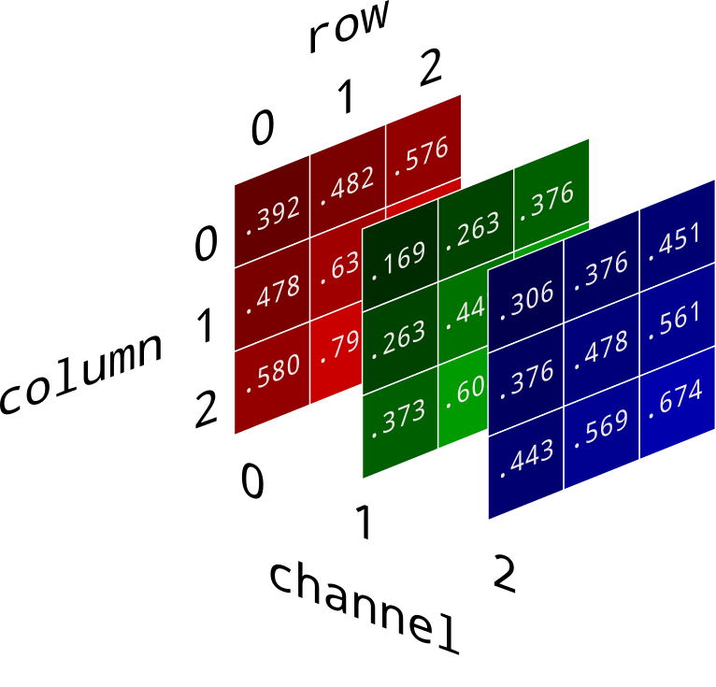
RGB images
Intensity
= 30%red
+ 30%green
+ 40% blue

Slide 12
1. What is the location of monster’s eye? 2. What type of image is this?
Pre-assessment
QUIZ
Notes:
1.What is the location of monster’s eye?
(5,4) (4,5) (5,2) (2,5)
2. What type of image is this?
Black and white, Binary, Grayscale, RGB

Slide 13
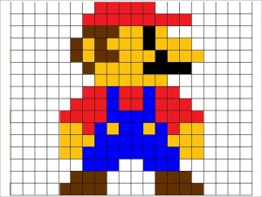
In a Nutshell
Image Processing is all around us!
Images are a collection of pixels.
Each have has a POSITION (x,y) and INTENSITY value (i)
Common types of images are Binary, Grayscale and RGB
Notes:
Thank you!

