Slide 1
Salary Predictions of Data Professions
ML Internship
Batch 3
Task 3
Made By Hareem Fatima

Slide 2
Problem Statement
Salaries in the field of data professions vary widely based on factors such as experience, job role, and performance. Accurately predicting salaries for data professionals is essential for both job seekers and employers.

Slide 3

Approach :
Exploring Data
Data PreProcessing
Splitting Data
ML Models

Slide 4
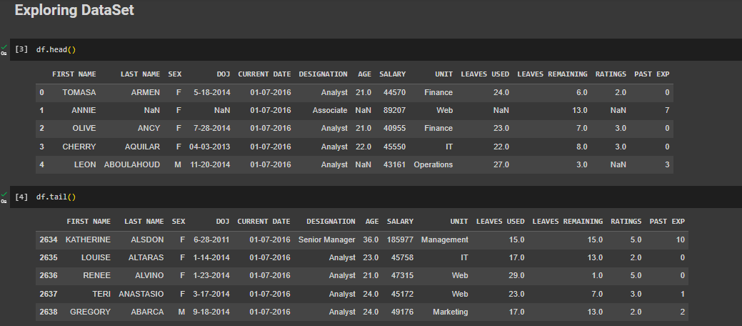
Exploring DataSet

Slide 5
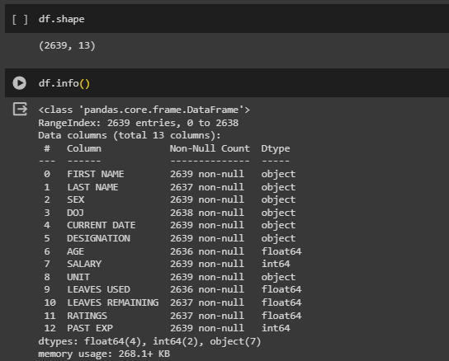
Exploring DataSet

Slide 6
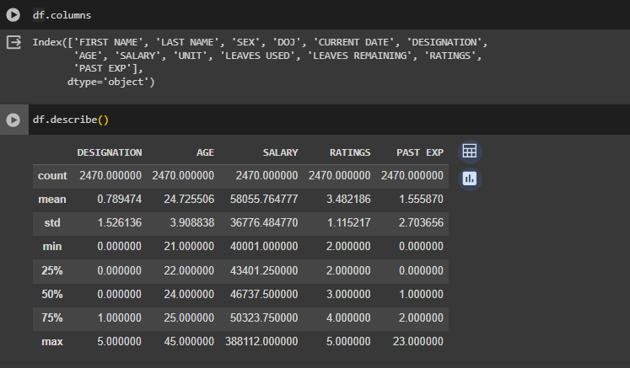
Exploring DataSet

Slide 7
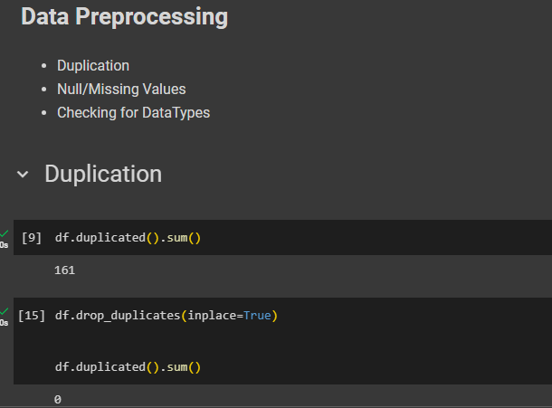
2. Data Preprocessing

Slide 8
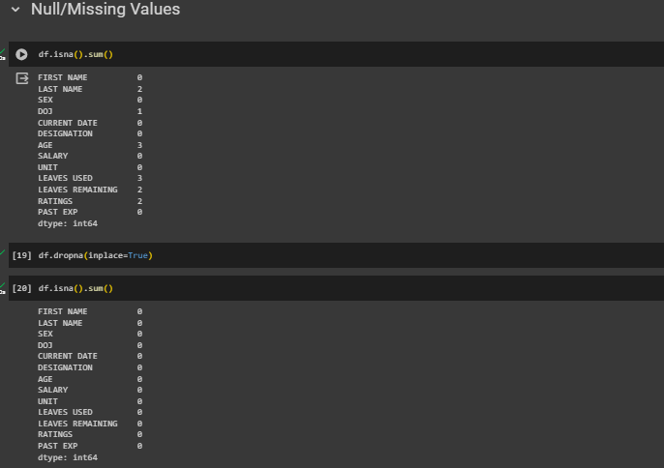
2. Data Preprocessing

Slide 9
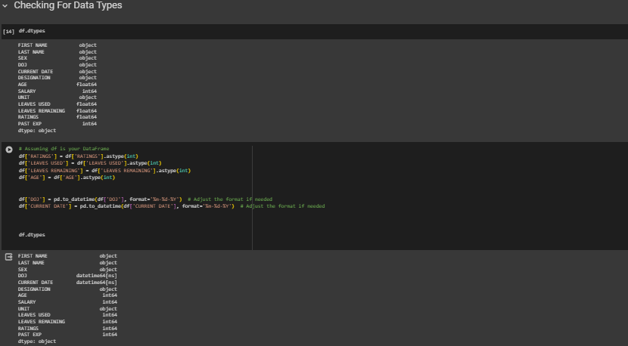
2. Data Preprocessing

Slide 10
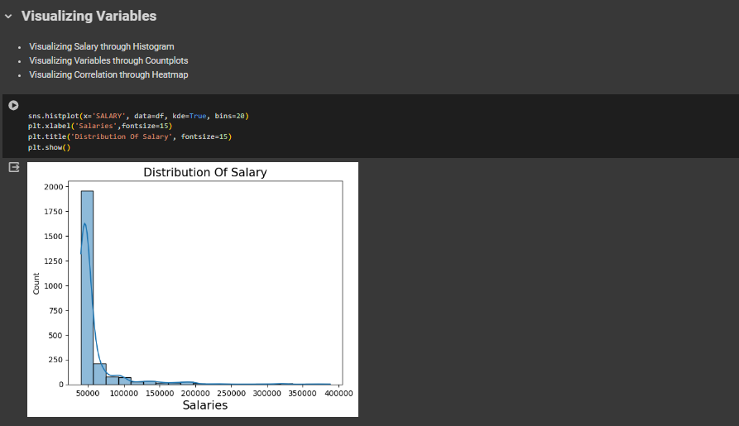
2. Data Preprocessing

Slide 11
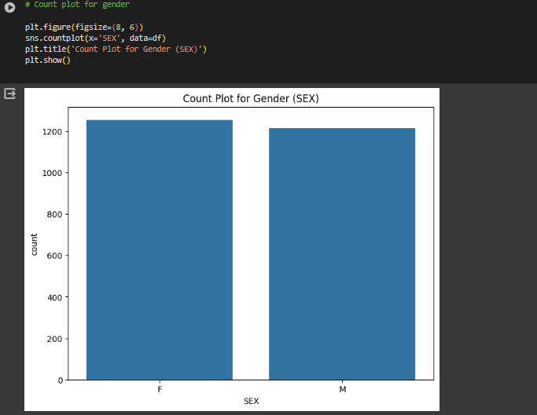
2. Data Preprocessing

Slide 12
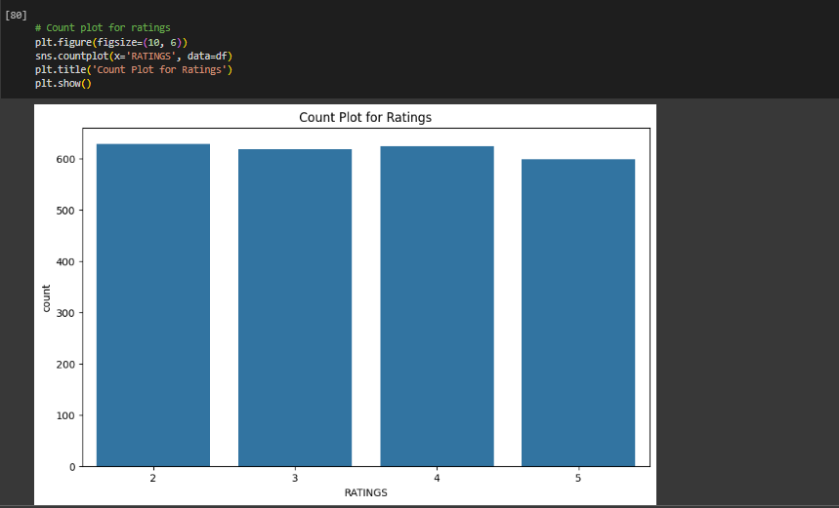
2. Data Preprocessing

Slide 13
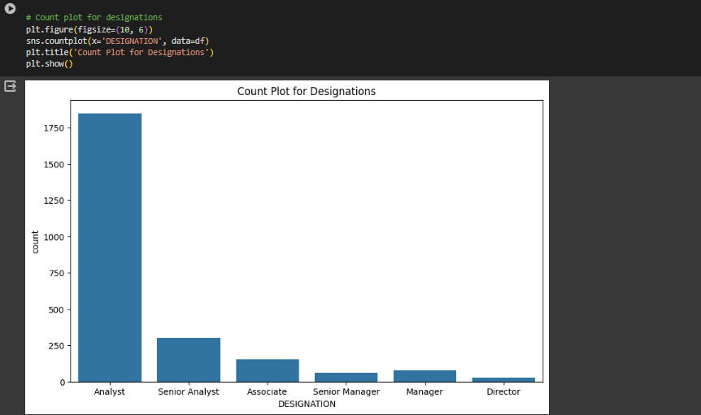
2. Data Preprocessing

Slide 14
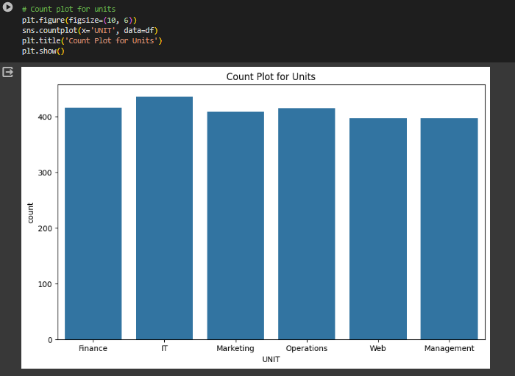
2. Data Preprocessing

Slide 15
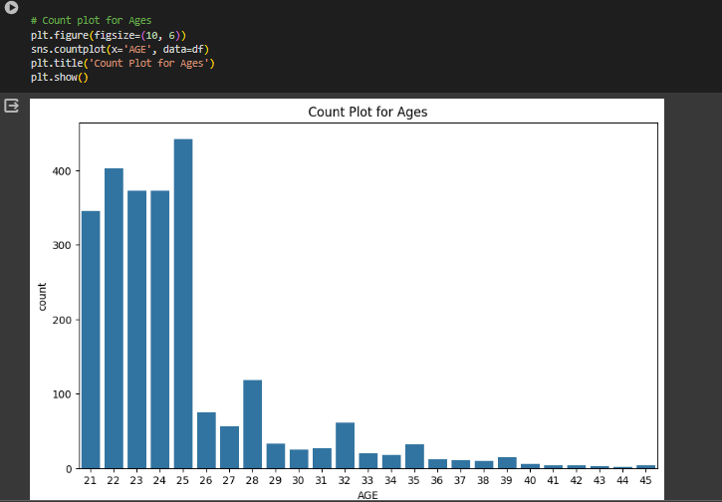
2. Data Preprocessing

Slide 16
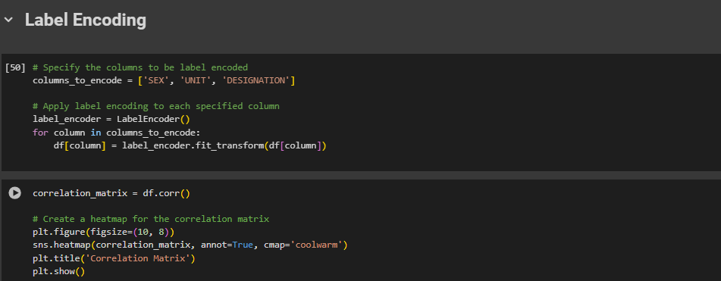
2. Data Preprocessing

Slide 17
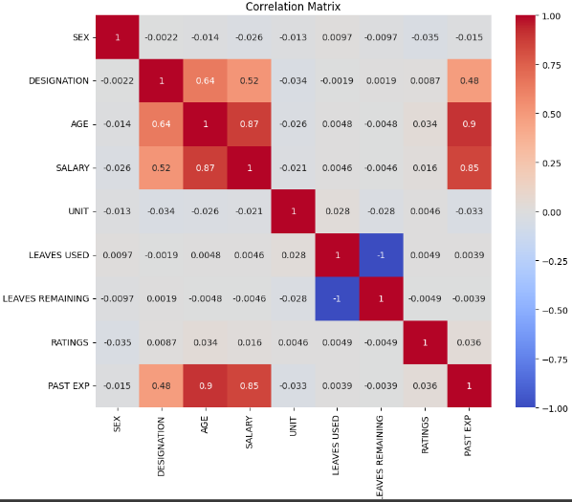
2. Data Preprocessing

Slide 18
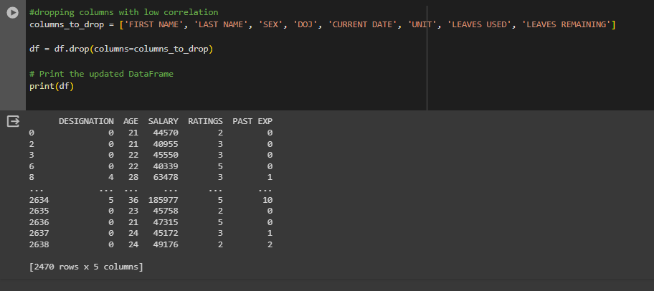
2. Data Preprocessing

Slide 19
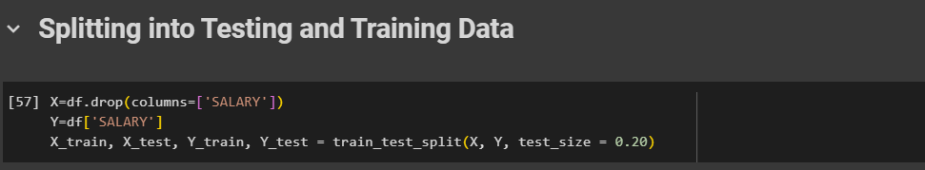
2. Data Preprocessing

Slide 20
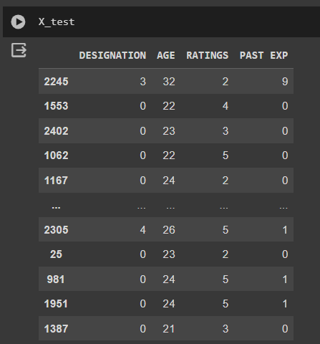
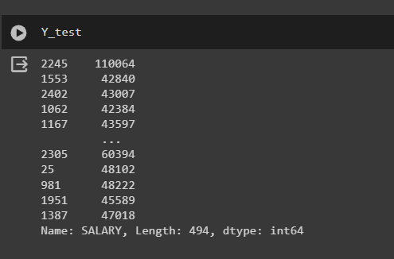
2. Data Preprocessing

Slide 21
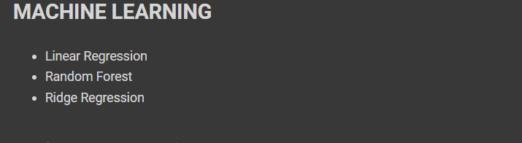
3. Machine Learning Models

Slide 22
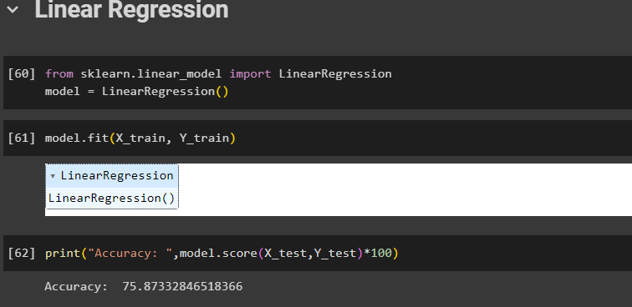
3. Machine Learning Models
Linear Regression

Slide 23
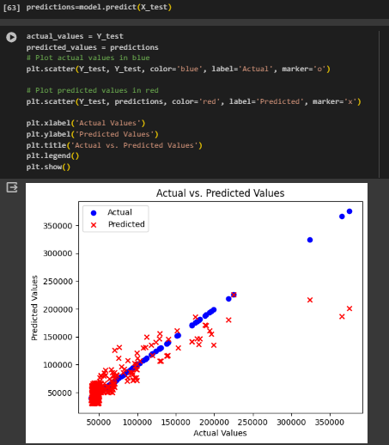
3. Machine Learning Models
Linear Regression

Slide 24
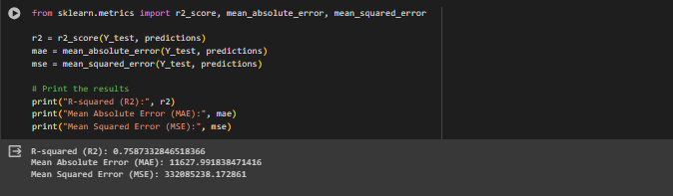
3. Machine Learning Models
Linear Regression

Slide 25
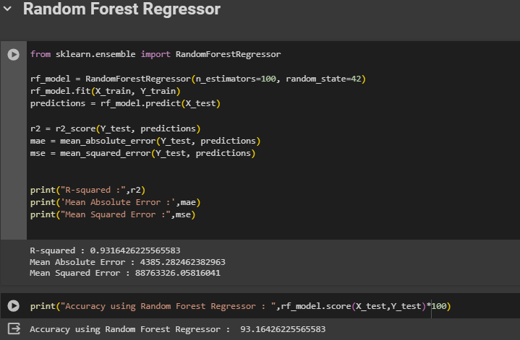
3. Machine Learning Models
Random Forest Regression Model

Slide 26
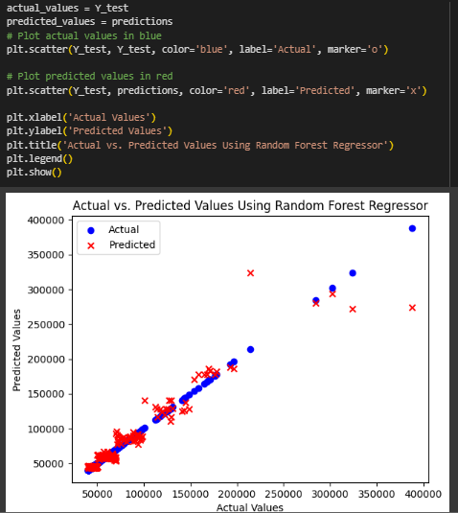
3. Machine Learning Models
Random Forest Regression Model

Slide 27
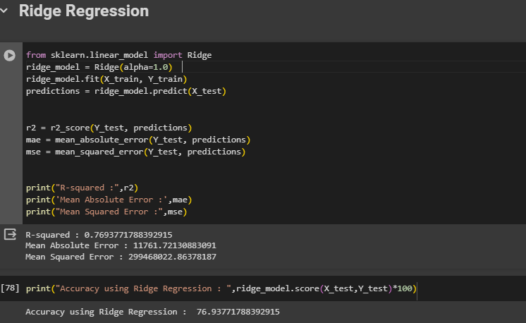
3. Machine Learning Models
Ridge Regression Model

Slide 28
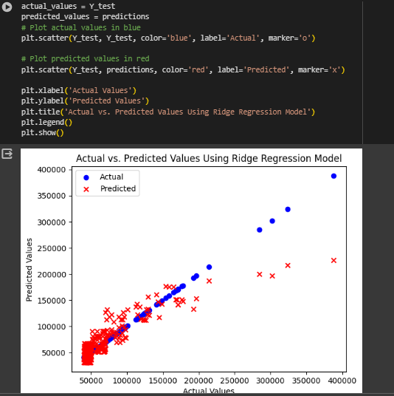
3. Machine Learning Models
Ridge Regression Model

Slide 29
THE END
PRESENTED BY
HAREEM FATIMA

