Slide 1
Automating SvH Scoring in Rheumatoid Arthritis
https://www.nature.com/articles/s41598-025-86073-0#:~:text=The%20Sharp%2Dvan%20der%20Heijde,from%20hand%20X%2Dray%20images

Slide 2
Introduction
Rheumatoid Arthritis (RA) is a chronic autoimmune disease that causes joint inflammation and damage.
Radiographic imaging (X-ray) is crucial for assessing disease progression.
The Sharp/van der Heijde (SvH) scoring system is the clinical standard for measuring joint damage.

Slide 3
Problem Statement
Manual scoring of rheumatoid arthritis (RA) radiographs using the Sharp/van der Heijde (SvH) method is time-consuming, subjective, and prone to inter-reader variability. As RA progresses, accurate and consistent scoring of joint erosions and joint space narrowing is essential for disease monitoring and treatment evaluation. However, manual assessments limit scalability in clinical practice and large-scale studies. There is a critical need for an automated, reliable, and standardized system to perform SvH scoring efficiently, ensuring consistent results, reducing clinician workload, and enabling timely clinical decisions.

Slide 4
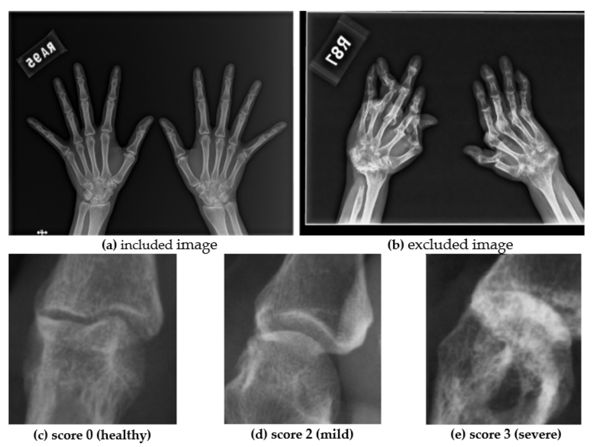
What is SvH Scoring?
Measures:
- Erosion (Bone destruction): 0–5 (hands), 0–10 (feet), max = 280
- JSN (Joint space narrowing): 0–4 per joint, max = 168
- Total Max Score = 448

Slide 5
Why Automate Scoring?
Manual scoring is slow, subjective, and requires specialists.
Automation enables:
- Faster, consistent, and scalable analysis
- Early detection and monitoring of joint damage

Slide 6
Pipeline Overview: Joint Detection + Scoring
Step 1: Detect joints using YOLOv7 or YOLOv5
Step 2: Crop joint areas from X-rays
Step 3: Use deep models (ResNet, EfficientNet, ViT) to predict:
- Erosion score
- JSN score

Slide 7
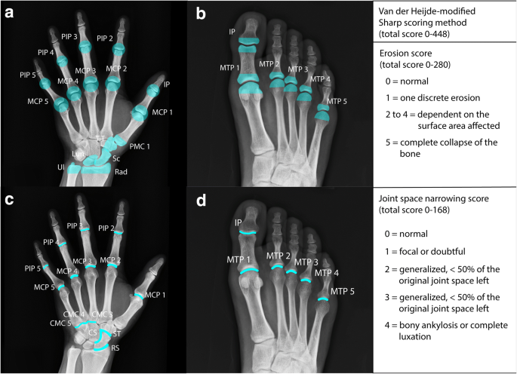
Pipeline Overview
Stage | Goal | Model/Library | Example Output
1. Preprocessing | Resize/normalize X-rays | OpenCV / PIL / torchvision.transforms | Uniform 512×512 images
2. Hand Segmentation | Extract hand mask (binary) | PyTorch U-Net (e.g. segmentation-models-pytorch) | Binary mask of hand region
3. Joint Detection | Detect joint locations (bboxes) | YOLOv7 (PyTorch Ultralytics YOLO) | Bounding boxes for PIP, MCP, wrists
4. Score Prediction | Predict Sharp score from joints | Vision Transformer (PyTorch torchvision.models.vit_b_16 or HuggingFace) | Scalar Sharp score prediction

Slide 8
Deep Learning Models Used
U-Net: Used for joint segmentation; excels in biomedical image tasks.
YOLOv7: Real-time object detection to identify joint locations.
Vision Transformer (ViT): Predicts final joint scores based on detected images.

Slide 9
Dataset Requirements
- X-ray images
- Annotations (bounding boxes per joint)
- Labels (SvH scores per joint)
If real scores not available → use dummy scores to prototype pipeline

Slide 10
Tools and Libraries
- Python, PyTorch, OpenCV
- YOLOv5 or YOLOv7 for detection
- timm, torchvision for classification/regression
- Optional: Label studio, Roboflow for annotations

Slide 11
Benefits of Automation
Consistent scoring across patients and clinicians
Saves time for doctors and radiologists
Supports large-scale clinical studies and trials
Reduces human error and inter-reader variability
Integrates easily into radiology workflows
Enables real-time feedback during image review
Tracks disease progression over time
Improves training for medical students and residents
Cost-effective in the long run
Enhances diagnostic accuracy and treatment monitoring

Slide 12
Future Directions
Train with real expert-labeled datasets
Extend to other RA features (e.g., swelling, bone density)
Mobile or cloud deployment for real-time scoring
Expand it to other joints (feet, knees, ankles, and elbows)

Slide 13
Thankyou

