Slide 1
SpyHunter
Under the guidance of
Dr.B.M.Mehtre
professor, IDRBT
Presented by
G HAREESH
18MCMB15

Slide 2
Contents
Introduction
Features
How it works
Screenshots of demo
Advantages
Disadvantages
Conclusion
References

Slide 3
Introduction
SpyHunter is a Windows application designed to scan for, identify, remove and block malware, potentially unwanted programs (PUPs) and other objects.
It is more sophisticated to evade detection by anti-malware/anti-virus programs.
It has been developed and engineered with precision programming to provide sophisticated online protection and security.

Slide 4
Features
It's remediation capabilities can remove trojans, ransomware, worms, viruses, rootkits, adware, potentially unwanted programs, and other objects.
It scan made to help you identify programs on your system that may contain reported vulnerabilities.
It also detects and can remove Potentially Unwanted Programs .
It's advanced scanning architecture features a robust multi-layer system scanner designed to detect new threats.
It's real-time malware blockers aim to prevent malware and other potentially unwanted programs from installing or executing.

Slide 5
How It Works
SpyHunter application can work Windows XP (32-bit)(SP2), Windows 7 (32-bit and 64-bit), Windows 8 (32-bit and 64-bit).
The SpyHunter is installed in the background and are not disturbing the user in any way.
It had an average performance while scanning, but was relatively light while being idle, taking up to 250 MB of RAM.
It application has an integrated advanced technology for rootkit detection.
It allows it to make an immediate rootkit scan and to inform the user with a message in case of rootkit detection.

Slide 6
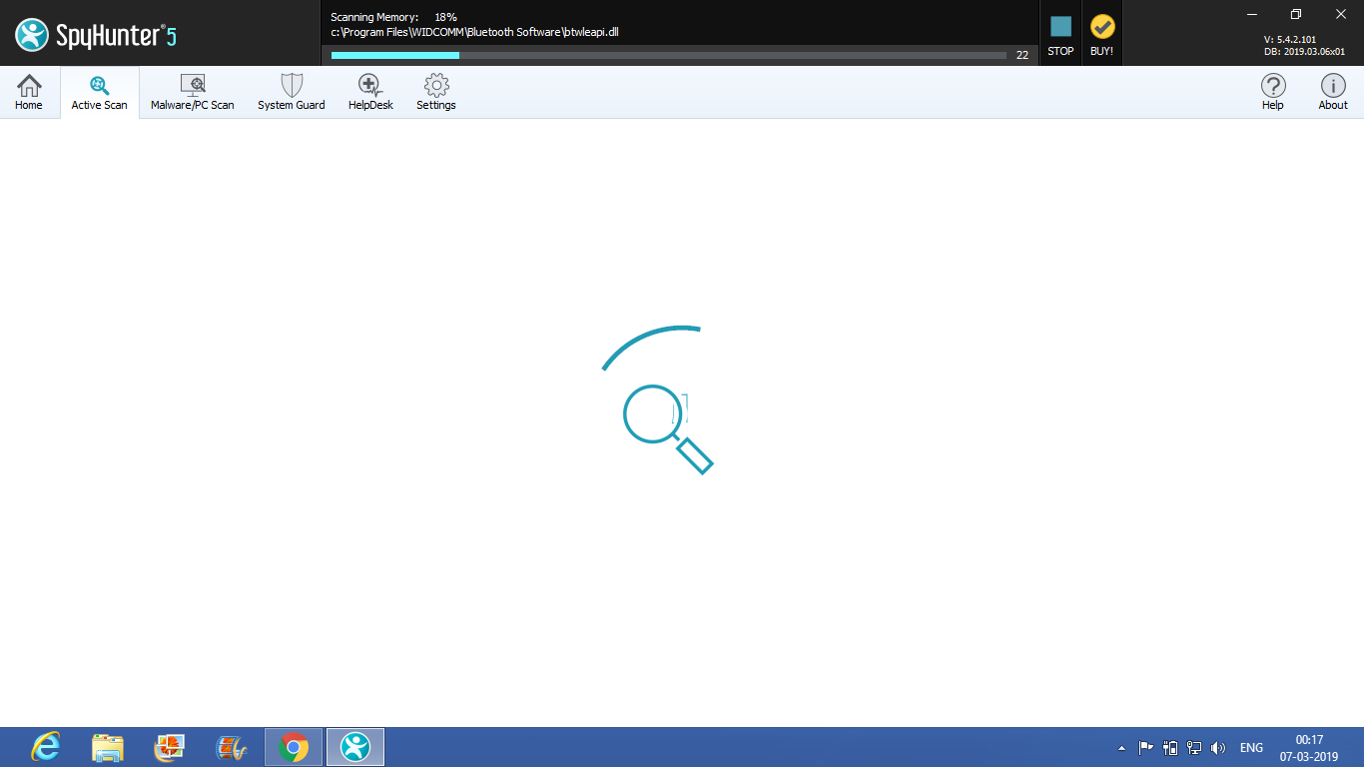

Slide 7
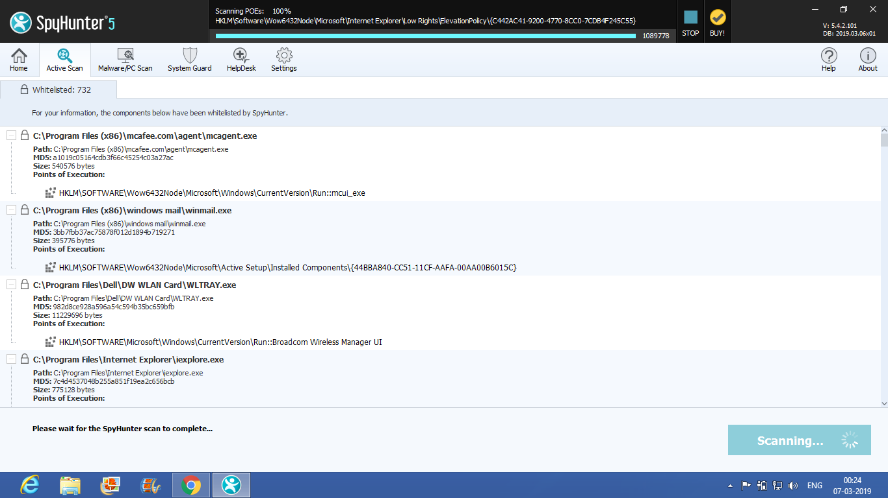

Slide 8
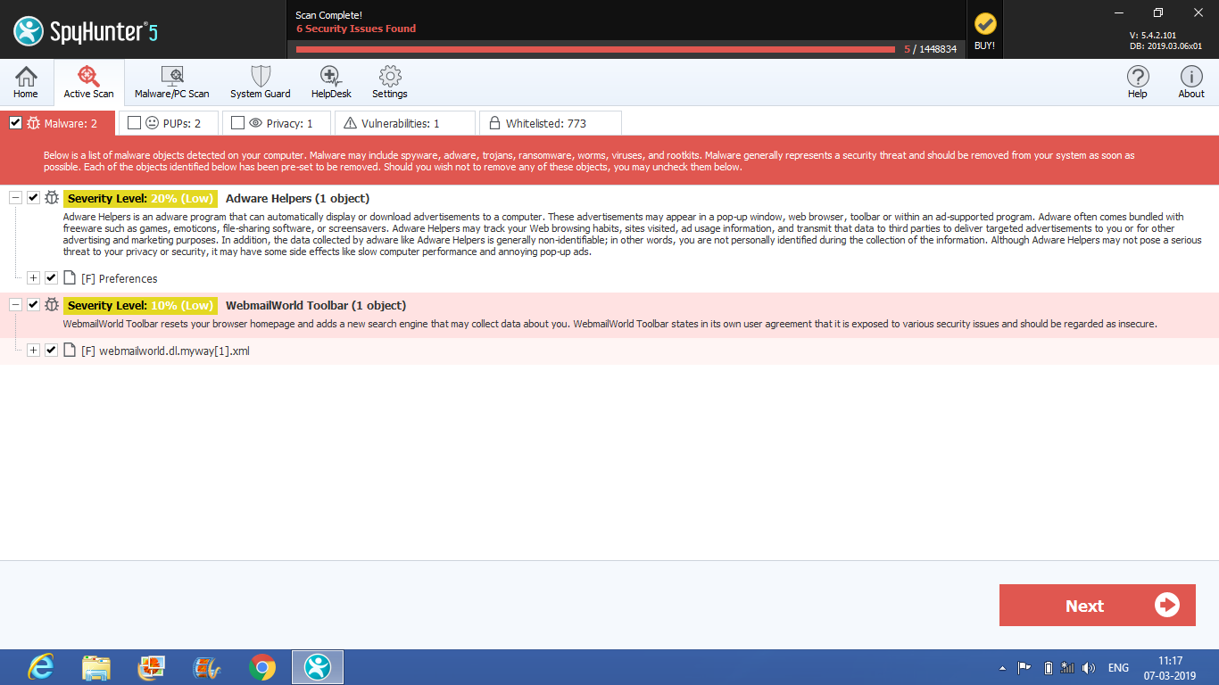

Slide 9
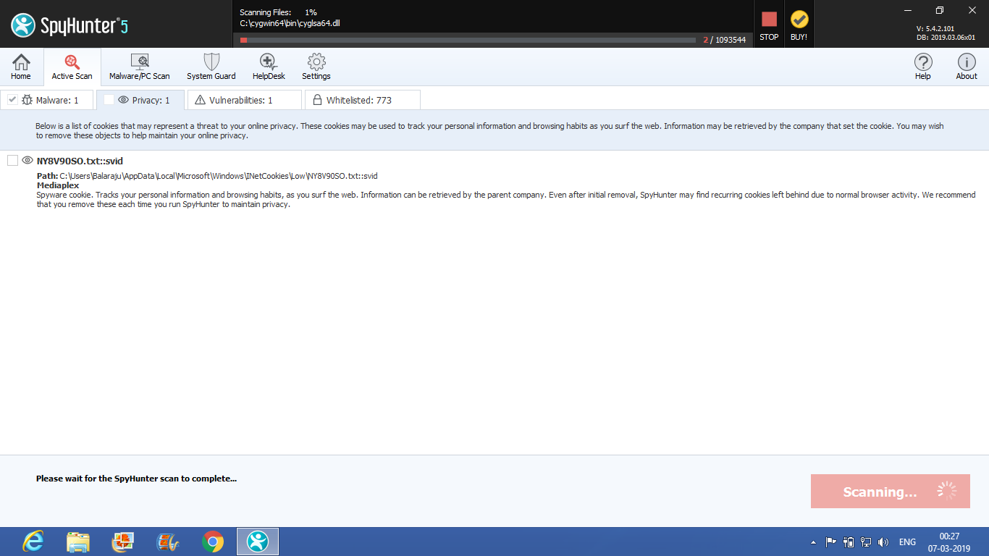

Slide 10
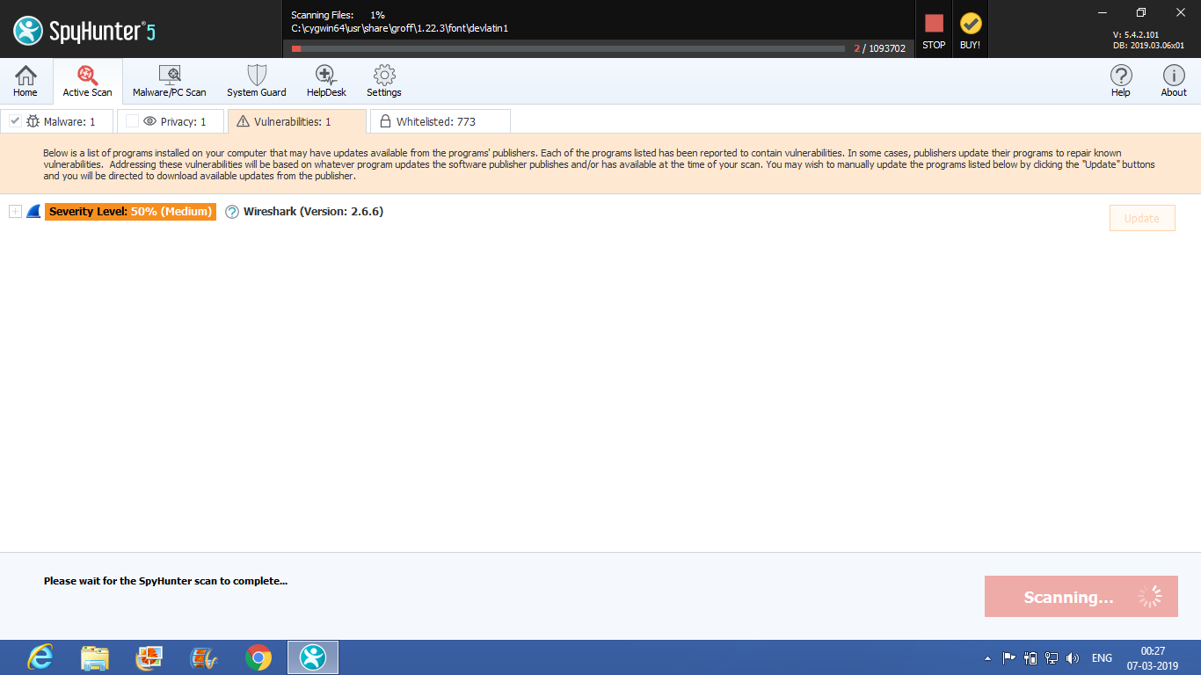

Slide 11
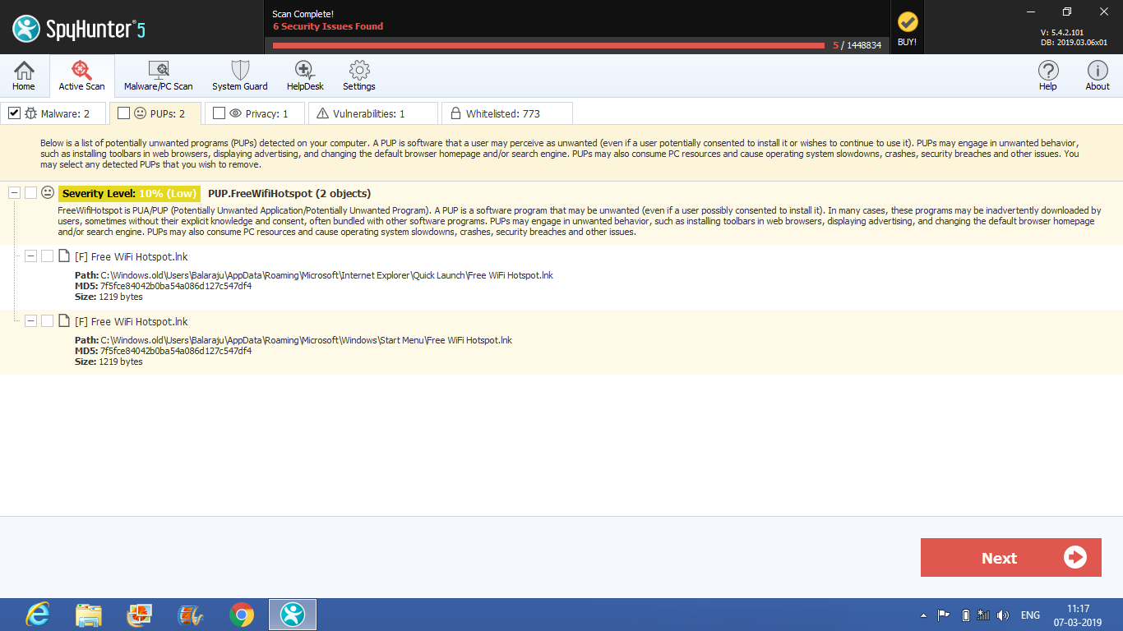

Slide 12
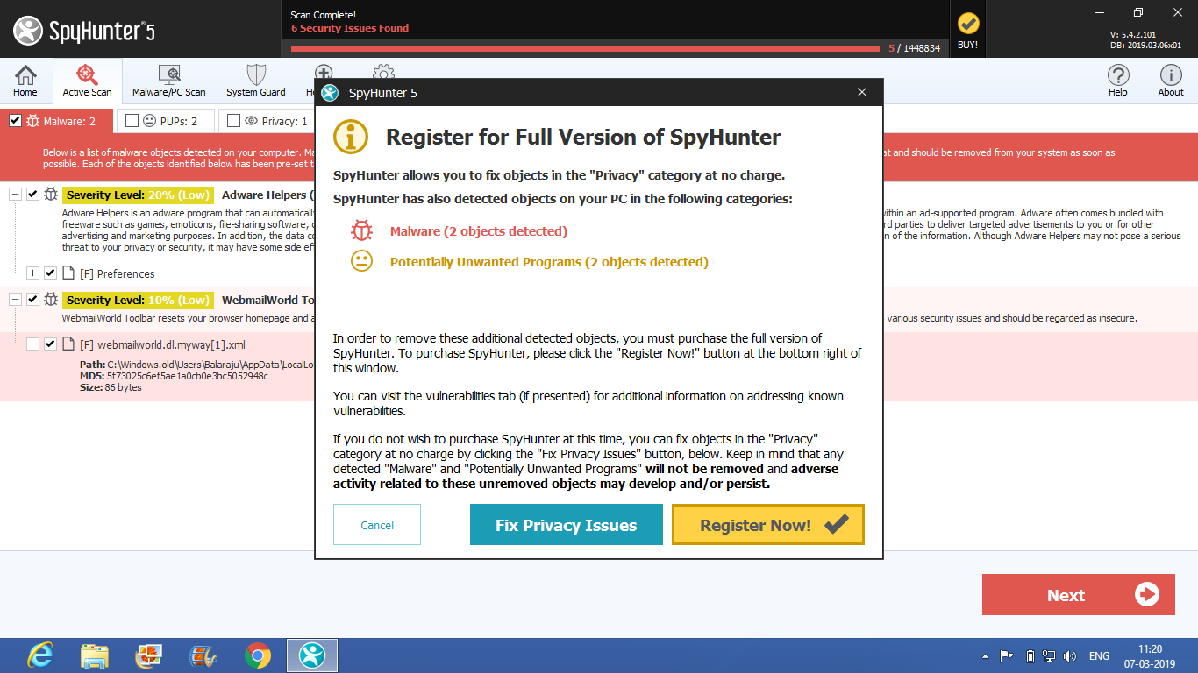

Slide 13
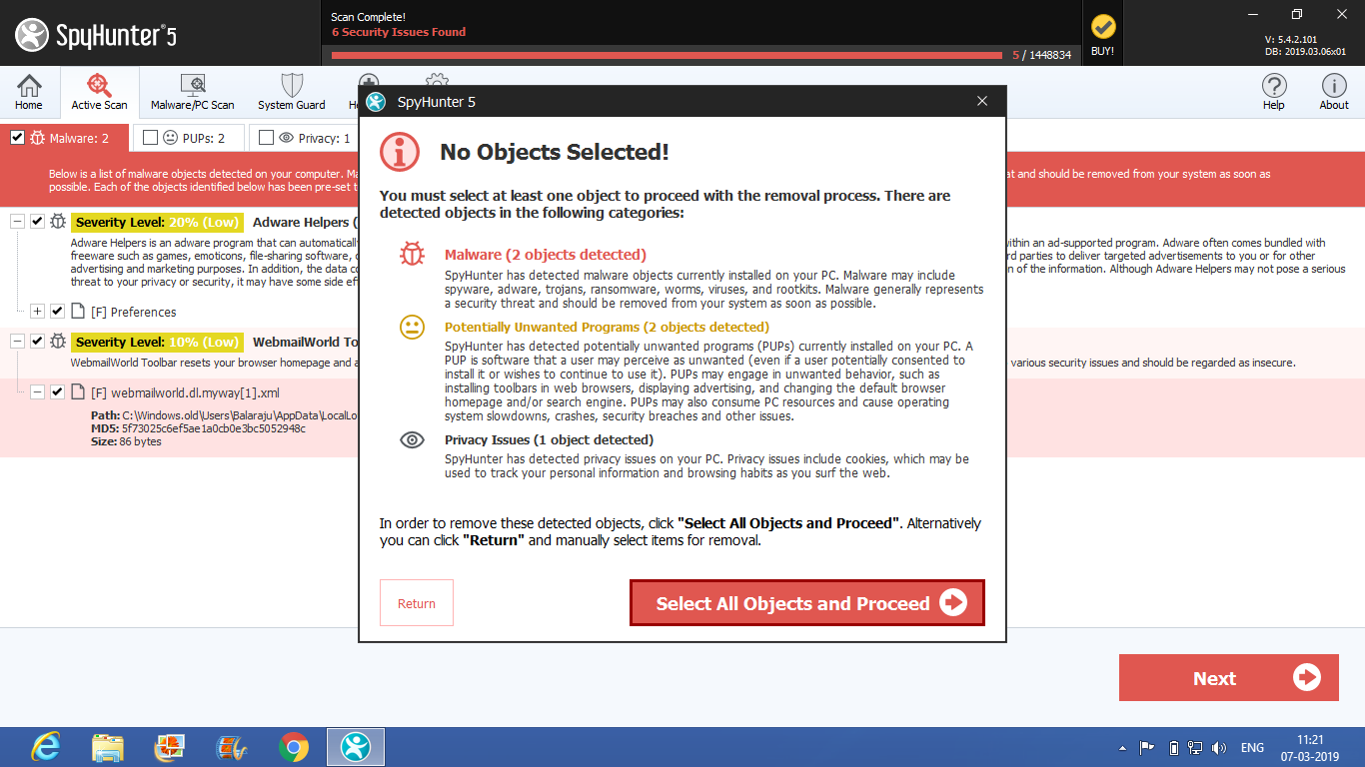

Slide 14
Advantages
Malware Detection & Removal.
Advanced System Guard.
Detection & Removal of Potentially Unwanted Programs & Privacy Issues.
Advanced Removal Capabilities.
24/7 Customer Support.
Regular Malware Definition Updates
User-Friendly Interface
Custom Malware Fixes

Slide 15
Disdvantages
In cases of a persistent threat that cannot be readily resolved.
It is paid version ,it detects malware which is present in your system but can’t remove.
If user can subscribe and then it removes malware.
Bear in mind that for an old computer, this could represent some difficulties.

Slide 16
Conclusion
In some cases, cookies may be used for overly extensive tracking purposes.
Cookies may also represent privacy concerns since they store information about your web browsing habits or history.
It can easily detect malware which is present in your system but can’t remove.
If user can subscribe spyhunter like paying money and then it removes malware.

Slide 17
References
https://www.enigmasoftware.com/products/spyhunter/
https://www.spyhunter.com/
https://en.wikipedia.org/wiki/SpyHunter_(software)

Slide 18
Thank you

