Slide 1
BMP180 Temperature and Pressure Sensor
- Hareesha
12-June-2019

Slide 2
Contents
Introduction
• What is Sensor
• Why Sensors
• Types of Sensors
• What is BMP180 Temperature and Pressure sensor
• Working principle & Applications
Advantages & Disadvantages
Block Diagram

Slide 3
What is Sensor
Sensor: It is an electronic device ,which detects and respond to the signal. It measures physical values converted into electrical values.
(or)
Sensor is an input device to the controller or processor which gives the output.
Example : Thermocouple

Slide 4
Why Sensors
Safety
Diagnostic
To know the functionality of each and every part of automobile.

Slide 5
Types of Sensors
Basic Sensors :
Radar sensor, wind sensor, photo sensor, IR sensor, weight sensor etc.
Proximity sensor
Temperature sensor
Pressure sensor

Slide 6
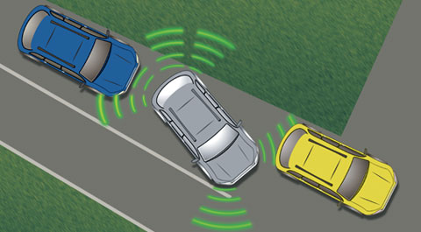
Continued..
Proximity Sensor: It is a device , which can able to detect the presence of nearby any object without any physical contact.

Slide 7
BMP180 Temperature and Pressure Sensor
Temperature sensor : It is a device ,which detects and measure the hotness, coolness and converts into electrical signal.
Types of Temperature sensor:
LM35 IC
Thermistor
Thermocouple
RTD(Resistive Temperature Device)

Slide 8
Continued..
Thermistor : It is a special type of resistor, whose resistance changes within the change in temperature.
Construction of Thermistor:
Characteristics of Thermistor:
• Resistance-temperature
• Voltage-current
• Current-time

Slide 9
Continued..
Applications of Thermistor
• Measurement of temperature
• Control of temperature
Advantages
Compact, inexpensive , response time fast , Not affected by environmental conditions.
Disadvantages
Non-linearity

Slide 10
Continued..
Thermocouple : It is a device ,which is used for measurement of temperature variations.
Principle of thermocouple
• See beck effect
• Peltier effect
• Thomson effect
Working: Thermocouples measures the voltage between two junctions
Mathematical expressions:
Construction:
Advantages,Disadvantages:

Slide 11
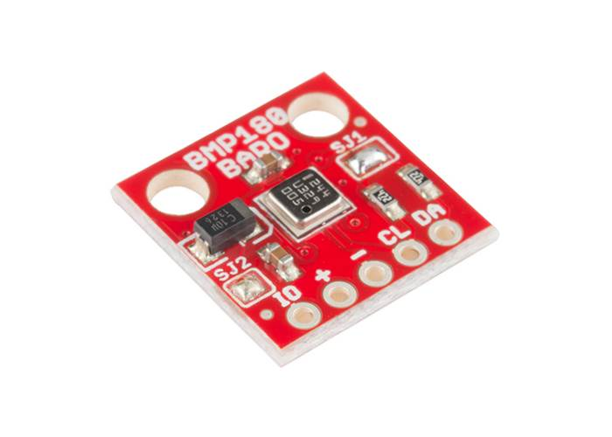
BMP180 Pressure sensor
Pressure sensor: It is a device ,which is used to measurement pressure of gases, liquids and fluid
Key features
Pressure voltage :300 -1100 hPa
Supply voltage :1.8 to 3.6v
Working principle: pressure values is converted into electrical signal.
Applications: weather forecast, navigation
Advantages:Reduce A to D Conversion errors.
Disadvantages :Restricted areas, high temperature dependency.

Slide 12
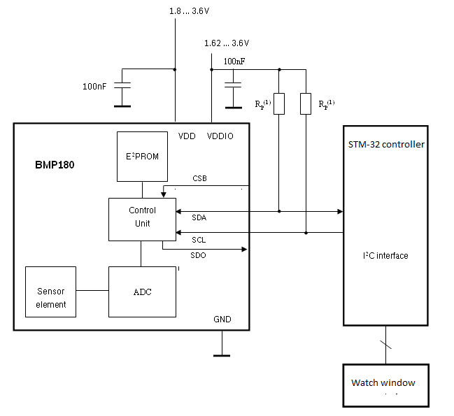
Block Diagram

Slide 13
THANK YOU

