Slide 1
Entity Framework

Slide 2
What is Entity Framework?
Entity Framework is an object-relational mapper(ORM) that enables developer to work with a database using objects.
ORM take care of creating database connections and executing commands as well as taking query results.

Slide 3
EF Core (cross-platform)
EF Core - a lightweight, extensible, and cross-platform version of the popular Entity Framework data access technology.
We use .NET Core and EF Core
Recommend SQL Server or SQLite

Slide 4
EF Keys
The ID property will become the primary key column of the database table that corresponds to this class.
By default, the Entity Framework interprets a property that's named ID or classnameID as the primary key

Slide 5
EF Keys
using System;
using System.Collections.Generic;
namespace demotest.Models
{
public class Student
{
public int ID { get; set; }
public string LastName { get; set; }
public string FirstMidName { get; set; }
public DateTime EnrollmentDate { get; set; } public ICollection<Enrollment> Enrollments { get; set; }}}

Slide 6
EF Foreign Keys
Entity Framework interprets a property as a foreign key property if it's named.
<navigation property name><primary key property name>
For example, StudentID for the Student navigation property since the Student entity's primary key is ID.

Slide 7
EF Foreign Keys
namespace demotest.Models{
public enum Grade
{
A, B, C, D, F
}
public class Enrollment
{
public int EnrollmentID { get; set; }
public int CourseID { get; set; }
public int StudentID { get; set; }
public Grade? Grade { get; set; }
public Course Course { get; set; }
public Student Student { get; set; }
} }

Slide 8
Migrations
Migrations defines initial state of the database and change of the state.
Migrations should be added as the schema evolves.
By convention, the first one is "InitialMigration" or simply "Initial".

Slide 9
SQL Server LocalDB
LocalDB is a lightweight version of the SQL Server Express Database Engine and is intended for application development, not production use
LocalDB starts on demand and runs in user mode, so there is no complex configuration

Slide 10
SQL Server LocalDB
By default, LocalDB creates .mdf database files in the C:/Users/<user> directory
"ConnectionStrings": {
"DefaultConnection": "Server=(localdb)\\mssqllocaldb;Database=NMSUDatabase1;Trusted_Connection=True;MultipleActiveResultSets=true“}

Slide 11
Database Context
Database context will be stored in Data folder.
It Contains and manages all entity classes and acts as starting point for data access and storage
Inherits from Microsoft.EntityFrameworkCore.DbContext
default name: SomethingDbContext.cs

Slide 12
SchoolContext
using demotest.Models;
using Microsoft.EntityFrameworkCore;
namespace demotest.Data
{ public class SchoolDbContext : DbContext
{
public SchoolContext(DbContextOptions<SchoolContext> options) : base(options)
{
}public DbSet<Course> Courses { get; set; }
public DbSet<Enrollment> Enrollments { get; set; }
public DbSet<Student> Students { get; set; }
}}

Slide 13
Register the context with DI
public void ConfigureServices(IServiceCollection services) { services.AddDbContext<SchoolDbContext>(options => options.UseSqlServer(Configuration.GetConnectionString(
"DefaultConnection"))); services.AddMvc(); }

Slide 14
Typical CRUD Views
Create - empty form for creating new instance
Delete - delete an instance
Details - shows details for an instance
Edit - shows details and allows editing
List - shows all instances in a list

Slide 15
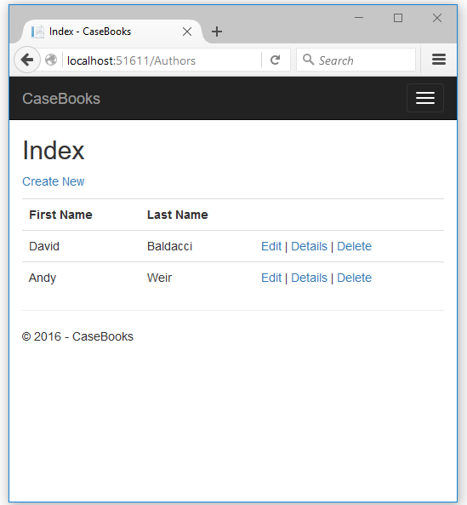
Typical CRUD Views

Slide 16
Entity Framework
The End

