Slide 1
TELECOMMUNICATION CHURN PREdiction
Team Members :
Mr. Hareesh KC
Mr. Basavaraj Patil
Mr. Stalin A
Mr. Subash S
Mr. Sai Charan Teja
Mr. Manpreet Banja
Mentor Name : Mr.Varun Vennelaganti
Date : 29-04-2022

Slide 2
BUSINESS
PROBLEMS
Customer churn is a big problem for telecommunication companies. Indeed, their annual churn rates are usually higher than 10%. For that reason, they develop strategies to keep as many clients as possible.

Slide 3
BUSINESS
OBJECTIVE
This is a classification project since the variable to be predicted is binary (churn or loyal customer). The Objective here is to Predict churn probability, conditioned on the customer features.

Slide 4
PROJECT ARCHITECTURE
Collection of Data
Busniess Understanding
Exploratory Data Analysis(EDA)
Deployment
Model Building

Slide 5
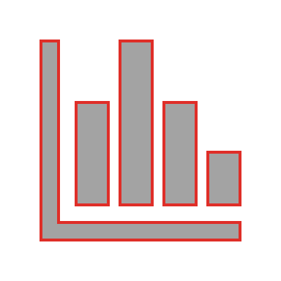
DATA SET DETAILS
The data file telecommunications_churn.csv contains a total of 19 features for 3333 customers. Each row corresponds to a client of a telecommunications company for whom it has been collected information about the type of plan they have contracted, the minutes they have talked, or the charge they pay every month.

Slide 6
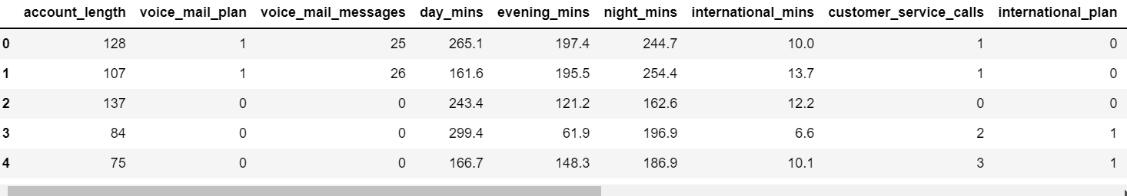
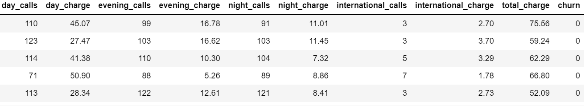
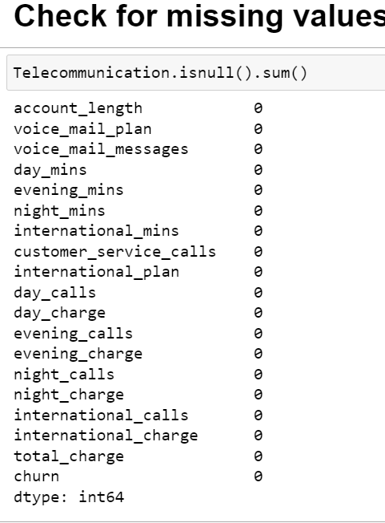
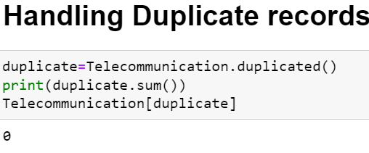
The Data set contains 3333 Rows and 19 Columns
There are no Missing Values or Duplicate Records

Slide 7
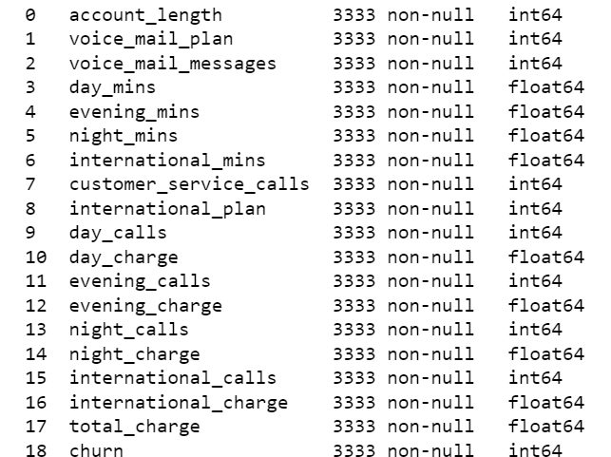
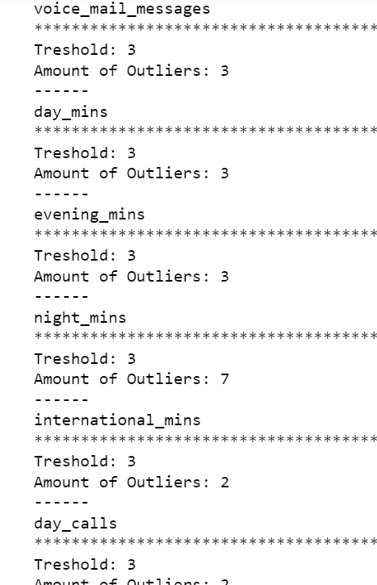
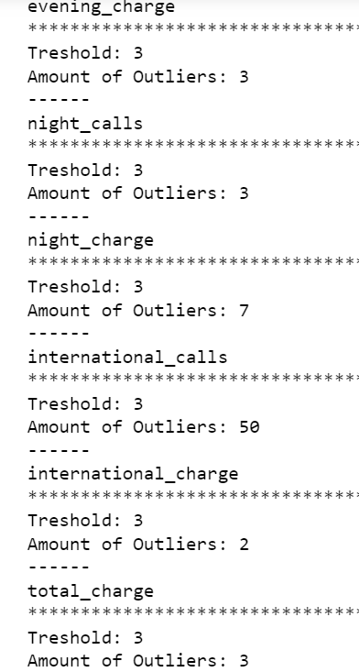
Exploratory Data Analysis(EDA)
The Data types were all Numerical , so we didn’t have to convert .
Outliers Perform Important Role , So we did not Remove outliers.

Slide 8
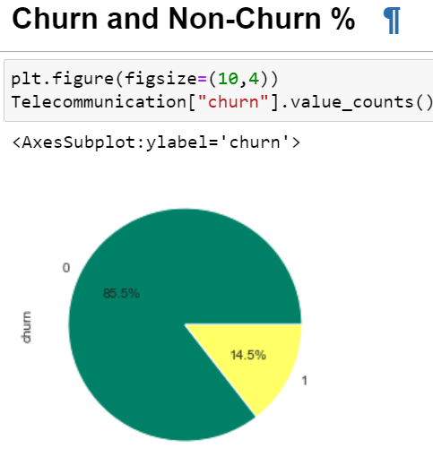
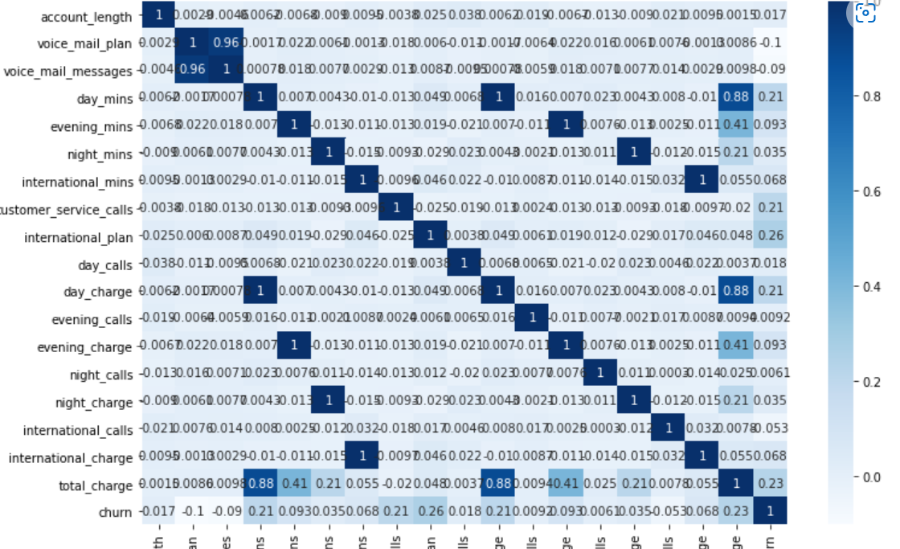
EDA VISUALIZATIONS
Churn % is 14.5% , Whereas Non-Churn % is 85.5%
Correlation Between the independent Variables

Slide 9
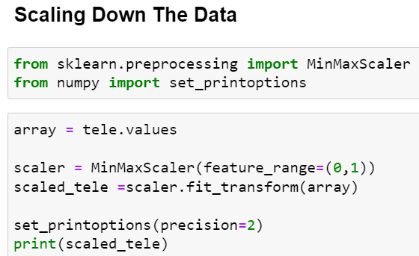
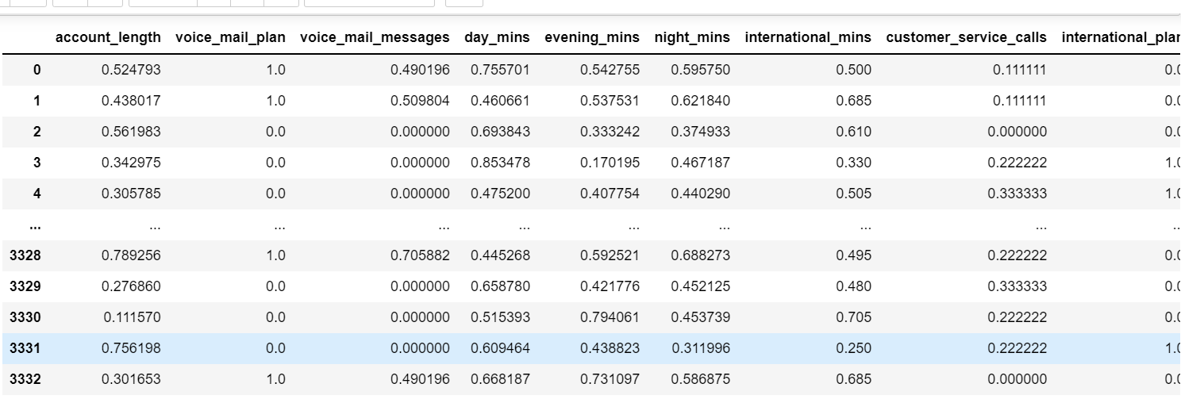
Scaling Down the Data to keep the values in Same Range

Slide 10
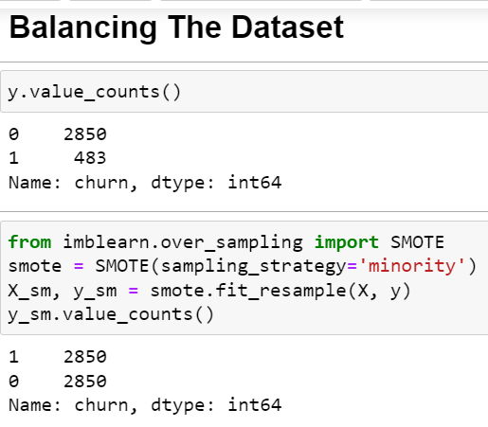
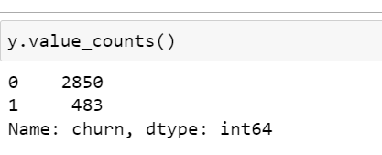
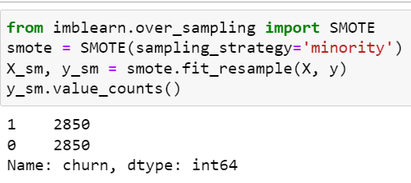
Balancing The Data Using SMOTE
Before Balancing
After Balancing
The Dataset Was Highly Imbalanced, so we balanced the Data.

Slide 11
MODEL BUILDING

Slide 12
Models Used For Model Building :
Logistic Regression
ANN Model
Random Forest
Decision Tree
KNN Model
SVM Model
Gradient Boosting

Slide 13
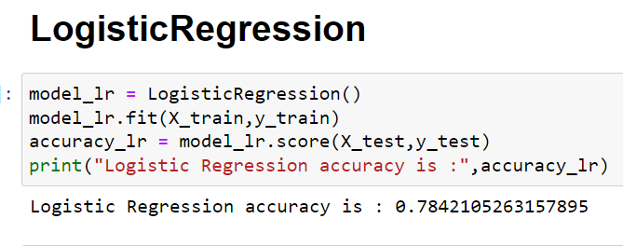
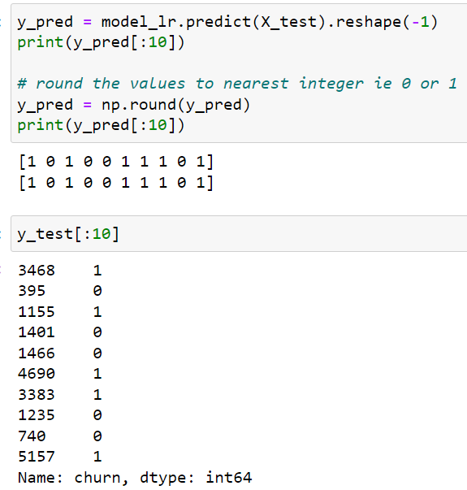
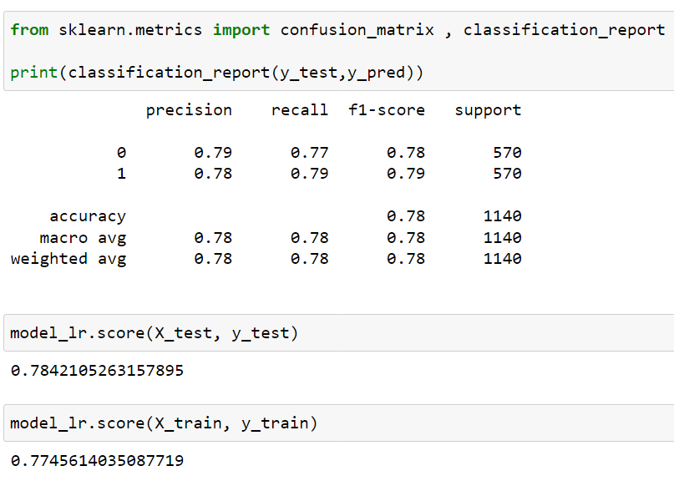
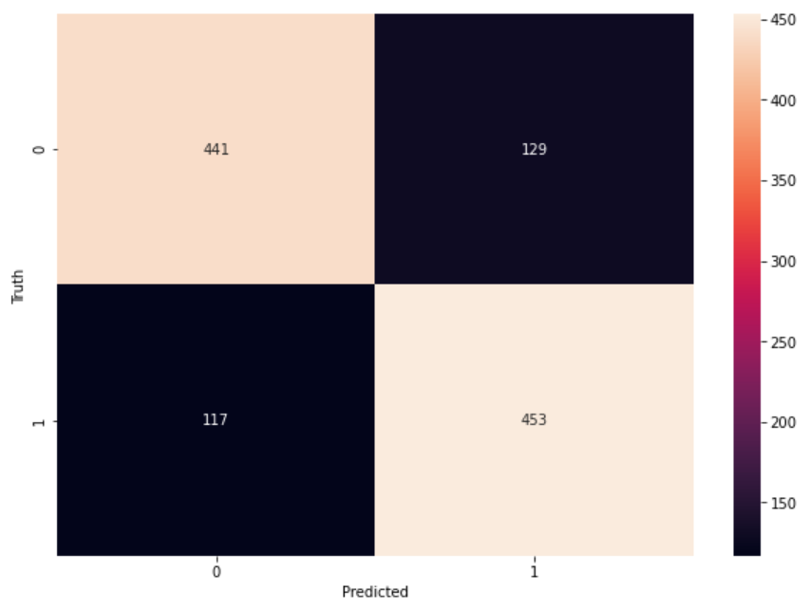
Logistic Regression
Accuracy is 77% for training and 78% for the testing data.

Slide 14
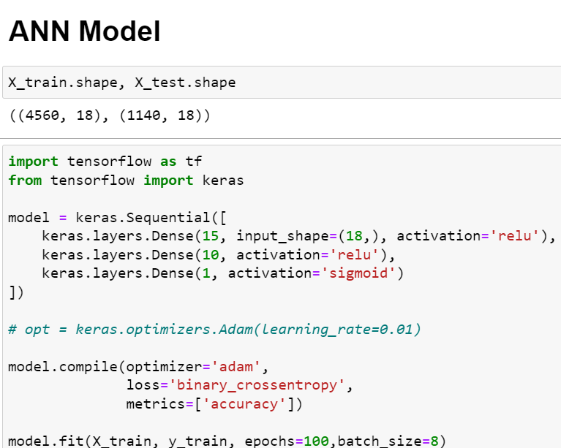
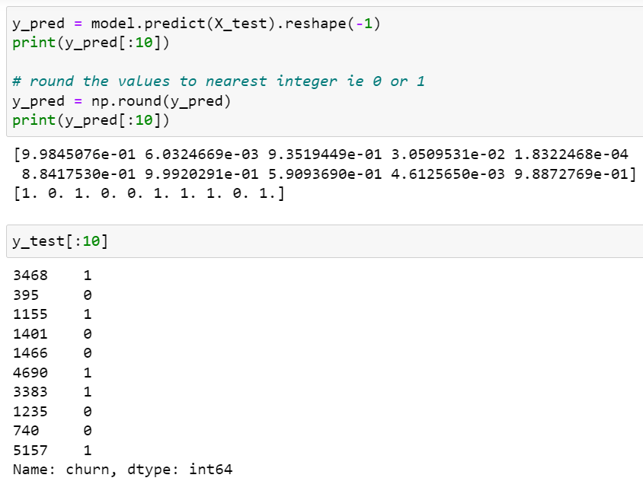
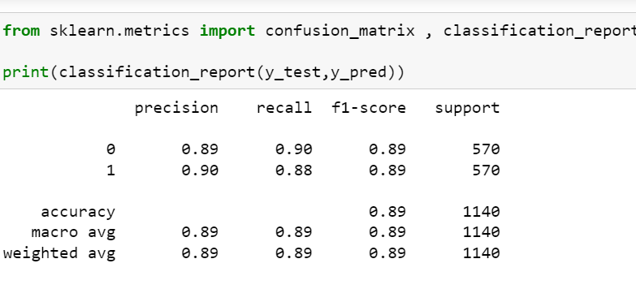
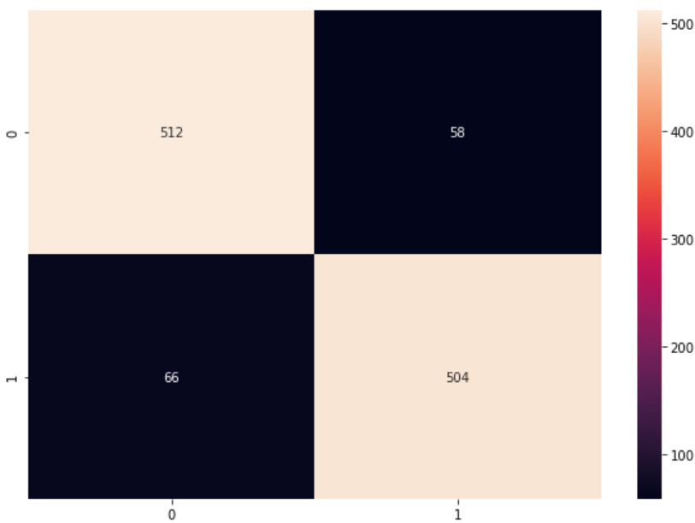
ANN MODEL
Accuracy for Artificial Neural Network Model is 89%
All the predicted values are matching.

Slide 15
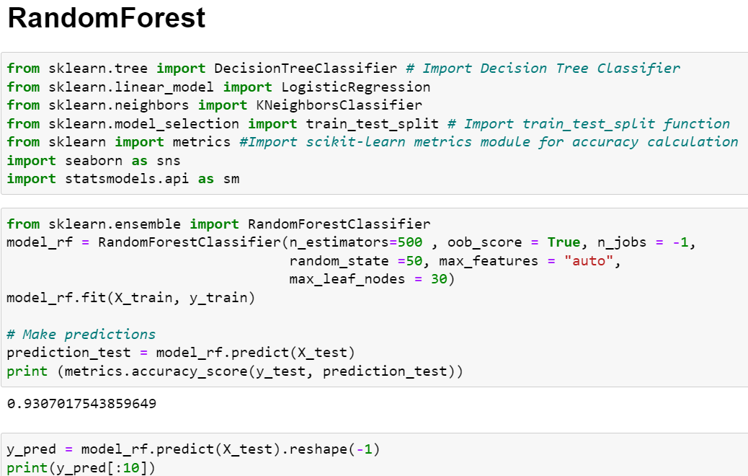
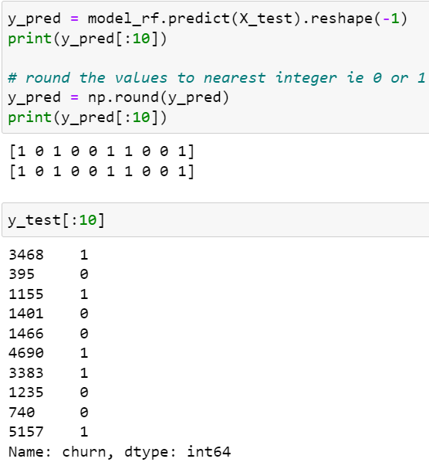
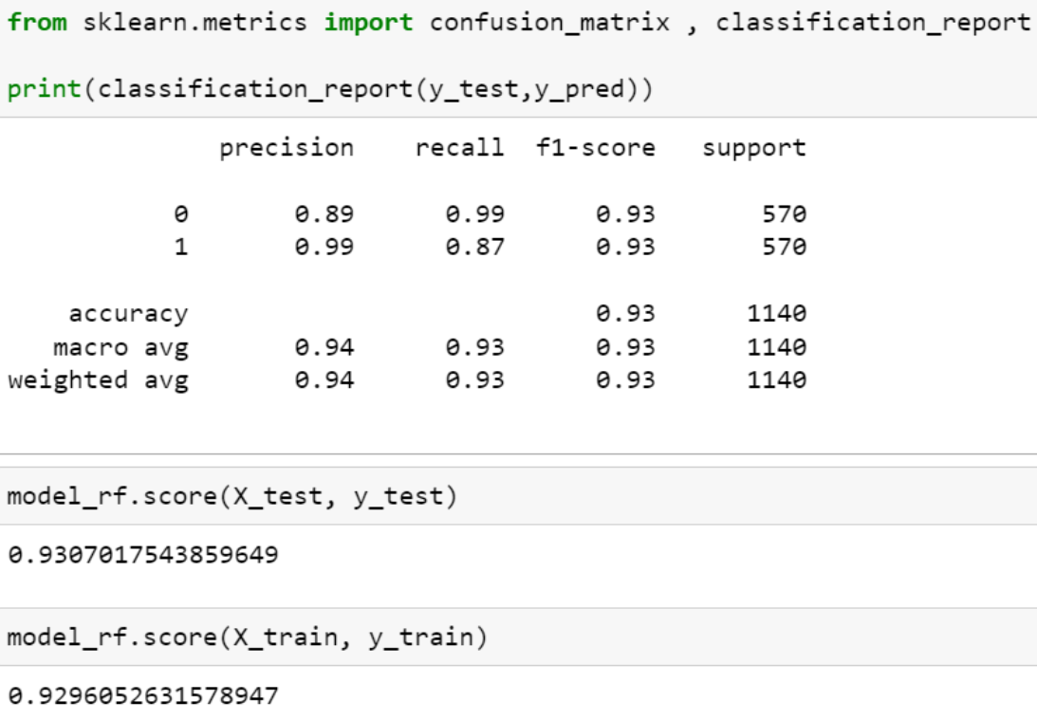
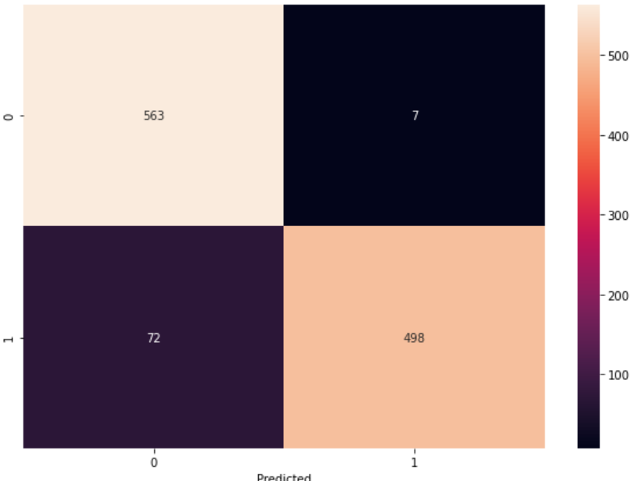
Random Forest
Accuracy for Random forest is 93%
For test data 93% and train data 92%
So we can say there is no Overfitting or Underfitting

Slide 16
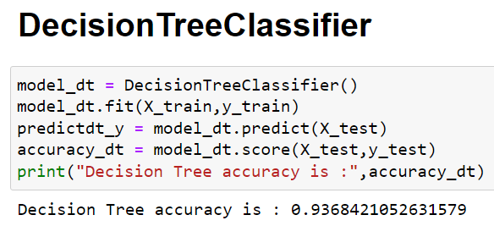
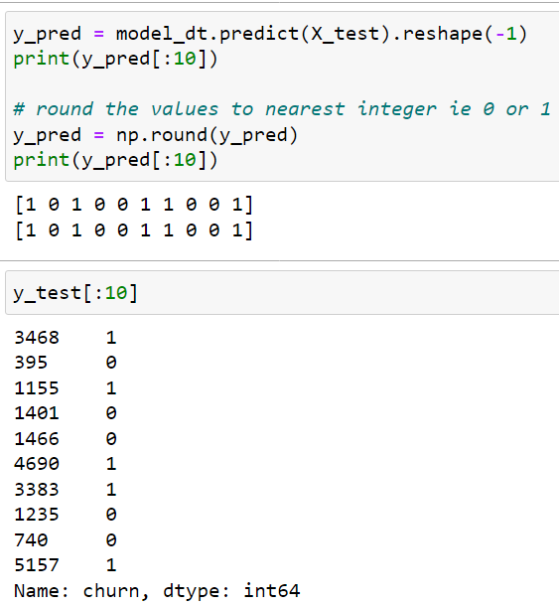
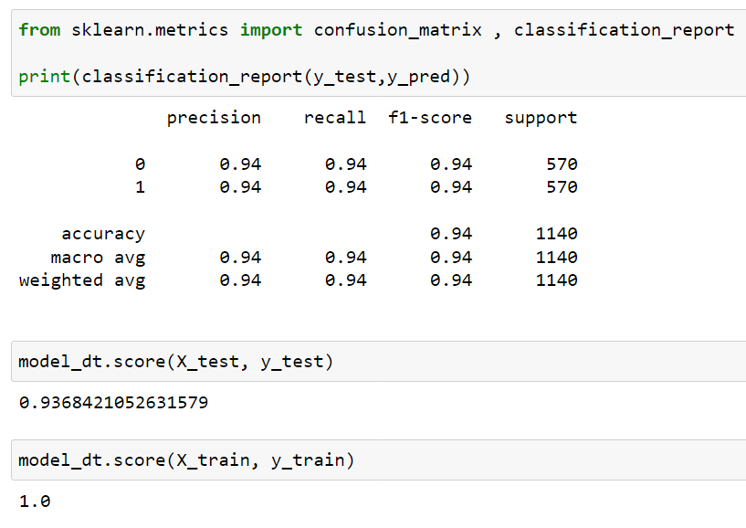
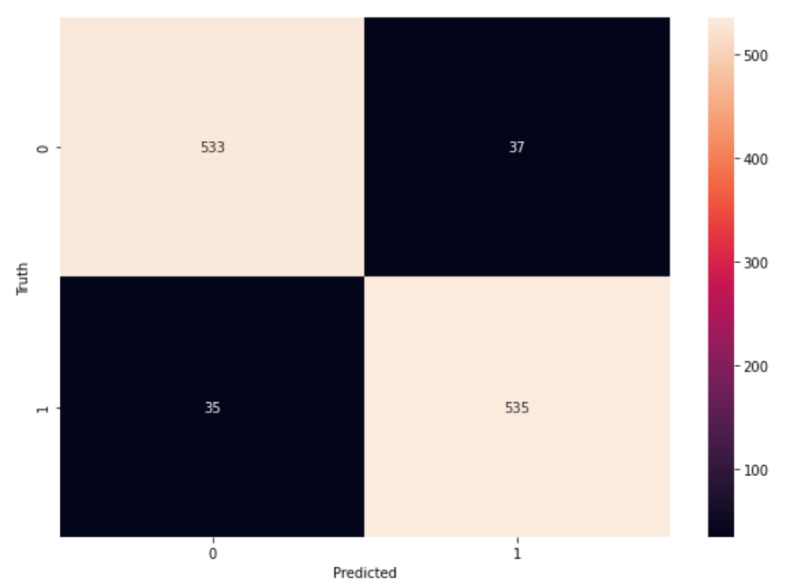
DECISION TREE
Accuracy of Decision tree Classifier is 100% for training data and 93% for testing data.
Here the training data is dominating the testing data so we can say that the model is overfitting.

Slide 17
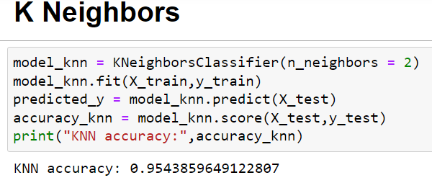
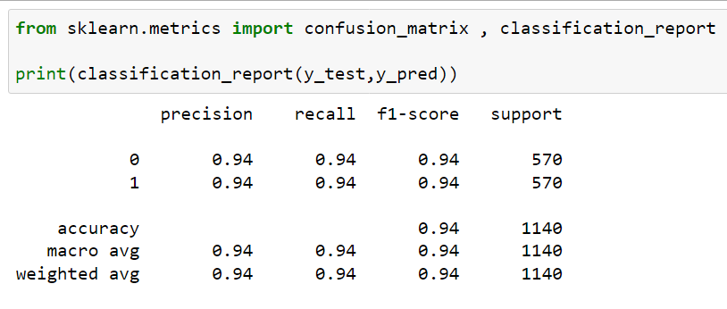
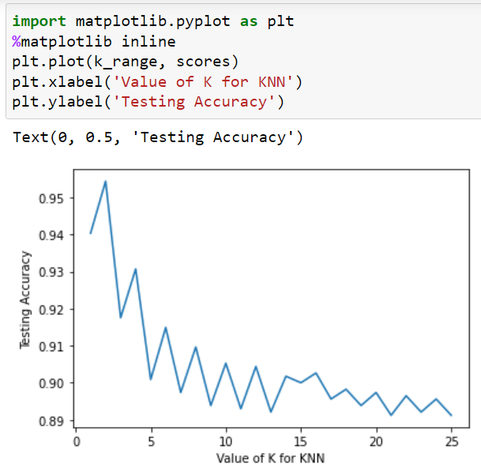
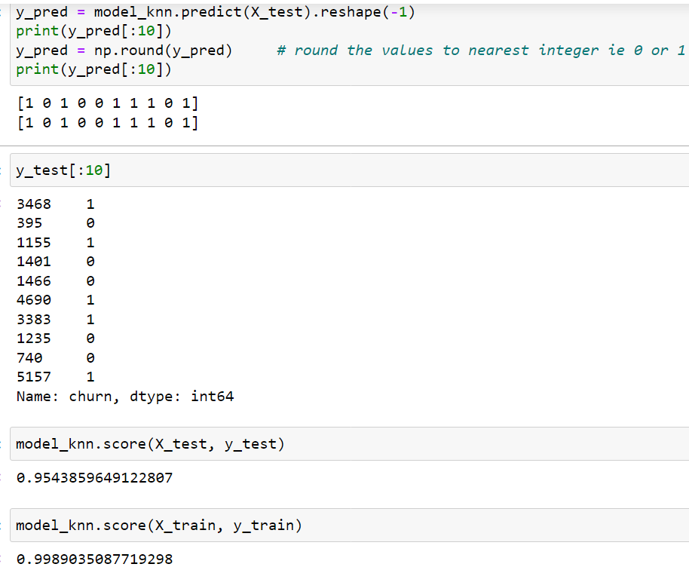
KNN MODEL
Accuracy for KNN model is 99% for the training data and 95% for the testing data.
The best value of K is 2 as predicted by the Graph.

Slide 18
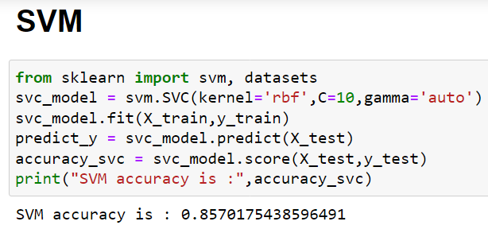
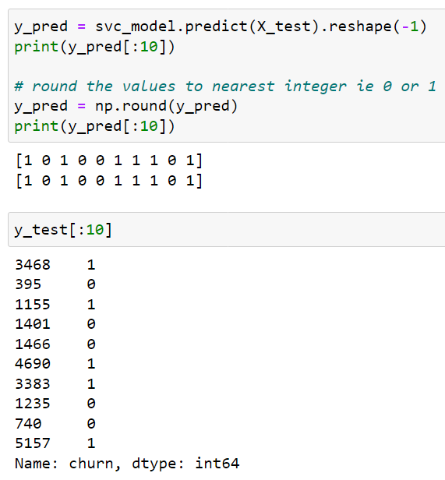
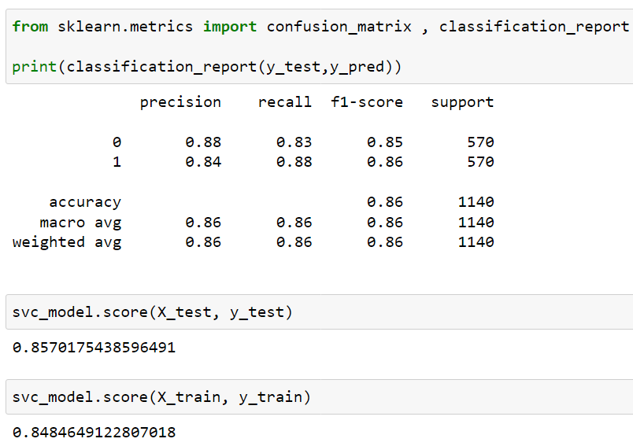
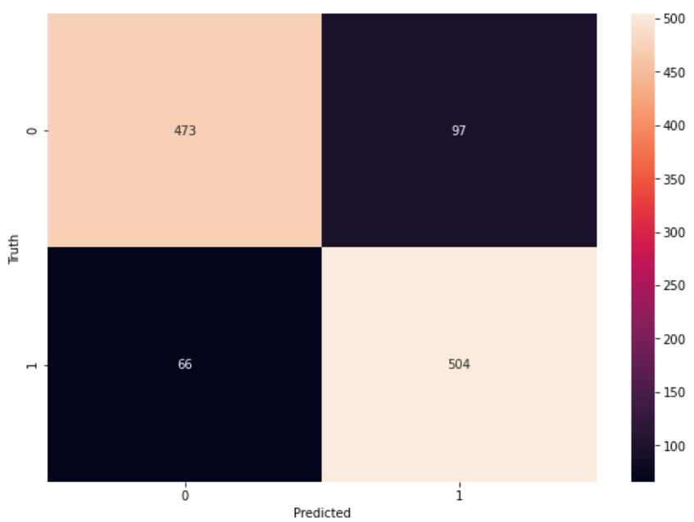
SVM MODEL
Accuracy for SVM Model is 84% for the training data and 85% for the testing data.
The model is balanced.

Slide 19
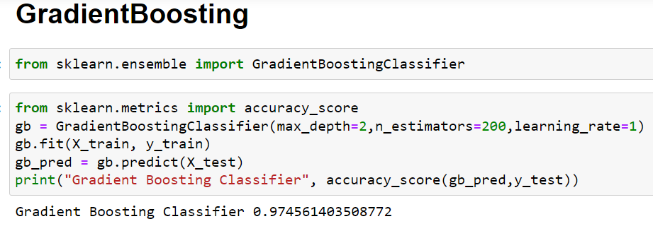
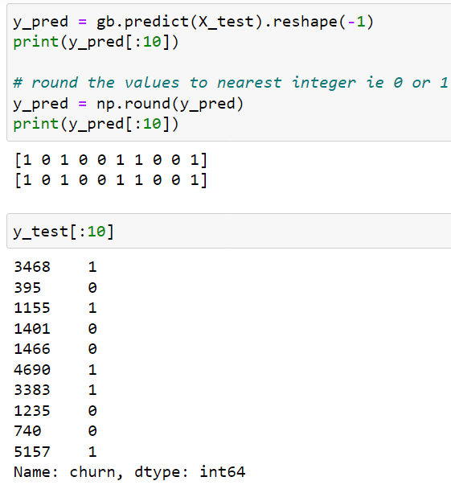
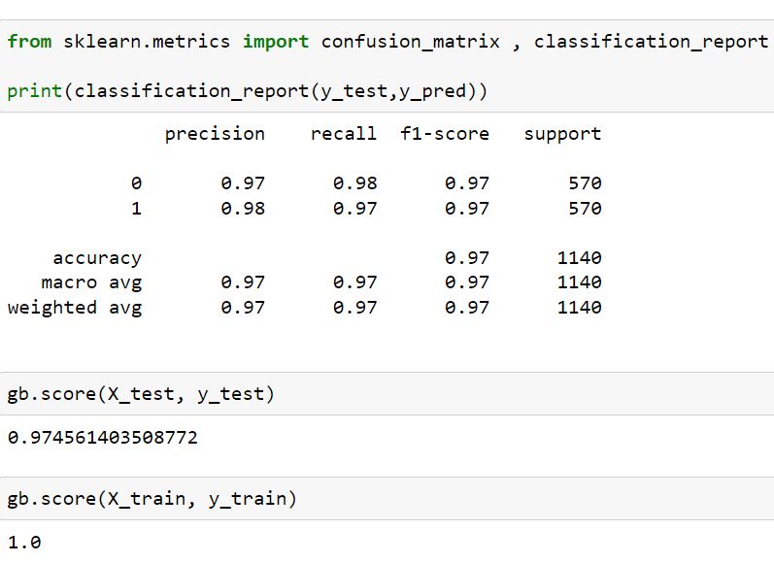
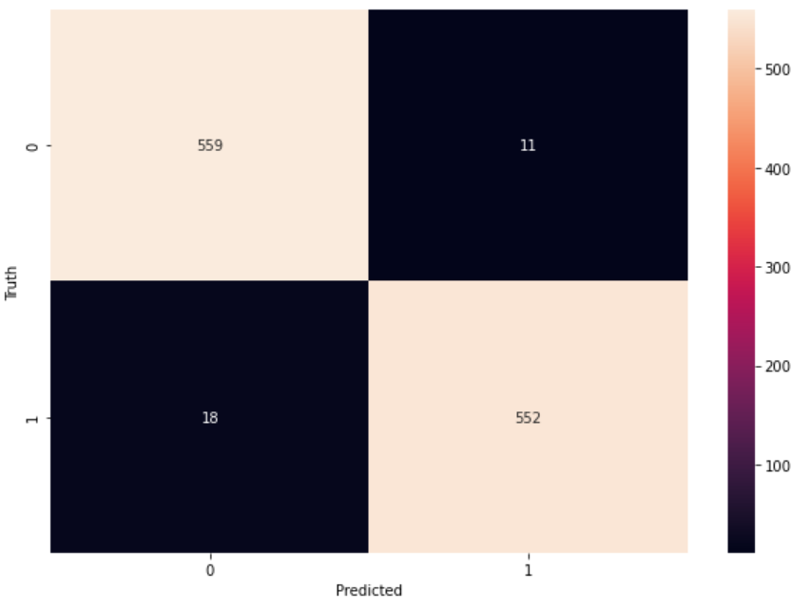
Gradient Boosting
Accuracy for Gradient Boosting Model is 100% for the training data and 97% for the testing data.

Slide 20
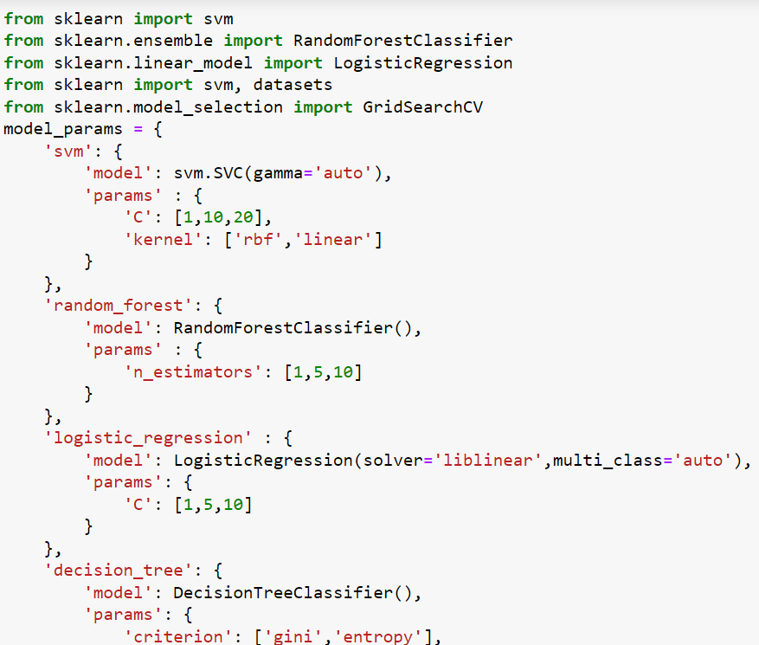
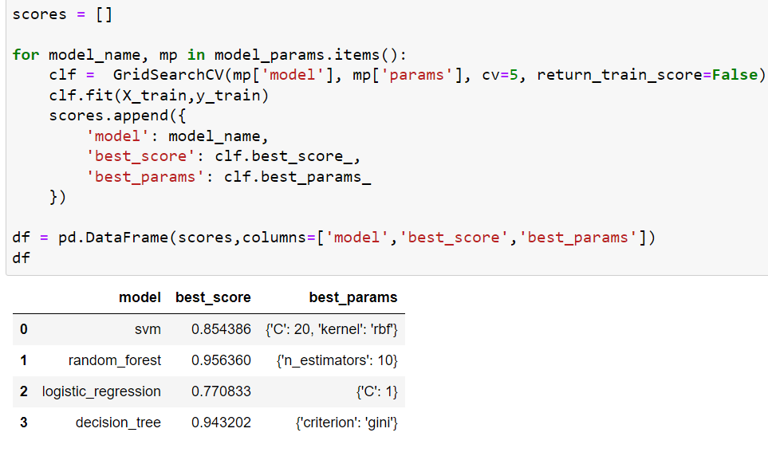
CHOOSING THE BEST MODEL
When Choosing the Best Model, “RANDOM FOREST” is the Best Model with 95% Accuracy.

Slide 21
After the Model building and Evaluation process, we have deployed the code using “Streamlit”.
DEPLOYMENT
We have selected the best model and used in our deployment
phase.

Slide 22
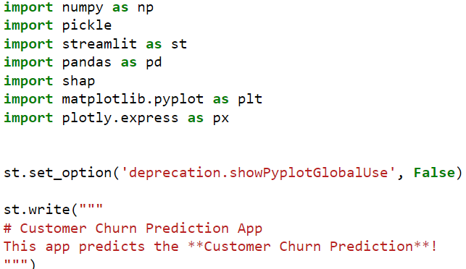
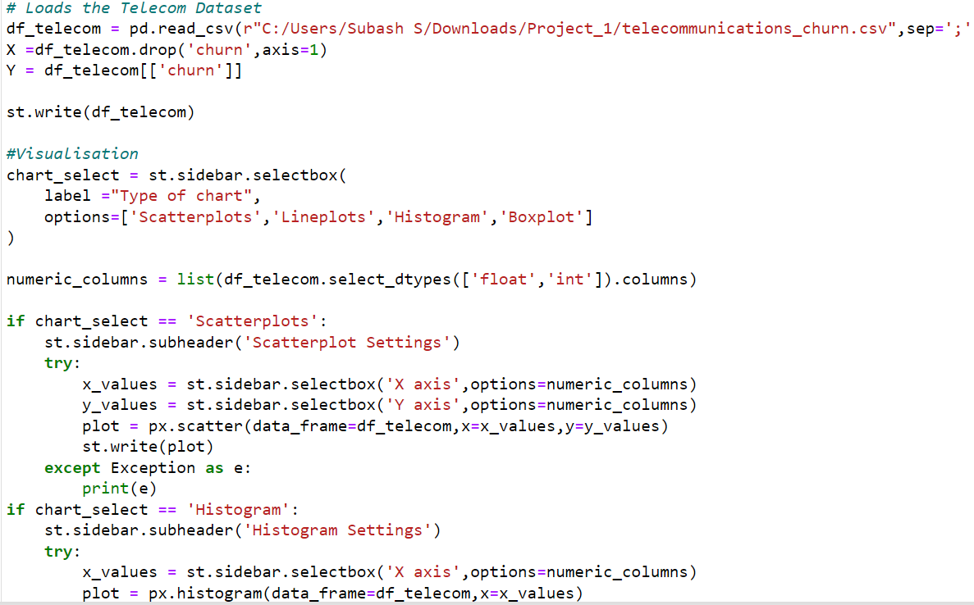
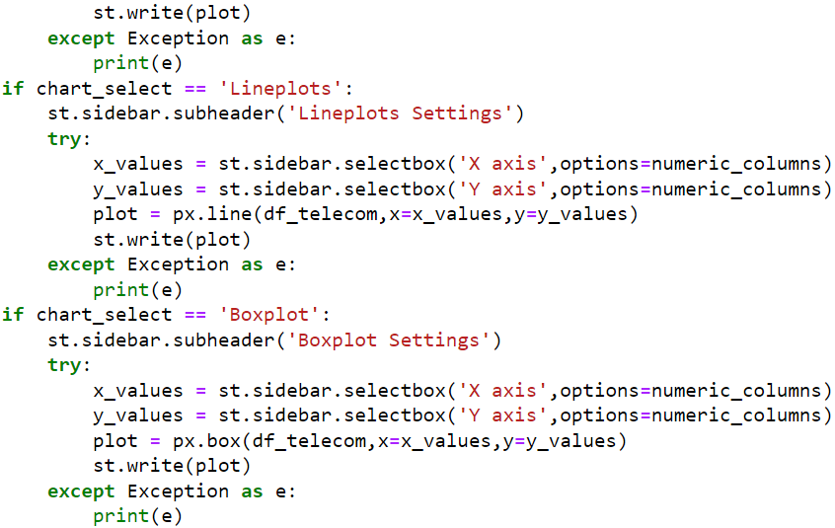

Slide 23
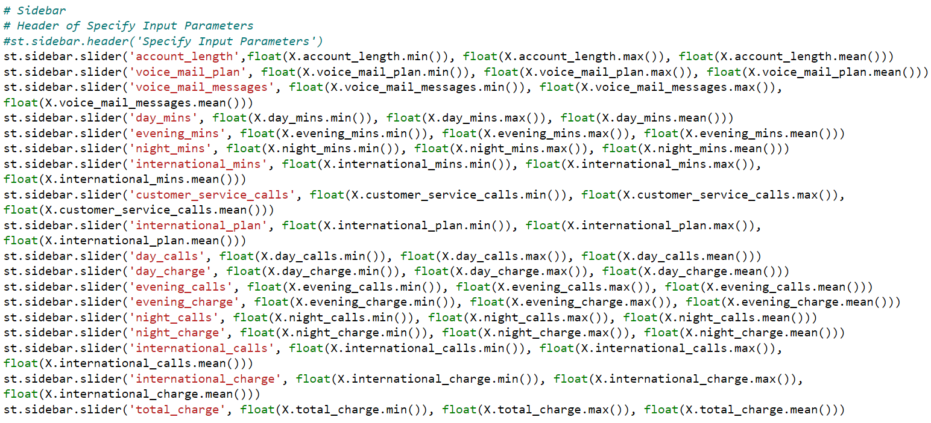
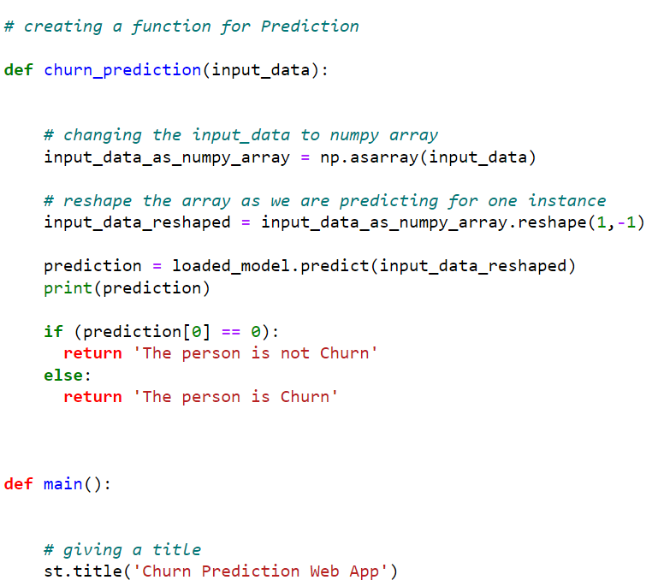


Slide 24



Slide 25



Slide 26



Slide 27
THANK YOU !!

