Slide 1
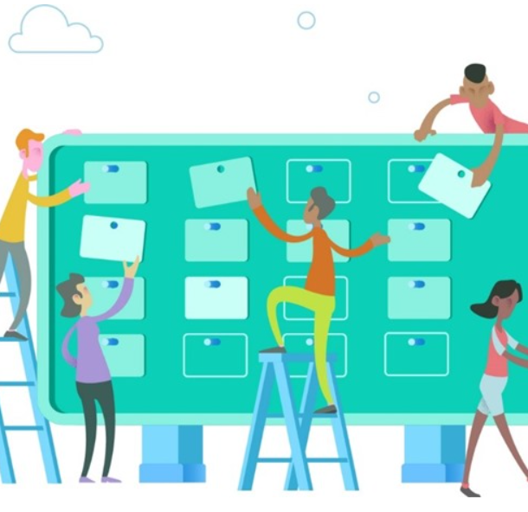
Azure Boards
Azure Boards is a service for managing the work for your software projects.
Azure Board brings a rich set of capabilities including native support for Scrum and Kanban, customizable dashboards, and integrated reporting.
You can create and track user stories, backlog items, features and bugs that are associated with a project
The Basic Process
The Agile Process
The Scrum Process
The CMMI Process

Slide 2
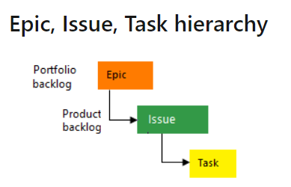
Basic Process
Two of the most popular processes used are Basic and Agile.
Choose Basic when your team wants the simplest model that uses Issues, Tasks, and Epics to track work.
Simplest process to work within Azure Boards
Add epics to track significant features or requirements.
Use issues to track user stories, bugs, or other smaller items of work.
Use tasks to track even smaller amounts of work for which you want to track time either in hours or days.

Slide 3
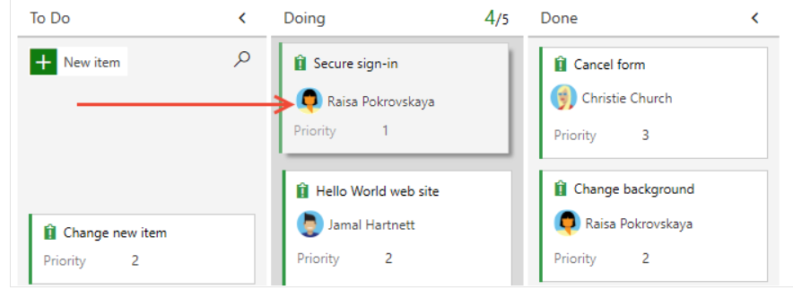
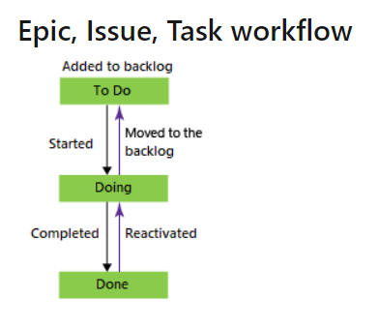
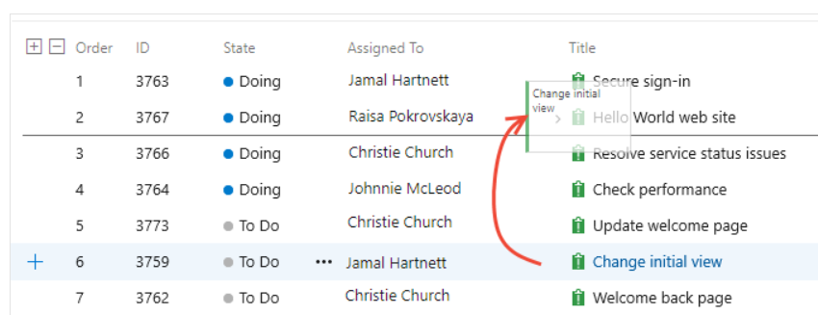
Basic Process – Workflow state
Quickly add and update the status of work using the Kanban board
You can also assign work to team members and tag with labels to support queries and filtering.

Slide 4
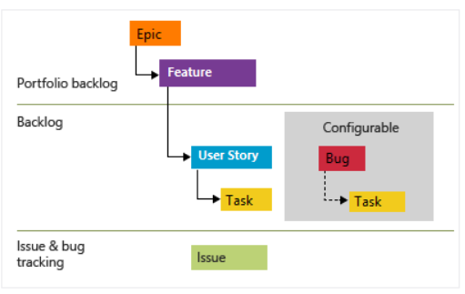
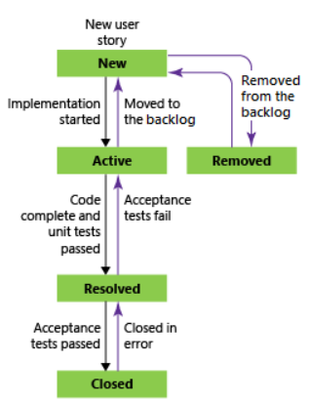
Agile Process
Choose Agile when your team uses Agile planning methods, including Scrum, and tracks development and test activities separately. This process works great if you want to track user stories and (optionally) bugs on the Kanban board, or track bugs and tasks on the taskboard.
Epics and Features are used to group work under larger scenarios
User Stories and Tasks are used to track work
Bugs track code defects
https://docs.microsoft.com/en-us/azure/devops/learn/agile/what-is-scrum?view=azure-devops

Slide 5
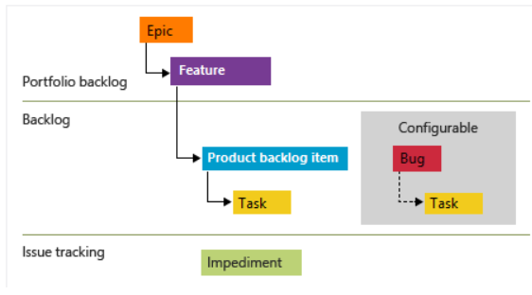
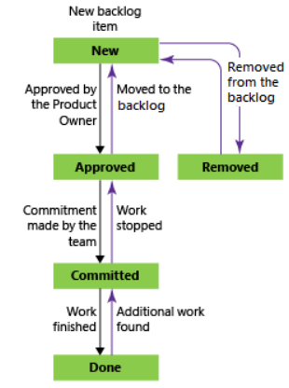
Scrum Process
Choose Scrum when your team practices Scrum. This process works great if you want to track product backlog items (PBIs) and bugs on the Kanban board, or break PBIs and bugs down into tasks on the taskboard
Epics and Features are used to group work under larger scenarios
Product Backlog Items and Tasks are used to track work
Bugs track code defects

Slide 6
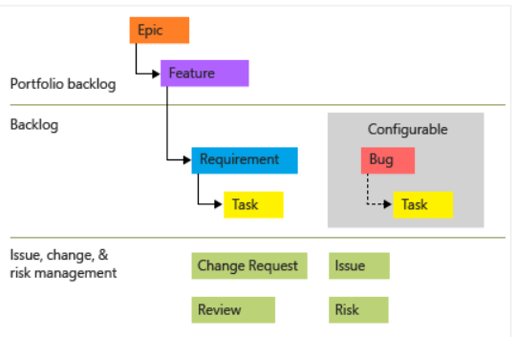
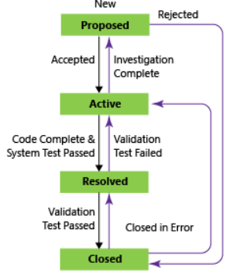
CMMI Process
Choose CMMI when your team follows more formal project methods that require a framework for process improvement and an auditable record of decisions. With this process, you can track requirements, change requests, risks, and reviews.
Epics and Features are used to group work under larger scenarios
Requirements and Tasks are used to track work
Bugs track code defects

