Slide 1
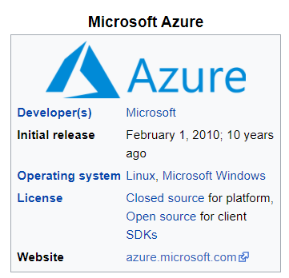
Microsoft Azure
Microsoft Azure, commonly referred to as Azure is a cloud computing service created by Microsoft for building, testing, deploying, and managing applications and services through Microsoft-managed data centers.
It provides software as a service (SaaS), platform as a service (PaaS) and infrastructure as a service (IaaS) and supports many different programming languages, tools, and frameworks, including both Microsoft-specific and third-party software and systems.
Azure was announced in October 2008, started with codename "Project Red Dog" and released on February 1, 2010, as Windows Azure before being renamed to Microsoft Azure on March 25, 2014.

Slide 2
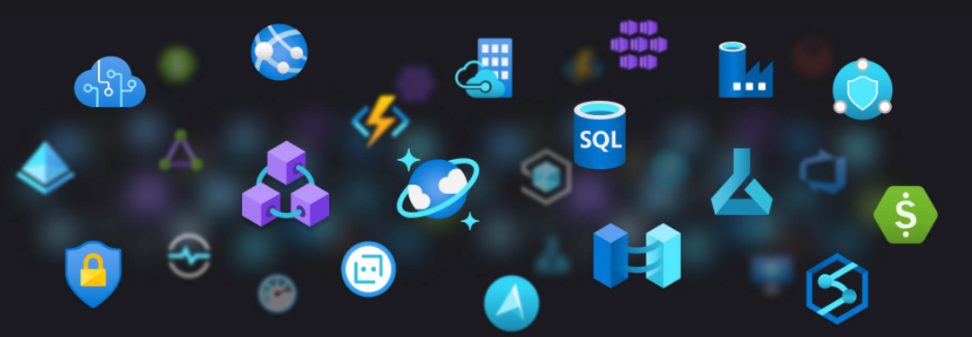
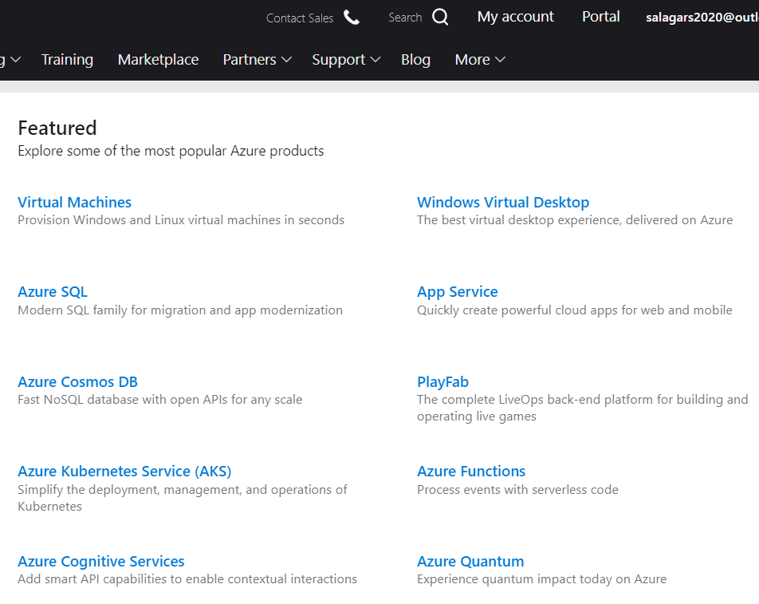
Azure Products
https://azure.microsoft.com/en-us/services/

Slide 3

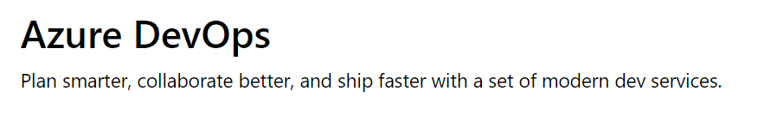

Slide 4
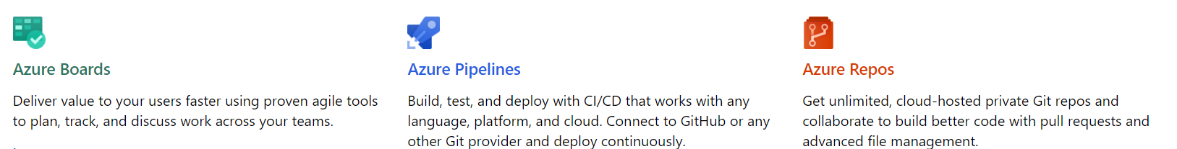
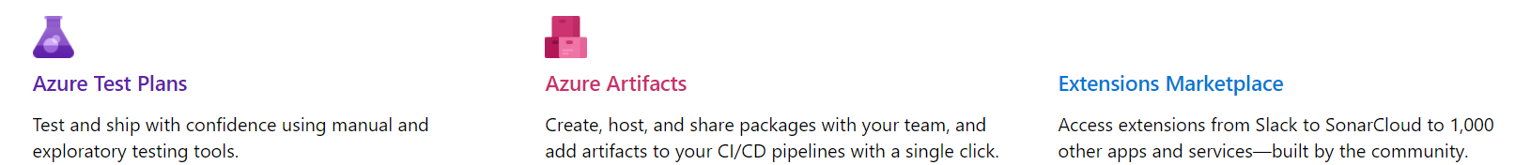
Azure DevOps
Azure DevOps provides developer services to support teams to plan work, collaborate on code development, and build and deploy applications. Developers can work in the cloud using Azure DevOps Services or on-premises using Azure DevOps Server.
Azure DevOps Server was formerly named Visual Studio Team Foundation Server (TFS).
Team Foundation Server became Azure DevOps Server 2019.
Azure DevOps Services also gives you access to cloud build and deployment servers, and application insights.

Slide 5
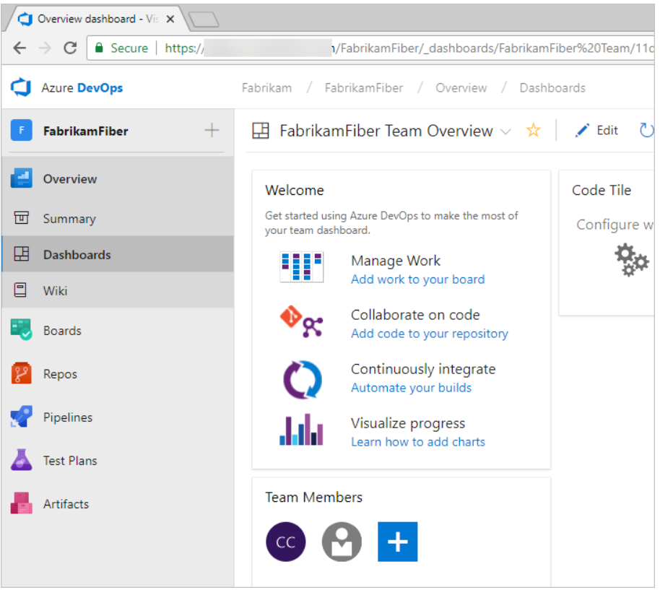
Azure DevOps Services - Dashboards
You can do the following tasks in Dashboards:
Add, configure, and manage dashboards
Configure widgets that you add to dashboards
Quickly navigate to different areas of your project

Slide 6
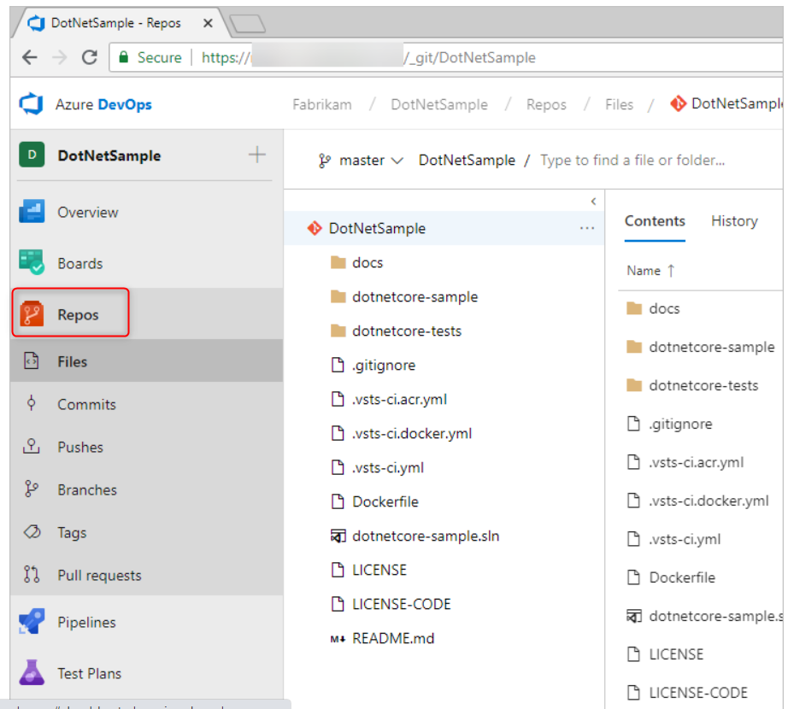
Repos
From Azure Repos for Git, you can do the following tasks
Review, download, and edit files, and review the change history for a file
Review and manage commits that have been pushed
Review, create, approve, comment on, and complete pull requests
Add and manage Git tags

Slide 7
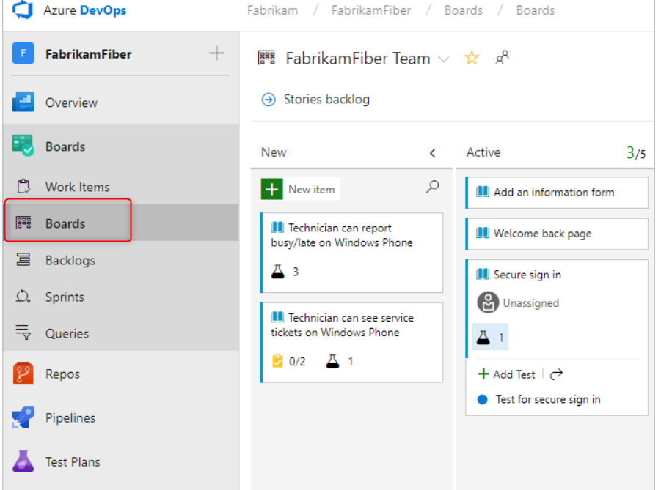
Plan and Track work
Add and update work items
Define work item queries, and create status and trend charts based on those queries
Manage your product backlog
Plan sprints by using sprint backlogs
Review sprint tasks and update tasks through the task boards
Visualize the workflow and update the status by using Kanban boards
Manage portfolios by grouping stories under features and grouping features under epics

Slide 8
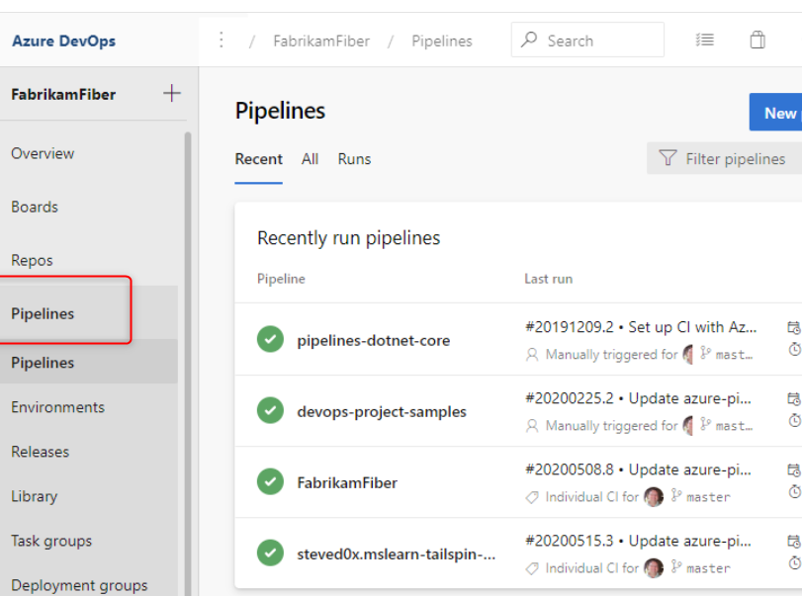
Continuous integration and deployment
Use pipelines to implement continuous integration and continuous delivery.
Build automation: Define the steps to take during build and the triggers that start a build.
Release management: Supports a rapid release cadence and management of simultaneous releases.
You can configure release pipelines that represent your environments from development to production. environment.
Create your release manually or automatically from a build. Then track your releases as they're deployed to various environments.

Slide 9
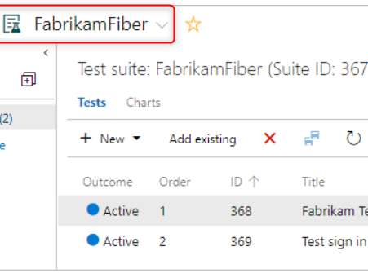
Manual and Exploratory Testing
Customization of workflows with test plan, test suite, and test case work items
End-to-end traceability from requirements to test cases and bugs with requirement-based test suites
Sharable test plans, test suites, and test cases for reviewing with Stakeholders

Slide 10
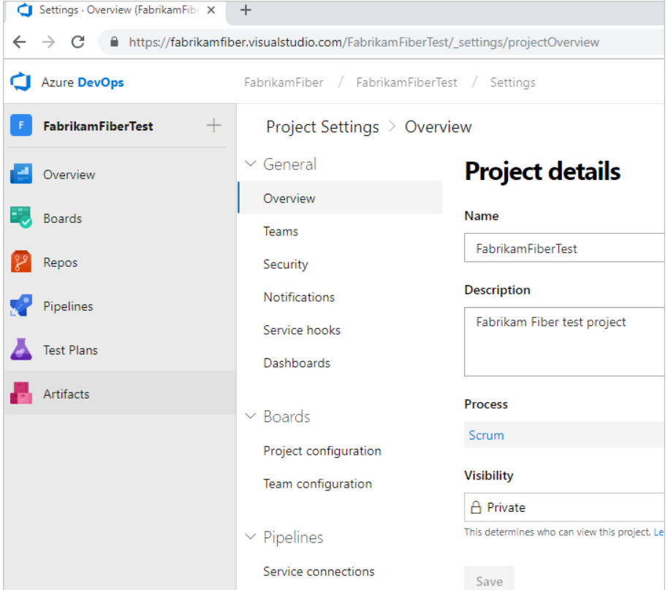
Administrative Services
There are features and tasks associated with administering a collaborative software development environment.
You complete most of these tasks through the web portal

Slide 11
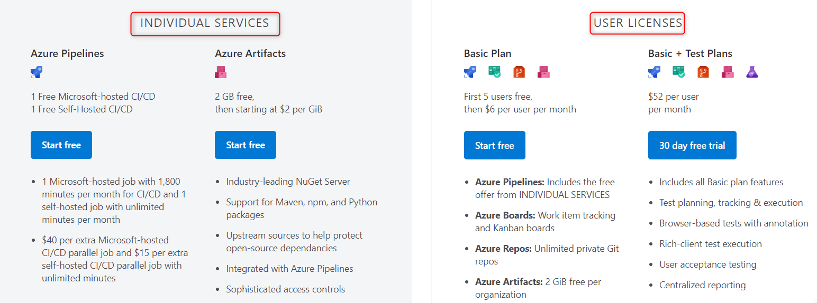
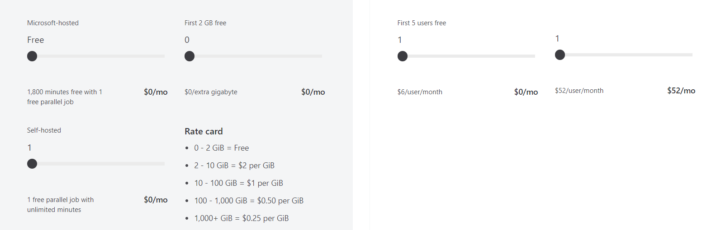
Azure DevOps Pricing

