Slide 1
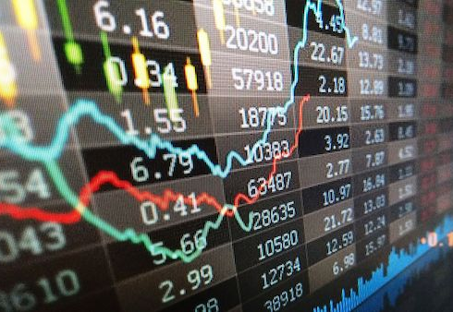
Google stock price Prediction
Regis University - MSDS696 – Data Science Practicum II
Hareesh Vijayanandan Nair
This Photo by Unknown Author is licensed under CC BY-NC-ND

Slide 2

Contents
Problem
Research Question
Data
Proposed Methodology
Results
Conclusions
Contact
References

Slide 3

Problem or Situation
Stock is a major investment option. Most of the retirement fund is also modelled in such a way that it is also used as a stock investment. This scenario gives more challenges to normal middleclass people on their future investment. People are trying to protect their hard-earned money without much loss.
Modelling and prediction of stock price is getting more attention. This project is to research on how to predict Google stock price as a model.
This Photo by Unknown Author is licensed under CC BY-ND

Slide 4

Research Question
How to understand and predict the stock price impact during the volatile market where national and international affairs are bringing impacts. This prediction model should help the users to avoid any loss on stock investment and maximize the profit.
This Photo by Unknown Author is licensed under CC BY-SA

Slide 5


Data
The data set for this project is obtained from yahoo finance stock data.
Google Stock data details are below.
This Photo by Unknown Author is licensed under CC BY-ND
Field | Description
Date | When the transaction is processed.
Open | The open price when the stock exchange is opened.
Close | The close price when the stock exchange is closed.
High | High price of stock on this day.
Low | Low price on this day.
Volume | The total volume of the stock transacted on this day.
Adj Close | The adjusted closing price amends a stock close price.

Slide 6

Proposed methodology
Long short-term memory (LSTM) with Recurrent neural Network (RNN) is used for this prediction. This model proved to be a good candidate for time series data prediction.
This Photo by Unknown Author is licensed under CC BY-ND

Slide 7

Results
Exploratory Data Analysis (EDA) and Data Visualization plots are used to ensure the Data validation and stability .
Multiple plots are generated to ensure the validation result.
Augmented Dickey Fuller test (ADF) and Kwiatkowski-Phillips-Schmidt-Shin Test (KPSS) is conducted to ensure the data is reliable for a Time series prediction.
Google Stock Price Predication is conducted using LSTM and RNN.
This Photo by Unknown Author is licensed under CC BY-ND

Slide 8
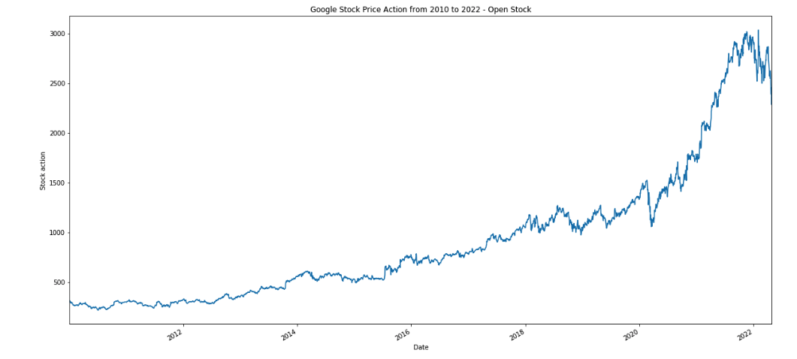
Google Stock Price Action from 2010 to 2022 - Open Stock

Slide 9
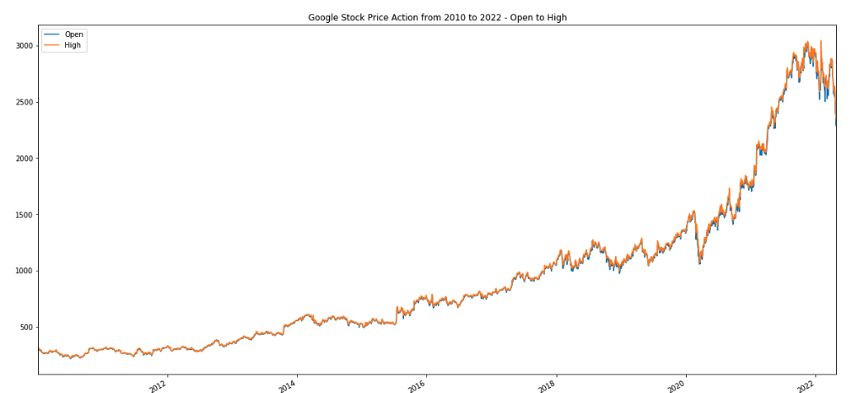
Google Stock Price Action from 2010 to 2022 - Open price and High price

Slide 10
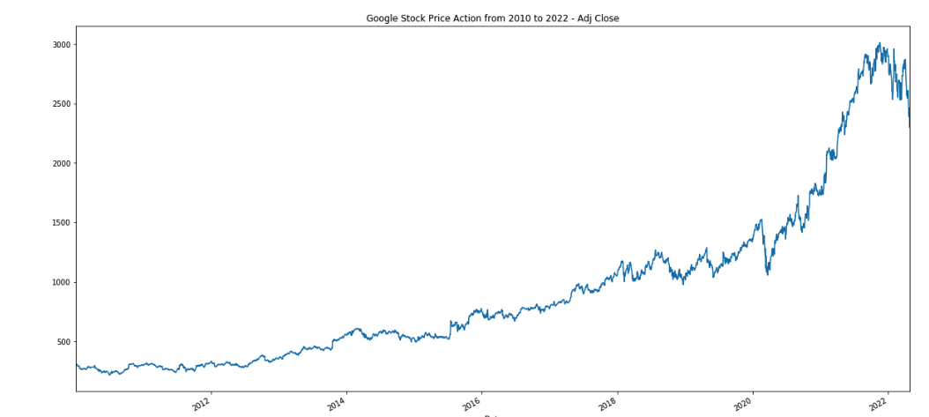
Google Stock Price Action from 2010 to 2022 - Adj Close Price

Slide 11
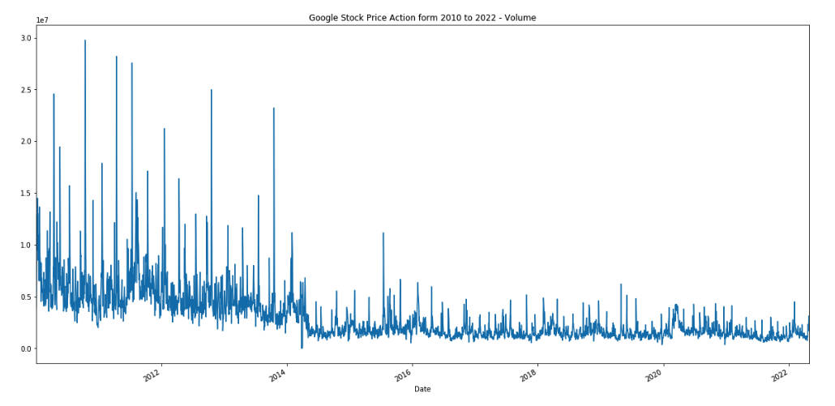
Google Stock Price Action from 2010 to 2022 – Volume of stock traded in millions

Slide 12
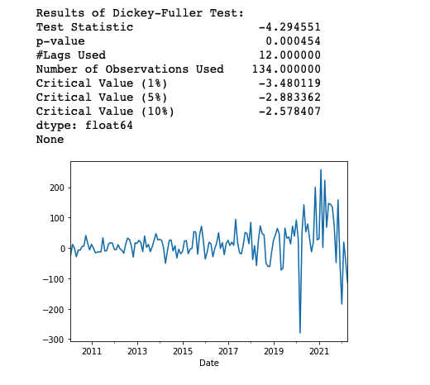
Augmented Dickey Fuller Test (ADF) Result

Slide 13

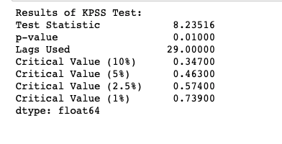
Kwiatkowski-Phillips-Schmidt-Shin Test (KPSS) Result

Slide 14
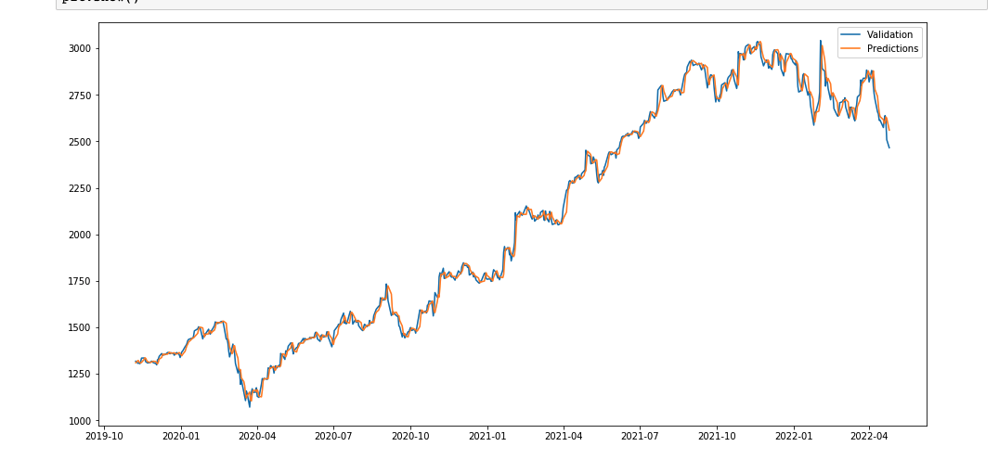
Validation versus Prediction Diagram

Slide 15
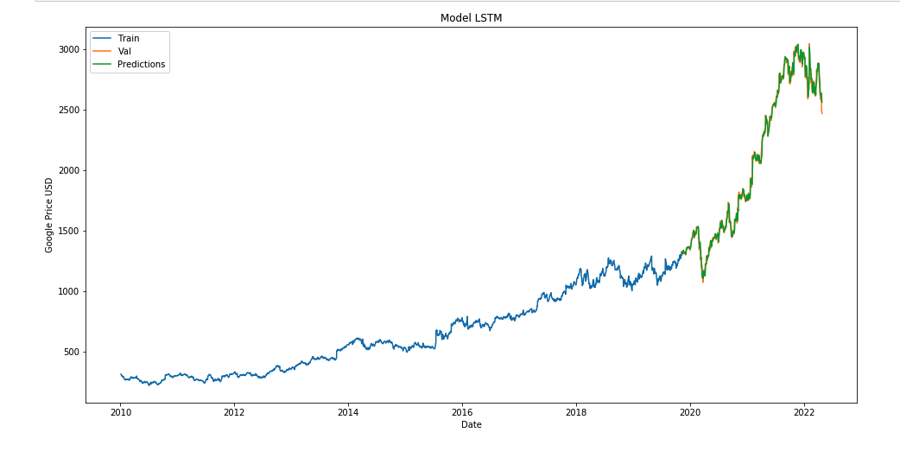
LSTM output plotted with Train, Validation and Prediction data

Slide 16

Conclusions
From RNN and LSTM method the plot looks almost similar to the validation results.
This model can be further improved and can be used to predict the Google stock price results.
On Further tuning with other data sets this model can be reused for other stock price predictions also.

Slide 17
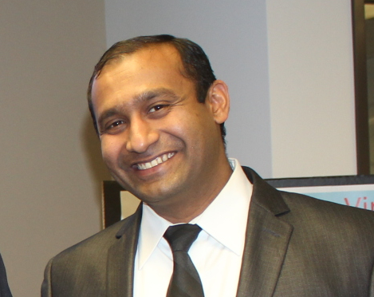
Contact
Hareesh Vijayanandan Nair
MSDS 696
Regis university
hareeshv@gmail.com
Cell : 216-225-9670

Slide 18
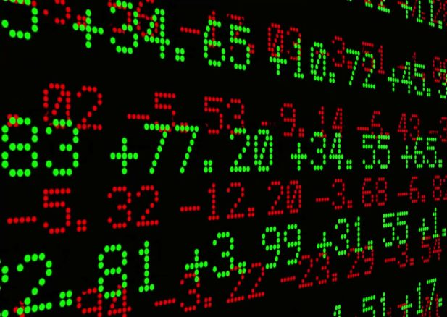
References
Slide Pictures included from Microsoft power point online browser.
Data - https://finance.yahoo.com/
https://learning.oreilly.com/library/view/python-for-finance/9781492024323/ch15.html#ts_clustering
Code References - https://www.kaggle.com/search?q=google+stock+price+in%3Anotebooks
This Photo by Unknown Author is licensed under CC BY-ND

