Slide 1
Google stock price Prediction
Regis University - MSDS696 – Data Science Practicum II
Hareesh Vijayanandan Nair

Slide 2
Contents
Problem
Research Question
Data
Proposed Methodology
Project Timeline
Contact

Slide 3
Problem or Situation
Stock is a major investment option. Most of the retirement fund is also modelled in such a way that it is also used as a stock investment. This scenario gives more challenges to normal middleclass people on their future investment. People are trying to protect their hard-earned money without much loss.
Modelling and prediction of stock price is getting more attention. This project is to research on how to predict Google stock price as a model.

Slide 4
Research Question
How to understand and predict the stock price impact during the volatile market where national and international affairs are bringing impacts. This prediction model should help the users to avoid any loss on stock investment and maximize the profit.

Slide 5
Data
The data set for this project is available in yahoo finance and Kaggle.
Stock data for this project contains the following details.
Data details are as follows.
Field | Description
Date | When the transaction is processed.
Open | The open price when the stock exchange is opened.
Close | The close price when the stock exchange is closed.
High | High price of stock on this day.
Low | Low price on this day.
Volume | The total volume of the stock transacted on this day.
Adj Close | The adjusted closing price amends a stock close price.

Slide 6
Proposed methodology
There are different types of methodologies need to be experimented and check the accuracies of this prediction method. Since this is a very serious model which can make financial decisions , this should be tested multiple times for the accuracies. There are time series analysis like LSTM model, Facebook Prophet model or ARIMA model.

Slide 7
Project Timeline
Time frame | Activity | Status
Week 1 | Research Project Analysis | Complete
Week 2 | Data Availability Analysis | Complete
Week 3 | Project proposal | In progress
Week 4 | Data Preparation
Week 5 | Data Visualization and Study
Week 6 | Analysis of machine learning algorithms and preparation
Week 7 | Finalize algorithm and research
Week 8 | Project preparation and presentation

Slide 8
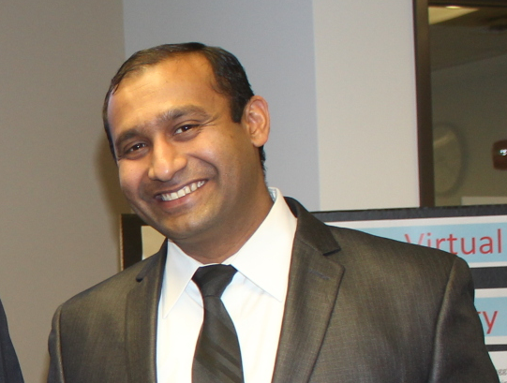
Contact
Hareesh Vijayanandan Nair
MSDS 696
Regis university
hareeshv@gmail.com
Cell : 216-225-9670

