Slide 1
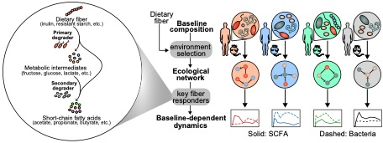

Slide 2
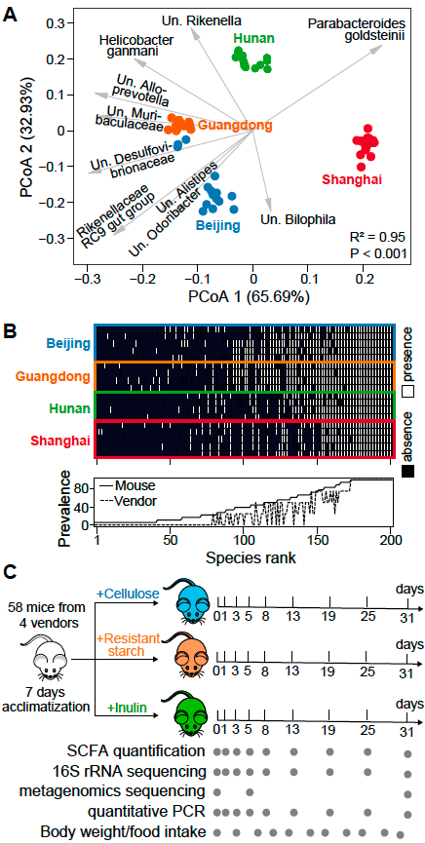
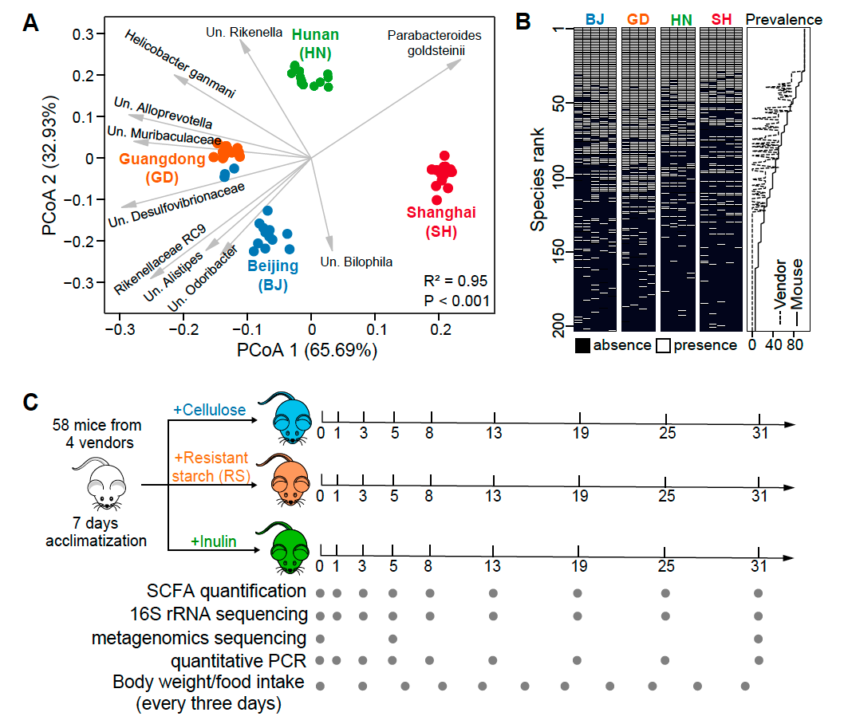

Slide 3
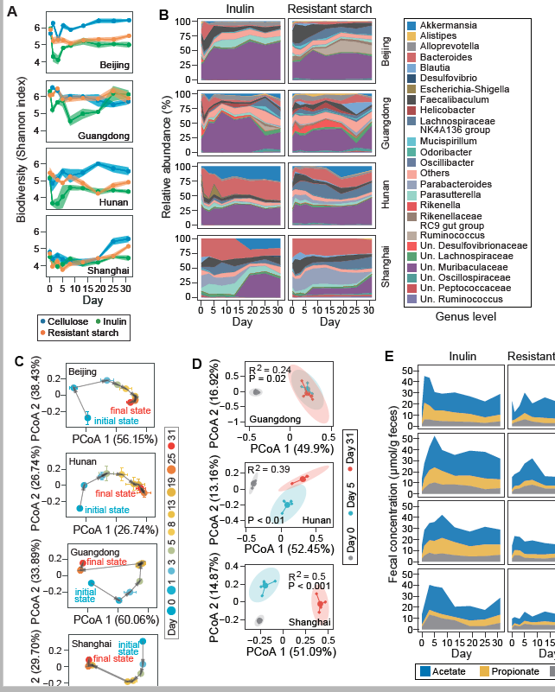

Slide 4
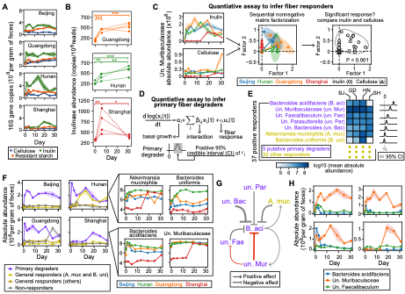

Slide 5
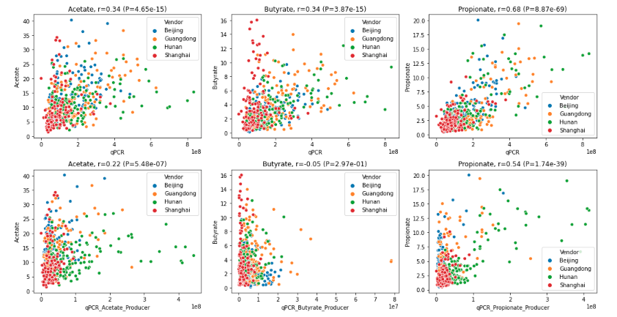
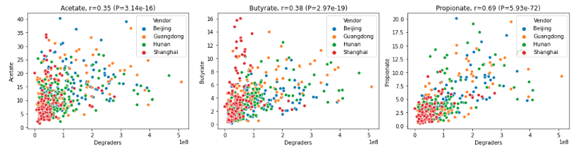
Correlation between primary degraders and SCFA
SCFA vs. total qPCR
SCFA vs. partial qPCR (SCFA producers)
SCFA vs. partial qPCR (primary degraders)

Slide 6
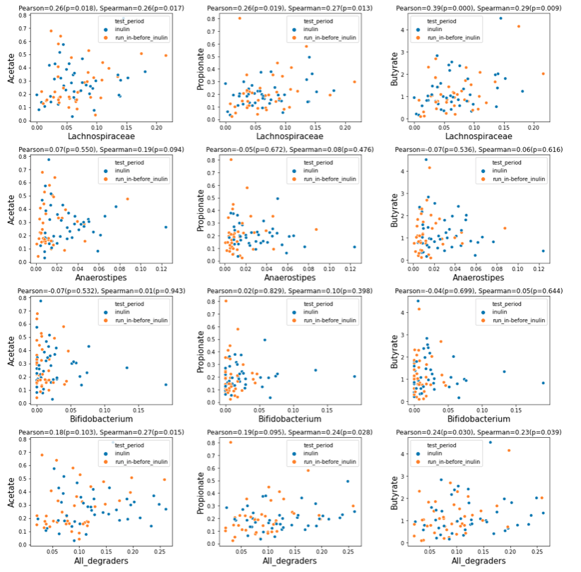
Vandeputte 2017 Gut

Slide 7
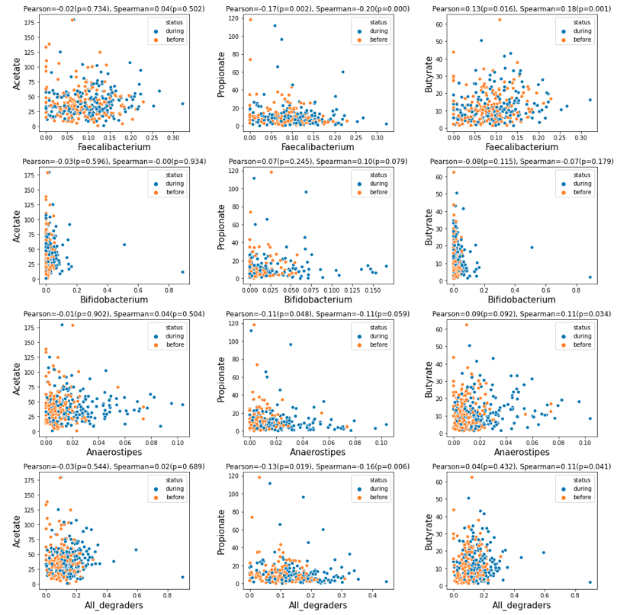
Baxter 2019 mBio

Slide 8
Difficult to predict SCFA in human studies (Pat Schloss). How about mice study? We designed two data split approach.
Since prediction is bad, generally, chanllege in finding prducers.
But, correlation between total degrader and propionate (ppa vs. muribaculce significant correlation in mice)
Can we translate knowledge to human studies? Meta-analysis

