Slide 1
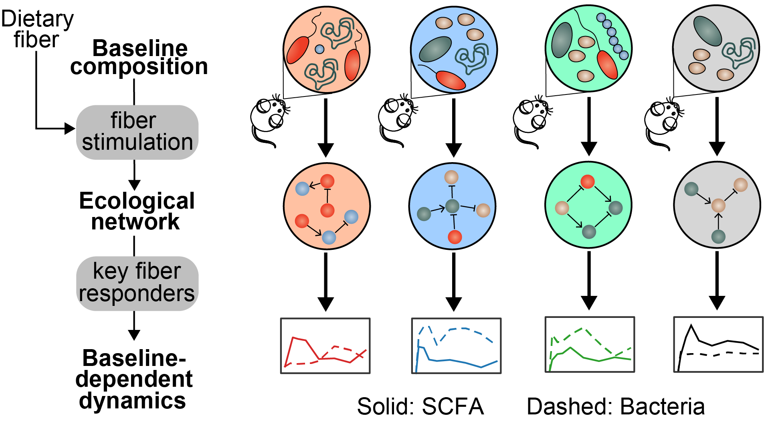
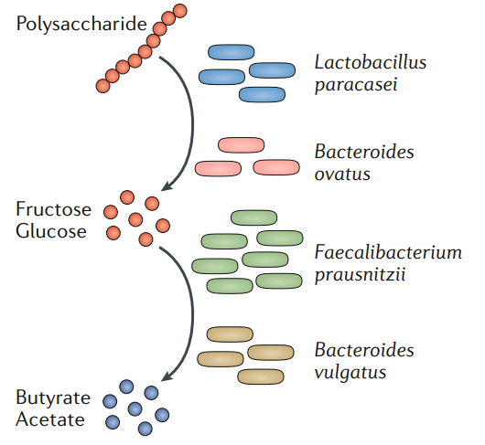
Figure 1 Ecological network in response to dietary fibers
Primary degrader
Secondary degrader
Liu and Liao et al, in prep

Slide 2
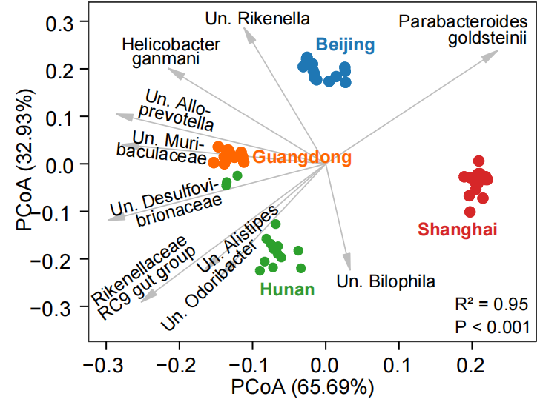
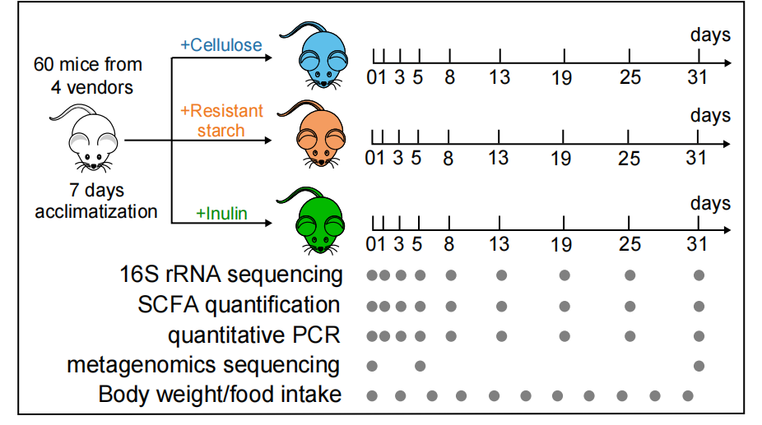
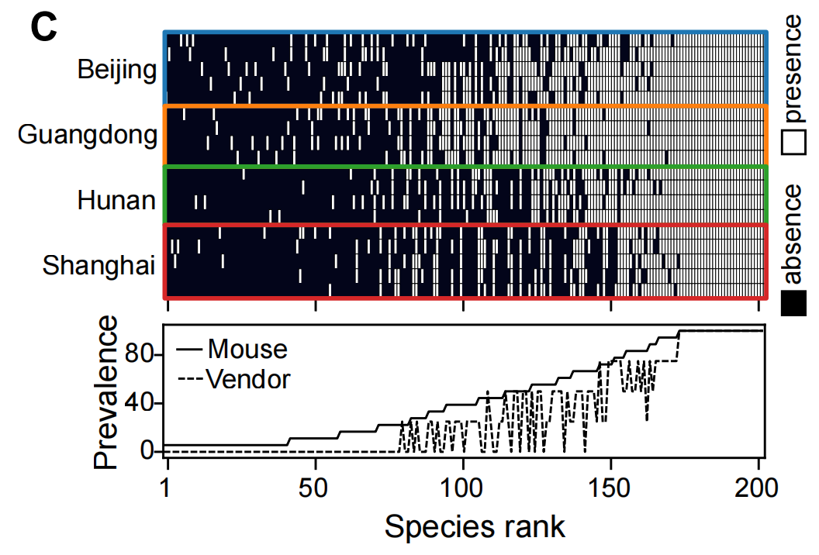
Figure 2 Heterogeneity in baseline gut microbiota: dynamical response to dietary interventions
Baseline murine gut microbiome across different vendors
Liu and Liao et al, in prep

Slide 3
Figure 3 Dynamical response: short vs. long-term
Total time series
-Microbiota: alpha diversity, composition
-metagenome
-SCFA: here?
Day 5, day 31 (supp?): limitation of cross-sectional analysis

Slide 4
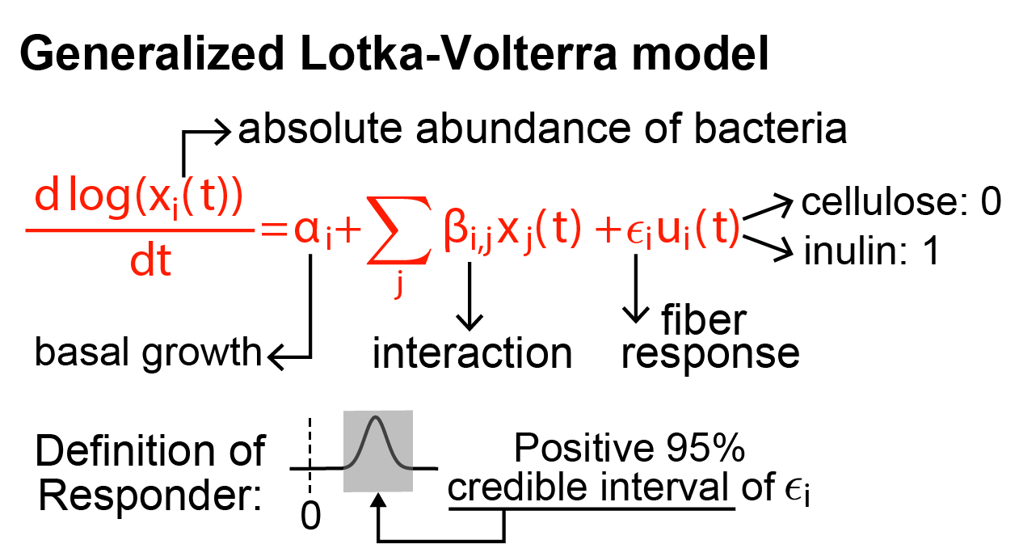
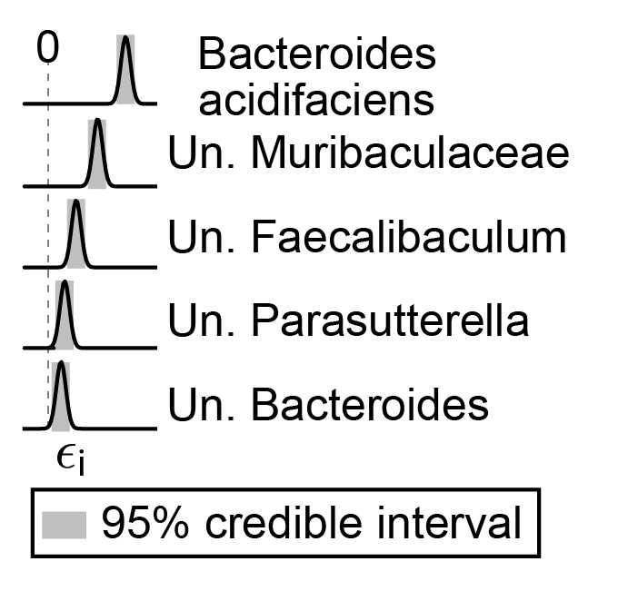
Figure 4 gLV: (Liao Chen slides)
共性的：基于network的知识
1）Eco-groups
2）Degraders competition
差异的：initial condition=baseline microbiota (next page)
Confirmed by reanalyzing data from Chijiiwa et al., Microbiome (2020)

Slide 5
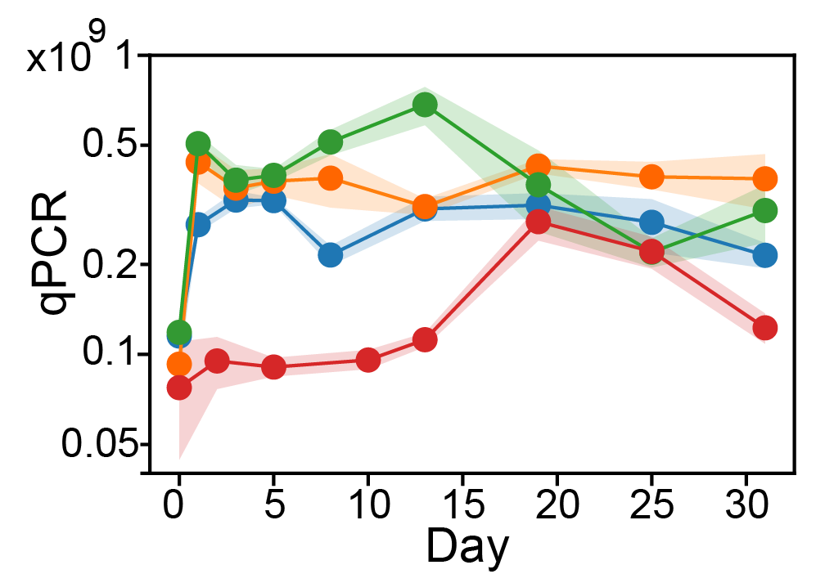
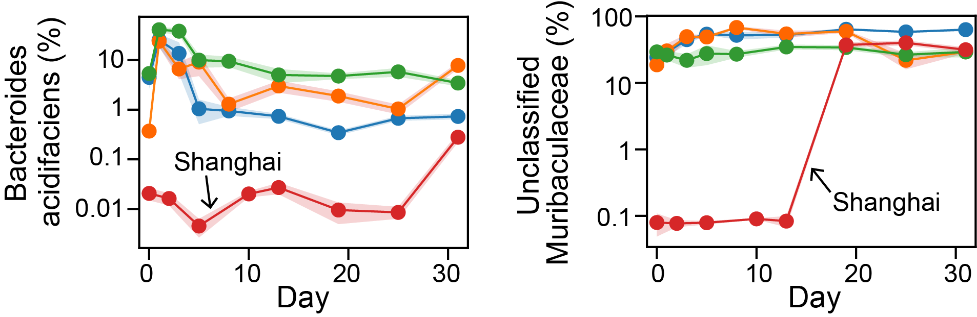
Figure 4:Dynamical response is dependent on baseline microbiota -Shanghai group: total abundance vs primary degrader -Hunan: other responders?
Total bacterial load
Additional point (for discussion section):
-similar abundance in different baseline microbiota, different dynamics -> dependent on the presence/absence of interacting species ?
Relative abundance
Liu and Liao et al, in prep

Slide 6
Figure: gLV analysis, extension
RS data: short vs long term (not strong), gLV analysis, baseline-dependent
Relate to human data

Slide 7
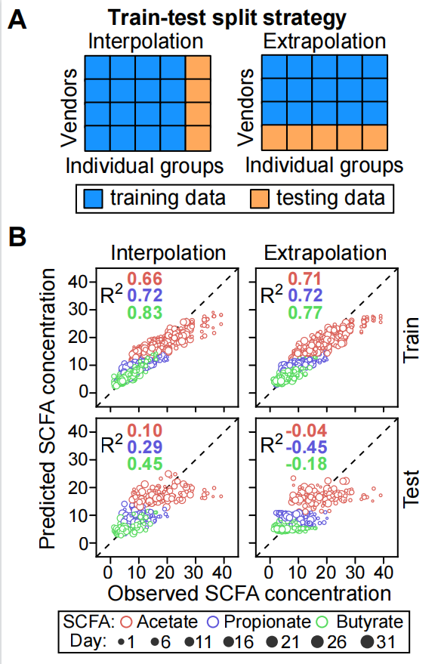
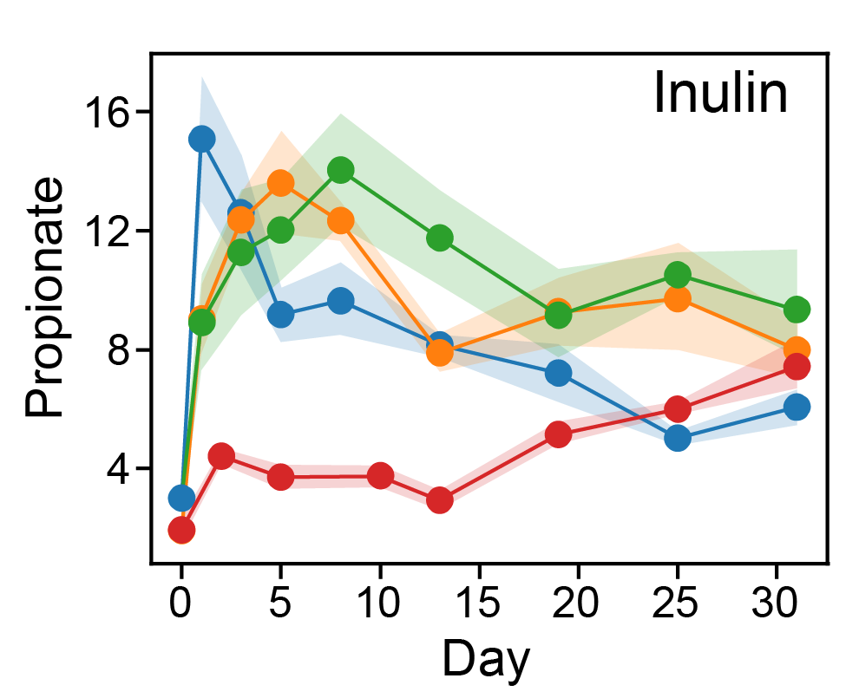
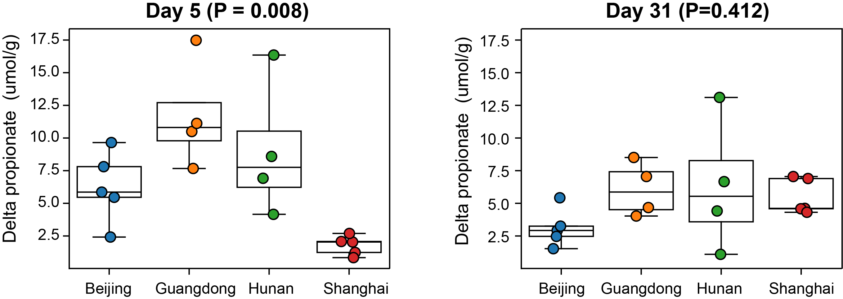
Figure5: SCFA -production is baseline-dependent: SCFA producer absence/presence profile -SCFA prediction from microbiome is limited, because SCFA producers are be missing in test data
unsuccessful prediction by machine learning
Liu and Liao et al, in prep

