Slide 1
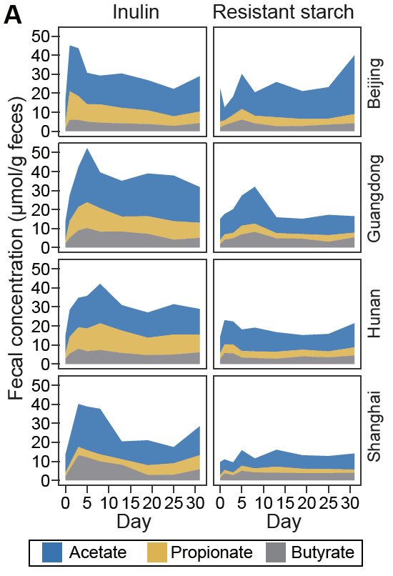
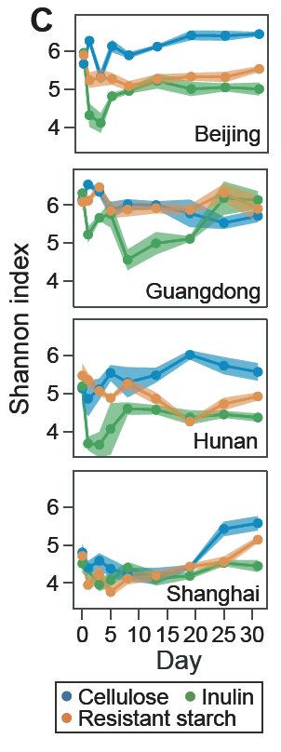
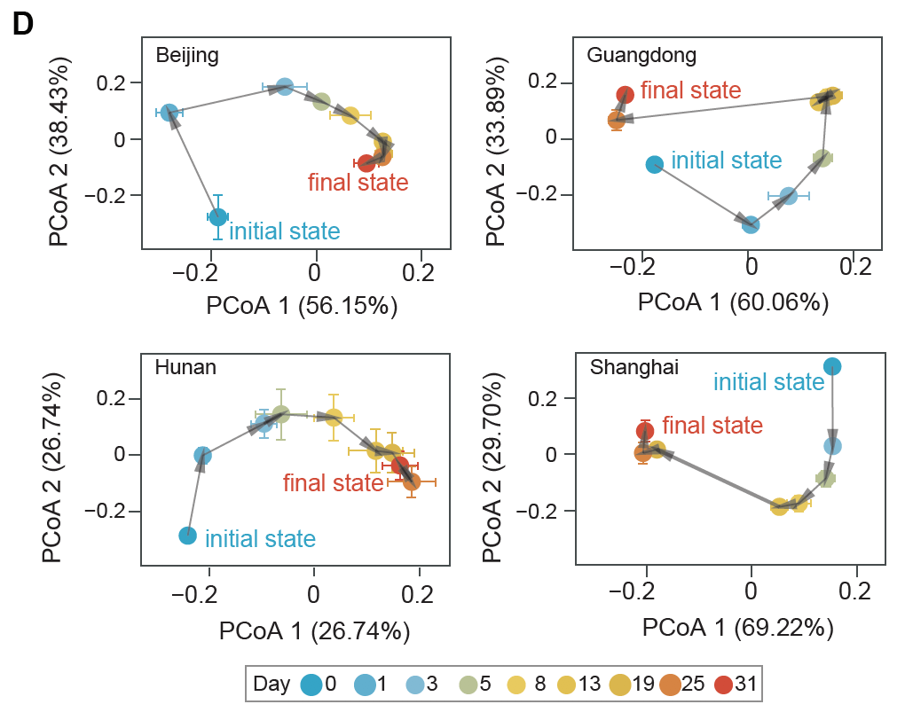
Take-home 1: Inulin shifts SCFA and microbiome to alternative steady state after overshoot response
Better fitting using harmonic oscillator model (may overshoot) allows than Hill function (no overshoot)
Similar pattern found in a previous study (Chijiwa 2020)
Concern: generalize to other alpha diversity metric (e.g., phylogenetic diversity)

Slide 2
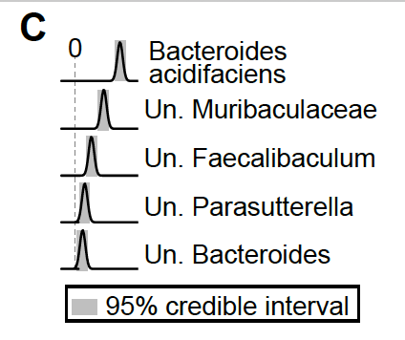
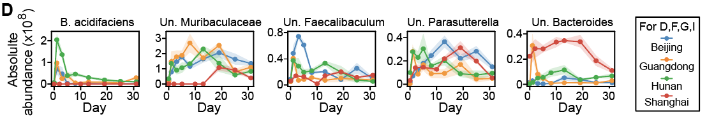
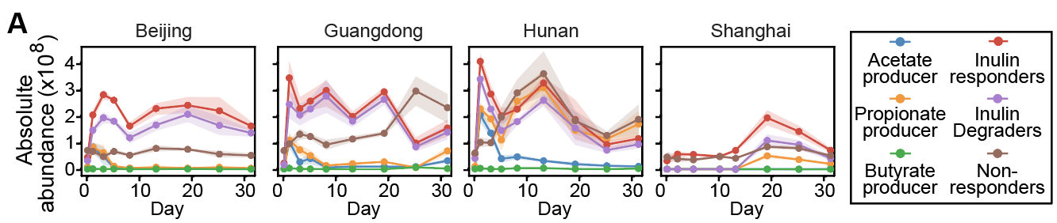
Take-home 2: Initial loss of diversity is mainly caused by rapid growth of two putative inulin degraders
degrader
Genetic analysis for Faecalibaculum and Parasutterella

Slide 3
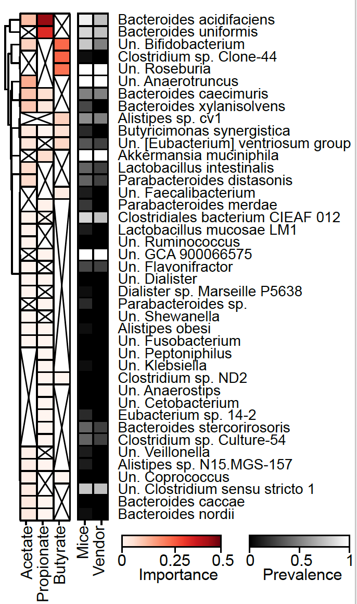
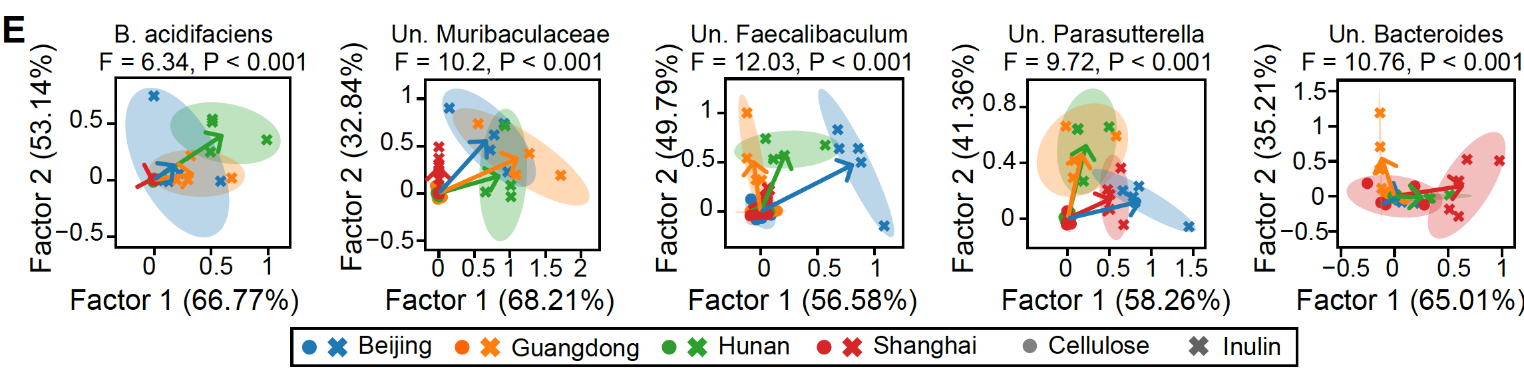
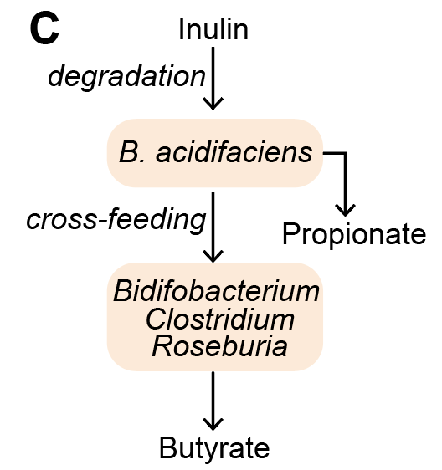
Take-home 3: Inulin responders exhibit individualized responses (potentially whole microbiome through interactions) and B. acidifaciens is strongly associated with propionate production

Slide 4
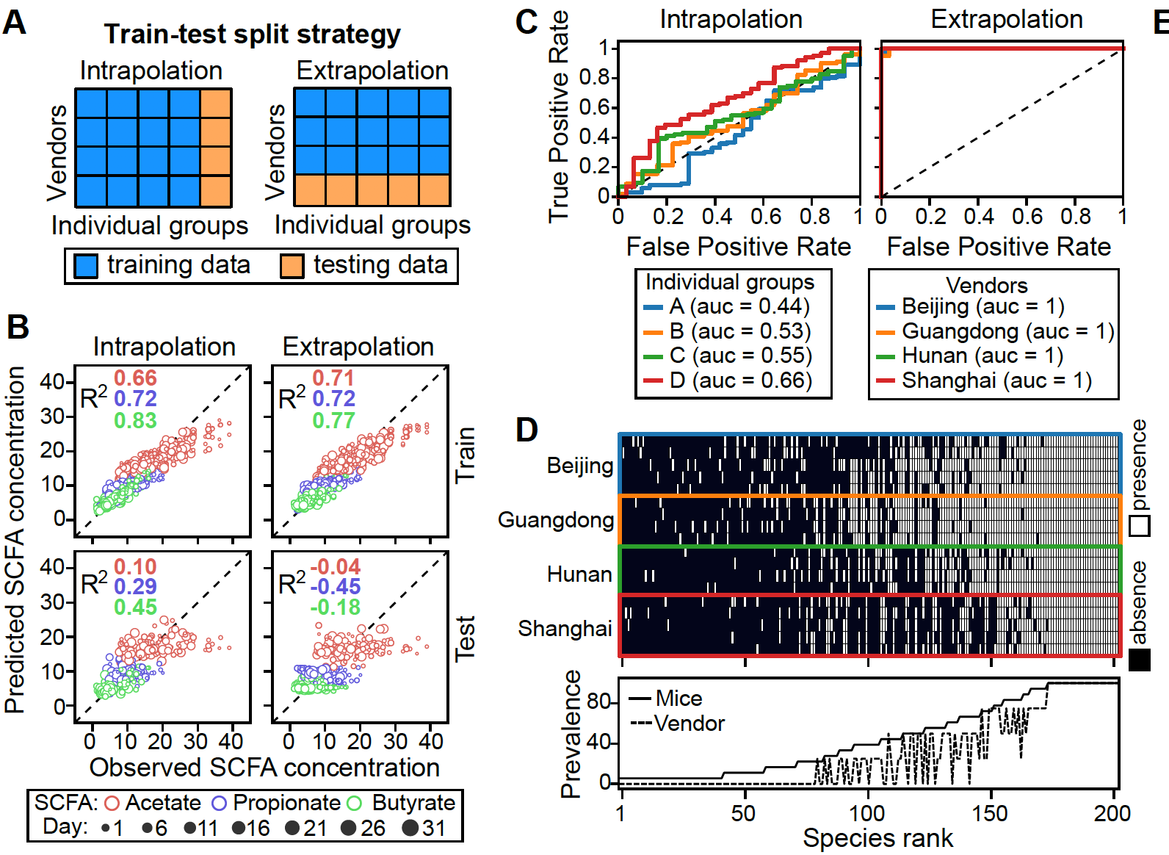
Take-home 4: Prediction of SCFA from microbiome is challenging due to violation of iid assumption

