Slide 1
Multiple alignment method
Find homologous sequences
Place the sequences in a relevant format (usually FASTA), and edit to similar length.
3. Run a multiple alignment program
ClustalW - oldest, flexible, robust
ClustalΩ - latest version, scalable, more accurate with addition of HMM
MUSCLE - fast, good for finding short motifs in small datasets
PRALINE - includes secondary structure information
T-Coffee - good for small datasets of shorter sequences, has a module for checking input seqs against the PDB
COBALT - uses domain conservation information (from BLAST page) which by definition has some structural information

Slide 2
Clustal family
Clustal X
Uses progressive global alignment algorithm
Graphic user interface only
Clustal W and W2
Command line tool, W2 also had a web interface
Has a parallelized version, to cope with larger datasets
ClustalΩ
HMM searches added to algorithm
Command line and web interface
Scalable to very large datasets

Slide 3
Input of Data
3 or more sequences are needed, nucleic or amino acids, several formats are accepted: eg FASTA text files
Remove any white space or empty lines
The analysis will fail if two sequences have the same name
Can copy/paste sequences into Clustal or upload a txt file

Slide 4
Biopython ClustalW
>import Bio.Align.Applications
>dir(Bio.Align.Applications)
['ClustalOmegaCommandline', 'ClustalwCommandline', 'DialignCommandline', 'MSAProbsCommandline', 'MafftCommandline', 'MuscleCommandline', 'PrankCommandline', 'ProbconsCommandline', 'TCoffeeCommandline', '_ClustalOmega', '_Clustalw', '_Dialign', '_MSAProbs', '_Mafft', '_Muscle', '_Prank', '_Probcons', '_TCoffee', '__all__', '__builtins__', '__doc__', '__file__', '__name__', '__package__', '__path__']

Slide 5
Biopython ClustalW
Using local ClustalW: http://www.clustal.org/clustal2/
#!/usr/bin/python
from Bio.Align.Applications import ClustalwCommandline
cline = ClustalwCommandline("clustalw2", infile="opuntia.fasta")
print(cline)
cline()
command line wrapper
running ClustalW, creates an alignment file ‘.aln’

Slide 6
Biopython ClustalW
Parsing ClustalW output
#!/usr/bin/python
from Bio import AlignIO
align = AlignIO.read("opuntia.aln", "clustal")
print(align)
Parsing ClustalW alignment
#!/usr/bin/python
from Bio import Phylo
tree = Phylo.read("opuntia.dnd", "newick")
Phylo.draw_ascii(tree)

Slide 7
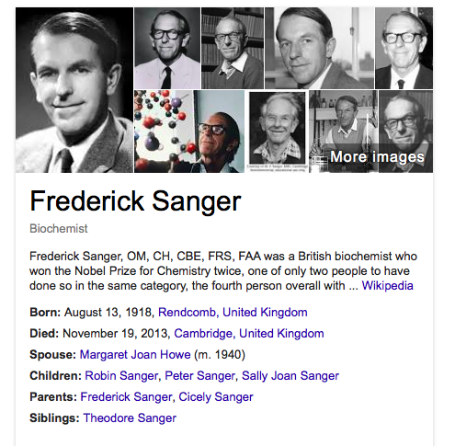

Slide 8
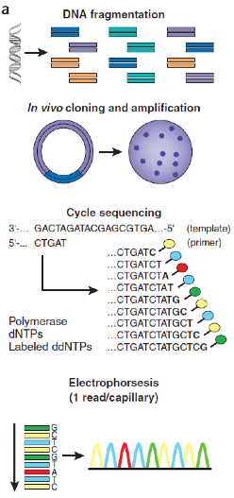
Sanger Sequencing
DNA is fragmented
Cloned to a plasmid vector
Cyclic sequencing reaction
Separation by electrophoresis
First generation: S³⁵ isotope
Second generation: fluorescent tags
Third generation: automation

Slide 9
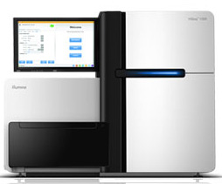
“Next” generation sequencing
Not Sanger based biochemistry
DNA is fragmented and sequenced directly
Much more chemistry, physics, and computer science
Characterized by
Parallel Sequencing
High Throughput
Cost
Generates billions of sequences per experiment, highly computational

Slide 10
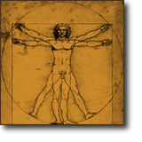
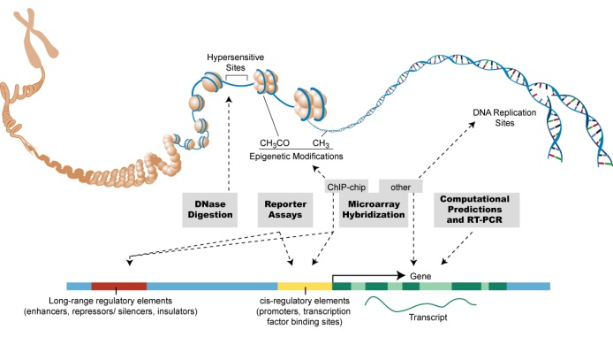
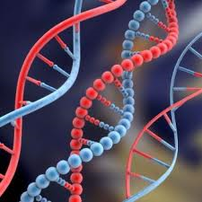
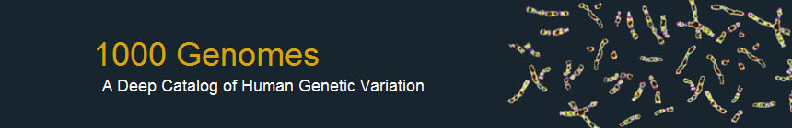
Human Genome Project
ENCODE project
HapMap project
SNP consortium
Individual human genomes
James Watson, Craig Venter,
3 asian gentlemen

Slide 11
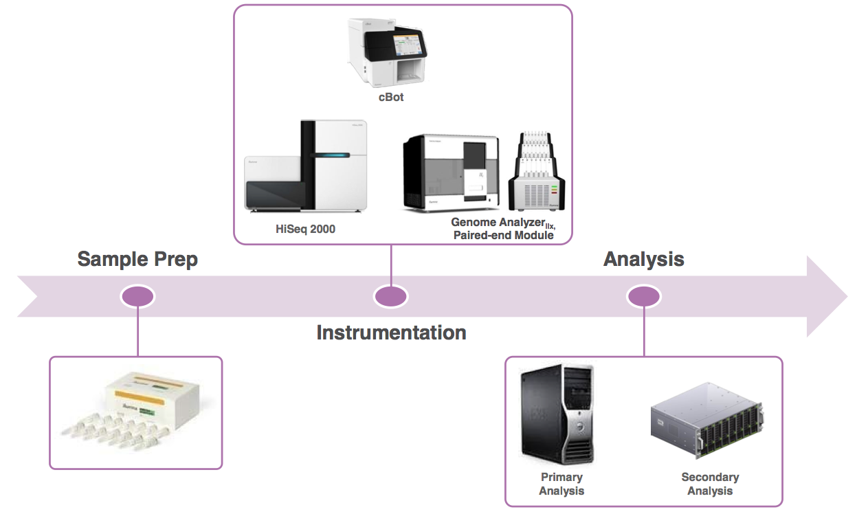
General Workflow (Illumina)

Slide 12
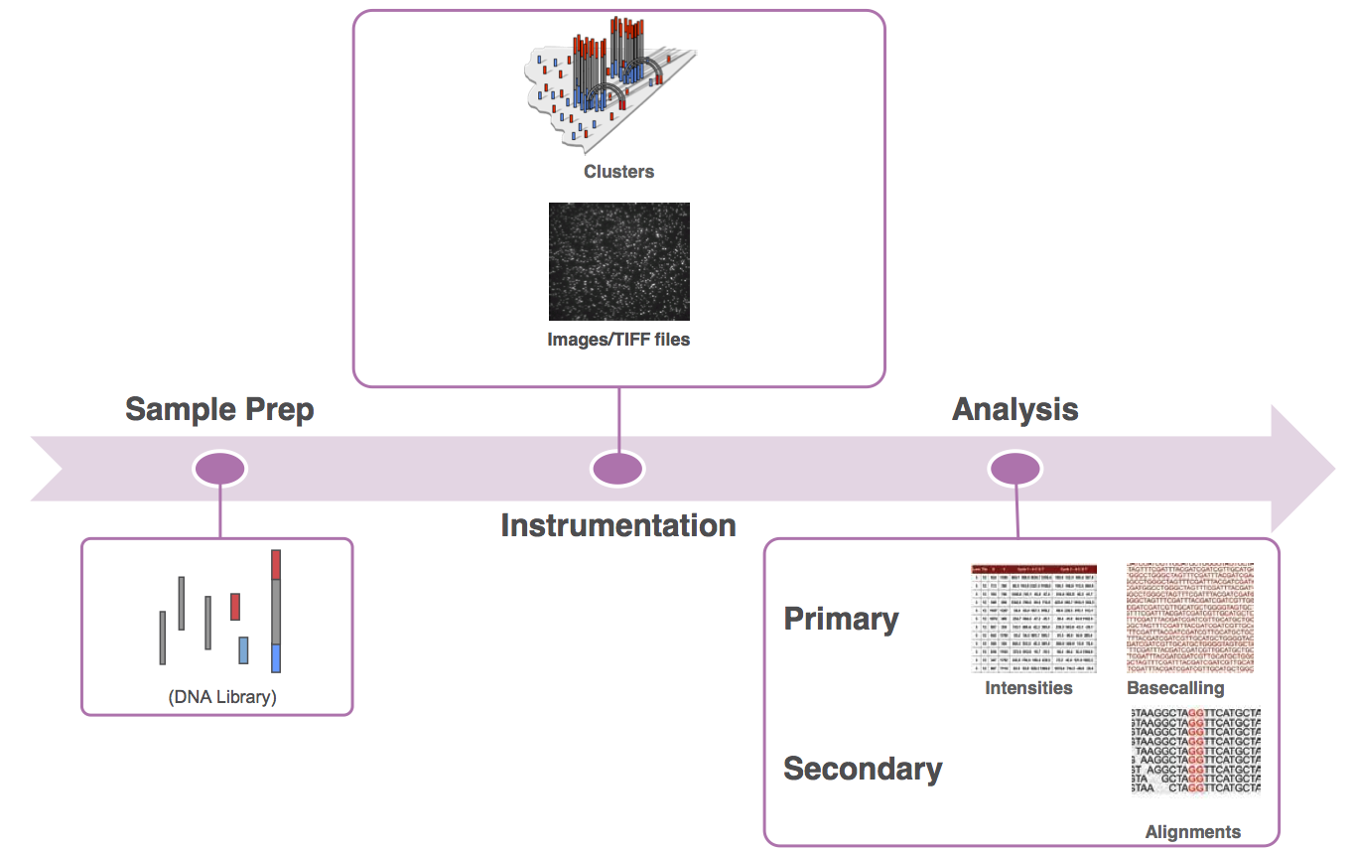
Workflow Outcomes

Slide 13
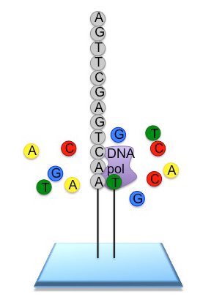
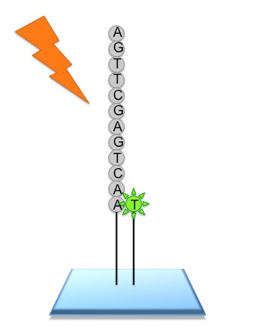
Workflow (Illumina)
Input sequence is cleaved in reads of 100-150 bp,
ligated to generic adaptors
and annealed to a slide using the adaptors.
These nucleotides are fluorescently labeled,
with the color corresponding to the base.
They also have a terminator, so that only one
base is added at a time.
These nucleotides are fluorescently labeled,
with the color corresponding to the base.
They also have a terminator, so that only one
base is added at a time.

Slide 14
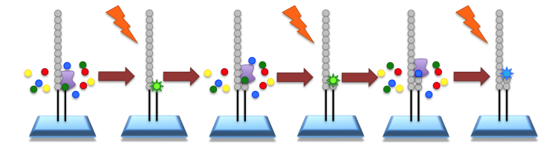
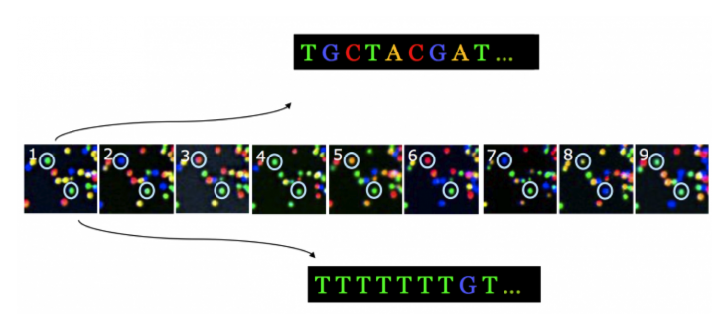
Workflow (Illumina)
An image is taken of the slide. In each read location, there will be a fluorescent signal indicating the base that has been added.
The terminators are removed, allowing the next base to be added, and the fluorescent signal is removed, preventing the signal from contaminating the next image

