Slide 1



A Machine Learning Based Parallelization Assistant
AI-SEPS 2019 workshop
Aleksandr Maramzin, Christos Vasiladiotis, Roberto Castañeda Lozano,
Björn Franke, Murray Cole
The University of Edinburgh
United Kingdom

Slide 2

A Machine Learning Based Parallelization Assistant
AI-SEPS 2019 workshop
Aleksandr Maramzin, Christos Vasiladiotis, Roberto Castañeda Lozano,
Björn Franke, Murray Cole
The University of Edinburgh
United Kingdom
“It Looks Like You’re Writing a Parallel Loop”

Slide 3
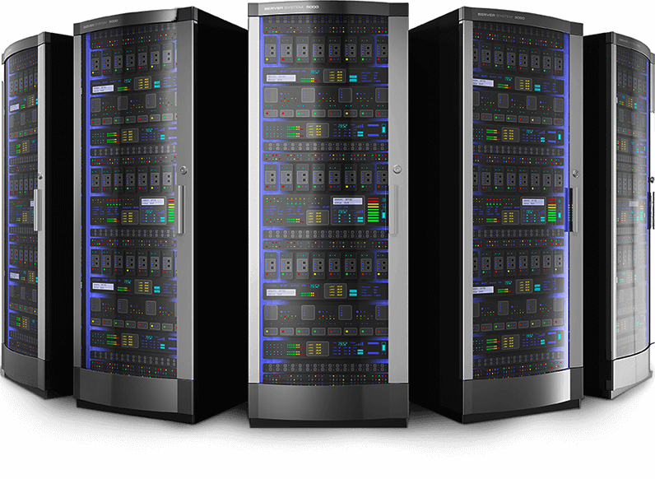
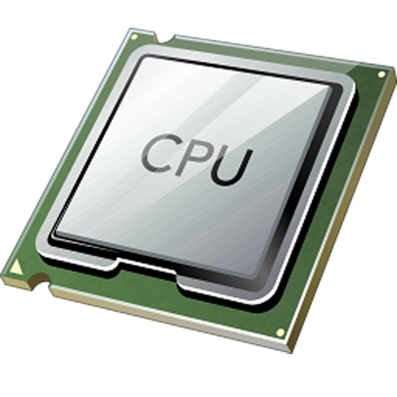
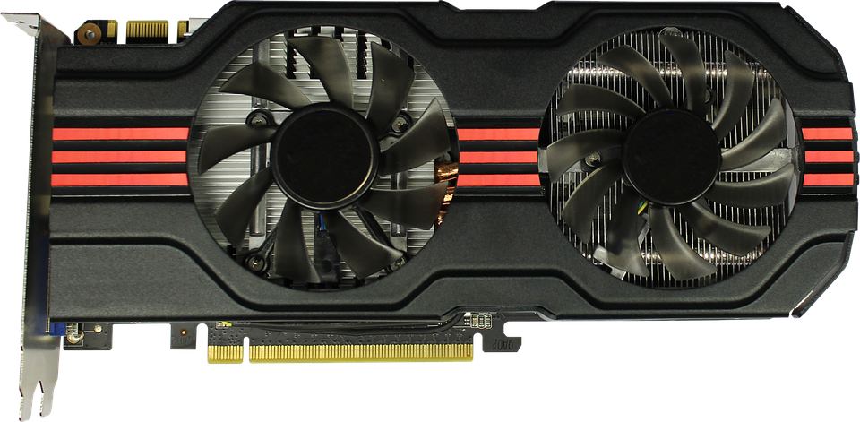


Problem Statement
Parallel Hardware
is Ubiqutous
Automatic Parallelization
is Limited
statement₁₁
statement₁₁
statement₁₁
statement₁₂
statement₁₂
...
statement₁₂
...
...
...
statement_{1n}
statement_{1n}
statement_{1n}
Software
is Sequential
Manual Parallelization
is Hard
statement₁
statement₂
...
statement_{n}

Slide 4
Problem Statement
Parallel Hardware
is Ubiqutous
Automatic Parallelization
is Limited
The assistant solution we propose alleviates
the process of manual parallelization
statement₁₁
statement₁₁
statement₁₁
statement₁₂
statement₁₂
...
statement₁₂
...
...
...
statement_{1n}
statement_{1n}
statement_{1n}
Manual Parallelization
is Hard
Software
is Sequential
statement₁
statement₂
...
statement_{n}

Slide 5
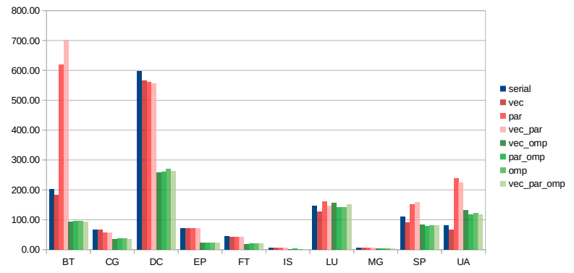


Problem Statement
NAS Parallel Benchmarks (NPB)
Speedup (Gmean)
OpenMP/Serial: 1.73x
Vector/Serial: 1.10x
Parallel/Serial: 0.79x

Slide 6

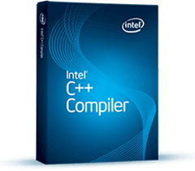
Programmer still plays the major role in the hard task of software parallelization
Problem Statement
NAS Parallel Benchmarks (NPB)

Slide 7
Manual Parallelization: Where Should I Start?
Source Code
L₀:
for (int i=0; … ) {
...
}
L₁:
for (int j=0; j<n;… ) {
...
}
...
L_{n}:
for (int m=0;… ) {
for (int k=m; k<n;… ) {
...
}
}

Slide 8
Manual Parallelization: Where Should I Start?
Source Code
L₀:
for (int i=0; … ) {
...
}
Where Should I Start?
L₁:
for (int j=0; j<n;… ) {
...
}
...
L_{n}:
for (int m=0;… ) {
for (int k=m; k<n;… ) {
...
}
}

Slide 9
Manual Parallelization: Where Should I Start?
Source Code
Program Loop Rankings
L₀:
for (int i=0; … ) {
...
}
Source Order
L₀, L₁, … , L_{n}
L₁:
for (int j=0; j<n;… ) {
...
}
...
L_{n}:
for (int m=0;… ) {
for (int k=m; k<n;… ) {
...
}
}

Slide 10
Manual Parallelization: Where Should I Start?
Source Code
Program Loop Rankings
L₀:
for (int i=0; … ) {
...
}
Source Order
L₀, L₁, … , L_{n}
L₁:
for (int j=0; j<n;… ) {
...
}
...
L_{n}:
for (int m=0;… ) {
for (int k=m; k<n;… ) {
...
}
}

Slide 11
Manual Parallelization: Where Should I Start?
Source Code
Program Loop Rankings
L₀:
for (int i=0; … ) {
...
}
Source Order
L₀, L₁, … , L_{n}
L₁:
for (int j=0; j<n;… ) {
...
}
Traditional Empirical and
Experimental Method
Profile Order
L₁₇, L₁₂, … , L₁
...
L_{n}:
for (int m=0;… ) {
for (int k=m; k<n;… ) {
...
}
}

Slide 12
Manual Parallelization: Where Should I Start?
Source Code
Program Loop Rankings
L₀:
for (int i=0; … ) {
...
}
Source Order
L₀, L₁, … , L_{n}
L₁:
for (int j=0; j<n;… ) {
...
}
Traditional Empirical and
Experimental Method
Profile Order
L₁₇, L₁₂, … , L₁
...
L_{n}:
for (int m=0;… ) {
for (int k=m; k<n;… ) {
...
}
}

Slide 13
Manual Parallelization: Where Should I Start?
Source Code
Program Loop Rankings
L₀:
for (int i=0; … ) {
...
}
Source Order
L₀, L₁, … , L_{n}
L₁:
for (int j=0; j<n;… ) {
...
}
Traditional Empirical and
Experimental Method
Profile Order
L₁₇, L₁₂, … , L₁
...
Profitability* Order
L₁₂, L₇, … , L₃
L_{n}:
for (int m=0;… ) {
for (int k=m; k<n;… ) {
...
}
}
AI-inspired Method
*

Slide 14
Manual Parallelization: Where Should I Start?
Source Code
Program Loop Rankings
L₀:
for (int i=0; … ) {
...
}
Source Order
L₀, L₁, … , L_{n}
L₁:
for (int j=0; j<n;… ) {
...
}
Traditional Empirical and
Experimental Method
Profile Order
L₁₇, L₁₂, … , L₁
...
Profitability* Order
L₁₂, L₇, … , L₃
L_{n}:
for (int m=0;… ) {
for (int k=m; k<n;… ) {
...
}
}
AI-inspired Method
*

Slide 15
Manual Parallelization: Where Should I Start?
Source Code
Program Loop Rankings
L₀:
for (int i=0; … ) {
...
}
Final Programmer
Decision
Source Order
L₀, L₁, … , L_{n}
L₁:
for (int j=0; j<n;… ) {
...
}
Traditional Empirical and
Experimental Method
Profile Order
L₁₇, L₁₂, … , L₁
...
Profitability* Order
L₁₂, L₇, … , L₃
L_{n}:
for (int m=0;… ) {
for (int k=m; k<n;… ) {
...
}
}
AI-inspired Method
*

Slide 16


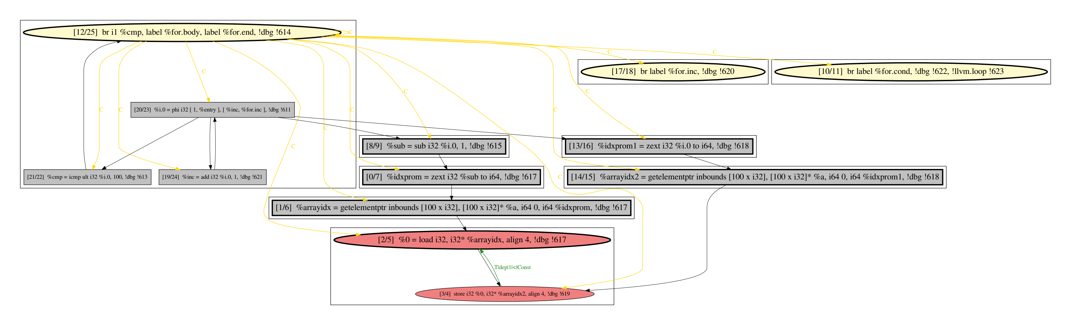
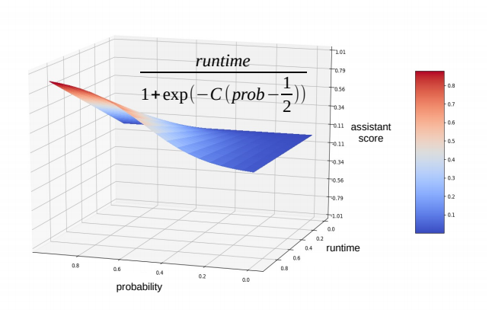
Proposed Solution:
Software Parallelization Assistant
AI-SEPS 2019 workshop
Tool
Methodology
&

Slide 17
Assistant Training

Slide 18
Assistant Training
SNU NPB
1415 loops

Slide 19
Assistant Training
Training Data Set
Parallelizable loops
for (int i=...) { … }
[ f₁,f₂,…,f_{n} ]
SNU NPB
…
for (int j=...) { … }
[ f₁,f₂,…,f_{n} ]
995 loops *
Non-parallelizable loops
while (true) { … }
[ f₁,f₂,…,f_{n} ]
…
1415 loops
for (int k=...) { … }
[ f₁,f₂,…,f_{n} ]
420 loops
* Intel Compiler succeeds in parallelizing 812 loops

Slide 20
Assistant Training
Training Data Set
Parallelizable loops
for (int i=...) { … }
[ f₁,f₂,…,f_{n} ]
SNU NPB
…
ML Based
Loop Parallelizability Model
for (int j=...) { … }
[ f₁,f₂,…,f_{n} ]
995 loops *
Non-parallelizable loops
while (true) { … }
[ f₁,f₂,…,f_{n} ]
…
1415 loops
for (int k=...) { … }
[ f₁,f₂,…,f_{n} ]
420 loops
* Intel Compiler succeeds in parallelizing 812 loops

Slide 21
Assistant Training
Training Data Set
Parallelizable loops
for (int i=...) { … }
[ f₁,f₂,…,f_{n} ]
SNU NPB
…
ML Based
Loop Parallelizability Model
for (int j=...) { … }
[ f₁,f₂,…,f_{n} ]
995 loops *
Loop Parallelizability Probability
Non-parallelizable loops
while (true) { … }
[ f₁,f₂,…,f_{n} ]
…
1415 loops
for (int k=...) { … }
[ f₁,f₂,…,f_{n} ]
420 loops
* Intel Compiler succeeds in parallelizing 812 loops

Slide 22
Loop Features
Loop Iterator
Loop Iterator
Loop Critical Payload
Loop features are based on static structural properties of loop program depencence graphs (PDGs):
  Absolute size
  Loop Iterator/Payload cohesion
  Number of dependence edges
  Instruction types (calls, loads/stores, etc.)
  etc.

Slide 23
Loop Ranking Score
ML Based
Loop Parallelizability Model

Slide 24
Loop Ranking Score
ML Based
Loop Parallelizability Model
Not Aware of Loop
Running Time

Slide 25
Loop Ranking Score
Profiler
ML Based
Loop Parallelizability Model
Not Aware of Loop
Running Time

Slide 26
Loop Ranking Score
Profiler
Not Aware of Loop
Parallelizability
ML Based
Loop Parallelizability Model
Not Aware of Loop
Running Time

Slide 27
Loop Ranking Score
Profiler
Not Aware of Loop
Parallelizability
ML Based
Loop Parallelizability Model
Predicted Probability
of Parallelization
Not Aware of Loop
Running Time

Slide 28
Loop Ranking Score
Profiler
Potential Contribution
to Speedup
Not Aware of Loop
Parallelizability
ML Based
Loop Parallelizability Model
Predicted Probability
of Parallelization
Not Aware of Loop
Running Time

Slide 29
Loop Ranking Score
Profiler
Potential Contribution
to Speedup
*
Not Aware of Loop
Parallelizability
ML Based
Loop Parallelizability Model
Predicted Probability
of Parallelization
Not Aware of Loop
Running Time
*

Slide 30
Loop Ranking Score
Profiler
Potential Contribution
to Speedup
Aware of Loop
Parallelizability
*
Not Aware of Loop
Parallelizability
ML Based
Loop Parallelizability Model
Aware of Loop
Running Time
Predicted Probability
of Parallelization
Not Aware of Loop
Running Time
*

Slide 31
Loop Ranking Score
Profiler
Potential Contribution
to Speedup
Aware of Loop
Parallelizability
*
Not Aware of Loop
Parallelizability
Improved Loop
Ranking
ML Based
Loop Parallelizability Model
Aware of Loop
Running Time
Predicted Probability
of Parallelization
Not Aware of Loop
Running Time
*

Slide 32
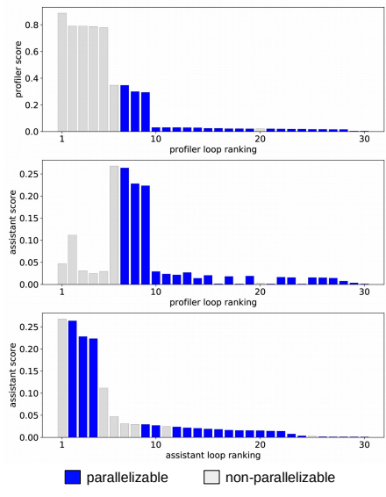
Loop Rankings: Profiler vs. Assistant

Slide 33
Loop Rankings: Profiler vs. Assistant
Profiler Loop
Ranking

Slide 34
Loop Rankings: Profiler vs. Assistant
Profiler Loop
Ranking
Transformation

Slide 35
Loop Rankings: Profiler vs. Assistant
Profiler Loop
Ranking
Transformation
Improved Loop
Ranking

Slide 36
Results
AI-SEPS 2019 workshop
Predictive performance of our ML based loop parallelizability model
Deployment of our assistant on SNU NPB benchmarks

Slide 37
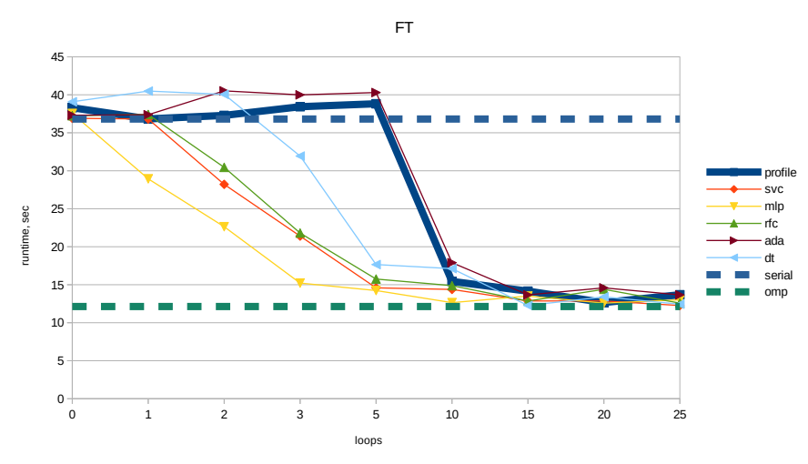
How well do we do?

Slide 38
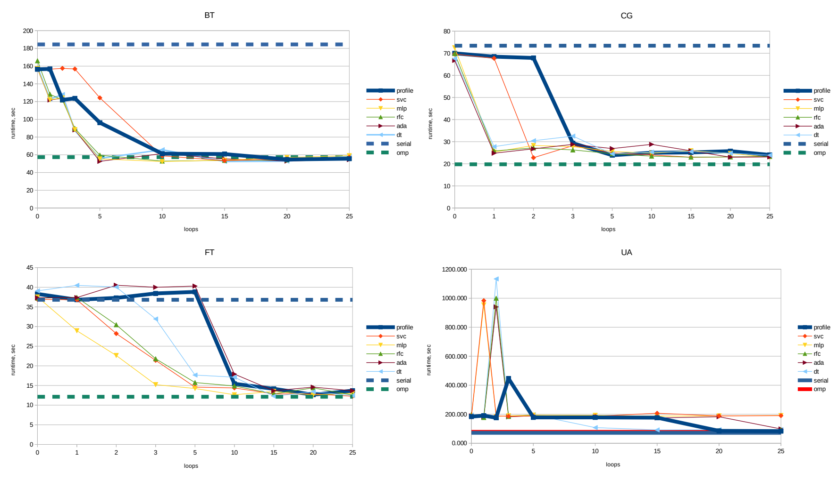
How well do we do?

Slide 39
How well do we do?
8 benchmarks in total: 4 wins / 4 draws

Slide 40
How well do we do?
20% Lines Of Code (LOCs) reduction
Might result into significant cost savings given a high human expert price

Slide 41
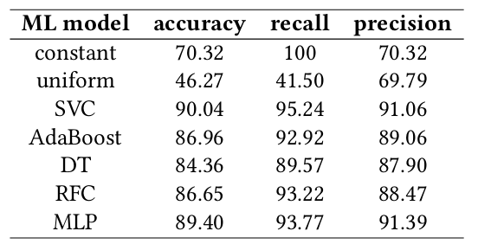
ML Model Predictive Performance
Reference
Around 90% predictive accuracy

Slide 42
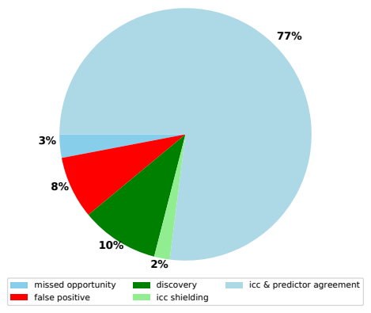
ML Model Predictive Performance
ML Based
Loop Parallelizability Model
Agreement rate of 80%
Discovery rate of 10%
False positive rate of 8%
is not critical

Slide 43
Summary & Conclusions
Human experts still play the major role in the task of software parallelization
Loop parallelizability is learnable property (we introduce a ML model and train it to work with the accuracy of above 90%)
ML model of loop parallelizability has been integrated into parallelization assistant
Deployed against SNU NPB benchmarks our assistant showed a faster parallelization process: 20% Lines Of Code (LOC) reduction

Slide 44
Thank you!
AI-SEPS 2019 workshop

Slide 45
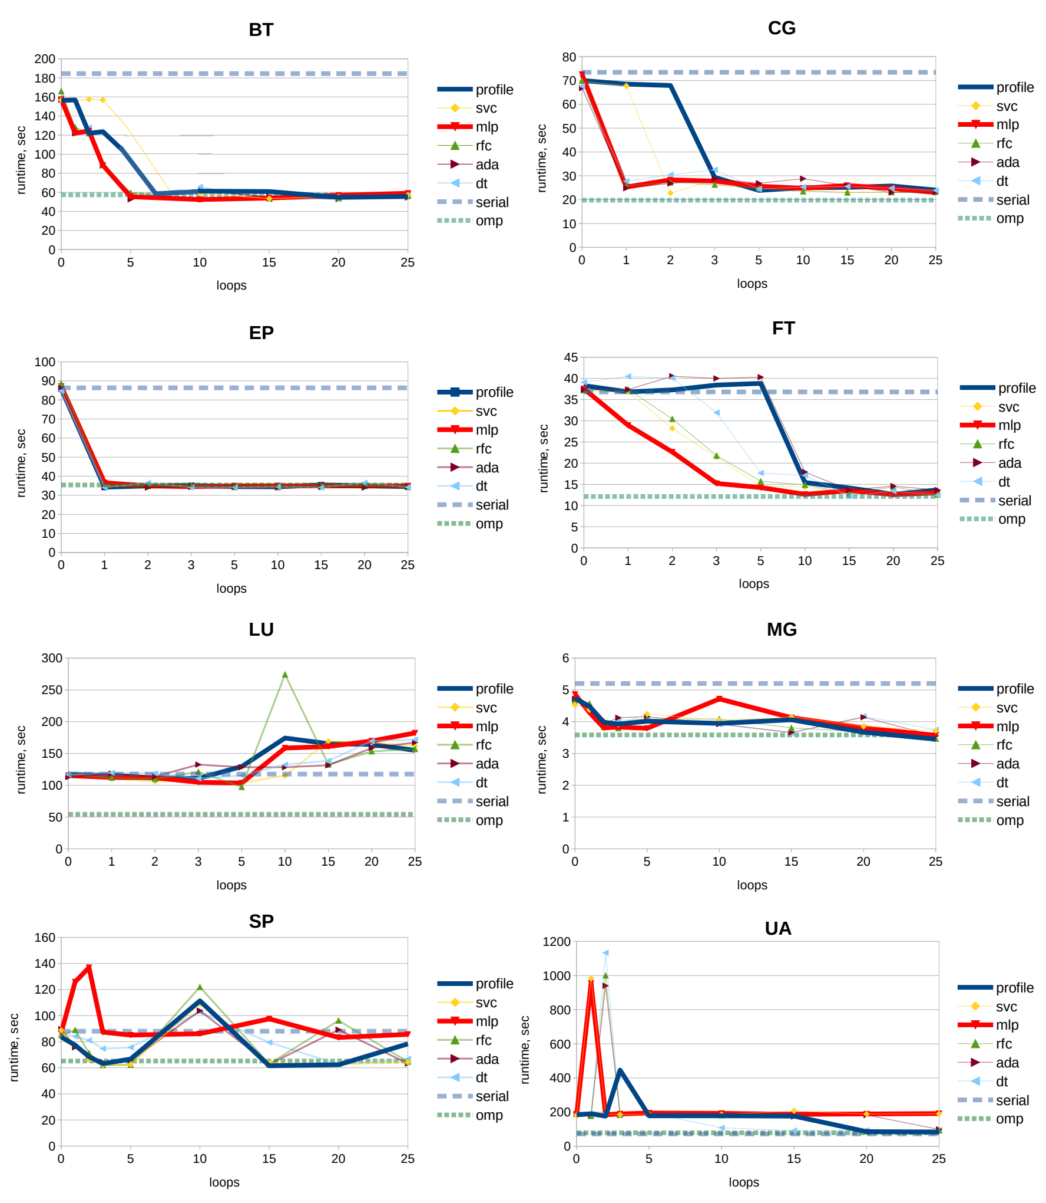
How well do we do?

Slide 46
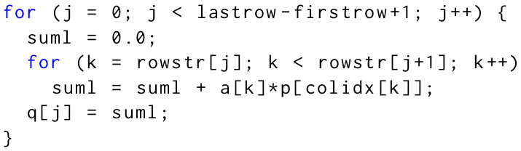
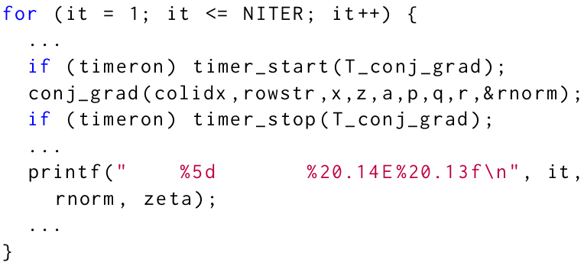
Motivating example
SNU NPB
Conjugate Gradient (CG)
benchmark
Profiler’s Loop Ranking
Assistant’s Loop Ranking
Assistant’s Parallel Loop
Probability
1
cg.c:326
vs.
1
cg.c:509
[ 85% ]
2
cg.c:484
2
cg.c:326
[ 29% ]
3
cg.c:509
3
cg.c:484
[ 8% ]
Profiler
Program Loop Ranking
...
cg.c:509
1
2
3
n
C/C++
program
ML Based
Loop Parallelizability Model
1
2
3
...
n
cg.c:326

Slide 47
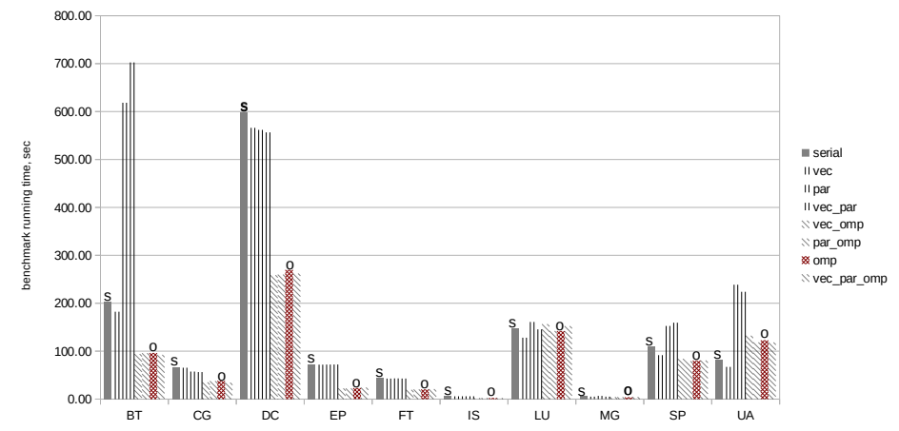
Problem Statement 2/2
NAS Parallel Benchmarks (NPB)

Slide 48
Programmer still plays the major role in the task of software parallelization
Problem Statement 2/2
NAS Parallel Benchmarks (NPB)

Slide 49
How to use the assistant
(from the programmers perspective)
Profiler
Ordered by the running time
...
1
2
3
n
Traditional Empirical and
Experimental Method
Final Programmer
Decision
C/C++
program
Program Loop Rankings
ML Based
Loop Parallelizability Model
Ordered by the assistant’s score
1
2
3
...
n
AI-inspired Method

Slide 50
Solution Scheme [1/2]
SNU NPB
Training Data Set
Loop Labels
Parallelizable loops
ML Based
Loop Parallelizability Model
for (int i=...) { … }
[ f₁,f₂,…,f_{n} ]
…
for (int j=...) { … }
[ f₁,f₂,…,f_{n} ]
995 loops *
1415 loops
Loop Features
Non-parallelizable loops
while (true) { … }
[ f₁,f₂,…,f_{n} ]
…
for (int k=...) { … }
[ f₁,f₂,…,f_{n} ]
420 loops
* Intel Compiler succeeds in parallelizing 812 loops
Loop features are based on static structural properties of loop program depencence graphs (PDGs):
Absolute size
Loop Iterator/Payload cohesion
Number of dependence edges
Instruction types (calls, loads/stores, etc.)
Loop labels are derived out of OpenMP pragmas present in parallelized SNU NPB versions as well as from the Intel Compiler’s parallelization/vectorization reports.

Slide 51
How well do we do?
No change in
4 other benchmarks
Improvement in
4 benchmarks

