Slide 1
Learning loop parallelisability property
(Towards machine learning based compilation)
90%

Slide 2
Loops challenging ICC
Loops with cross-iteration dependencies
Loops with a statically unknown number of iterations
Loops with unidentified control variable
Loops with function calls inside the body
Loops with multiple exits (break, return statements, etc.)

Slide 3
Compiler conservativeness vs programmer-specific knowledge

Slide 4
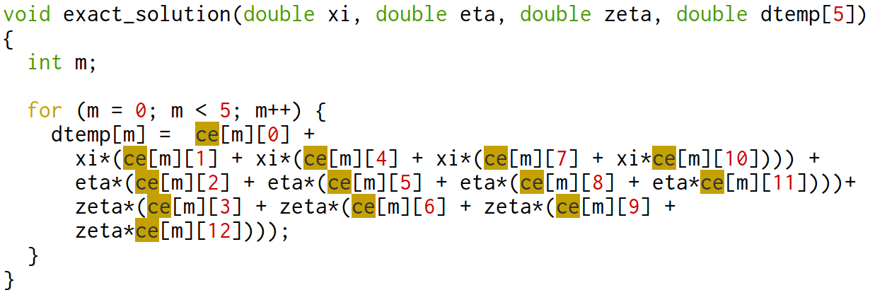
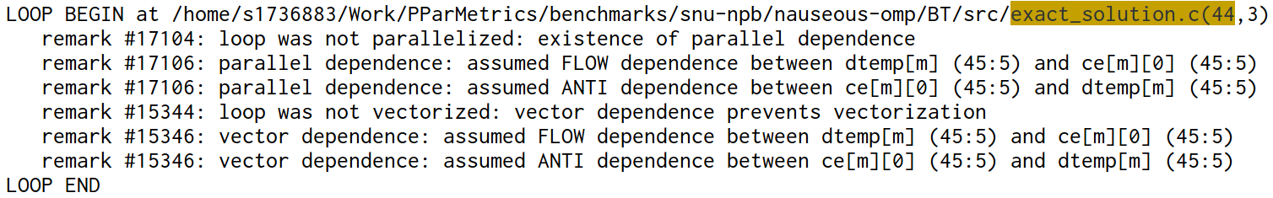

Slide 5
Getting parallel classification labels for a
Machine Learning
Unclear undestanding what is parallel and what is not
Complexity of compiler loop optimizations (not

Slide 6
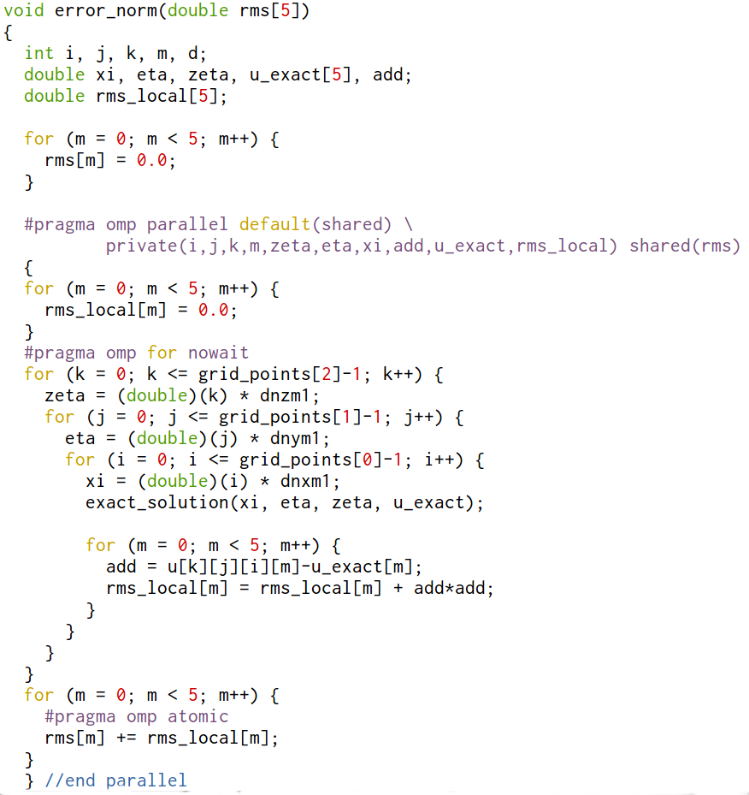
Loop classification problem [1]: what is parallel and what is not?
How to label these loops for a ML-based tool?
OpenMP semantics is supposed to replicate rmh_local[] and ensure atomic mutually exclusive access to a shared rhs[]
OpenMP puts in an additional semantics, without which there is a memory dependence
No dependence in OpenMP version, but memory cross-iteration dependence in the sequential version
Need to provide memory in rhs_local[] for every parallel thread, before we parallelise it. Compiler does not do it automatically, without programmer’s instruction
Function calls scare conservative compiler. Should we classify the code as it is or only after assumed inlining is done?

Slide 7
Loop classification problem [1]: what is parallel and what is not?

Slide 8
OpenMP pragma [2]:
(k,j,i) 3 loop nest accumulates the total error (difference between solution u and exact solution
Every iteration (k,j,i) we use rms_local[] memory to compute one portion of reduction
No dependence in OpenMP version, but memory cross-iteration dependence in the sequential version
Need to provide memory in rhs_local[] for every parallel thread, before we parallelise it. Compiler does not do it automatically, without programmer’s instruction
Function calls scare conservative compiler. Should we classify the code as it is or only after assumed inlining is done?

Slide 9
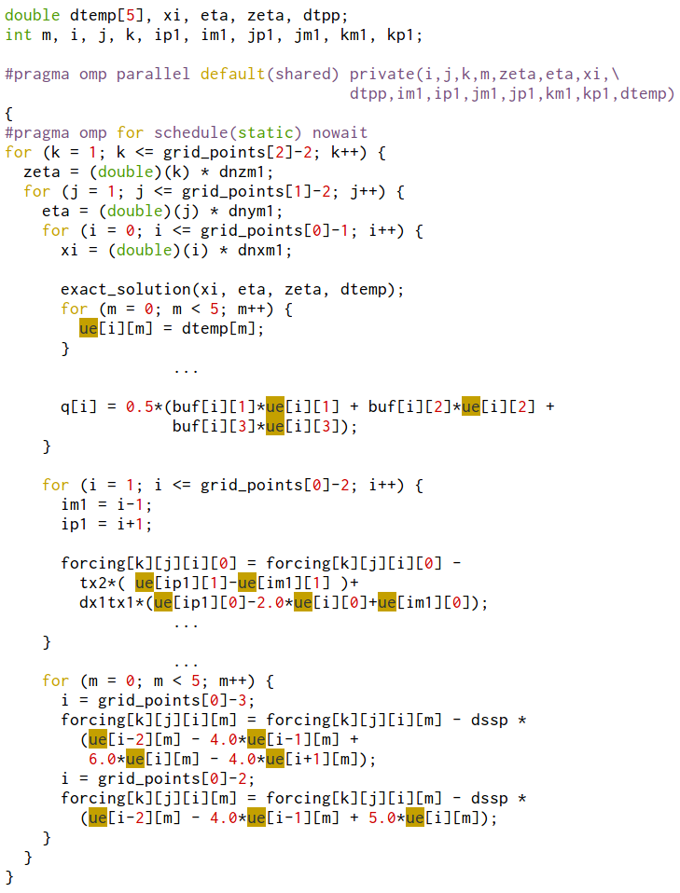
OpenMP pragma [1]: BT, SP, LU benchmarks
ue[PROBLEM_SIZE+1][5] is a global 2D array, which contains different values as a function of 2 loop nest iteration (k,j)
Programmer does not replicate ue’s memory per every thread, but seemingly relies on the non-overlapping timing of loop iterations
Intel Compiler correctly detects all dependencies and refuses to parallelise this code
True
Anti

