Slide 1
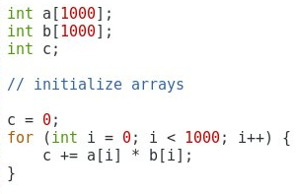
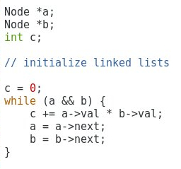

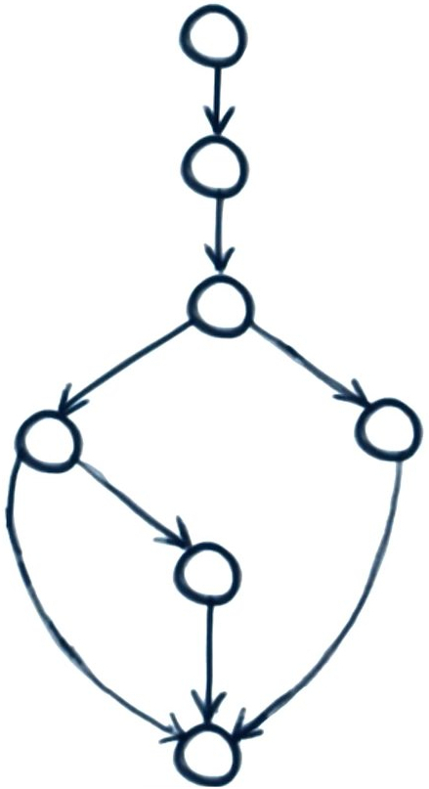




Software metrics for parallelism
MSc by Research project
Student: Aleksandr Maramzin Primary supervisor: Björn Franke Secondary supervisor: Mike O’Boyle
Code parallelisability metrics
Software quality metrics
Good
Score
Bad
Score
The Cyclomatic Complexity (CC) of a section of a code is the number of linearly independent paths through it
LLVM

