Slide 1


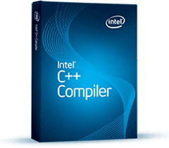


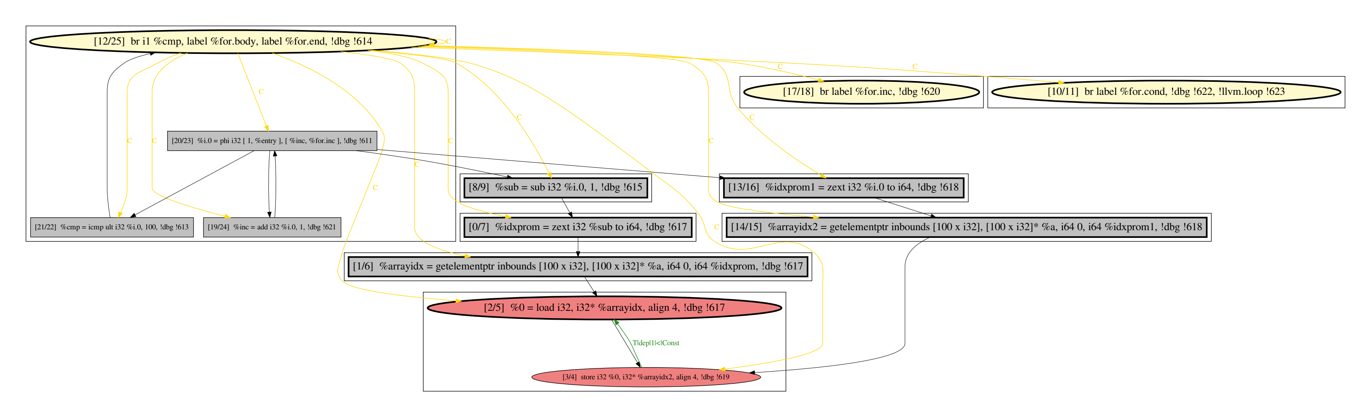


Machine Learning Assisted Parallelism Discovery
(Learning to Predict Loop Parallelisability Property)
ML Training Labels
NAS Parallel Benchmarks
ML Model Training
Intel C/C++ Compiler
Parallel Loop Prediction
ML Features
Program Dependence Graph (PDG)
Achieved 94% (baseline 60%) prediction accuracy
Increased NAS Parallel Benchmarks available parallelism utilisation from 86% to 99%
LLVM

