Slide 1


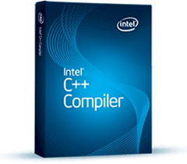

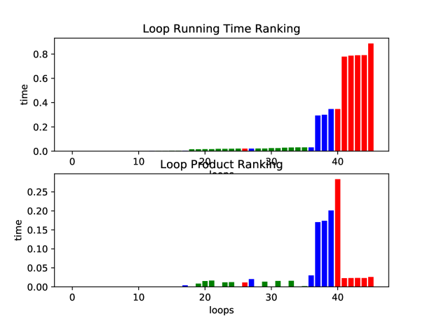
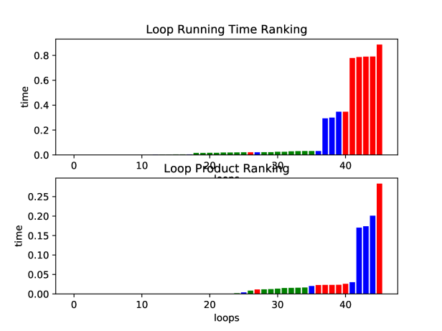

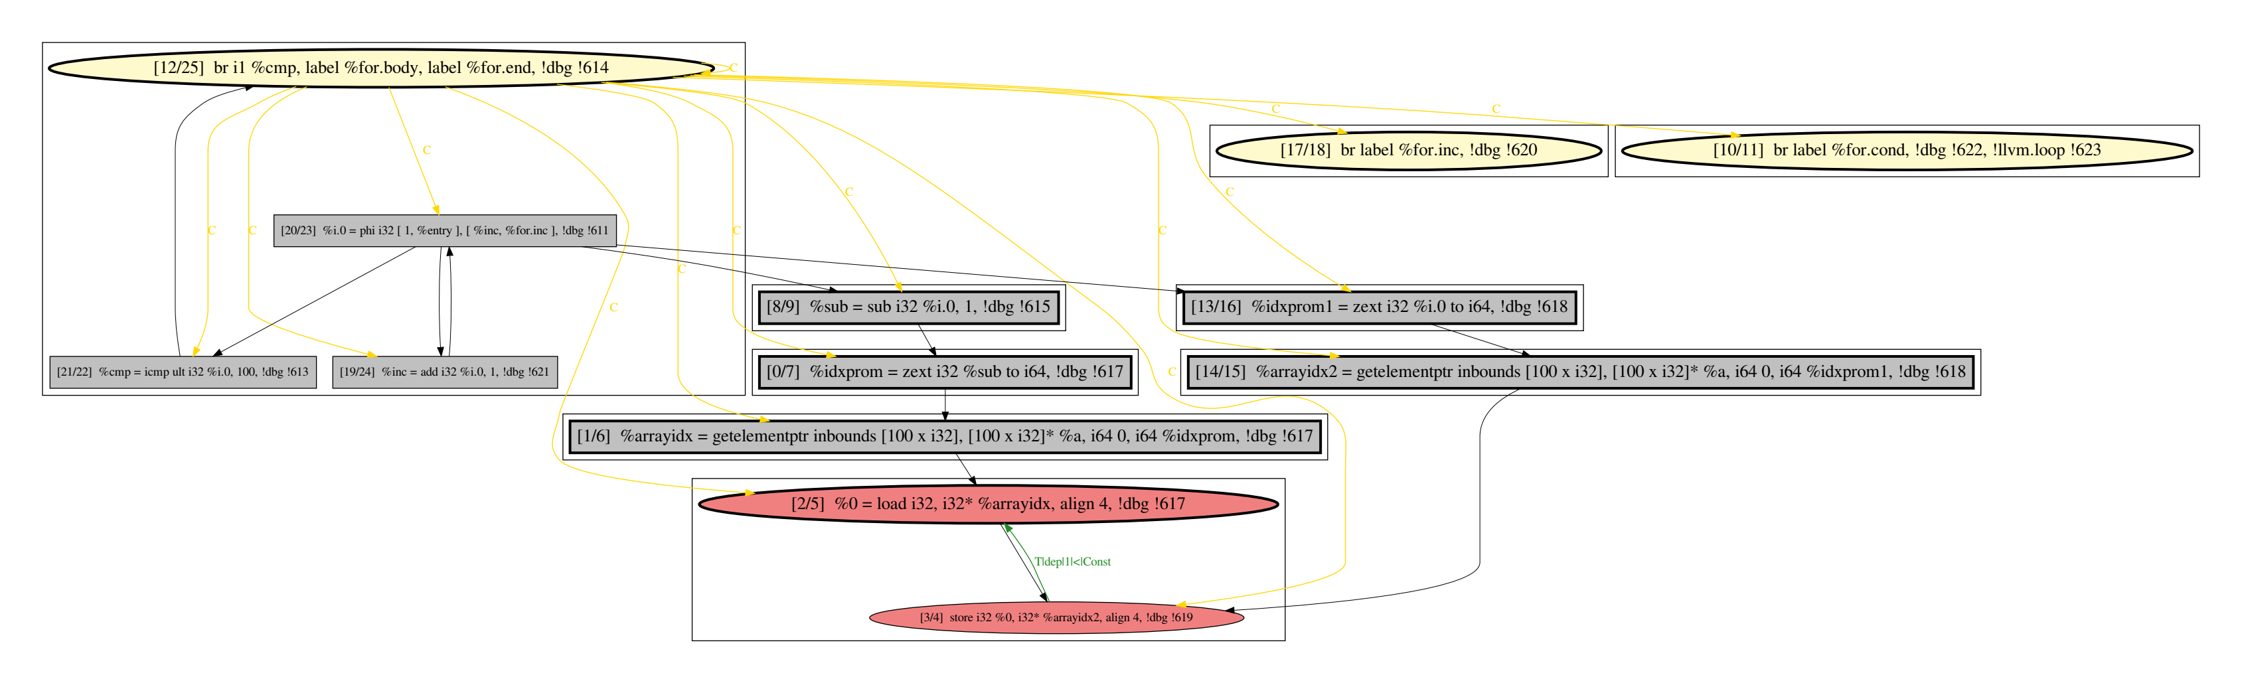


“Smart” Software Manual Parallelisation Assistant
(Learning to Predict Loop Parallelisability Property)
ML Training Labels
NAS Parallel Benchmarks
Intel C/C++ Compiler
ML Model Training
Manual Parallelisation Guidance
ML Features
Program Dependence Graph (PDG)
LLVM

