Slide 1




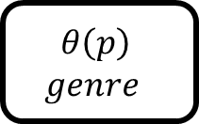
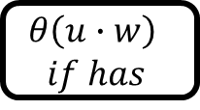
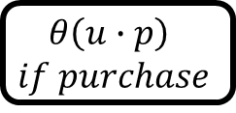
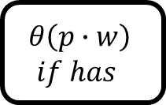
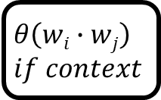
$$θ\left(wi∙wj\right)$$
$$if context$$
$$θ\left(u∙w\right)$$
$$if has$$
$$θ\left(p∙w\right)$$
$$if has$$
$$θ\left(u∙p\right)$$
$$if purchase$$
$$θ\left(p\right)$$
$$genre$$

Slide 2



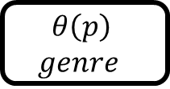
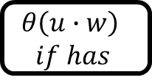



Word Embedding
$$θ\left(wi∙wj\right)$$
$$if context$$
DOC
S₁: w₁, w₂, …, w_{n}
S_{k}: w₁, w₂, …, w_{n}
Embedding
User Embedding
$$θ\left(u∙w\right)$$
$$if has$$
Sentence
Encoder
$$θ\left(p∙w\right)$$
$$if has$$
+
$$θ\left(u∙p\right)$$
$$if purchase$$
Doc
Encoder
+
Product Embedding
$$θ\left(p\right)$$
$$genre$$
Predictor

