Slide 1
Robust Text Classification in the Presence of Confounding Bias
Virgile Landeiro & Aron Culotta
Illinois Institute of Technology
Chicago
Notes:
Nowadays, computational social science is using text classification in ways that didn’t exist before.
New issues have risen such as small labeled datasets or a target distribution that is changing over time and these issues can introduce confounding bias.
So I am going to walk you through our research to build a text classifier robust to confounding variables.

Slide 2
Introduction
Development of text classification over more than 50 years¹
Mostly centered around categorization of documents into topics
New areas of research (computational science):
Public health surveillance
Political science
Marketing
etc
But algorithms stay the same: standard supervised classification algorithms
To ensure validity of study ➔ need classifiers robust to confounding variables
1 - Maron, M. E. 1961. Automatic indexing: an experimental inquiry. Journal of the ACM (JACM) 8(3):404–417.
Notes:
Text classification is a well known topic and algorithms have been developed to solve this task for more than fifty years.
One of the first paper published was in 1961 by Maron and since then, most of the text classification work has been centered around categorization of documents into topics.
With the increase of user-generated data, new fields have appeared such as computational social science or computational epidemiology.
These new fields created new areas of research such as:
- public health surveillance (influenza rate surveillance using Twitter)
- political science (predict gender and political affiliation of Swedish politicians from their speeches)
- marketing (discover consumer insight from twitter using sentiment analysis)
This is different than classifying documents.
The objects to be classified are often people and their online writings, and the predicted labels may be health status, or political affiliation
However the methods used for these computational social science studies are the same than the ones used in documents classification.
To ensure…

Slide 3
50 top features for Logistic Regression
nyc | angeles | ny | york | california
los | la | brooklyn | snow | disneyland
jersey | city | san | ca | hollywood
monica | santa | nj | manhattan | losangeles
earthquake | team | dodgers | hills | cute
heart | vegas | chill | state | happiness
makeup | pacific | cali | father | brother
also | guess | socal | field | job
cant | venice | tacos | boo | wonderful
laugh | train | single | wanna | brothers
Female (resp. Male) and New York (resp. Los Angeles) are highly correlated.
Notes:
Let’s see a quick example of how there can be an issue due to a confounding variable.
Here, we ran an experiment where we try to predict the location of a Twitter user (NY or LA) based on his/her tweets.
But in this case, the dataset is such that the LA class is highly correlated with male and the NY class is highly correlated with female. Such a situation can happen because training dataset are typically small and this would happen without us knowing it.
We printed the top 50 features of a LR classifier without the signs and we can see that 4 gender-related features made it in the top 50 amongst location-related features.
This is going to be a problem as the classifier is clearly affected by the user’s gender.

Slide 4
50 top features for Logistic Regression
nyc | angeles | ny | york | california
los | la | brooklyn | snow | disneyland
jersey | city | san | ca | hollywood
monica | santa | nj | manhattan | losangeles
earthquake | team | dodgers | hills | cute
heart | vegas | chill | state | happiness
makeup | pacific | cali | father | brother
also | guess | socal | field | job
cant | venice | tacos | boo | wonderful
laugh | train | single | wanna | brothers
Male (resp. Female) and New York (resp. Los Angeles) are highly correlated.
Notes:
Let’s see a quick example of how there can be an issue due to a confounding variable.
Here, we ran an experiment where we try to predict the location of a Twitter user (NY or LA) based on his/her tweets.
But in this case, the dataset is such that the LA class is highly correlated with male and the NY class is highly correlated with female. Such a situation can happen because training dataset are typically small and this would happen without us knowing it.
We printed the top 50 features of a LR classifier without the signs and we can see that 4 gender-related features made it in the top 50 amongst location-related features.
This is going to be a problem as the classifier is clearly affected by the user’s gender.

Slide 5
What is a confounding Variable?
Z
X
Y
Graphical model: a confounding variable Z correlated with both X and Y.
Prediction vs. causal inference.
Assume same impact in training and testing sets.
Small training datasets;
Confounder shifts over time.
Notes:
A confounding variable (𝑍) is correlated both with the input (𝑋) and the output (𝑌) variables.
From the graphical model, we can see that when Z is observed, there is no association between X and Y as Z is blocking the path between X and Y. However, when Z is not observed, then there can be a false correlation between X and Y.
Even though controlling for confounding variables is central in empirical social science, it is often ignored in text classification.
In text classification, the primary goal is not causal inference as in social science but prediction.
Therefore, the assumption is made that the confounder’s influence is the same in the training and testing sets. Under this assumption, the prediction accuracy should be only slightly affected by the confounding bias.
But this assumption often does not hold and there are two reasons why:
First, the training sets are typically small due to the cost of annotation
Second, and most importantly, the relation between the confounding variable and the target variable is likely to change over time leading to poor accuracy. This is especially witnessed in social media, where languages can change quickly
Studies based on the output of text classifiers are at risk of reaching false conclusions if these classifiers do not adjust for confounding variables.

Slide 6
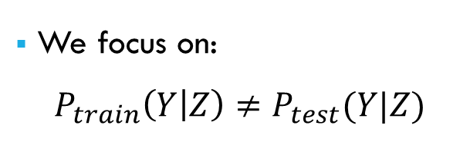
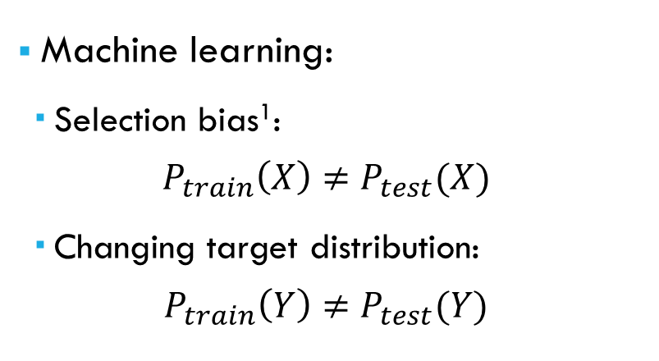
Related Work
Social science:
Matching
Stratification
J. Pearl developed the back-door adjustment
Machine learning:
Selection bias¹: $P_{train}\left(X\right)≠P_{test}(X)$
Changing target distribution: $P_{train}\left(Y\right)≠P_{test}(Y)$
We focus on: $P_{train}\left(Y | Z\right)≠P_{test}(Y|Z)$
1 - Bareinboim, Elias and Judea Pearl. “Controlling Selection Bias in Causal Inference.” AAAI(2011).
Notes:
Methods have been developed to control for confounding variables:
Matching: construct pair-wise classification by pairing an instance with a given label y and a given confounder value z to another instance with the same label but a different confounder value.
Stratification: create group of instances where the confounder does not vary and evaluate the outcome within each group of the confounder.
Features removal: remove features that introduce bias
Back-door adjustment by Pearl will be explained later
Solutions have been designed to solve:
- Selection bias problem
- Changing target distribution problem
We focus on the problem where the relation between the confounder Z and the target Y varies and to the best of our knowledge, we don’t know of any work that has been focusing on this problem in text classification.

Slide 7
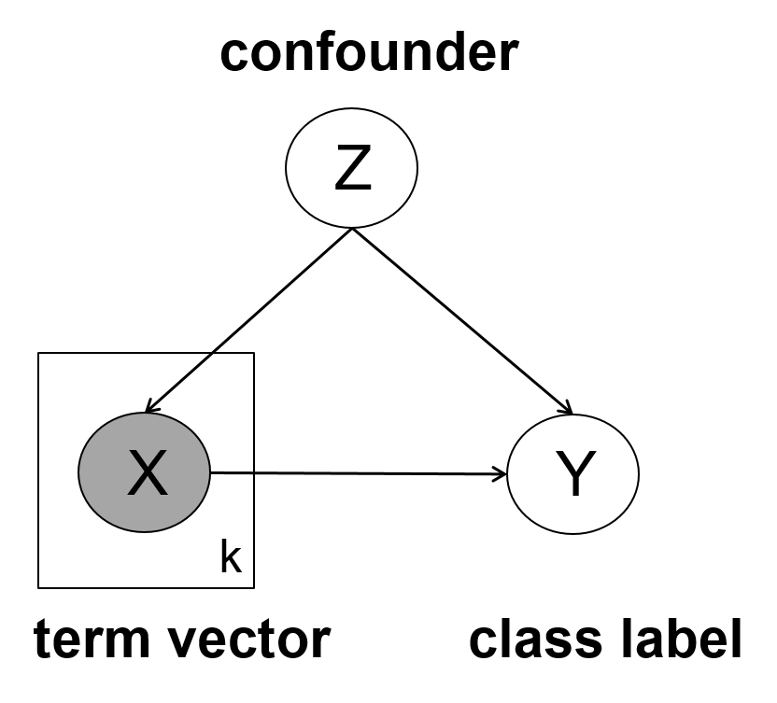
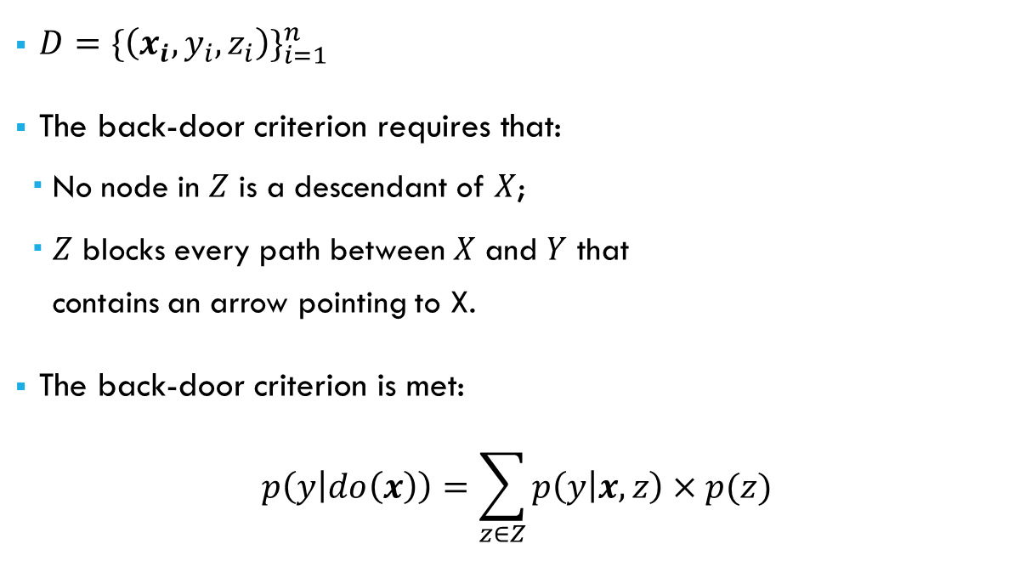
Back-door adjustment for Text Classification
$D={\{\left(x_{i}, y_{i},z_{i}\right)\}}_{i=1}^{n}$
The back-door criterion requires that:
No node in $Z$ is a descendant of $X$;
$Z$ blocks every path between $X$ and $Y$ that contains an arrow pointing to X.
The back-door criterion is met: $p\left(y | do\left(x\right)\right)=\sum_{z∈Z}{p\left(y | x,z\right)×p(z)}$
Notes:
We assume a dataset D of n instances where $x_{i}$ is a vector of terms, $y_{i}$ is the class label and $z_{i}$ is the confounder value.
Objective is to predict the label $y_{j}$ for some new instance $x_{j}$, while controlling for an unobserved confounder $z_{j}$.
We assume the confounder is observed at training time but not at testing time.
Figure:
When we omit the confounding variable Z, then we are back to a standard approach to text classification where we model P(Y|X).
We assume that the confounder influences both the term vector and the target label
In our previous example, we were trying to label the position of a Twitter user given his/her tweets. And the confounder variable was the user’s gender.
The back-door criterion is a graphical test that determines whether Z is a sufficient set of variables to estimate the causal effect:
No node…
Z blocks every path…
Our model meets the back-door criterion in theory even though this can be broken in the real world.
Back-door adjustment is typically used as a method of identifying the causal effect of X on Y, we are not attempting any causal interpretation.
We use it as a framework for making a prediction for Y given X while controlling for Z.
This is the back-door adjustment equation to compute the effect on y of setting x to a certain value (hence the notation do to differentiate of just observing x).

Slide 8
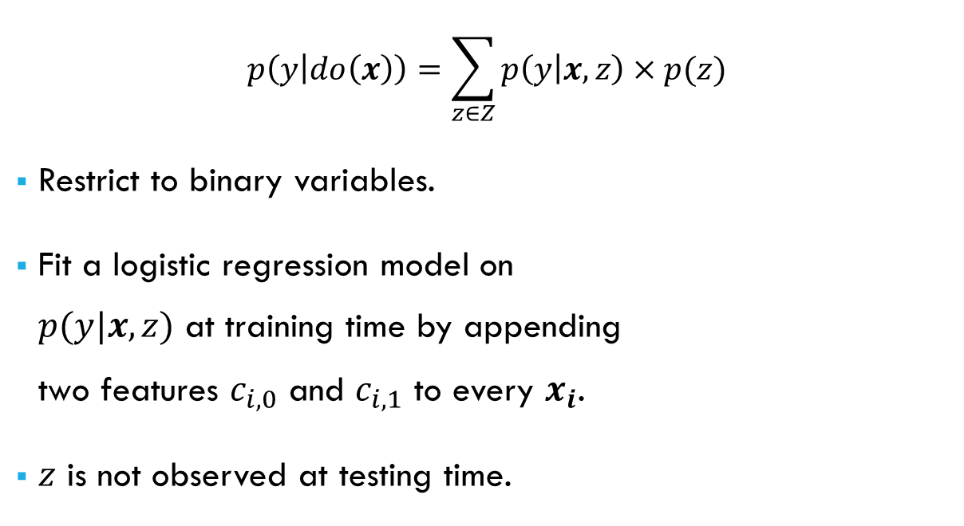

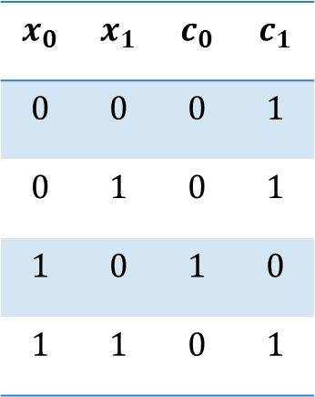
Back-door adjustment for Text Classification
$$p\left(y | do\left(x\right)\right)=\sum_{z∈Z}{p\left(y | x,z\right)×p(z)}$$
Restrict to binary variables.
Fit a logistic regression model on $p(y|x,z)$ at training time by appending two features $c_{i,0}$ and $c_{i,1}$ to every $x_{i}$.
$z$ is not observed at testing time.
Features matrix
$$x_{0}$$ | $$x_{1}$$ | $$c_{0}$$ | $$c_{1}$$
$$0$$ | $$0$$ | $$0$$ | $$1$$
$$0$$ | $$1$$ | $$0$$ | $$1$$
$$1$$ | $$0$$ | $$1$$ | $$0$$
$$1$$ | $$1$$ | $$0$$ | $$1$$
$$z$$
$$1$$
$$1$$
$$0$$
$$1$$
Notes:
For simplicity, we assumed that x is a vector of binary features and that y and z are binary variables.
Compute p(z) at training time using maximum likelihood estimation, and we use this computation at testing time.
We fit a model on p(y|x,z) at training time by adding two features to every term vector: one for each value of the confounder.

Slide 9
Datasets
Dataset | Target variable | Confounder
Twitter | Location of a user: New York City or Los Angeles | Gender of the user: Male or Female
IMDb | Sentiment of the review: Positive or Negative | Genre of the film: Horror or Other
Canadian Parliament | Political affiliation: Liberal or Conservative | Political position: Government or Opposition
3 different datasets to experiment with back-door adjustment.
Notes:
Twitter:
Predict the location of a user from their messages, where gender is a potential confounder.
Collected 250K tweets from NYC and 220K tweets from LA
Filtered out bots, celebrities, and marketing accounts by removing users with fewer than 10 followers/followees, more than 1000 followers/followees, more than 5K posts.
We label users gender using the US census, removing ambiguous names.
For each users, we collect all the available tweets (up to 3200)
Finally, we subsample our dataset to keep 6,000 users such that gender and location are uniformly distributed over the users.
IMDb:
Predict the sentiment of a movie review confounded by movie genre using an existing dataset.
It contains 50K movie reviews from IMDb labeled as showing either positive or negative sentiment.
We create the confounder value as being 1 if the movie is a horror movie, 0 otherwise.
Canadian parliament:
Predict the political affiliation of a member of parliament base on the content of their speeches. The confounder is whether the speaker is from the government party or the opposition party.
We obtained data from previous researchs for the 36th and 39th parliament where the government parties are different.
For brevity, I will only be presenting the Twitter experiment and results but the other ones are available and detailed in the paper.

Slide 10

Injecting Confounding Bias
Introduce confounding bias according to the following constraints:
$P_{train}\left(Y\right)=P_{test}\left(Y\right)$
$P_{train}\left(Z\right)=P_{test}\left(Z\right)$
$P\left(Y=1 | Z=1\right)=b$
Notes:
Now we want to show that when the confounding bias is changing, our classifier keeps a high accuracy.
To do so, we built new datasets by subsampling the original dataset according to the following constraints.
We do not alter the distributions of the class label or the confounder
We introduce a given confounding bias
Note that to build these new datasets, we do not alter the label or confounder values. We only subsample the original dataset.

Slide 11
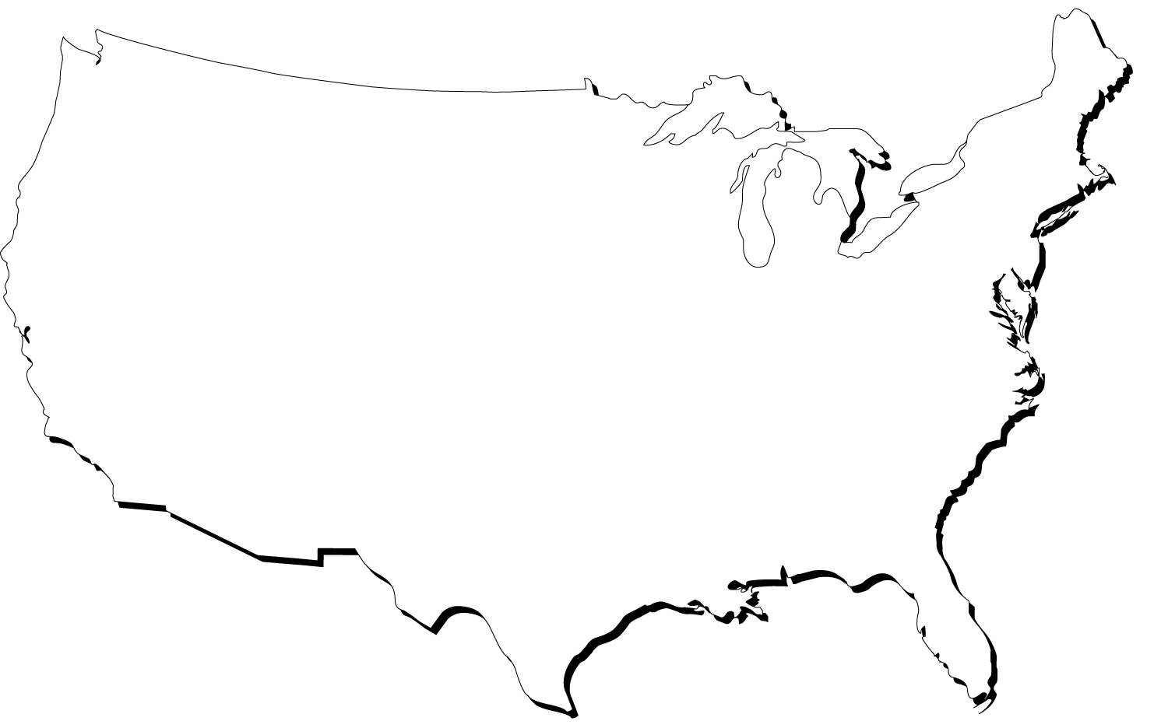

Injecting Confounding Bias
Original Dataset
$$P\left(Male\right)=0.504$$
$$P\left(NYC\right)=0.491$$
$P\left(NYC | Male\right)=0.489$

Slide 12

Injecting Confounding Bias
Biased Dataset
$$P\left(Male\right)=0.501$$
$$P\left(NYC\right)=0.5$$
$P\left(NYC | Male\right)=0.1$

Slide 13
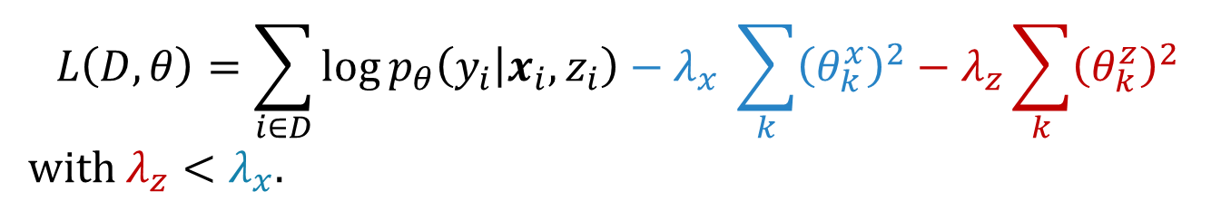
Baselines
Back-door Adjustment (BA and BAZ10)
$$L\left(D,θ\right)=\sum_{i∈D}{\log{p_{θ}\left(y_{i} | x_{i},z_{i}\right)−λ_{x}} \sum_{k}{{\left(θ_{k}^{x}\right)}^{2}}−λ_{z}\sum_{k}{{\left(θ_{k}^{z}\right)}^{2}}}$$
with $λ_{z}<λ_{x}$.
Logistic Regression (LR)
Subsampling (S)
Matching (M)
Sum Out (S)
Notes:
BA is the method we described before. BAZ10 is an improved method that leverages undertraining to improve accuracy. By setting the features encoding z to 10 instead of 1 in the features matrix, we increase the importance of these features and therefore we reduce the importance of other features and specifically features related to the confounder. It has the same effect as distinguishing between the coefficients for the term vector $θ^{x}$ (blue) and the coefficients for the confounder $θ^{z}$ (red) in the L2-regularized log-likelihood function where $λ_{x}$ and $λ_{z}$ control the regularization strength of the term coefficients and confounder coefficients. By setting $λ_{z}<λ_{x}$, we allow the coefficients $θ^{z}$ to play a larger role in classification than $θ^{x}$, thus lowering the effect of confounder-related features.
Our main baseline is LR which is the most commonly used technique in text classification today.
The other baselines are ideas from social science implemented to compare to our method.
Details:
Subsampling remove bias by selecting a subsample of the training dataset where P(Y, Z) is uniformly distributed. This approach can discard many instances when one of the pair y/z has a very small number of instances
Matching has been described previously: it consists in training a pair-wise classifier
Sum out model the distribution P(Y,Z|X) at training time, and sum over z at testing time to compute P(Y|X)

Slide 14
Results for the Twitter dataset
Notes:
We made the bias value b vary from 0.1 to 0.9 for both the training and the testing sets and we compared the accuracy of several classification models.
The figure shows the accuracy given the difference between the training correlation and the testing correlation.
In other words, the left-most part of the graph shows experiments where the correlation between the label and the confounder is low or negative in the training set and highly positive in the testing set.
Similarly, the right-most part shows experiments where the correlation between the label and the confounder is high in the training set and low in the testing set.
Back to the Twitter dataset, the extreme cases show experiments where for instance NY is highly correlated with Male in the training dataset but highly correlated with Female in the testing dataset.
These experiments show the accuracy when the confounding bias is different in the training and testing sets.
First of all, we can observe that LR is greatly affected by the correlation difference and it performs poorly in the extreme cases. We see that BAZ10 is much more robust and outperforms the other methods in the extreme cases by at least 10 points with a minimal sacrifice to accuracy when there is no change in the confounder relationship (middle area).

Slide 15
Results for the Twitter dataset
Notes:
Compared to the other baselines, we can see that subsampling is close to performing as well as BAZ10 but this is not the case in other experiments.

Slide 16
Effects of Back-door Adjustment
Simpson’s Paradox
Notes:
So we’ve seen that back-door adjustment is robust to the changes in the relationship between the confounding variable and the class variable.
To explain how the back-door adjustment improve robustness, we examined two things
First, recall Simpson’s paradox that arises when the effect of X on Z is inverted when comparing the general population to the subpopulations. Here we plotted the percentage of features that display Simpson’s paradox for each classifier when stratifying on the confounder value.
We can see that BAZ10 has a constant number of features displaying this paradox whereas LR has a growing number of features when the bias is increasing (there is no bias when bias is .5). This indicates that BAZ10 fixes the sign of coefficients that are predictive of Y but have been misled by the confounder.

Slide 17
Effects of Back-door Adjustment
Coefficients of features predictive of the confounding variable:
Notes:
We also plot the coefficient values for the ten most predictive features of the confounder. (using chi 2 test that compute dependency)
Even though the gender-related features had small coefficients in the initial classifier (LR), they are driven down close to 0 by BAZ10.
This shows that BAZ10 drives to zero coefficients for term correlated with the confounder Z.

Slide 18
Conclusion / Future Work
Efficient and effective method to use back-door adjustment in text classification.
Use back-door adjustment with a vector of confounders.
Use back-door adjustment with a noisy measurement of the confounder.

