Slide 1
VGGSound
王泓予

Slide 2
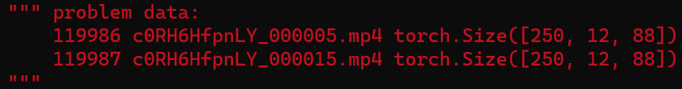
Avhubert
Problem
Preprocessed video gets wrong frame size
(expected [88*88] but get [12*88] instead)
Found 2 video files that would cause the problem
(already run through 160000/200000 data , still checking dataset)

Slide 3
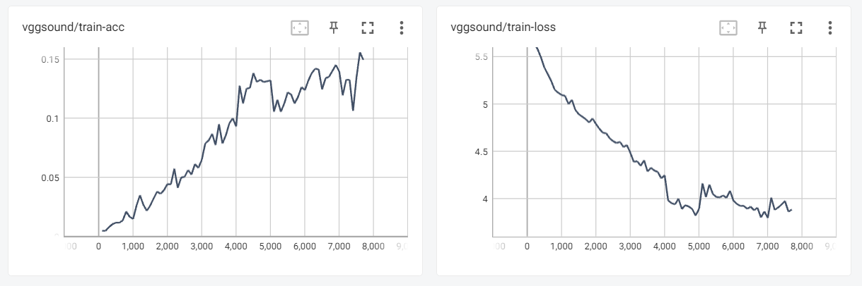
Avhubert
Resume from ckpt if error
Batch size = 16*1
(batch size x gradient accumulate steps)
Learning rate = 2.0E-04
Best training accuracy = 0.138

Slide 4
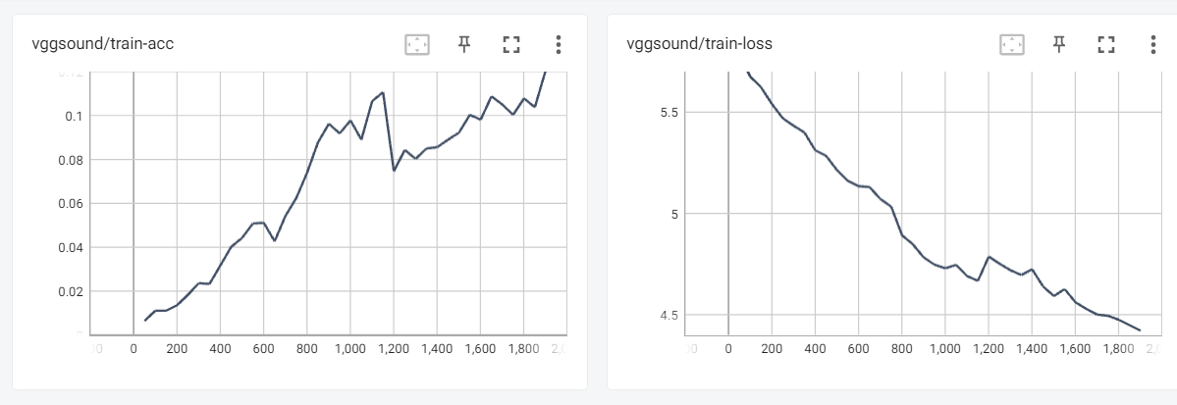
Avhubert
Remove the 2 problem data
Batch size = 8 x 8
(batch size x gradient accumulate steps)
Learning rate = 1.0E-04
Best training accuracy = 0.121

Slide 5
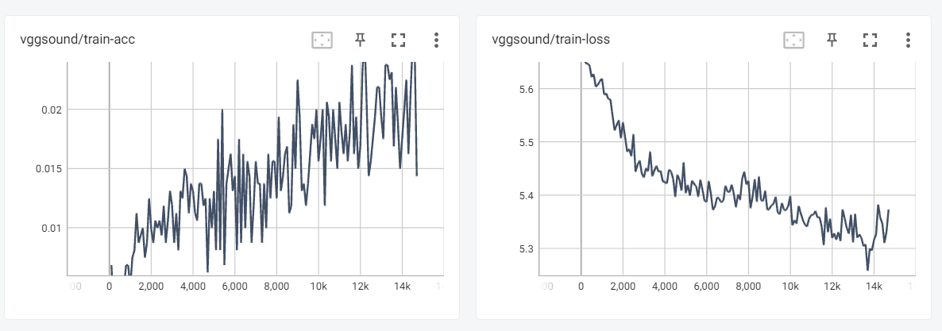
Replai
Batch size = 8 x 8
(batch size x gradient accumulate steps)
Learning rate = 1.0E-04
Best training accuracy = 0.121
Test accuracy = 0.01
(at step 10000)

