Slide 1

nirA PMT_2239 ferredoxin--nitrite reductase
NIR_SIR_ferr
NIR_SIR
NIR_SIR_ferr
NIR_SIR
http://pfam.xfam.org/protein/Q7V3U9
Frame shift – only at day 0
Missense variant (Gly->Asn)
http://www.microbesonline.org/cgi-bin/treeBrowse.cgi?locus=569383&range=10000&offset=0&verifyBLAST=0&show=context&showOriginal=domains&noshcdefault=1&gtree569383=GENE3D.1aopA02.67&cluster=50&ngenes=25&useLen=on&useLenOff=&colorSlow=0

Slide 2
gsmt PMT_0552: class I SAM-dependent methyltransferase, Probable glycine-sarcosine methyltransferase
proV PMT_0553: betaine/proline/choline family ABC transporter ATP-binding protein
COG-ProX PMT_O555: glycine/betaine ABC transporter substrate-binding protein
operon
Missense variant
Synonymous variant
http://www.microbesonline.org/cgi-bin/treeBrowse.cgi?locus=567661&gtree567661=TIGRFAMs.TIGR01186

Slide 3

spoT PMT_2111: bifunctional (p)ppGpp synthetase/guanosine-3',5'-bis(diphosphate) 3'-pyrophosphohydrolase
HD_4
RelA_SpoT
TGS
ACT_4
Missense variant
http://pfam.xfam.org/protein/Q7TUK5

Slide 4

PMT_0909: DAACS family symporter for glutamate/aspartate/dicarboxylates
Frame shift
DAACS family symporter for glutamate/aspartate/dicarboxylates
COG1301: Na+/H+-dicarboxylate symporters
IPR001638: Extracellular solute-binding protein, family 3
IPR001991: Sodium:dicarboxylate symporter
http://pfam.xfam.org/protein/Q7TUK5

Slide 5
Enrichment for mutant genes in the genomic islands was tested by calculating the hypergeometric probability for finding this number of genes in genomic islands at random, according to the length of the islands in comparison to the rest of the genome.

Slide 6
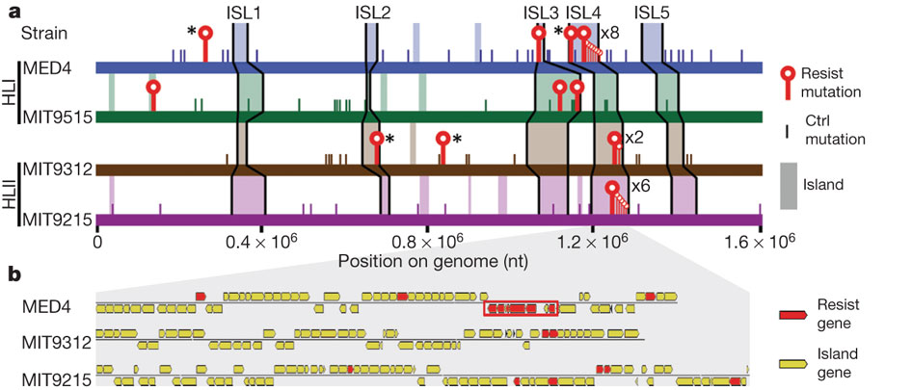

Distribution of resistance-conferring mutations.
a, Diagram of high-light-adapted Prochlorococcus genomes. Genes with resistance-conferring mutations (‘resist’) are shown by red lines and circles, and core genes are shown by asterisks. Mutations in controls relative to reference genomes (‘ctrl’) are shown by short lines. Genomic islands are shaded, and those defined previously¹⁹ are named above the genomes. nt, nucleotides. b, Expansion of most of ISL4, the viral susceptibility region. Genes with resistance-conferring mutations are shown in red. The red box surrounds a cluster of six mutant genes between PMM1242 and PMM1249. MIT9515 is not shown as it had no resistance-conferring mutations in this island.
S Avrani et al. Nature 474, 604-608 (2011) doi:10.1038/nature10172

Slide 7
