Slide 1
Models
14/6

Slide 2
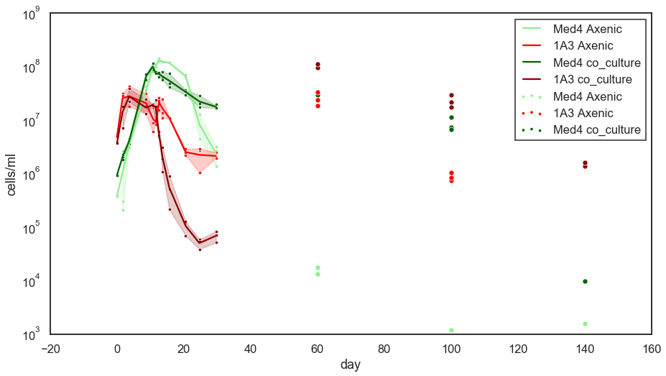
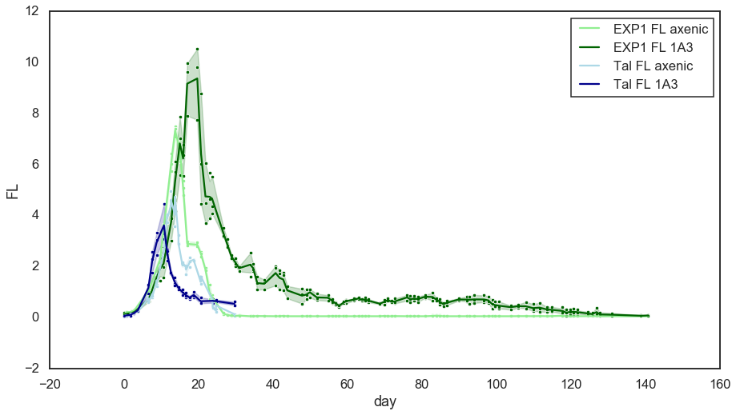
Tal’s MED4 + 1A3 different than Dikla’s EXP1 ☹
FCM
FL

Slide 3
Experiment plan
Setup:
Negative control?
Axenic PRO
Axenic ALT
Co-culture
?
Multiple strains
Measurements:
FL
FCM: PRO + ALT
DOC, DIC, DIN, DON ? (refractory?)
HOOH
pH, alkalinity?
RNA SEQ?

