Slide 1



[08.10.2021]
Bulky mediastinal lymphoma classification with ML-techniques
Activity report
Matteo Barbetti
University of Florence
INFN - Firenze
Meeting ML_INFN @ Firenze
[8 October 2021]

Slide 2
Bulky mediastinal lymphoma classification with ML-techniques
Objective
Classification of bulky mediastinal lymphoma using Machine Learning techniques applied to PET and CT images.
Lymphoma types:
Hodgkin (HL)
Gray Zone (GZ)
Primary Mediastinal Lymphoma (PML)
PLANNED
IN PROGRESS
From low-level data
Data: PET and CT images
Technique: Image classification
Algorithm: Convolutional Neural Nets
From high-level data
Data: features drawn by LIFEx from images
Technique: Binary and multiclass classification
Algorithm: Logistic regression + Random Forest
Matteo Barbetti (University of Florence)
[08.10.2021]
ML_INFN @ Firenze meeting
02|18

Slide 3


Bulky mediastinal lymphoma classification with ML-techniques
First attempts: high-level dataset
Database of 119 rows x 101 columns
different data types → need for homogeneous dataset
numbers
dates
texts
intervals
dim[instance space] ~ dim[feature space] → need for reducing the feature space
Public repository on GitHub to prepare, clean and study the high-level dataset through Jupyter Notebooks:
data_preparation -- data format correction
data_visualization -- correlated features removal
binary_classification -- classification in HL and non-HL
multiclass_classification -- classification in HL, GZ and PML
mbarbetti/LNHunter
Matteo Barbetti (University of Florence)
[08.10.2021]
ML_INFN @ Firenze meeting
03|18

Slide 4
Bulky mediastinal lymphoma classification with ML-techniques
Feature list
ID
Lymphoma typer (HL =1, GZ = 2, PML =3)
Data nascita
dPET staging
SUVmin (SUV)
SUVmean (SUV)
SUVstd (SUV)
SUVmax (SUV)
MTV (# vx)
MTV (mL)
SMTV (mL/Kg)
TLG (SUV*mL)
STLG (SUV*mL/Kg)
MTV (# vx) TOT
MTV (mL) TOT
SMTV (mL/Kg) TOT
TLG (SUV*mL) TOT
STLG (SUV*mL/Kg) TOT
NGLDM_Coarseness
NGLDM_Contrast
NGLDM_Busyness
GLZLM_SZE
GLZLM_LZE
GLZLM_LGZE
GLZLM_HGZE
GLZLM_SZLGE
GLZLM_SZHGE
GLZLM_LZLGE
GLZLM_LZHGE
GLZLM_GLNU
GLZLM_ZLNU
GLZLM_ZP
TimePosition
zLocation[onlyFor2DROI]
CHECK_Cluster(s)ToSmall
GLCM_Homogeneity[=InverseDifference]
GLCM_Energy[=AngularSecondMoment]
GLCM_Contrast[=Variance]
GLCM_Correlation
GLCM_Entropy_log10
GLCM_Entropy_log2[=JointEntropy]
GLCM_Dissimilarity
GLRLM_SRE
GLRLM_LRE
GLRLM_LGRE
GLRLM_HGRE
GLRLM_SRLGE
GLRLM_SRHGE
GLRLM_LRLGE
GLRLM_LRHGE
GLRLM_GLNU
GLRLM_RLNU
GLRLM_RP
SHAPE_Volume(mL)
SHAPE_Volume(vx)
SHAPE_Sphericity[onlyFor3DROI])
SHAPE_Surface(mm2)[onlyFor3DROI]
SHAPE_Compacity[onlyFor3DROI]
PARAMS_DistanceOfNeighbours
PARAMS_NumberOfGreyLevels
PARAMS_BinSize
PARAMS_IntensityResampling
PARAMS_BoundsRangeOfValueAfterDiscretisation(SUVbw)
PARAMS_ZSpatialResampling
PARAMS_YSpatialResampling
PARAMS_XSpatialResampling
DISCRETIZED_SUVbwmean
DISCRETIZED_SUVbwstd
DISCRETIZED_SUVbwmax
DISCRETIZED_SUVbwQ1
DISCRETIZED_SUVbwQ2
DISCRETIZED_SUVbwQ3
DISCRETIZED_SUVbwSkewness
DISCRETIZED_SUVbwKurtosis
DISCRETIZED_SUVbwExcessKurtosis
DISCRETIZED_SUVbwpeakSphere0,5mL:discretized volume sought
DISCRETIZED_SUVbwpeakSphere0,5mL(value only for PET or NM)
DISCRETIZED_SUVbwpeakSphere1mL:discretized volume sought
DISCRETIZED_SUVbwpeakSphere1mL(value only for PET or NM)
DISCRETIZED_TLG(mL)[onlyForPETorNM]
DISCRETIZED_HISTO_Skewness
DISCRETIZED_HISTO_Kurtosis
DISCRETIZED_HISTO_ExcessKurtosis
DISCRETIZED_HISTO_Entropy_log10
DISCRETIZED_HISTO_Entropy_log2
DISCRETIZED_HISTO_Energy[=Uniformity]
CONVENTIONAL_SUVbwmin
CONVENTIONAL_SUVbwmean
CONVENTIONAL_SUVbwstd
CONVENTIONAL_SUVbwmax
CONVENTIONAL_SUVbwQ1
CONVENTIONAL_SUVbwQ2
CONVENTIONAL_SUVbwQ3
CONVENTIONAL_SUVbwSkewness
CONVENTIONAL_SUVbwKurtosis
CONVENTIONAL_SUVbwExcessKurtosis
CONVENTIONAL_SUVbwpeakSphere0,5mL:discretized volume sought
CONVENTIONAL_SUVbwpeakSphere0,5mL(value only for PET or NM)
CONVENTIONAL_SUVbwpeakSphere1mL:discretized volume sought
CONVENTIONAL_SUVbwpeakSphere1mL(value only for PET or NM)
CONVENTIONAL_TLG(mL)[onlyForPETorNM]
■ number
■ date
■ text
■ interval
Matteo Barbetti (University of Florence)
[08.10.2021]
ML_INFN @ Firenze meeting
04|18

Slide 5
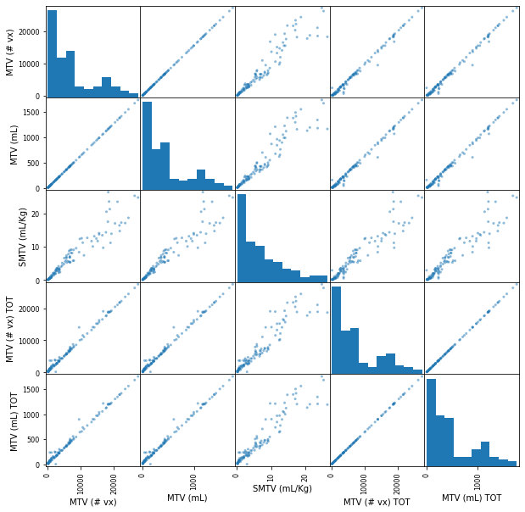
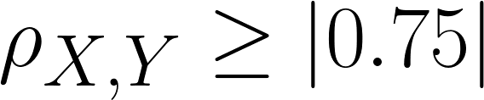
Bulky mediastinal lymphoma classification with ML-techniques
Dataset cleaning
Features with no clear contents dropped
text data
intervals
Variables with strong correlations dropped
… → strong correlation
New feature added
age, from dates subtraction (then dropped)
99 → 17 FEATURES
Matteo Barbetti (University of Florence)
[08.10.2021]
ML_INFN @ Firenze meeting
05|18

Slide 6
Bulky mediastinal lymphoma classification with ML-techniques
binary_classification
Matteo Barbetti (University of Florence)
[08.10.2021]
ML_INFN @ Firenze meeting
06|18

Slide 7
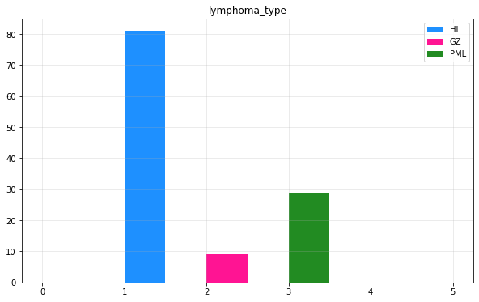
Bulky mediastinal lymphoma classification with ML-techniques
Instance space
Missing information
some features not available for all the instances
instances dropped to keep homogeneity
119 → 101 rows (instances)
Dataset strongly unbalanced
HL-class is over-represented w.r.t. the other two ones
classification suffers from unbalancing
Binary classification
HL and non-HL classification
dataset a bit more balanced
NHL-HL ratio : 55.4%
Train/Test split : 80%/20%
k-Folds Cross Validation with k=3
Matteo Barbetti (University of Florence)
[08.10.2021]
ML_INFN @ Firenze meeting
07|18

Slide 8
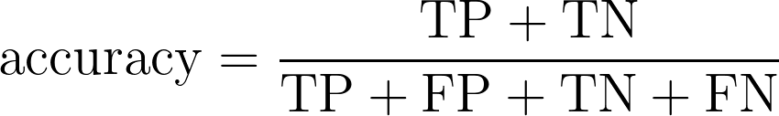
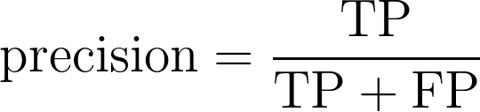
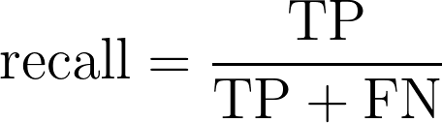
Bulky mediastinal lymphoma classification with ML-techniques
Performance measures: accuracy, precision & recall
Predicted labels
The accuracy is generally not the preferred performance measure for classifiers, especially when one are dealing with unbalanced datasets. In fact, classifiers succeed in recognizing instances belonging to most frequent label, resulting in high accuracy even if the other instances are mis-classified.
In order to ensure a model evaluation robust against unbalanced datasets, one can use precision or recall scores.
Negative
Positive
True Negative (TN) | False Positive (FP)
False Negative (FN) | True Positive (TP)
Negative
Actual labels
Positive
In the Jupyter Notebook we have used RECALL!
Matteo Barbetti (University of Florence)
[08.10.2021]
ML_INFN @ Firenze meeting
08|18

Slide 9
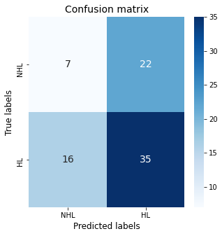
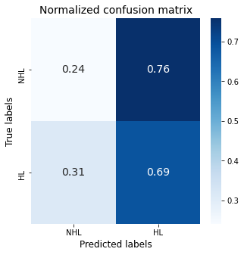
Bulky mediastinal lymphoma classification with ML-techniques
Dummy Classifier: performance
Matteo Barbetti (University of Florence)
[08.10.2021]
ML_INFN @ Firenze meeting
09|18

Slide 10

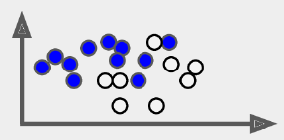
Bulky mediastinal lymphoma classification with ML-techniques
Model combination
Logistic
regression
prediction: “HL”
Random
Forest
final prediction: “HL”
prediction: “NHL”
Hard voting
TRAIN-SET
Gradient
BDT
prediction: “HL”
Diverse predictors
Matteo Barbetti (University of Florence)
[08.10.2021]
ML_INFN @ Firenze meeting
10|18

Slide 11
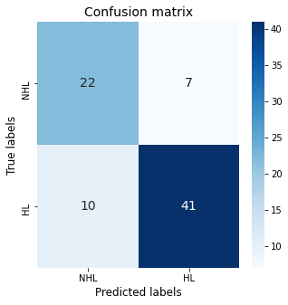
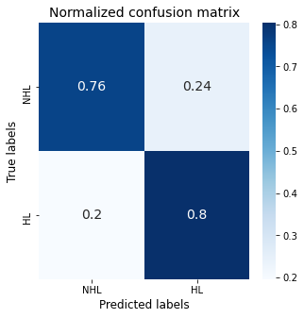
Bulky mediastinal lymphoma classification with ML-techniques
Model combination: performance
Matteo Barbetti (University of Florence)
[08.10.2021]
ML_INFN @ Firenze meeting
11|18

Slide 12
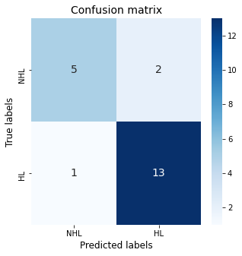
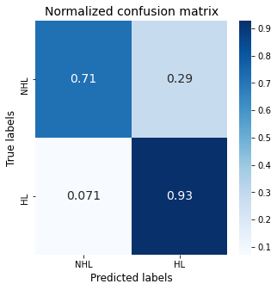
Bulky mediastinal lymphoma classification with ML-techniques
Results on the test-set
Matteo Barbetti (University of Florence)
[08.10.2021]
ML_INFN @ Firenze meeting
12|18

Slide 13
Bulky mediastinal lymphoma classification with ML-techniques
multiclass_classification
Matteo Barbetti (University of Florence)
[08.10.2021]
ML_INFN @ Firenze meeting
13|18

Slide 14
Bulky mediastinal lymphoma classification with ML-techniques
Instance space
Missing information
some features not available for all the instances
instances dropped to keep homogeneity
119 → 101 rows (instances)
Dataset strongly unbalanced
HL-class is over-represented w.r.t. the other two ones
classification suffers from unbalancing
Multiclass classification
HL, GZ and PML classification
GZ-HL ratio : 13.8%
PML-HL ratio : 41.5%
Train/Test split : 80%/20%
k-Folds Cross Validation with k=3
Matteo Barbetti (University of Florence)
[08.10.2021]
ML_INFN @ Firenze meeting
14|18

Slide 15
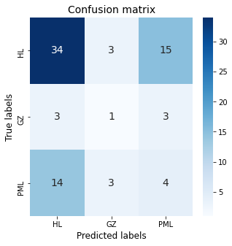
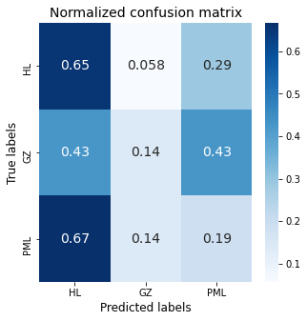
Bulky mediastinal lymphoma classification with ML-techniques
Dummy Classifier: performance
Matteo Barbetti (University of Florence)
[08.10.2021]
ML_INFN @ Firenze meeting
15|18

Slide 16
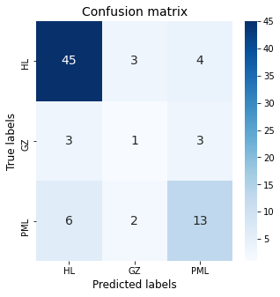
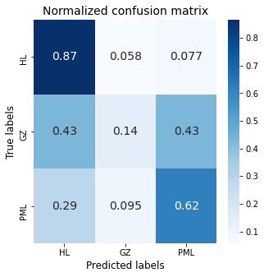
Bulky mediastinal lymphoma classification with ML-techniques
Model combination: performance
Matteo Barbetti (University of Florence)
[08.10.2021]
ML_INFN @ Firenze meeting
16|18

Slide 17
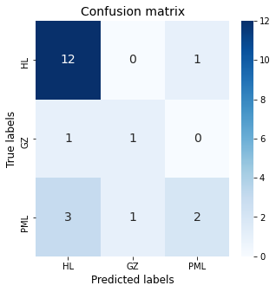
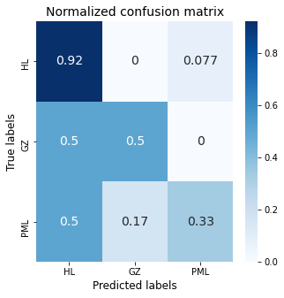
Bulky mediastinal lymphoma classification with ML-techniques
Results on the test-set
Matteo Barbetti (University of Florence)
[08.10.2021]
ML_INFN @ Firenze meeting
17|18

Slide 18
Bulky mediastinal lymphoma classification with ML-techniques
Conclusion
Preliminary studies
There is room for improvements
increasing the dataset → more data
balancing the dataset → expanding low-represented classes
working with low-level data → image classification techniques
Binary classification looks promising
GZ-class should be treated as a classification uncertainty
custom probability thresholds → multiclass classification
Open to any kind of suggestions!
Matteo Barbetti (University of Florence)
[08.10.2021]
ML_INFN @ Firenze meeting
18|18

Slide 19
Bulky mediastinal lymphoma classification with ML-techniques
Backup
Matteo Barbetti (University of Florence)
[08.10.2021]
ML_INFN @ Firenze meeting
19|18

Slide 20
Bulky mediastinal lymphoma classification with ML-techniques
Train/Test split
DATASET | size: 101 | ratio: 100%
TRAIN-SET | size: 80 | ratio: 80%
TEST-SET | size: 21 | ratio: 20%
To ensure that our Machine Learning model will be able to generalize well to new cases, namely to behave like a true predictor, we should avoid to use all the dataset to train our model. A better option is to split the data into two sets:
training set to train the model
test set to test the model
The error rate on new cases is called the generalization error, and we can estimate it evaluating the trained model on the test set.
Matteo Barbetti (University of Florence)
[08.10.2021]
ML_INFN @ Firenze meeting
20|18

Slide 21
Bulky mediastinal lymphoma classification with ML-techniques
Model optimization: k-Folds Cross Validation
In the search of the best possible predictor, we should avoid that our model learns by heart the training instances, because it will result in a greater generalization error.
A possible solution is to use k-Folds Cross Validation, an algorithm based on the splitting of the training set into k different subsets. We will use k-1 subsets to train the model and leave the last subset to validate it. Then, the average performance of our model against each of the folds can be used as a robust score to build an optimization problem, namely to find the best possible model.
TRAIN-SET
In the Jupyter Notebook we have used k = 3!
TRAIN
TRAIN
VALIDATION
→ score
TRAIN
VALIDATION
TRAIN
→ score
mean score ± standard deviation
VALIDATION
TRAIN
TRAIN
→ score
Matteo Barbetti (University of Florence)
[08.10.2021]
ML_INFN @ Firenze meeting
21|18

Slide 22
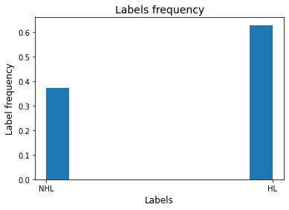
Bulky mediastinal lymphoma classification with ML-techniques
Dummy Classifier: model baseline
The Dummy Classifier is a simple classifier that makes predictions using simple rules:
computes the frequency of each label
interprets such frequencies as probabilities
predicts new instances label on the basis of computed probabilities
This classifier is useful as a simple baseline to compare with other (real) classifiers
Matteo Barbetti (University of Florence)
[08.10.2021]
ML_INFN @ Firenze meeting
22|18

Slide 23
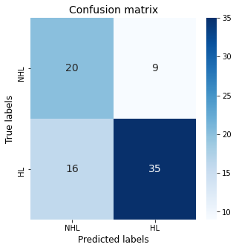
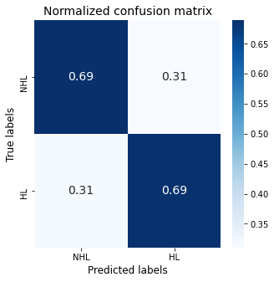
Bulky mediastinal lymphoma classification with ML-techniques
Logistic regression: performance
Matteo Barbetti (University of Florence)
[08.10.2021]
ML_INFN @ Firenze meeting
23|18

Slide 24
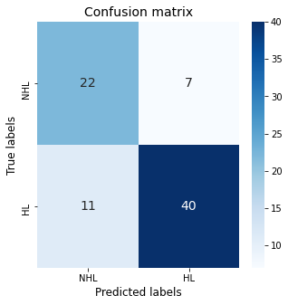
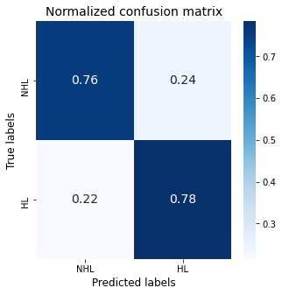
Bulky mediastinal lymphoma classification with ML-techniques
Random Forest classifier: performance
Matteo Barbetti (University of Florence)
[08.10.2021]
ML_INFN @ Firenze meeting
24|18

Slide 25
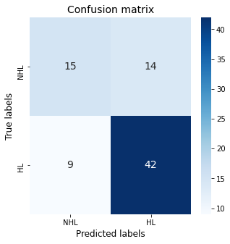
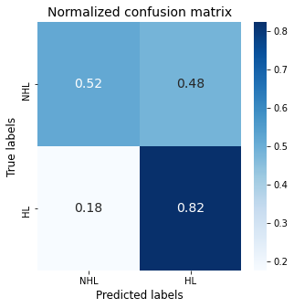
Bulky mediastinal lymphoma classification with ML-techniques
Gradient BDT classifier: performance
Matteo Barbetti (University of Florence)
[08.10.2021]
ML_INFN @ Firenze meeting
25|18

Slide 26
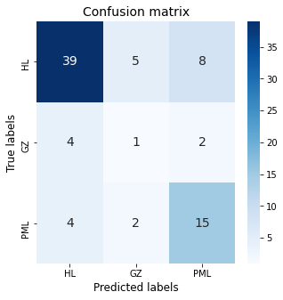
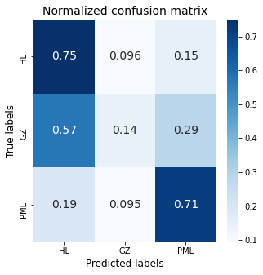
Bulky mediastinal lymphoma classification with ML-techniques
Logistic regression: performance
Matteo Barbetti (University of Florence)
[08.10.2021]
ML_INFN @ Firenze meeting
26|18

Slide 27
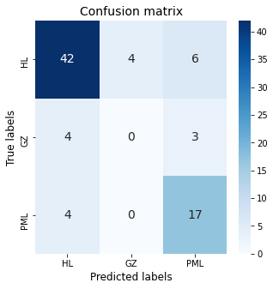
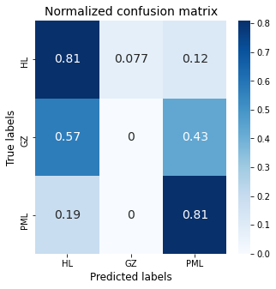
Bulky mediastinal lymphoma classification with ML-techniques
Random Forest classifier: performance
Matteo Barbetti (University of Florence)
[08.10.2021]
ML_INFN @ Firenze meeting
27|18

Slide 28
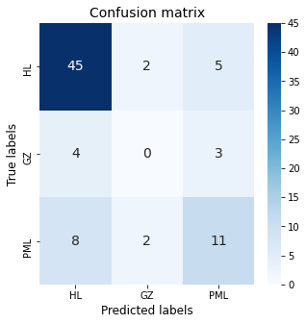
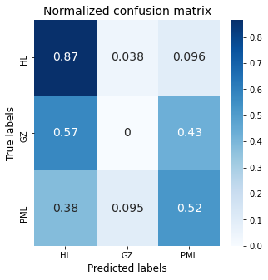
Bulky mediastinal lymphoma classification with ML-techniques
Gradient BDT classifier: performance
Matteo Barbetti (University of Florence)
[08.10.2021]
ML_INFN @ Firenze meeting
28|18

