Slide 1


[2021.11.09]
Bulky mediastinal lymphoma classification with ML-techniques
Activity status n. 2
Matteo Barbetti
University of Florence
INFN - Firenze

Slide 2
Bulky mediastinal lymphoma classification with ML-techniques
From previous meetings: objective
Classification of bulky mediastinal lymphoma using Machine Learning techniques applied to PET and CT images.
Lymphoma types:
Hodgkin (HL)
Gray Zone (GZ)
Primary Mediastinal Lymphoma (PML)
PLANNED
IN PROGRESS
From low-level data
Data: PET and CT images
Technique: Image classification
Algorithm: Convolutional Neural Nets
From high-level data
Data: features drawn by LIFEx from images
Technique: Binary and multiclass classification
Algorithm: Logistic regression + Random Forest
Matteo Barbetti (University of Florence)
[2021.11.09]
AIMN-Firenze meeting
02|21

Slide 3
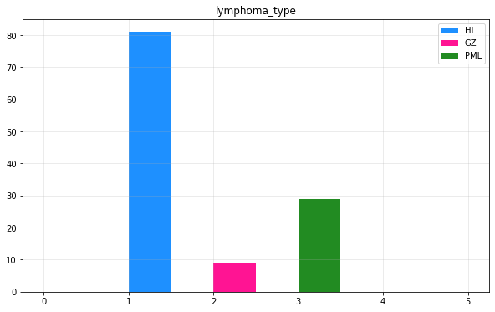
Bulky mediastinal lymphoma classification with ML-techniques
From previous meetings: learned lessons
Dataset heavily unbalanced
HL-class is over-represented w.r.t. the other two ones
classification suffers from unbalancing
Binary classification looks promising
HL and non-HL classification
dataset a bit more balanced
Multiclass classification fails
HL, GZ and PML classification
only HL-class is well-identified by models
GZ-class is a middle-class
classification uncertainty btw HL and PML
only HL and PML are true disjoint classes
Matteo Barbetti (University of Florence)
[2021.11.09]
AIMN-Firenze meeting
03|21

Slide 4


Bulky mediastinal lymphoma classification with ML-techniques
From previous meetings: implemented suggestions
Classifiers performance improvement
custom probability threshold to make decisions
more robustness against unbalanced datasets
ROC AUC score for optimization
New multiclass classification implementation
GZ-class treated as a classification uncertainty
binary classifiers promoted to multiclass classifiers
mbarbetti/lymphoma-classification
Matteo Barbetti (University of Florence)
[2021.11.09]
AIMN-Firenze meeting
04|21

Slide 5
Bulky mediastinal lymphoma classification with ML-techniques
Binary classification
Matteo Barbetti (University of Florence)
[2021.11.09]
AIMN-Firenze meeting
05|21

Slide 6
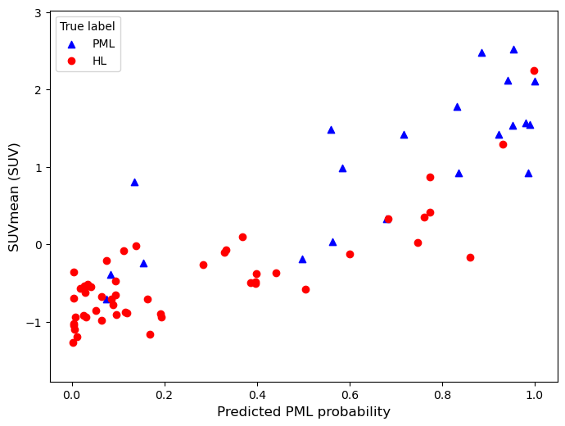
Bulky mediastinal lymphoma classification with ML-techniques
Decision rules: custom probability threshold
A trained classifier induces a 1-D space (represented by the predicted probability) where items belonging to different classes are separated as much as possible: more powerful classifiers result in greater separations.
Classifiers typically adopt the standard threshold of 0.5 in predicted probability to make a decision. Customizing this threshold allows to obtain models more robust against unbalanced dataset, and to have more control on models performance.
HL
PML
Matteo Barbetti (University of Florence)
[2021.11.09]
AIMN-Firenze meeting
06|21

Slide 7
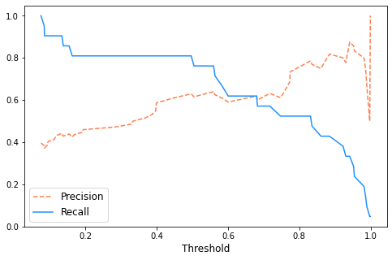
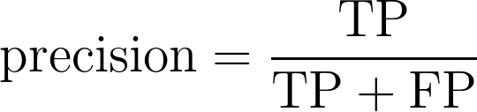
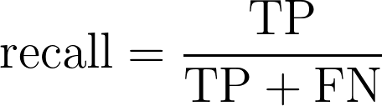
Bulky mediastinal lymphoma classification with ML-techniques
Decision rules: precision/recall tradeoff
Moving the threshold at will, one can obtain any target score desired (recall or precision).
high recall → low precision
high TPR → low TNR
high precision → low recall
high TNR → low TPR
Predicted labels
Negative
Positive
TN | FP
FN | TP
Negative
Actual labels
Positive
Matteo Barbetti (University of Florence)
[2021.11.09]
AIMN-Firenze meeting
07|21

Slide 8
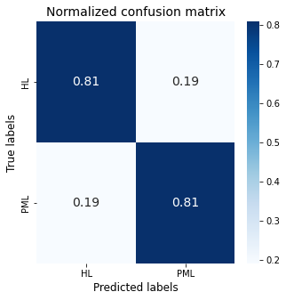
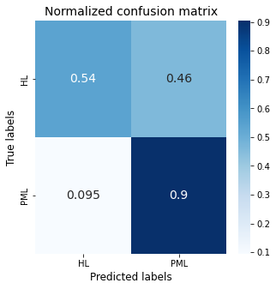
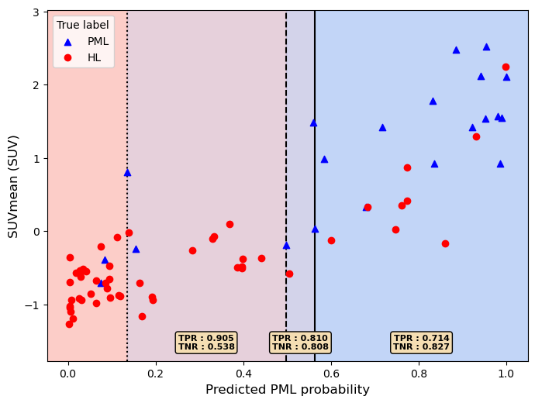
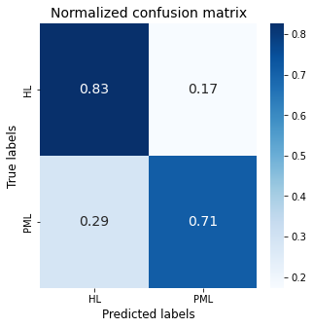
Bulky mediastinal lymphoma classification with ML-techniques
Logistic regression: decision regions
Most important feature in classification
Matteo Barbetti (University of Florence)
[2021.11.09]
AIMN-Firenze meeting
08|21

Slide 9
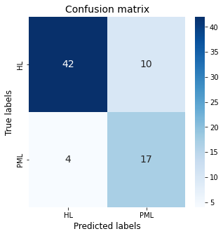
Bulky mediastinal lymphoma classification with ML-techniques
Logistic regression: performance
Matteo Barbetti (University of Florence)
[2021.11.09]
AIMN-Firenze meeting
09|21

Slide 10
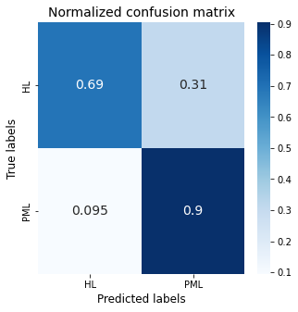
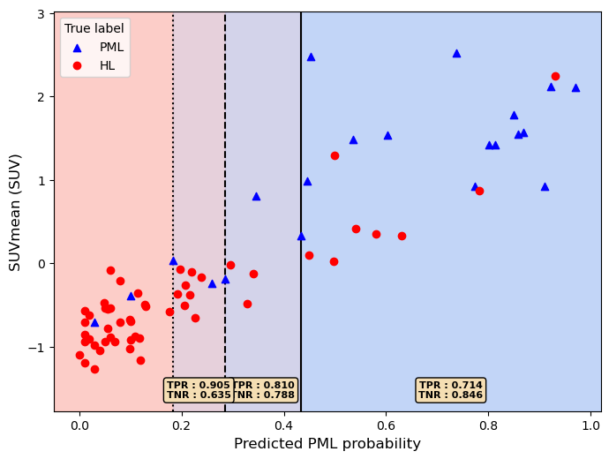
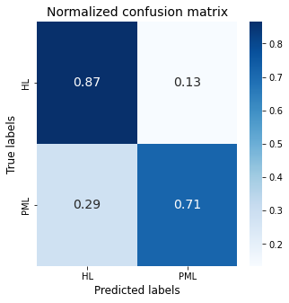
Bulky mediastinal lymphoma classification with ML-techniques
Random Forest: decision regions
Most important feature in classification
Matteo Barbetti (University of Florence)
[2021.11.09]
AIMN-Firenze meeting
10|21

Slide 11
Bulky mediastinal lymphoma classification with ML-techniques
Random Forest: performance
Matteo Barbetti (University of Florence)
[2021.11.09]
AIMN-Firenze meeting
11|21

Slide 12
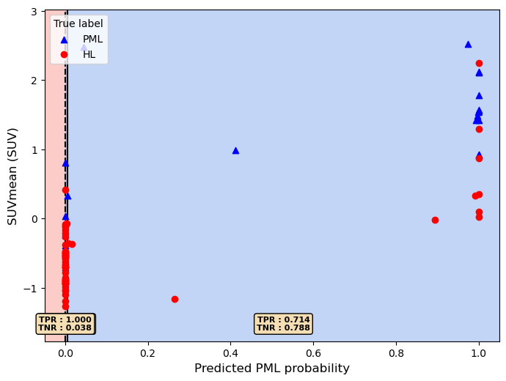
Bulky mediastinal lymphoma classification with ML-techniques
Gradient BDT: decision regions
Most important feature in classification
Matteo Barbetti (University of Florence)
[2021.11.09]
AIMN-Firenze meeting
12|21

Slide 13
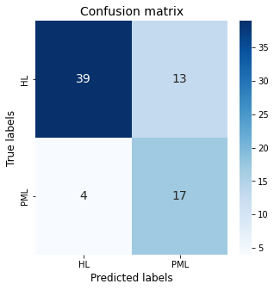
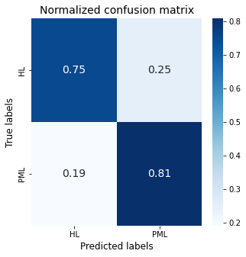
Bulky mediastinal lymphoma classification with ML-techniques
Gradient BDT: performance
Matteo Barbetti (University of Florence)
[2021.11.09]
AIMN-Firenze meeting
13|21

Slide 14
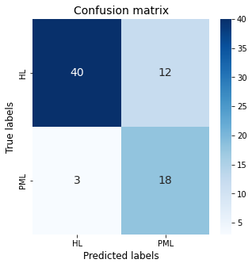
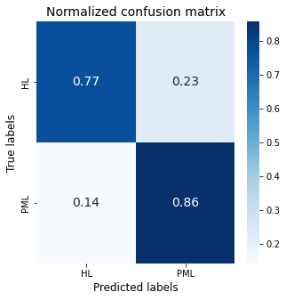
Bulky mediastinal lymphoma classification with ML-techniques
Model combination: performance
Matteo Barbetti (University of Florence)
[2021.11.09]
AIMN-Firenze meeting
14|21

Slide 15
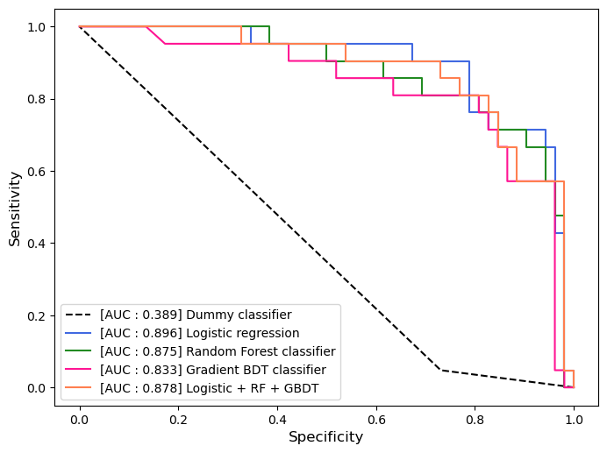
Bulky mediastinal lymphoma classification with ML-techniques
Models comparison
Matteo Barbetti (University of Florence)
[2021.11.09]
AIMN-Firenze meeting
15|21

Slide 16
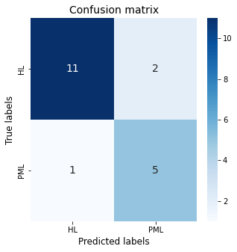
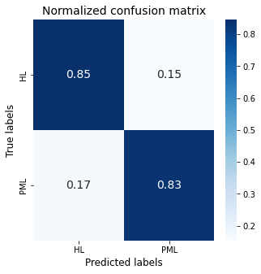
Bulky mediastinal lymphoma classification with ML-techniques
Results on the test-set
Matteo Barbetti (University of Florence)
[2021.11.09]
AIMN-Firenze meeting
16|21

Slide 17
Bulky mediastinal lymphoma classification with ML-techniques
Multiclass classification
Matteo Barbetti (University of Florence)
[2021.11.09]
AIMN-Firenze meeting
17|21

Slide 18
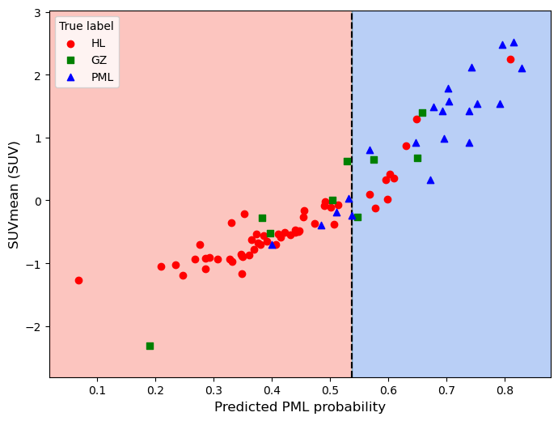
Bulky mediastinal lymphoma classification with ML-techniques
The Gray Zone class
Binary classifier
trained to separate HL-PML classes
good performance also on the test-set
Behaviour with the third class
half of GZ-items are predicted as HL
GZ-items have mixed characteristics btw HL and PML
GZ is a sort of middle-class
Matteo Barbetti (University of Florence)
[2021.11.09]
AIMN-Firenze meeting
18|21

Slide 19
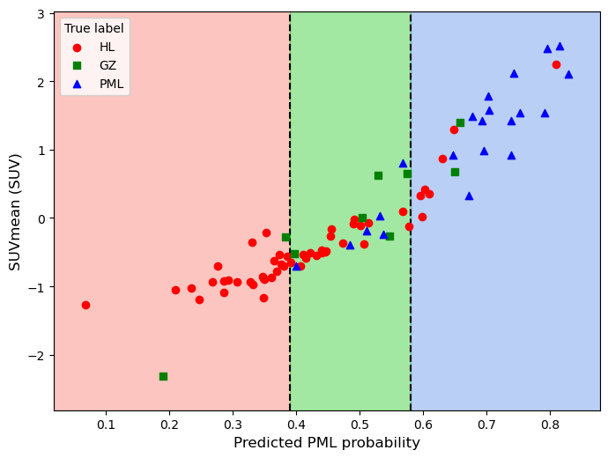
Bulky mediastinal lymphoma classification with ML-techniques
Promotion to multiclass classification
2 thresholds → 3 decision regions
outer regions for HL and PML predictions
middle region for GZ predictions
lower performance w.r.t. binary classifier
promising performance w.r.t. the multiclass classifier trained with HL, GZ and PML as disjoint classes
Custom thresholds can be used
to promote trained binary classifiers
into multiclass classifiers!
Matteo Barbetti (University of Florence)
[2021.11.09]
AIMN-Firenze meeting
19|21

Slide 20
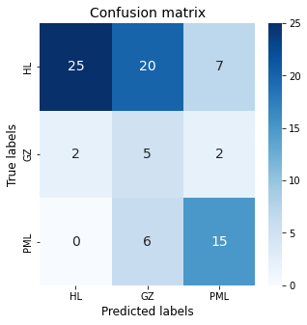
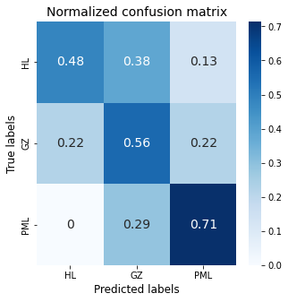
Bulky mediastinal lymphoma classification with ML-techniques
Multiclass classification: performance
Matteo Barbetti (University of Florence)
[2021.11.09]
AIMN-Firenze meeting
20|21

Slide 21
Bulky mediastinal lymphoma classification with ML-techniques
Conclusion
Preliminary studies
Still need for taking a look at literature
There is room for improvements
increasing the dataset → more performant classifiers
balancing the dataset → more sensitive classifiers
working with low-level data → image classification techniques
Necessity to define a final pipeline for models optimization
Accuracy? Precision? Recall? ROC AUC?
Necessity to add statistical errors for performance evaluation
Open to any kind of suggestions!
Matteo Barbetti (University of Florence)
[2021.11.09]
AIMN-Firenze meeting
21|21

Slide 22
Bulky mediastinal lymphoma classification with ML-techniques
Backup
Matteo Barbetti (University of Florence)
[2021.11.09]
AIMN-Firenze meeting
22|21

Slide 23
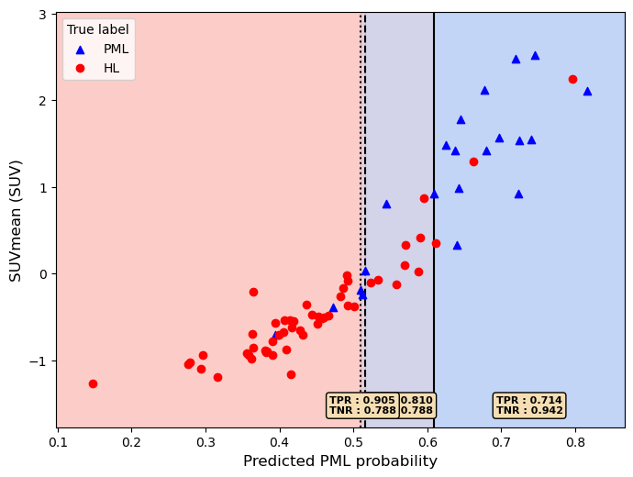
Bulky mediastinal lymphoma classification with ML-techniques
Logistic regression: AUC optimized version
Matteo Barbetti (University of Florence)
[2021.11.09]
AIMN-Firenze meeting
23|21

Slide 24
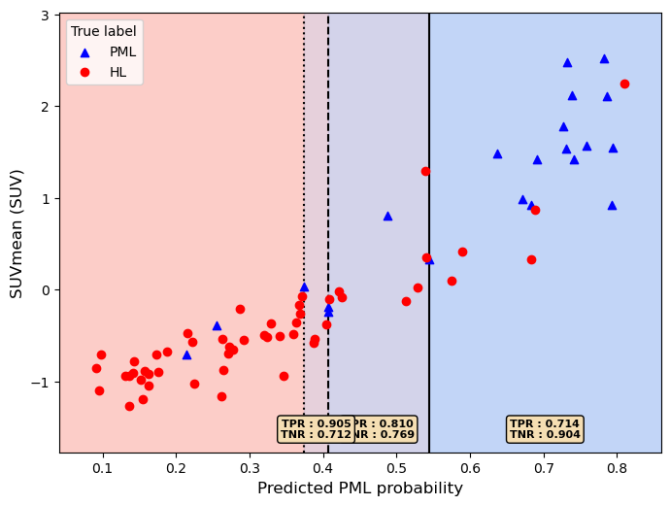
Bulky mediastinal lymphoma classification with ML-techniques
Random Forest: AUC optimized version
Matteo Barbetti (University of Florence)
[2021.11.09]
AIMN-Firenze meeting
24|21

Slide 25

Bulky mediastinal lymphoma classification with ML-techniques
Gradient BDT: AUC optimized version
Matteo Barbetti (University of Florence)
[2021.11.09]
AIMN-Firenze meeting
25|21

