Slide 1


[16.09.2021]
Bulky mediastinal lymphoma classification with ML-techniques
Activity status n. 1
Matteo Barbetti
University of Firenze
INFN - Firenze

Slide 2
Bulky mediastinal lymphoma classification with ML-techniques
Objective
Classification of bulky mediastinal lymphoma using Machine Learning techniques applied to PET and CT images.
Lymphoma types:
Hodgkin (HL)
Gray Zone (GZ)
Primary Mediastinal Lymphoma (PML)
PLANNED
IN PROGRESS
From low-level data
Data: PET and CT images
Technique: Image classification
Algorithm: Convolutional Neural Nets
From high-level data
Data: features drawn by LIFEx from images
Technique: Binary and multiclass classification
Algorithm: Logistic regression + Random Forest
Matteo Barbetti (University of Firenze)
[16.09.2021]
AIMN-Firenze meeting
02|34

Slide 3


Bulky mediastinal lymphoma classification with ML-techniques
First attempts: high-level dataset
Database of 119 rows x 101 columns
different data types → need for homogeneous dataset
numbers
dates
texts
intervals
dim[instance space] ~ dim[feature space] → need for reducing the feature space
Public repository on GitHub to prepare, clean and study the high-level dataset through Jupyter Notebooks:
data_preparation -- data format correction
data_visualization -- correlated features removal
binary_classification -- classification in HL and non-HL
multiclass_classification -- classification in HL, GZ and PML
mbarbetti/LNHunter
Matteo Barbetti (University of Firenze)
[16.09.2021]
AIMN-Firenze meeting
03|34

Slide 4
Bulky mediastinal lymphoma classification with ML-techniques
data_preparation
Matteo Barbetti (University of Firenze)
[16.09.2021]
AIMN-Firenze meeting
04|34

Slide 5
Bulky mediastinal lymphoma classification with ML-techniques
Feature list
ID
Lymphoma typer (HL =1, GZ = 2, PML =3)
Data nascita
dPET staging
SUVmin (SUV)
SUVmean (SUV)
SUVstd (SUV)
SUVmax (SUV)
MTV (# vx)
MTV (mL)
SMTV (mL/Kg)
TLG (SUV*mL)
STLG (SUV*mL/Kg)
MTV (# vx) TOT
MTV (mL) TOT
SMTV (mL/Kg) TOT
TLG (SUV*mL) TOT
STLG (SUV*mL/Kg) TOT
NGLDM_Coarseness
NGLDM_Contrast
NGLDM_Busyness
GLZLM_SZE
GLZLM_LZE
GLZLM_LGZE
GLZLM_HGZE
GLZLM_SZLGE
GLZLM_SZHGE
GLZLM_LZLGE
GLZLM_LZHGE
GLZLM_GLNU
GLZLM_ZLNU
GLZLM_ZP
TimePosition
zLocation[onlyFor2DROI]
CHECK_Cluster(s)ToSmall
GLCM_Homogeneity[=InverseDifference]
GLCM_Energy[=AngularSecondMoment]
GLCM_Contrast[=Variance]
GLCM_Correlation
GLCM_Entropy_log10
GLCM_Entropy_log2[=JointEntropy]
GLCM_Dissimilarity
GLRLM_SRE
GLRLM_LRE
GLRLM_LGRE
GLRLM_HGRE
GLRLM_SRLGE
GLRLM_SRHGE
GLRLM_LRLGE
GLRLM_LRHGE
GLRLM_GLNU
GLRLM_RLNU
GLRLM_RP
SHAPE_Volume(mL)
SHAPE_Volume(vx)
SHAPE_Sphericity[onlyFor3DROI])
SHAPE_Surface(mm2)[onlyFor3DROI]
SHAPE_Compacity[onlyFor3DROI]
PARAMS_DistanceOfNeighbours
PARAMS_NumberOfGreyLevels
PARAMS_BinSize
PARAMS_IntensityResampling
PARAMS_BoundsRangeOfValueAfterDiscretisation(SUVbw)
PARAMS_ZSpatialResampling
PARAMS_YSpatialResampling
PARAMS_XSpatialResampling
DISCRETIZED_SUVbwmean
DISCRETIZED_SUVbwstd
DISCRETIZED_SUVbwmax
DISCRETIZED_SUVbwQ1
DISCRETIZED_SUVbwQ2
DISCRETIZED_SUVbwQ3
DISCRETIZED_SUVbwSkewness
DISCRETIZED_SUVbwKurtosis
DISCRETIZED_SUVbwExcessKurtosis
DISCRETIZED_SUVbwpeakSphere0,5mL:discretized volume sought
DISCRETIZED_SUVbwpeakSphere0,5mL(value only for PET or NM)
DISCRETIZED_SUVbwpeakSphere1mL:discretized volume sought
DISCRETIZED_SUVbwpeakSphere1mL(value only for PET or NM)
DISCRETIZED_TLG(mL)[onlyForPETorNM]
DISCRETIZED_HISTO_Skewness
DISCRETIZED_HISTO_Kurtosis
DISCRETIZED_HISTO_ExcessKurtosis
DISCRETIZED_HISTO_Entropy_log10
DISCRETIZED_HISTO_Entropy_log2
DISCRETIZED_HISTO_Energy[=Uniformity]
CONVENTIONAL_SUVbwmin
CONVENTIONAL_SUVbwmean
CONVENTIONAL_SUVbwstd
CONVENTIONAL_SUVbwmax
CONVENTIONAL_SUVbwQ1
CONVENTIONAL_SUVbwQ2
CONVENTIONAL_SUVbwQ3
CONVENTIONAL_SUVbwSkewness
CONVENTIONAL_SUVbwKurtosis
CONVENTIONAL_SUVbwExcessKurtosis
CONVENTIONAL_SUVbwpeakSphere0,5mL:discretized volume sought
CONVENTIONAL_SUVbwpeakSphere0,5mL(value only for PET or NM)
CONVENTIONAL_SUVbwpeakSphere1mL:discretized volume sought
CONVENTIONAL_SUVbwpeakSphere1mL(value only for PET or NM)
CONVENTIONAL_TLG(mL)[onlyForPETorNM]
■ number
■ date
■ text
■ interval
Matteo Barbetti (University of Firenze)
[16.09.2021]
AIMN-Firenze meeting
05|34

Slide 6

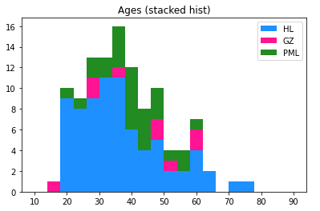
Bulky mediastinal lymphoma classification with ML-techniques
Dataset transformation
CSV file → Pandas DataFrame (Python object)
Features with no clear contents dropped
PARAMS_IntensityResampling
PARAMS_BoundsRangeOfValueAfterDiscretisation(SUVbw)
CHECK_Cluster(s)ToSmall
Data format correction
decimal separator : “,” → “.”
date notation : “dd/mm/yyyy” → datetime (Python object)
New feature added
age, from dates subtraction (then dropped)
99 → 95 FEATURES
Matteo Barbetti (University of Firenze)
[16.09.2021]
AIMN-Firenze meeting
06|34

Slide 7
Bulky mediastinal lymphoma classification with ML-techniques
data_visualization
Matteo Barbetti (University of Firenze)
[16.09.2021]
AIMN-Firenze meeting
07|34

Slide 8
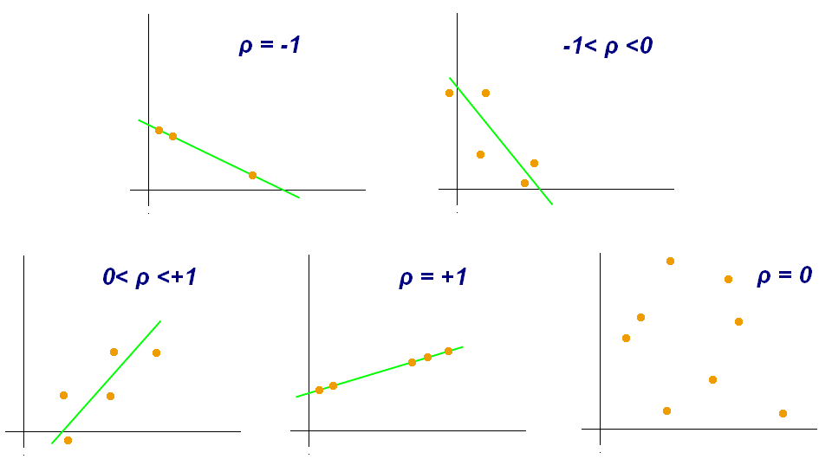
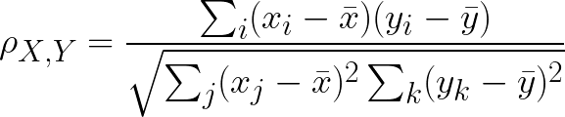
Bulky mediastinal lymphoma classification with ML-techniques
Feature correlation [1/2]
Two features strongly correlated bring the same statistical information then, in order to increase the Machine Learning capabilities, one should clean the dataset to have independent features.
Pearson correlation coefficient
Matteo Barbetti (University of Firenze)
[16.09.2021]
AIMN-Firenze meeting
08|34

Slide 9
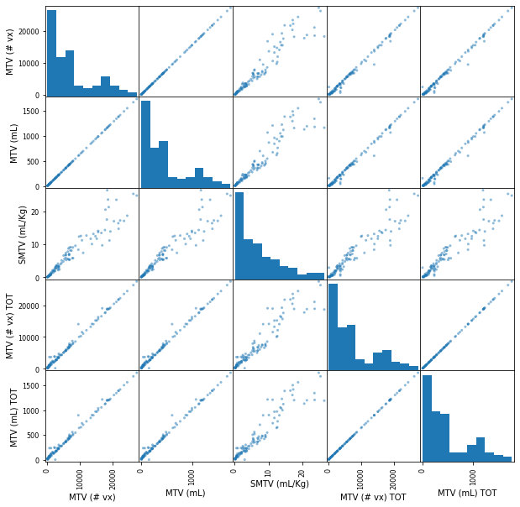
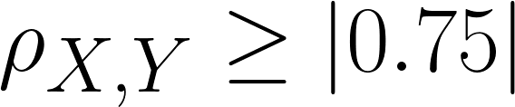
Bulky mediastinal lymphoma classification with ML-techniques
Feature correlation [2/2]
Pandas DataFrame is able to compute easily pairwise correlation of columns (features), excluding NA/null values
Here a graphical example for a bunch of variables
MTV (# vx)
MTV (mL)
SMTV (mL/Kg)
MTV (# vx) TOT
MTV (mL) TOT
Variables with strong correlations dropped
… → strong correlation
95 → 17 FEATURES
Matteo Barbetti (University of Firenze)
[16.09.2021]
AIMN-Firenze meeting
09|34

Slide 10
Bulky mediastinal lymphoma classification with ML-techniques
binary_classification
Matteo Barbetti (University of Firenze)
[16.09.2021]
AIMN-Firenze meeting
10|34

Slide 11
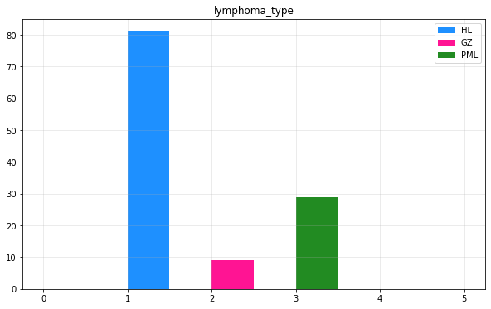
Bulky mediastinal lymphoma classification with ML-techniques
Instance space
Missing information
some features not available for all the instances
instances dropped to keep homogeneity
119 → 101 rows (instances)
Dataset clearly unbalanced
HL-class is over-represented w.r.t. the other two ones
classification suffers from unbalancing
Binary classification
HL and non-HL classification
dataset a bit more balanced
NHL-HL ratio : 55.4%
Matteo Barbetti (University of Firenze)
[16.09.2021]
AIMN-Firenze meeting
11|34

Slide 12
Bulky mediastinal lymphoma classification with ML-techniques
Train/Test split
DATASET | size: 101 | ratio: 100%
TRAIN-SET | size: 80 | ratio: 80%
TEST-SET | size: 21 | ratio: 20%
To ensure that our Machine Learning model will be able to generalize well to new cases, namely to behave like a true predictor, we should avoid to use all the dataset to train our model. A better option is to split the data into two sets:
training set to train the model
test set to test the model
The error rate on new cases is called the generalization error, and we can estimate it evaluating the trained model on the test set.
Matteo Barbetti (University of Firenze)
[16.09.2021]
AIMN-Firenze meeting
12|34

Slide 13
Bulky mediastinal lymphoma classification with ML-techniques
Model optimization: k-Folds Cross Validation
In the search of the best possible predictor, we should avoid that our model learns by heart the training instances, because it will result in a greater generalization error.
A possible solution is to use k-Folds Cross Validation, an algorithm based on the splitting of the training set into k different subsets. We will use k-1 subsets to train the model and leave the last subset to validate it. Then, the average performance of our model against each of the folds can be used as a robust score to build an optimization problem, namely to find the best possible model.
TRAIN-SET
In the Jupyter Notebook we have used k = 3!
TRAIN
TRAIN
VALIDATION
→ score
TRAIN
VALIDATION
TRAIN
→ score
mean score ± standard deviation
VALIDATION
TRAIN
TRAIN
→ score
Matteo Barbetti (University of Firenze)
[16.09.2021]
AIMN-Firenze meeting
13|34

Slide 14
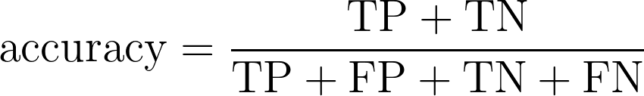
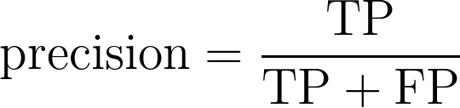
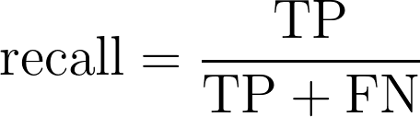
Bulky mediastinal lymphoma classification with ML-techniques
Performance measures: accuracy, precision & recall
Predicted labels
The accuracy is generally not the preferred performance measure for classifiers, especially when one are dealing with unbalanced datasets. In fact, classifiers succeed in recognizing instances belonging to most frequent label, resulting in high accuracy even if the other instances are mis-classified.
In order to ensure a model evaluation robust against unbalanced datasets, one can use precision or recall scores.
Negative
Positive
True Negative (TN) | False Positive (FP)
False Negative (FN) | True Positive (TP)
Negative
Actual labels
Positive
In the Jupyter Notebook we have used RECALL!
Matteo Barbetti (University of Firenze)
[16.09.2021]
AIMN-Firenze meeting
14|34

Slide 15
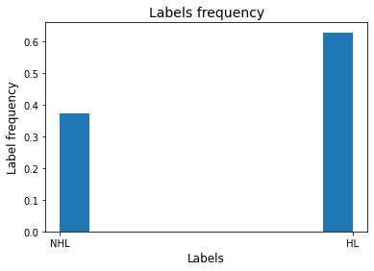
Bulky mediastinal lymphoma classification with ML-techniques
Dummy Classifier: model baseline
The Dummy Classifier is a simple classifier that makes predictions using simple rules:
computes the frequency of each label
interprets such frequencies as probabilities
predicts new instances label on the basis of computed probabilities
This classifier is useful as a simple baseline to compare with other (real) classifiers
Matteo Barbetti (University of Firenze)
[16.09.2021]
AIMN-Firenze meeting
15|34

Slide 16
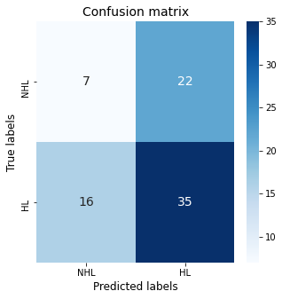
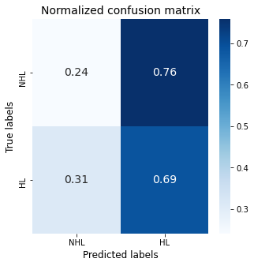
Bulky mediastinal lymphoma classification with ML-techniques
Dummy Classifier: performance
Matteo Barbetti (University of Firenze)
[16.09.2021]
AIMN-Firenze meeting
16|34

Slide 17
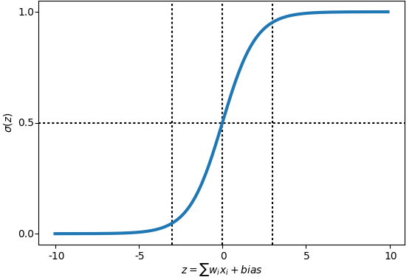
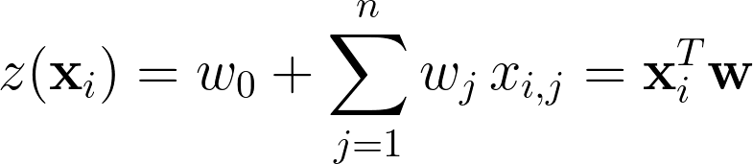
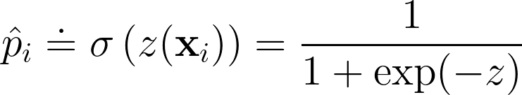
Bulky mediastinal lymphoma classification with ML-techniques
Logistic regression
The Logistic Regression (LR) is a statistical model that in its basic form uses a logistic function σ(· ) to model a binary dependent variable.
LR model computes a weighted sum of the input features z (plus a bias term)
This weighted sum are mapped it to a number between 0 and 1 through the logistic function
The logistic output σ(x) can be interpreted as the probability that x belongs to the positive class
< 0.5 → NHL
≥ 0.5 → HL
weighted sum of features
predictions
Matteo Barbetti (University of Firenze)
[16.09.2021]
AIMN-Firenze meeting
17|34

Slide 18
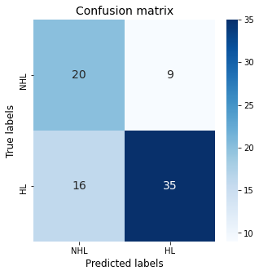
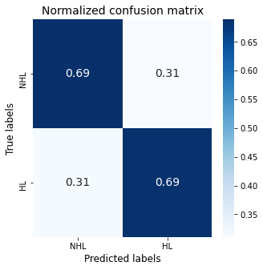
Bulky mediastinal lymphoma classification with ML-techniques
Logistic regression: performance
Matteo Barbetti (University of Firenze)
[16.09.2021]
AIMN-Firenze meeting
18|34

Slide 19
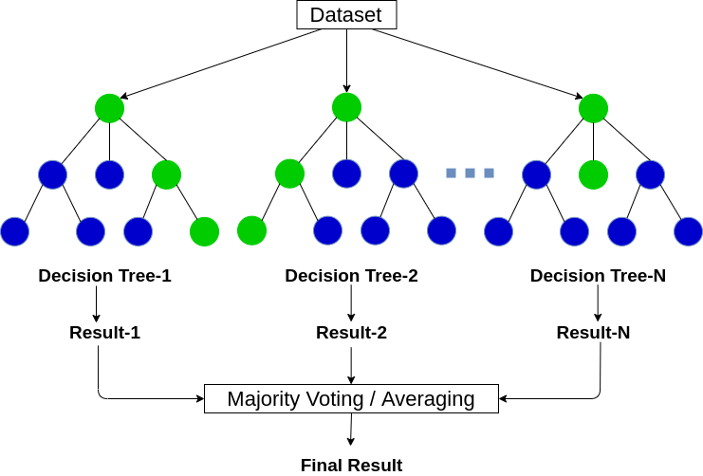
Bulky mediastinal lymphoma classification with ML-techniques
Random Forest classifier
Matteo Barbetti (University of Firenze)
[16.09.2021]
AIMN-Firenze meeting
19|34

Slide 20
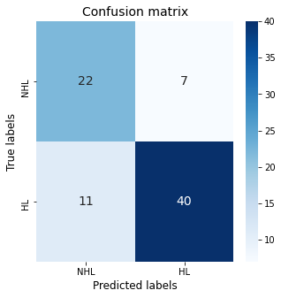
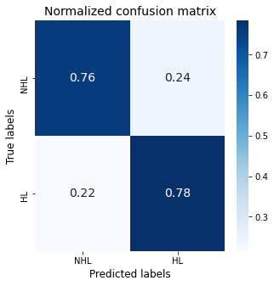
Bulky mediastinal lymphoma classification with ML-techniques
Random Forest classifier: performance
Matteo Barbetti (University of Firenze)
[16.09.2021]
AIMN-Firenze meeting
20|34

Slide 21
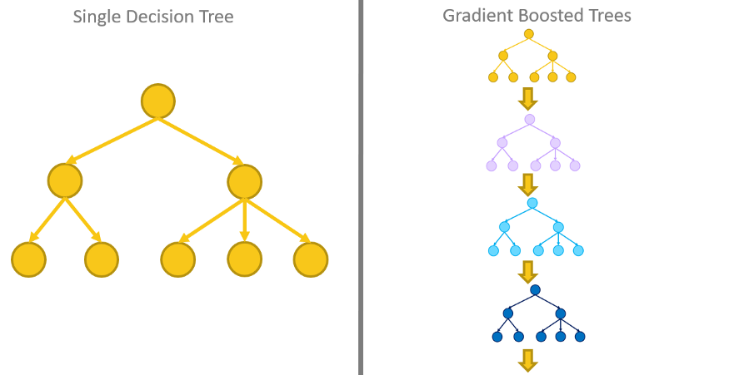
Bulky mediastinal lymphoma classification with ML-techniques
Gradient BDT classifier
Gradient BDT combines multiple simple decision trees into a stronger learner
Each tree is trained on the residuals from the previous sequence of trees
All trees are then combined together using an additive model
Matteo Barbetti (University of Firenze)
[16.09.2021]
AIMN-Firenze meeting
21|34

Slide 22
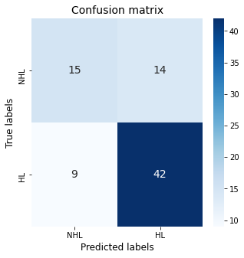
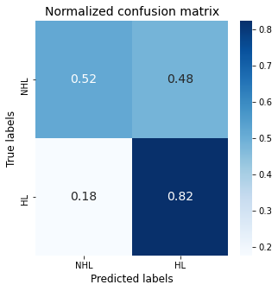
Bulky mediastinal lymphoma classification with ML-techniques
Gradient BDT classifier: performance
Matteo Barbetti (University of Firenze)
[16.09.2021]
AIMN-Firenze meeting
22|34

Slide 23

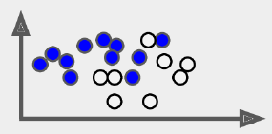
Bulky mediastinal lymphoma classification with ML-techniques
Model combination
Logistic
regression
prediction: “HL”
Random
Forest
final prediction: “HL”
prediction: “NHL”
Hard voting
TRAIN-SET
Gradient
BDT
prediction: “HL”
Diverse predictors
Matteo Barbetti (University of Firenze)
[16.09.2021]
AIMN-Firenze meeting
23|34

Slide 24
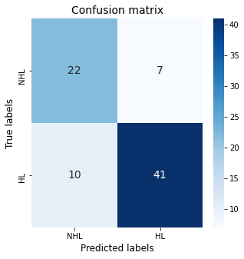
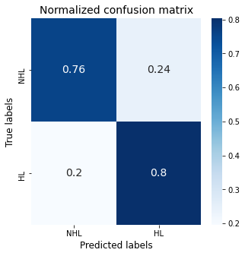
Bulky mediastinal lymphoma classification with ML-techniques
Model combination: performance
Matteo Barbetti (University of Firenze)
[16.09.2021]
AIMN-Firenze meeting
24|34

Slide 25
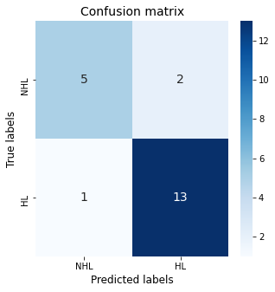
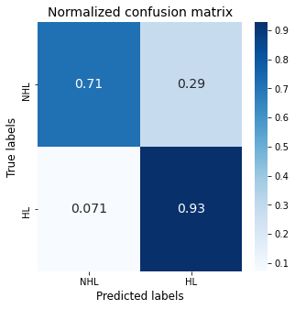
Bulky mediastinal lymphoma classification with ML-techniques
Results on the test-set
Matteo Barbetti (University of Firenze)
[16.09.2021]
AIMN-Firenze meeting
25|34

Slide 26
Bulky mediastinal lymphoma classification with ML-techniques
multiclass_classification
Matteo Barbetti (University of Firenze)
[16.09.2021]
AIMN-Firenze meeting
26|34

Slide 27
Bulky mediastinal lymphoma classification with ML-techniques
Instance space
Missing information
some features not available for all the instances
instances dropped to keep homogeneity
119 → 101 rows (instances)
Dataset strongly unbalanced
HL-class is over-represented w.r.t. the other two ones
classification suffers from unbalancing
Multiclass classification
HL, GZ and PML classification
GZ-HL ratio : 13.8%
PML-HL ratio : 41.5%
Train/Test split : 80%/20%
k-Folds Cross Validation with k=3
Matteo Barbetti (University of Firenze)
[16.09.2021]
AIMN-Firenze meeting
27|34

Slide 28
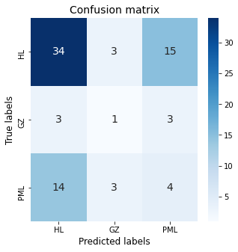
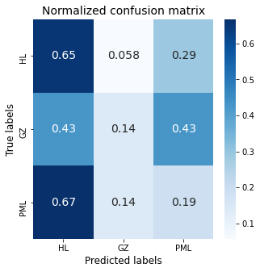
Bulky mediastinal lymphoma classification with ML-techniques
Dummy Classifier
Matteo Barbetti (University of Firenze)
[16.09.2021]
AIMN-Firenze meeting
28|34

Slide 29
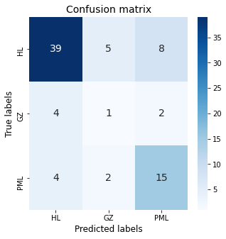
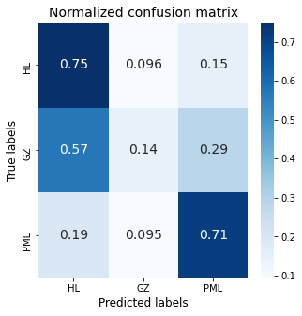
Bulky mediastinal lymphoma classification with ML-techniques
Logistic regression: performance
Matteo Barbetti (University of Firenze)
[16.09.2021]
AIMN-Firenze meeting
29|34

Slide 30
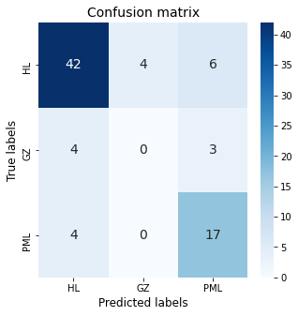
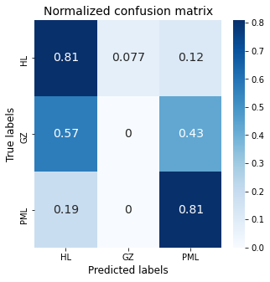
Bulky mediastinal lymphoma classification with ML-techniques
Random Forest classifier: performance
Matteo Barbetti (University of Firenze)
[16.09.2021]
AIMN-Firenze meeting
30|34

Slide 31
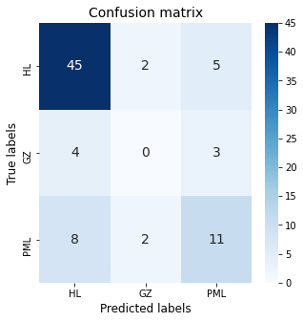
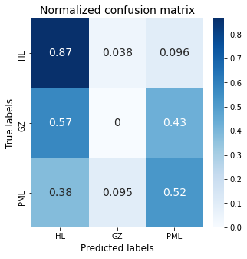
Bulky mediastinal lymphoma classification with ML-techniques
Gradient BDT classifier: performance
Matteo Barbetti (University of Firenze)
[16.09.2021]
AIMN-Firenze meeting
31|34

Slide 32
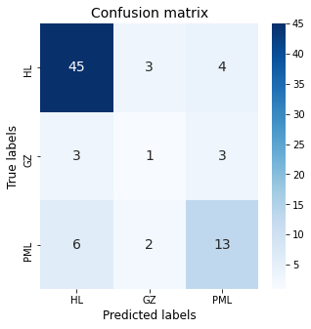
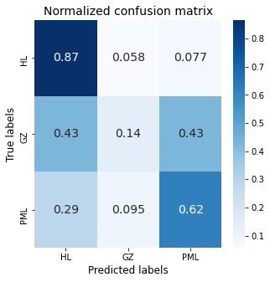
Bulky mediastinal lymphoma classification with ML-techniques
Model combination: performance
Matteo Barbetti (University of Firenze)
[16.09.2021]
AIMN-Firenze meeting
32|34

Slide 33
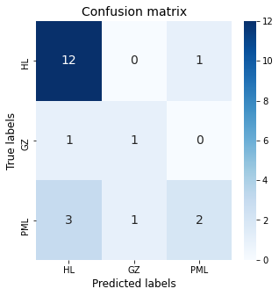
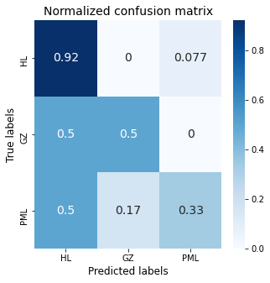
Bulky mediastinal lymphoma classification with ML-techniques
Results on the test-set
Matteo Barbetti (University of Firenze)
[16.09.2021]
AIMN-Firenze meeting
33|34

Slide 34
Bulky mediastinal lymphoma classification with ML-techniques
Conclusion
Preliminary studies
There is room for improvements
increasing the dataset → more data
balancing the dataset → expanding low-represented classes
working with low-level data → image classification techniques
Still need for taking a look at literature
Open to any kind of suggestions!
Matteo Barbetti (University of Firenze)
[16.09.2021]
AIMN-Firenze meeting
34|34

Slide 35
Bulky mediastinal lymphoma classification with ML-techniques
Backup
Matteo Barbetti (University of Firenze)
[16.09.2021]
AIMN-Firenze meeting
35|34

Slide 36
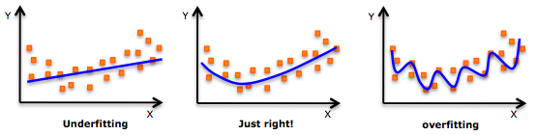
Bulky mediastinal lymphoma classification with ML-techniques
Undertraining & overtraining
Matteo Barbetti (University of Firenze)
[16.09.2021]
AIMN-Firenze meeting
36|34

