Slide 1

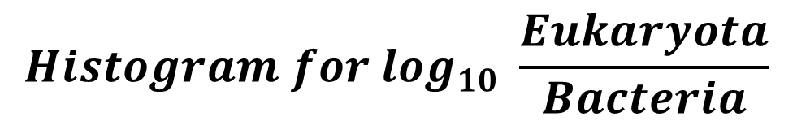
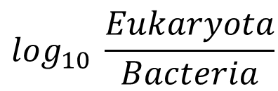
$$Histogram for \log_{10} \frac{Eukaryota}{Bacteria}$$
10
Histogram for log₁₀ Eukaryota
median = −2.80
Percentage
10
median = 4.31
8
8
6
Percentage
4
2
6
0
1
2
3
4
5
6
Histogram for log₁₀ Bacteria
4
Percentage
8
median = 7.19
6
4
2
2
0
4
5
6
7
8
0
−6
−5
−4
−3
−2
−1
$$\log_{10} \frac{Eukaryota}{Bacteria}$$
Sequence quality control
2,052 samples
filter history
surgery patients
1,986 samples
filter none
stage patients
1,919 samples
filter the low-alignment-reads sample (< 1M )
1,901 samples
Outlier samples filtering
1,636 samples
filter suspected of fungal contamination
(1 species> 50%)
1,731 samples
filter suspected of bacteria contamination
(1 species> 50%)
1,802 samples
filter the
high-Eukaryota
sample (> 1% )
1,882 samples
filter the
low-Eukaryota
sample (< 0.01% )
Downstream analysis
Items | adenoma | CRC | CTRL | filter | leave
import samples | - | - | - | - | 1,919
filter low-align-reads samples | 10 | 1 | 7 | 18 | 1,901
filter low-Eukaryota samples | 14 | 36 | 30 | 80 | 1,882
filter high-Eukaryota samples | 5 | 8 | 6 | 19 | 1,802
filter suspected bacteria contamination samples | 19 | 20 | 32 | 71 | 1,731
filter suspected fungal contamination samples | 22 | 36 | 37 | 95 | 1,636
filter low sample counts cohort | 1 | 6 | 4 | 11 | 1,625
low samples counts leave cohort
1,625 samples

Slide 2
Import OTU matrix
analysis by the kraken2 & bracken
1
2
3
Fungi alpha diversity
Meta-analysis significant fungi
Correlation distribution
1. Each cohorts performance [violin plot]
1. General significant difference [bar plot]
1. Fungi internal correlations [strangle hm]
2. Line regression with bac alpha diversity [point plot]
2. Selected in each cohort relative abundance [hm]
2. Fungi & bacteria relationships [hm + bar plot]
3. Clinical subgroup (AJCC, gender, BMI) [bar plot]
3. Selected in each cohort fold change [boxplot]
Fungi beta diversity
4
1. PCOA
Individual fungi
2. t-SNE/ CCA/ RDA
1. Correlation with clinical info
3. PCA contribution
[stages/ cohorts/ clinical info]
2. Functional analysis
Fungi composition
2. Meta-analysis significant fungi
把阈值放宽，挑选出所有有相同trend (≥ 7)的features， 画分布直方图，分方向。[绘制柱状图，加个横线分开]
根据Wilcoxon rank test再去筛选 p value 。[cohort的热图，p-value + CTRL + CRC]
最后卡一个|log₂FC| ≥ 0.5的阈值，筛选得到最终的结果。[小提琴图]
1. Phylum
2. Species
1. Fungi profiles:
Alpha 多样性，
绘制小提琴图，根据不同的stages分组，可以包含所有的features， 也可以去掉一些0过多的features。
Alpha 多样性，把每个cohort的情况以点图 + Quarter 的形式添加到小提琴中。
画一个回归，看看fungi和bac的alpha diversity的相关性情况，是否共增或者共减。
通过AJCC/ 性别分组，去绘制alpha 多样性图，也可以画和BMI的相关性。
Beta 多样性
非监督聚类，PCoA
监督性聚类， t-SNE/ CCA/ RDA
根据stages/ cohorts/ 或者其他clinic的信息去看看他们在每个PCoA中的贡献是怎么样的 [参考cell那篇文章]。
真菌的组成
从不同的level去看（phylum和species），画堆积直方图，对数据进行拟合（参考Wilson和长安他们文章）
真菌的比例在不同的samples、stages中的分布，画直方图，也可以做一个线性拟合。

Slide 4



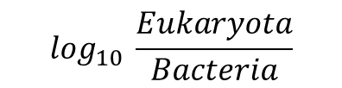





$$Histogram for \log_{10} \frac{Eukaryota}{Bacteria}$$
200
$$Histogram for \log_{10 }Eukaryota$$
$$median=−2.80$$
200
$$median=4.31$$
$$Frequency$$
150
150
100
$$Frequency$$
50
0
1
2
3
4
5
6
100
150
$$Histogram for \log_{10} Bacteria$$
100
$$median=7.19$$
50
$$Frequency$$
50
0
4
5
6
7
8
0
−6
−5
−4
−3
−2
−1
0
$$\log_{10} \frac{Eukaryota}{Bacteria}$$
Sequence quality control
2,052 samples
filter history
surgery patients
1,986 samples
filter none
stage patients
1,919 samples
filter the low-alignment-reads sample (< 1M )
1,901 samples
Outlier samples filtering
1,636 samples
filter suspected of fungal contamination
(1 species> 50%)
1,731 samples
filter suspected of bacteria contamination
(1 species> 50%)
1,802 samples
filter the
high-Eukaryota
sample (> 1% )
1,882 samples
filter the
low-Eukaryota
sample (< 0.01% )
Downstream analysis
Items | adenoma | CRC | CTRL | filter | leave
import samples | - | - | - | - | 1,919
filter low-align-reads samples | 10 | 1 | 7 | 18 | 1,901
filter low-Eukaryota samples | 14 | 36 | 30 | 80 | 1,882
filter high-Eukaryota samples | 5 | 8 | 6 | 19 | 1,802
filter suspected bacteria contamination samples | 19 | 20 | 32 | 71 | 1,731
filter suspected fungal contamination samples | 22 | 36 | 37 | 95 | 1,636
filter low sample counts cohort | 1 | 6 | 4 | 11 | 1,625
low samples counts leave cohort
1,625 samples

Slide 5
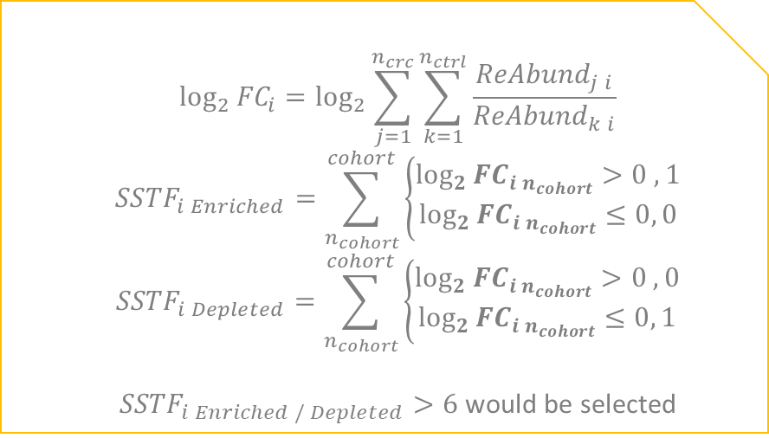
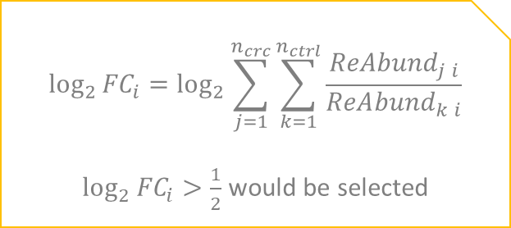
Import OTU matrix
(analysis by the kraken2 & bracken)
$${\log_{2}{FC}}_{i}=\log_{2}{\sum_{j=1}^{n_{crc}}{\sum_{k=1}^{n_{ctrl}}{\frac{{ReAbund}_{j i}}{{ReAbund}_{k i}}}}}$$
$${SSTF}_{i Enriched}=\sum_{n_{cohort}}^{cohort}{\left\{\begin{aligned}{\log_{2}{FC}}_{i n_{cohort}}>0 , 1 \\ {\log_{2}{FC}}_{i n_{cohort}}≤0, 0\end{aligned}\right.}$$
$${SSTF}_{i Depleted}=\sum_{n_{cohort}}^{cohort}{\left\{\begin{aligned}{\log_{2}{FC}}_{i n_{cohort}}>0 , 0 \\ {\log_{2}{FC}}_{i n_{cohort}}≤0, 1\end{aligned}\right.}$$
${SSTF}_{i Enriched / Depleted}>6$would be selected
SSTF
(selected same trend features)
$$i: fungi names$$
$$n_{crc}:counts of CRC samples$$
Significant difference
(Wilcoxon rank test: p value < 0.05)
28 fungi leave
Internal correlations
Log2(General Fold Change) > 1/2
$${\log_{2}{FC}}_{i}=\log_{2}{\sum_{j=1}^{n_{crc}}{\sum_{k=1}^{n_{ctrl}}{\frac{{ReAbund}_{j i}}{{ReAbund}_{k i}}}}}$$
${\log_{2}{FC}}_{i}>\frac{1}{2}$would be selected
Fungi
Aspergillus rambellii
Tilletia controversa
Aspergillus kawachii
Rhizophagus irregularis
Torulaspora globosa
Eremothecium sinecaudum
6 fungi leave
Bacteria analysis
candidates

Slide 6


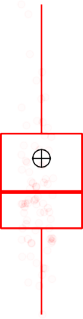


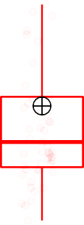
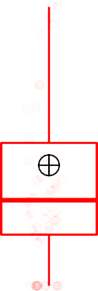
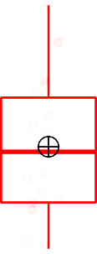
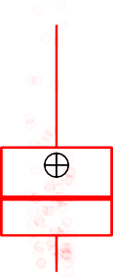





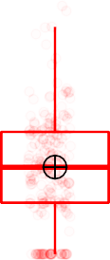


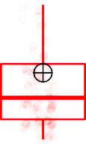

























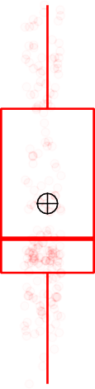

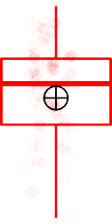
























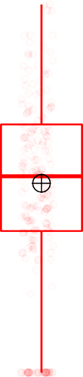




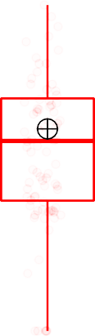



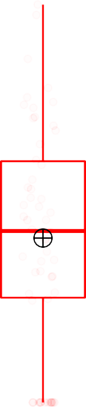

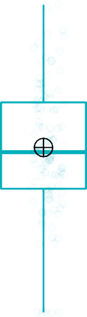
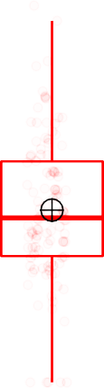

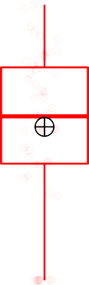


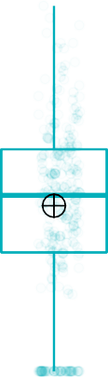

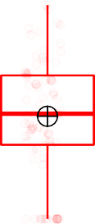
Aspergillus rambellii
8 cohorts has same trend in CRC entiched.
7 cohorts play significant different.
Stage
CTRL
CRC
1.2
p = 0.0018
p = 6.1e−05
p = 2.7e−05
p = 0.0034
p = 1.4e−06
p = 7.5e−05
p = 0.001
0.8
0.4
0.0
Tilletia controversa
7 cohorts has same trend in CRC entiched.
4 cohorts play significant different.
0.3
p = 0.00026
p = 0.0037
p = 9.3e−07
p = 0.0036
0.2
0.1
0.0
Aspergillus kawachii
7 cohorts has same trend in CRC depleted.
5 cohorts play significant different.
0.2
p = 0.02
p = 0.021
p = 0.012
p = 0.0039
p = 0.0018
0.1
0.0
Rhizophagus irregularis
1.00
p = 7.6e−05
7 cohorts has same trend in CRC depleted.
6 cohorts play significant different.
0.75
0.50
p = 7.9e−07
p = 0.029
p = 0.00085
p = 0.026
p = 3.5e−05
0.25
0.00
Torulaspora globosa
p = 0.0025
p = 0.0095
p = 0.0043
7 cohorts has same trend in CRC depleted.
4 cohorts play significant different.
0.20
p = 1.8e−05
0.15
0.10
0.05
0.00
Eremothecium sinecaudum
7 cohorts has same trend in CRC depleted.
4 cohorts play significant different.
0.2
p = 0.03
p = 0.008
p = 0.017
p = 0.0042
0.1
0.0
2014_ZellerG
2015_FengQ
2016_VogtmannE
2019_Thom
2019_WirbelJ
2019_Yachida
2021_JunY_1
2021_JunY_2

Slide 7
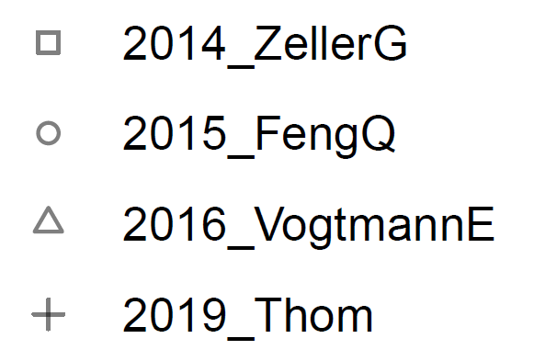
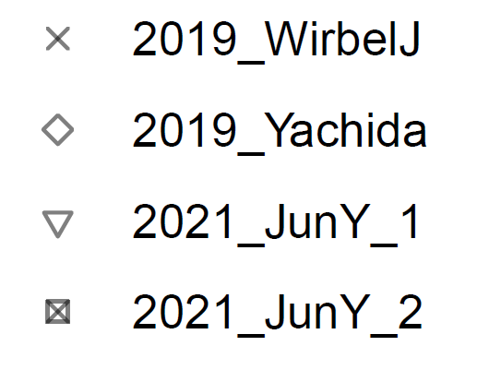
Aspergillus rambellii
Tilletia controversa Aspergillus kawachii Rhizophagus irregularis Torulaspora globosa Eremothecium sinecaudum
−2.5
0.0
Log2(FC)
2.5
5.0
CRC Enriched
CRC Depleted
Aspergillus rambellii
A. rambellii have been shown to accumulate both aflatoxin (AF) and the aflatoxin precursor sterigmatocystin (ST).^{[1]}
A. rambellii secreted a greater concentration of AFB1 than any other aflatoxigenic species. ^{[2]}
Aflatoxins are the most carcinogenic natural products known. ^{[2]}
Aspergillus kawachii
In the present study, fermented silkworm larvae was developed via solid-state fermentation with Aspergillus kawachii and investigated its anti-cancer activity in human hepatocellular carcinoma cells. ^{[3]}
Viscum album var. coloratum (Korean mistletoe; KM) is a promising agent for treating colon cancer, ^{[4]} hepatoma and immunomodulation. The anti-oxidative activities of KM can be enhanced by fermentation using the crude enzyme extract derived from A. kawachii. ^{[5]}
Cary JW, Ehrlich KC, Beltz SB, Harris-Coward P, Klich MA. Characterization of the Aspergillus ochraceoroseus aflatoxin/sterigmatocystin biosynthetic gene cluster. Mycologia. 2009;101(3):352-362. doi:10.3852/08-173
Frisvad JC, Skouboe P, Samson RA. Taxonomic comparison of three different groups of aflatoxin producers and a new efficient producer of aflatoxin B1, sterigmatocystin and 3-O-methylsterigmatocystin, Aspergillus rambellii sp. nov. Syst Appl Microbiol. 2005;28(5):442-453. doi:10.1016/j.syapm.2005.02.012
Cho HD, Min HJ, Won YS, Ahn HY, Cho YS, Seo KI. Solid state fermentation process with Aspergillus kawachii enhances the cancer-suppressive potential of silkworm larva in hepatocellular carcinoma cells. BMC Complement Altern Med. 2019;19(1):241. Published 2019 Sep 5. doi:10.1186/s12906-019-2649-7
Khil, L. Y., Kim, W., Lyu, S., Park, W. B., Yoon, J. W., & Jun, H. S. (2007). Mechanisms involved in Korean mistletoe lectin-induced apoptosis of cancer cells. World journal of gastroenterology, 13(20), 2811–2818. https://doi.org/10.3748/wjg.v13.i20.2811
Kim, S. Y., Yang, E. J., Son, Y. K., Yeo, J. H., & Song, K. S. (2016). Enhanced anti-oxidative effect of fermented Korean mistletoe is originated from an increase in the contents of caffeic acid and lyoniresinol. Food & function, 7(5), 2270–2277. https://doi.org/10.1039/c6fo00138f

Slide 8
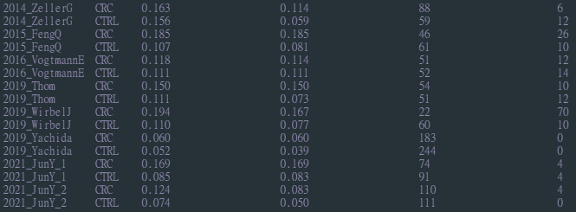
Weak internal correlation between the (selected) fungi
SparCC:
cohort
stage
Max |cor|
Max |cor| of A.R.
Sample counts
Counts(|cor| > 0.08)

