Slide 1

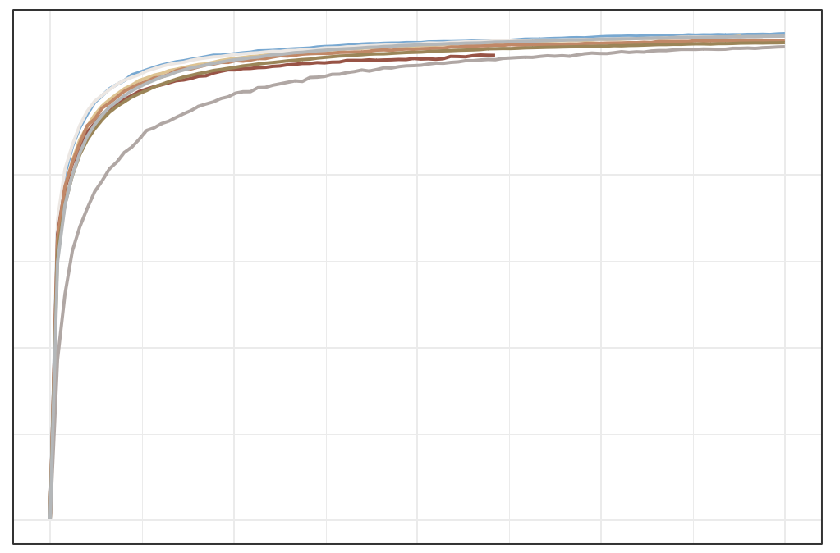
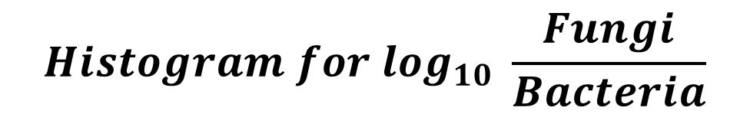
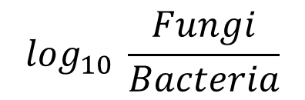
a
$$Histogram for \log_{10} \frac{Fungi}{Bacteria}$$
10
Histogram for log₁₀ $Fungi$
median = −2.80
Percentage
10
median = 4.31
8
8
6
Percentage
4
2
6
0
1
2
3
4
5
6
Histogram for log₁₀ Bacteria
4
Percentage
8
median = 7.19
6
4
2
2
0
4
5
6
7
8
0
−6
−5
−4
−3
−2
−1
$$\log_{10} \frac{Fungi}{Bacteria}$$
b
c
Sample sequence quality control
2,052 samples
filter abnormal
patients
1,935 samples
filter none
stage patients
1,919 samples
400
filter the
high-Fungi
sample (> 1% )
1,836 samples
filter the low-alignment-reads sample (< 1M )
1,837 samples
PCR free
chao1
2014_ZellerG
2015_FengQ 2016_VogtmannE 2019_ThomasA 2019_WirbelJ 2019_YachidaS 2017_JunY_1
2021_JunY_2
Suspected contamination samples filtering
1,817 samples
filter the
low-Fungal sample (< 0.01% )
1,739 samples
filter suspected of bacteria contamination
(1 species> 50%)
1,670 samples
200
Low-fungal sequence depth samples discarding
1,329 samples
filter low-fungal
sequencing depth samples ( < 10k)
1,625 samples
filter suspected of fungal
contamination
(1 species> 50%)
0
0
5000
10000
15000
20000
Sequencing Depth in Fungi
Notes:
F:\GitHub\multi-CRC-fungi\01.Histogram_data_profile
F:\GitHub\multi-CRC-fungi\04.RarefactionCurve\Cohort

Slide 2
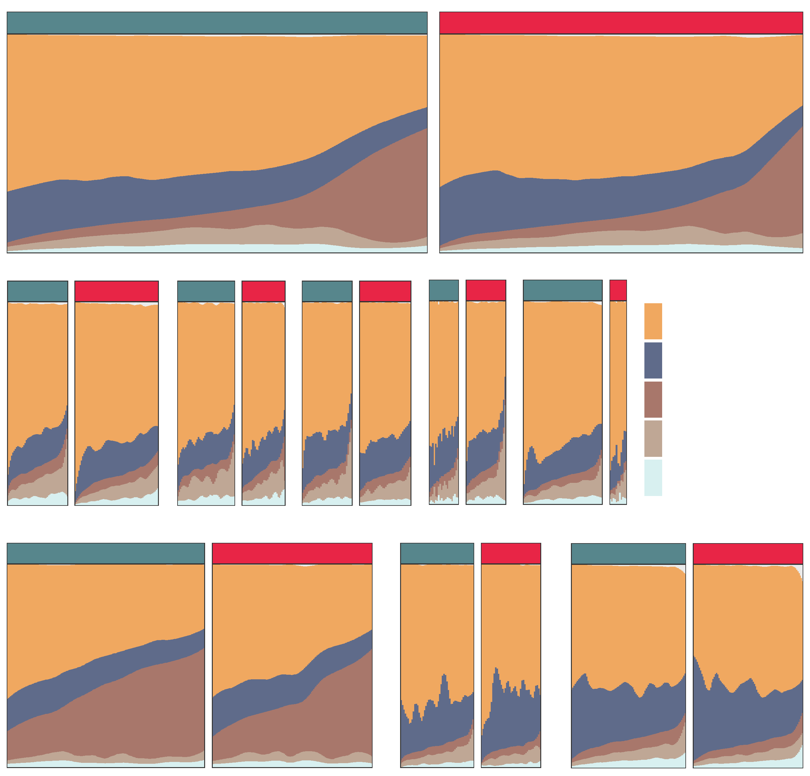
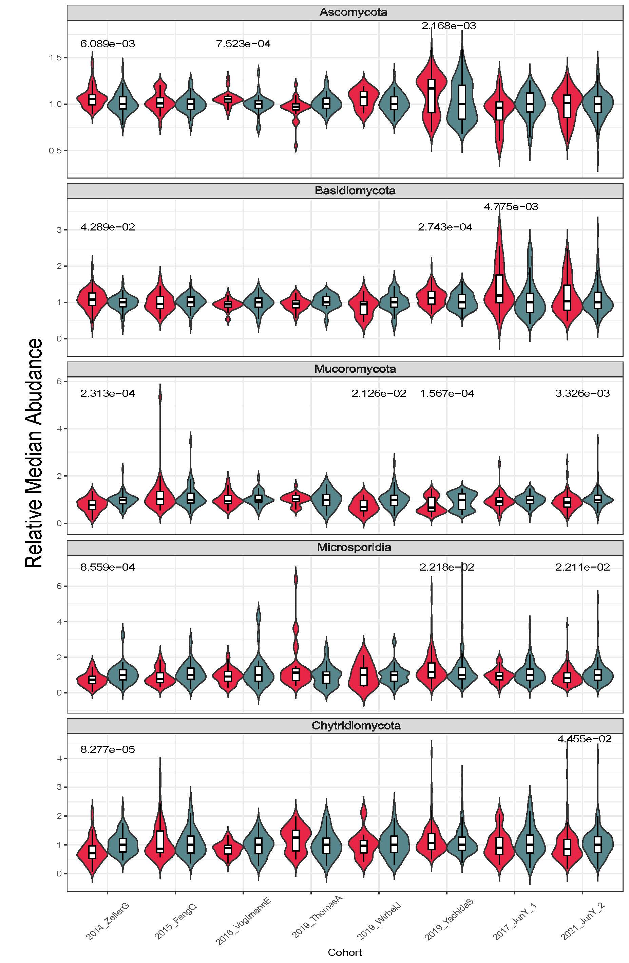
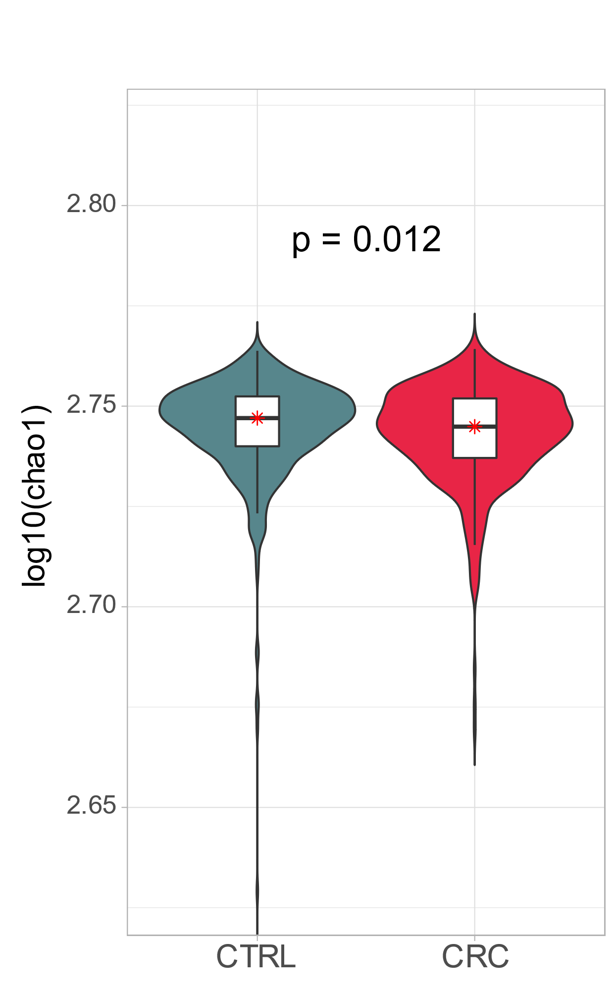
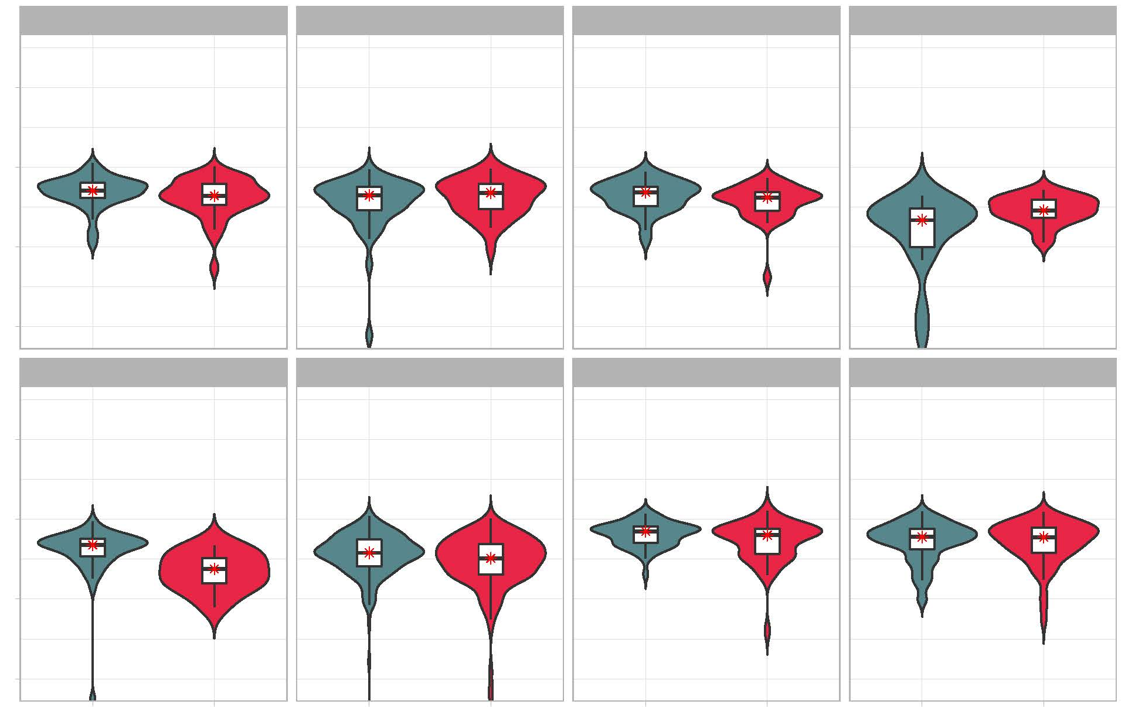
a
Control
CRC
c
b
2014_ZellerG (EU)
2015_FengQ (OC)
2016_VogtmannE (NA)
2019_ThomasA (EU)
2019_WirbelJ (EU)
CORE PHYLUM
Control
CRC
Control
CRC
Control
CRC
Control
CRC
Control
CRC
Ascomycota
Basidiomycota
Mucoromycota
Microsporidia
Chytridiomycota
Control
2019_YachidaS (AS)
CRC
2017_JunY (AS)
2021_JunY (AS)
Control
CRC
Control
CRC
d
2014_ZellerG (EU)
2015_FengQ (OC)
2016_VogtmannE (NA)
2019_ThomasA (EU)
2.80
0.014
2.76
2.72
2.68
2019_WirbelJ (EU)
2019_YachidaS (AS)
2017_JunY (AS)
2021_JunY (AS)
2.80
0.00038
0.017
2.76
2.72
2.68
CTRL
CRC
CTRL
CRC
CTRL
CRC
CTRL
CRC
Notes:
F:\GitHub\multi-CRC-fungi\06.AlphaDiversity\AlphaIndex\figure
F:\GitHub\multi-CRC-fungi\06.AlphaDiversity\Normaled_Median
F:\GitHub\multi-CRC-fungi\06.AlphaDiversity\Fungal_Components

Slide 3
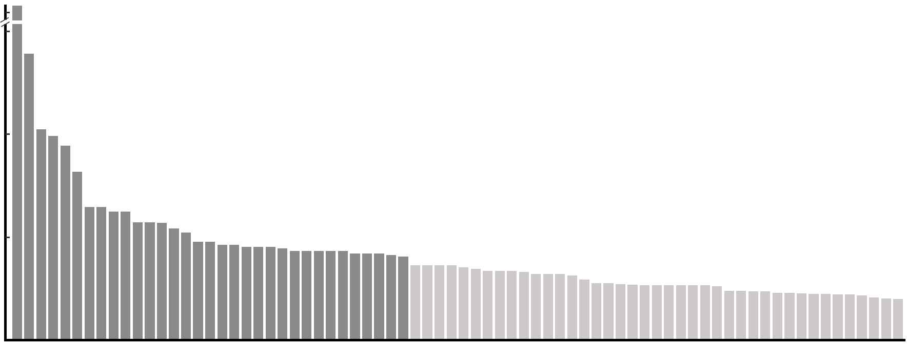
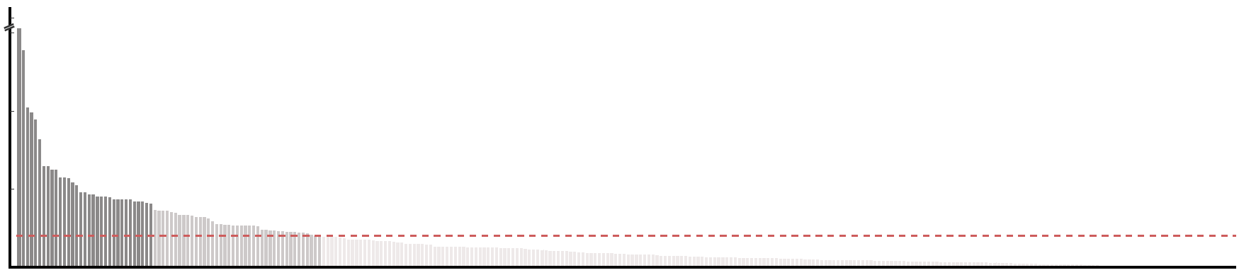
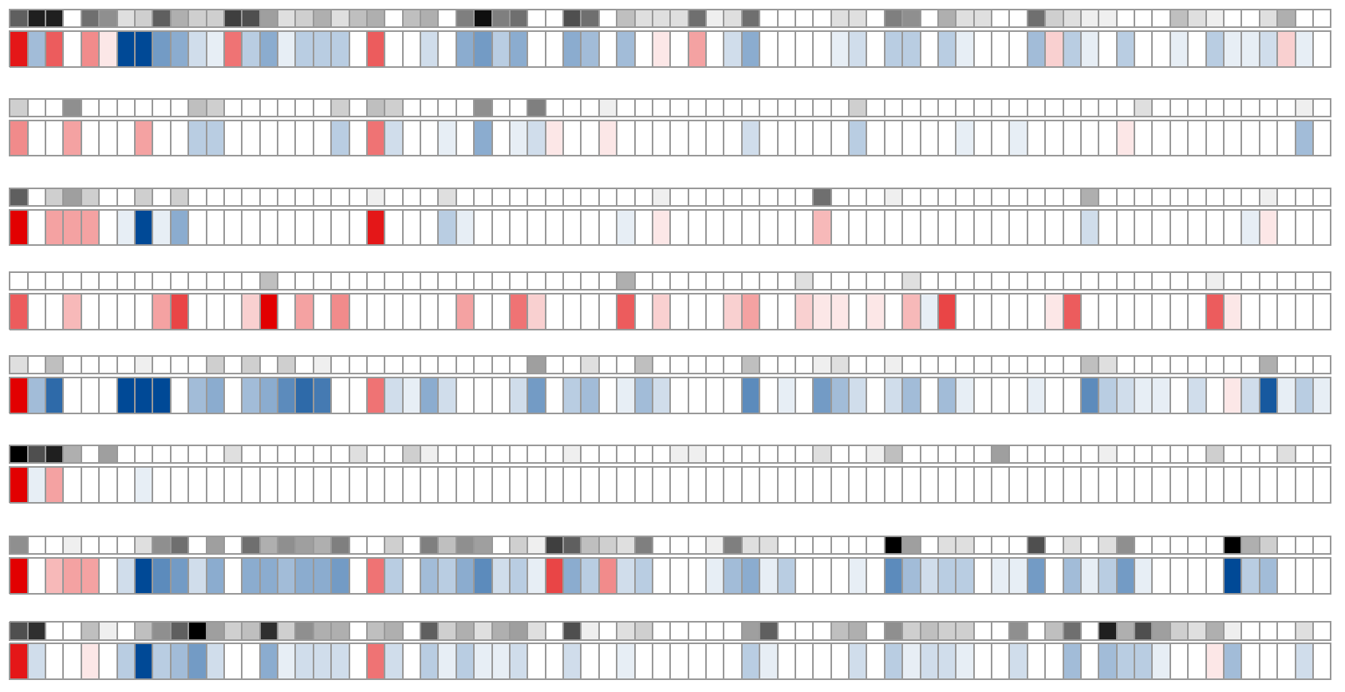
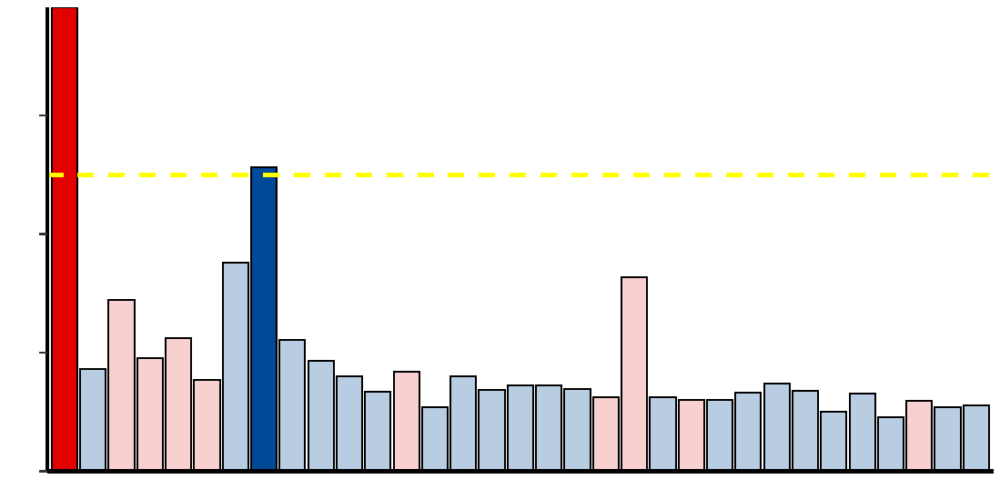
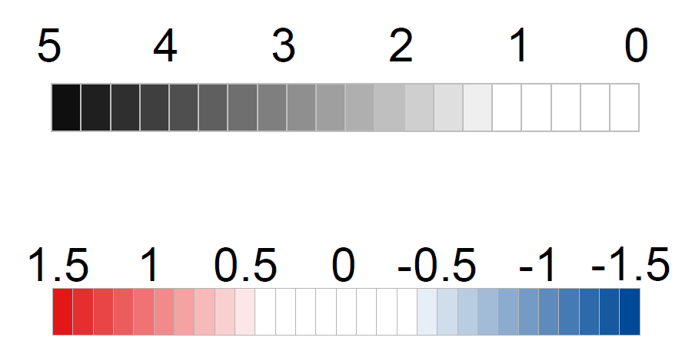
a
Fungal features selection
(control vs. CRC)
17.0
7.5
17.0
- log₁₀ FDR
7.5
- log₁₀ FDR
5.0
5.0
2.5
FDR < 0.1
2.5
0.0
FDR < 0.01
0.0
Aspergillus rambellii
Rhizophagus irregularis
Moniliophthora perniciosa
Erysiphe pulchra
Sphaerulina musiva
Phytophthora capsici
Trichophyton mentagrophytes
Aspergillus kawachii
Pneumocystis murina
Debaryomyces hansenii
Trichoderma atroviride
Pseudocercospora musae
Cordyceps sp. RAO−2017
Rhizophagus clarus
Pichia kudriavzevii
Paracoccidioides brasiliensis
Albugo candida
Lipomyces starkeyi
Naumovozyma dairenensis
Phytopythium vexans
Aspergillus ochraceoroseus
Colletotrichum fioriniae
Coniochaeta ligniaria
Leucoagaricus sp. SymC.cos
Colletotrichum salicis
[Candida] arabinofermentans
Baudoinia panamericana
Hyaloscypha variabilis
Schizosaccharomyces pombe
Tuber magnatum
Thielaviopsis punctulata
Edhazardia aedis
Choanephora cucurbitarum
Elsinoe australis
Piromyces sp. E2
Mucor circinelloides
Amorphotheca resinae
Colletotrichum tofieldiae
Sporisorium reilianum
Periconia macrospinosa
Blastomyces gilchristii
Cyberlindnera fabianii
Rhizoctonia solani
Spizellomyces punctatus
Pseudocercospora eumusae
Blumeria graminis
Pseudocercospora fijiensis
Aureobasidium namibiae
Calocera cornea
Polytolypa hystricis
Rhizopus delemar
Pythium aphanidermatum
Rozella allomycis
Batrachochytrium salamandrivorans
Rhizoclosmatium globosum
Cercospora zeina
Aspergillus steynii
Pezoloma ericae
Cordyceps fumosorosea
Pneumocystis carinii
Phialocephala subalpina
Moniliophthora roreri
Hanseniaspora valbyensis
Syncephalastrum racemosum
Histoplasma capsulatum
Tuber borchii
Phycomyces blakesleeanus
Saitoella complicata
Saccharomyces cerevisiae
Aspergillus udagawae
Candida maltosa
Rhodotorula graminis
Rutstroemia sp. NJR−2017a WRK4
Tolypocladium paradoxum
b
2014_ZellerG
(EU)
2015_FengQ
(OC)
2016_VogtmannE
(NA)
2019_ThomasA
(EU)
2019_WirbelJ
(EU)
2019_YachidaS
(AS)
2017_JunY_1
(AS)
2021_JunY_2
(AS)
c
Aspergillus rambellii
- log₁₀(p value)
abs( log₂ FC )
1.2
Aspergillus kawachii
abs( log₂ FC ) > 1.0
0.8
log₂(Fold change)
0.4
0.0
CRC Enriched
CRC Depleted
d
Aspergillus rambellii
Aspergillus kawachii
Notes:
F:\GitHub\multi-CRC-fungi\07.FeatureSelection\03.Plot
With multiple criteria, we obtained 74 significant different features, 33 mainly different features and 2 core features.
We also explored the performance of these 74 features in different cohorts and do some comparison between Control group and CRC group.
In order to validation our results, we utilized the same method in bacteria selection.

Slide 4
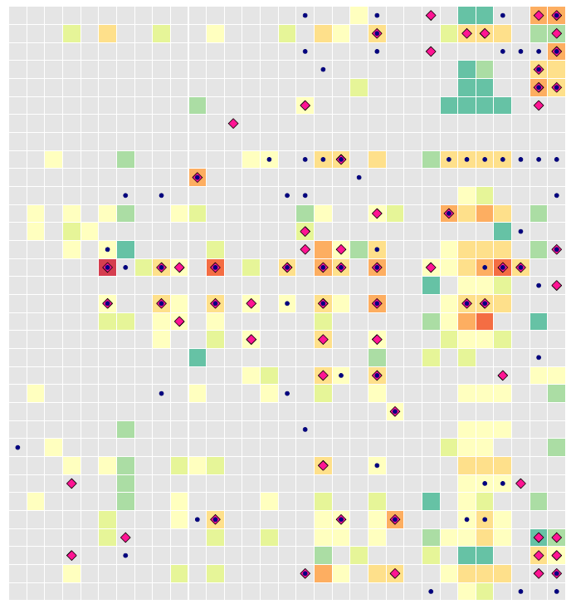
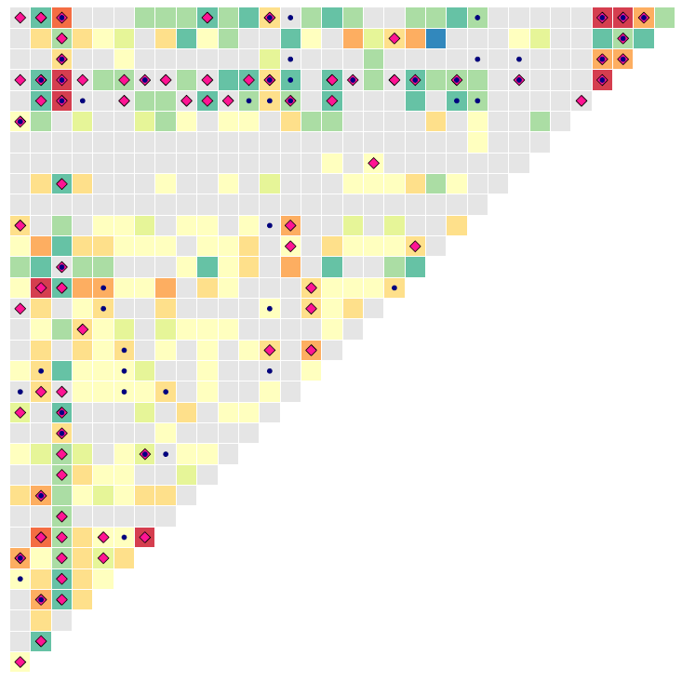
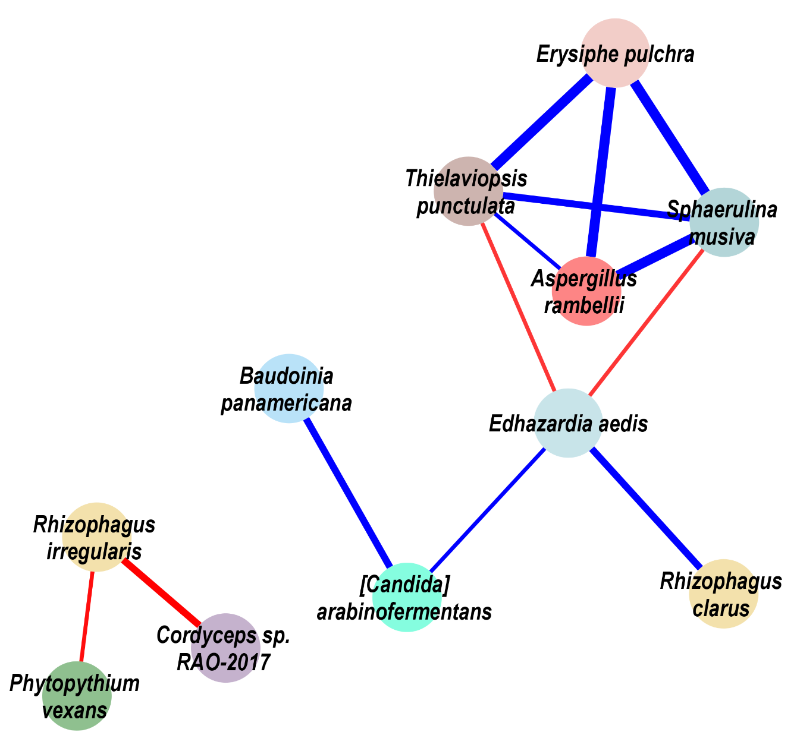
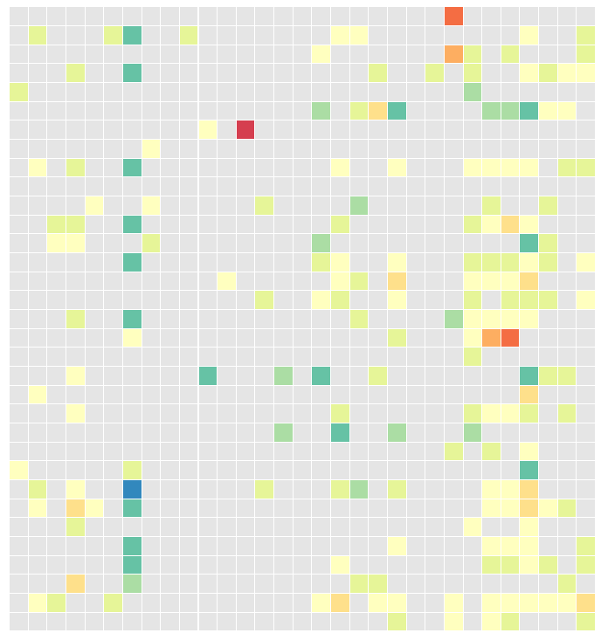
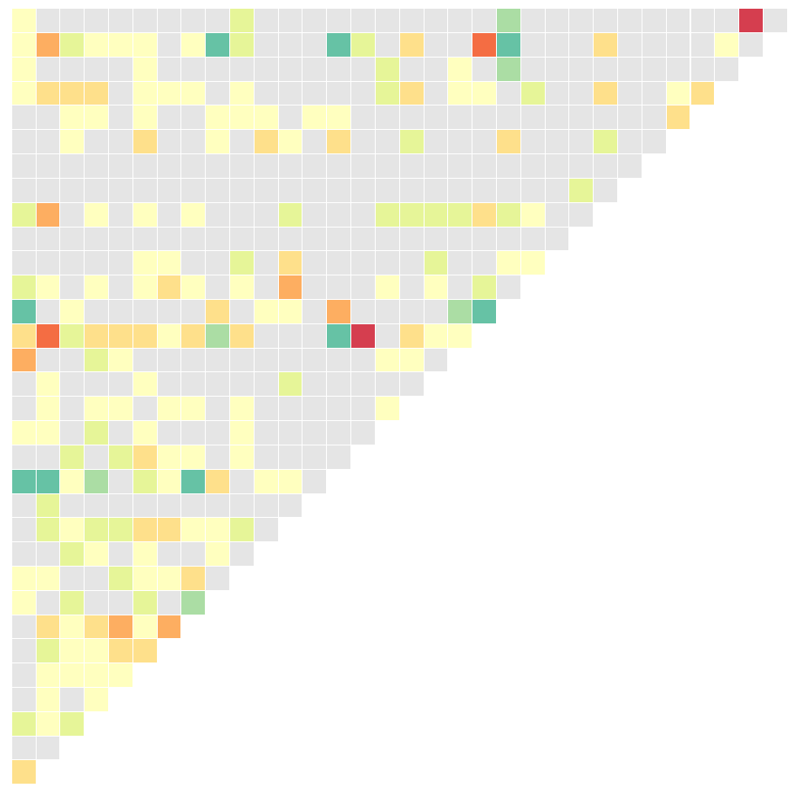
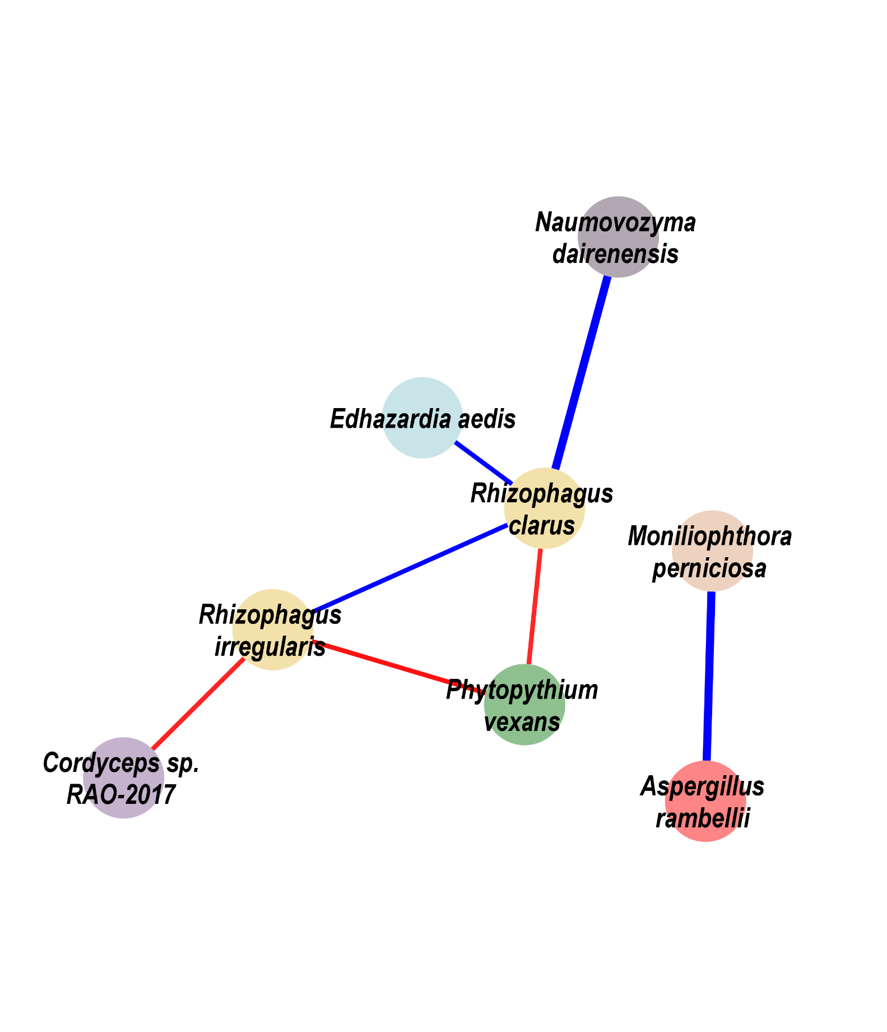

a
CRC group
Escherichia coli | Bifidobacterium longum | Ruminococcus bicirculans | Adlercreutzia equolifaciens | Bifidobacterium adolescentis | Streptococcus thermophilus | Prevotella intermedia | Bifidobacterium bifidum | Streptococcus milleri | Streptococcus equinus | Bifidobacterium pseudocatenulatum | Streptococcus salivarius | Bifidobacterium angulatum | Lactobacillus ruminis | Bifidobacterium catenulatum | Streptococcus anginosus | Fusobacterium periodonticum | Clostridium beijerinckii | [Eubacterium] eligens | Porphyromonas asaccharolytica | Romboutsia ilealis | Brachyspira pilosicoli | Lactococcus garvieae | Dialister pneumosintes | Roseburia intestinalis | Butyrivibrio proteoclasticus | Pseudobutyrivibrio xylanivorans | Anaerostipes hadrus | Gemella morbillorum | Parvimonas micra | Fusobacterium nucleatum
Choanephora cucurbitarum | Edhazardia aedis | Thielaviopsis punctulata | Tuber magnatum | Schizosaccharomyces pombe | Hyaloscypha variabilis | Baudoinia panamericana | [Candida] arabinofermentans | Colletotrichum salicis | Leucoagaricus sp. SymC.cos | Coniochaeta ligniaria | Colletotrichum fioriniae | Aspergillus ochraceoroseus | Phytopythium vexans | Naumovozyma dairenensis | Lipomyces starkeyi | Albugo candida | Paracoccidioides brasiliensis | Pichia kudriavzevii | Rhizophagus clarus | Cordyceps sp. RAO−2017 | Pseudocercospora musae | Trichoderma atroviride | Debaryomyces hansenii | Pneumocystis murina | Aspergillus kawachii | Trichophyton mentagrophytes | Phytophthora capsici | Sphaerulina musiva | Erysiphe pulchra | Moniliophthora perniciosa | Rhizophagus irregularis | Aspergillus rambellii
Aspergillus rambellii
Rhizophagus irregularis
Moniliophthora perniciosa
Erysiphe pulchra
Sphaerulina musiva
Phytophthora capsici
Trichophyton mentagrophytes
Aspergillus kawachii
Pneumocystis murina
Debaryomyces hansenii
Trichoderma atroviride
Pseudocercospora musae
Cordyceps sp. RAO−2017
Rhizophagus clarus
Pichia kudriavzevii
Paracoccidioides brasiliensis
Albugo candida
Lipomyces starkeyi
Naumovozyma dairenensis
Phytopythium vexans
Aspergillus ochraceoroseus
Colletotrichum fioriniae
Coniochaeta ligniaria
Leucoagaricus sp. SymC.cos
Colletotrichum salicis
[Candida] arabinofermentans
Baudoinia panamericana
Hyaloscypha variabilis
Schizosaccharomyces pombe
Tuber magnatum
Thielaviopsis punctulata
Edhazardia aedis
Choanephora cucurbitarum
b
Healthy control
Aspergillus rambellii
Rhizophagus irregularis
Moniliophthora perniciosa
Erysiphe pulchra
Sphaerulina musiva
Phytophthora capsici
Trichophyton mentagrophytes
Aspergillus kawachii
Pneumocystis murina
Debaryomyces hansenii
Trichoderma atroviride
Pseudocercospora musae
Cordyceps sp. RAO−2017
Rhizophagus clarus
Pichia kudriavzevii
Paracoccidioides brasiliensis
Albugo candida
Lipomyces starkeyi
Naumovozyma dairenensis
Phytopythium vexans
Aspergillus ochraceoroseus
Colletotrichum fioriniae
Coniochaeta ligniaria
Leucoagaricus sp. SymC.cos
Colletotrichum salicis
[Candida] arabinofermentans
Baudoinia panamericana
Hyaloscypha variabilis
Schizosaccharomyces pombe
Tuber magnatum
Thielaviopsis punctulata
Edhazardia aedis
Choanephora cucurbitarum
Bacteria
Reported potential
pathogens
Asperillaceae
Ceratocystidaceae
Choanephoraceae
Bacteria
Reported potential
probiotic
Erysiphaceae
Glomeraceae
Hyaloscyphaceae
CRC Enriched
Fungus
Pichiaceae
Pythiaceae
Saccharomycetaceae
Fungus
Culicosporidae
Mycosphaerallaceae
Cordycipitaceae
Fungus
CRC Depleted
Fungus
Marasmiaceae
Teratosphaeriaceae
Notes:
F:\GitHub\multi-CRC-fungi\08.correlation
As you can see, the bacterial selection is credible, most of them are the reported potential probiotic or pathogens.
In order to showing the most importance interaction in micro-eukaryota, we also plot the network for it in each stages.
As the picture shows, the correlation counts would be increased during the disease development.

Slide 5
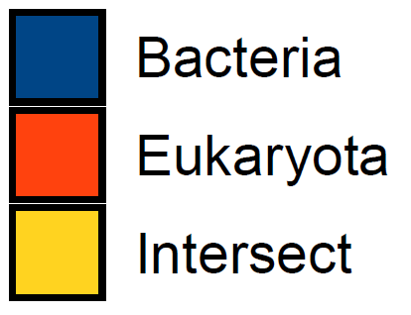

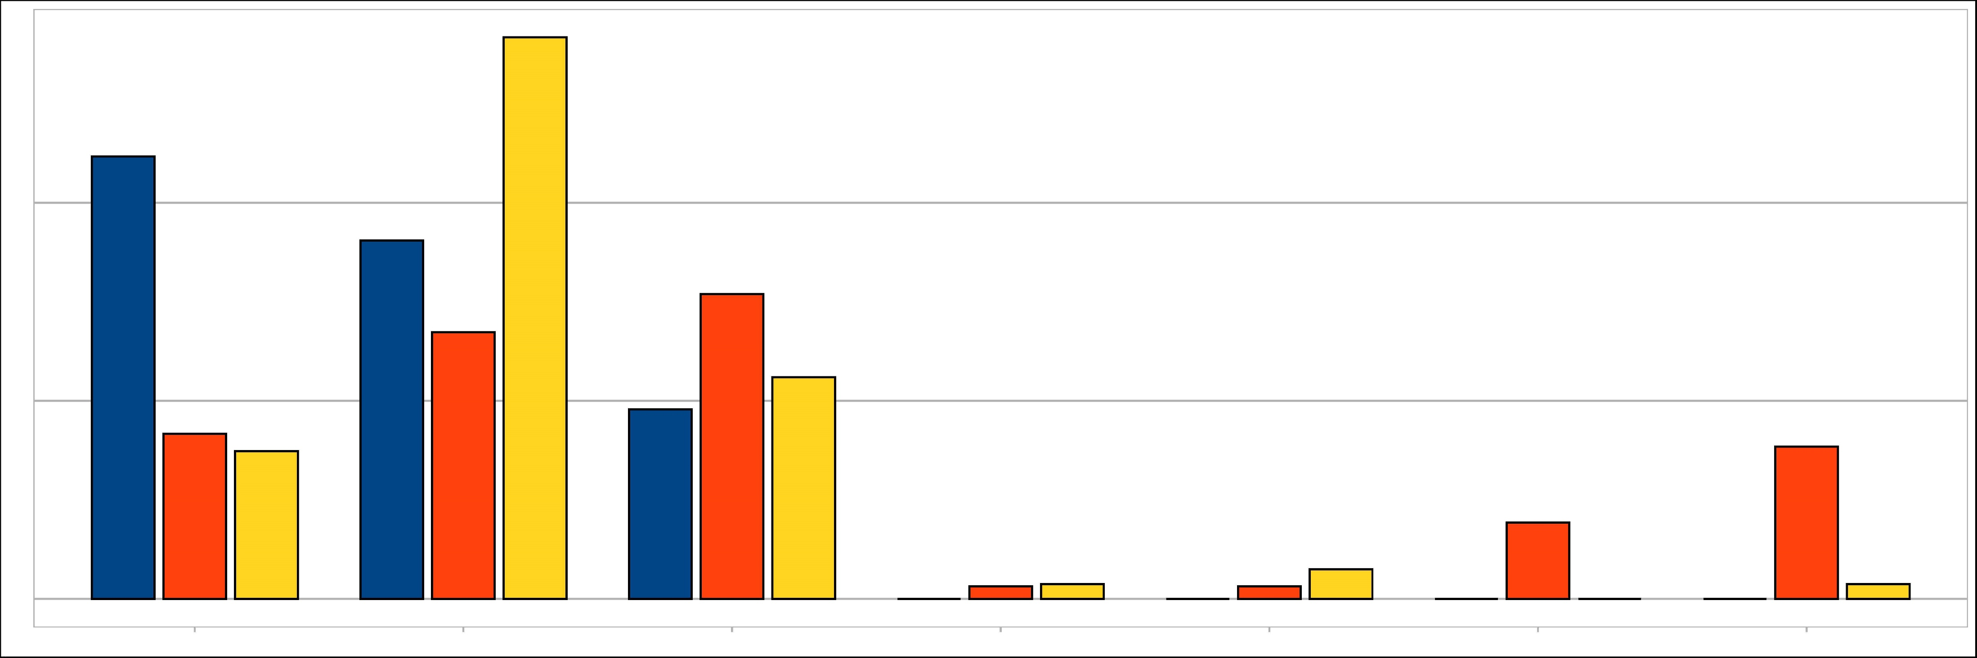
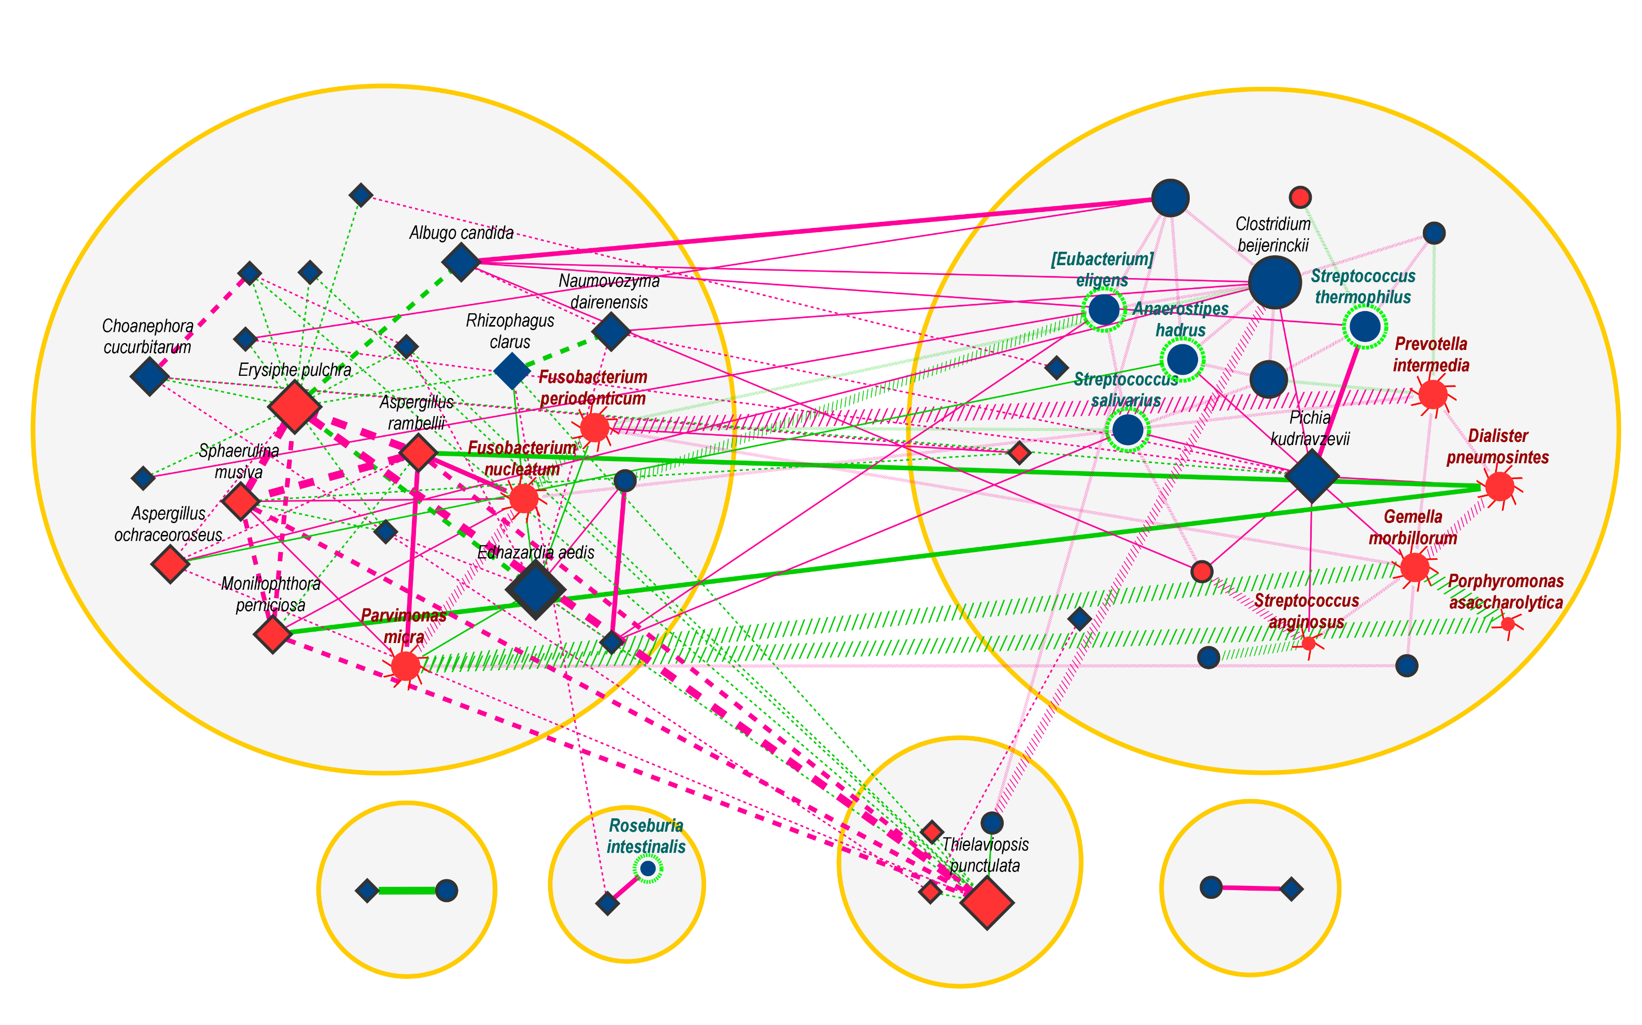



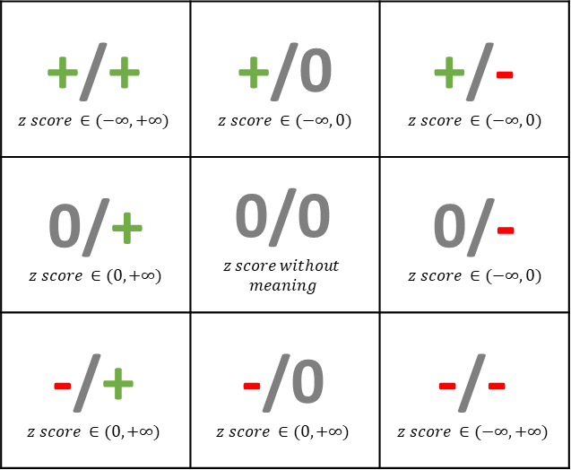
a
Density graph with z-score
(control vs CRC)
0.3
z-score represents the relative strength of differential correlation
Bac & Bac
0.08
0.06
Euk & Euk
0.04
Bac & Euk
0.02
0.2
0.00
-10
0
10
20
30
0.08
0.06
0.04
0.1
0.02
0.00
-10
0
10
20
30
0.15
0.10
0.0
0.05
-10
0
10
20
30
0.00
-10
0
10
20
30
b
Definition of differential correlation classes
c
Percentage of differential
correlation classes
Feature Pair Correlation in CRC
Feature Pair Correlation in control
56.72%
ρ > 0
p < 0.05
p > 0.05
ρ < 0
p < 0.05
ρ > 0
p < 0.05
+/+ $$z score ∈(−∞, +∞)$$ | +/0 $$z score ∈(−∞, 0)$$ | +/- $$z score ∈(−∞, 0)$$
0/+ $$z score ∈(0, +∞)$$ | 0/0 $$z score without$$ $$meaning$$ | 0/- $$z score ∈(−∞, 0)$$
-/+ $$z score ∈(0, +∞)$$ | -/0 $$z score ∈(0, +∞)$$ | -/- $$z score ∈(−∞, +∞)$$
40%
44.68%
36.17%
30.77%
p < 0.05
20%
26.92%
19.15%
22.39%
16.67%
15.38%
ρ < 0
p < 0.05
14.93%
7.69%
0%
0.00%
1.28%
1.49%
0.00%
1.28%
2.99%
0.00%
0.00%
0.00%
1.49%
+/+
+/0
0/+
0/0
0/-
-/+
-/0
d
Network for the differential correlation between CRC and control
Fun_Cluster
Bac_Cluster
CRC Enriched
CRC Depleted
Reported potential
probiotic
Reported potential
pathogens
Unreported bacteria
Fungus
Counts_{corr} ≤ 5
External Correlation
5 < Counts_{corr} ≤ 10
Bacterial Correlation
10 < Counts_{corr}
Fungal Correlation
z-score < 0 [Corr_{CRC} > Corr_{Ctrl} ]
Abs(z-score) ≤ 5
z-score > 0 [Corr_{CRC} < Corr_{Ctrl} ]
5 ≤ Abs(z-score) < 6
6 ≤ Abs(z-score)
Notes:
In order to determine the relative strength of differential correlation between control group and CRC group,
We used the DGCA (Differential Gene Correlation Analysis) to show the difference.
As the figure a, we could know that the correlation between bacteria would play much stronger in CRC than control group,
but it play the opposite in the correlation between eukaryota.
In addition, the correlation between bacteria and eukaryota is clear hierarchy in two stage.
The figure b is the definition of differential correlation classes and figure c is the composition of each correlation classes.
At last, figure d shows the network for the differential correlation in these 2 stages.

