Slide 1

CSCI E-96 Data Mining, Discovery and Exploration Distance and Similarity Measures
Steve Elston
Copyright 2021, 2022, 2023, 2024, 2025 Stephen F Elston. All rights reserved.

Slide 2
Measuring similarity and dissimilarity
Many data mining algorithms require searching for the most similar or dissimilar cases
Cluster models
Nearest neighbor graph algorithms
Recommender systems
Dimensionality reduction
Document and image search
Retrieval augmented generation (RAG)
Etc…

Slide 3
Measuring similarity and dissimilarity
Many data mining solutions use search for the most similar or dissimilar cases
Searching for similar documents
Searching for similar images
Web search
Discovering similar mRNA sequences
Finding the most similar sensor streams
Finding similar products for recommendation
And many others………………..

Slide 4
Measuring similarity and dissimilarity
Measuring similarity and dissimilarity is fundamental to data mining
Distance and similarity measures are the foundation of unsupervised learning
A wide range of metrics used in data mining
The metrics used must fit the nature of the data and the analysis
Binary data
Text strings
Numeric data
Ordinal data; e.g. rankings and ratings
Unordered categorical data
There is no one best metric!

Slide 5
Properties of Distance Metrics

Slide 6
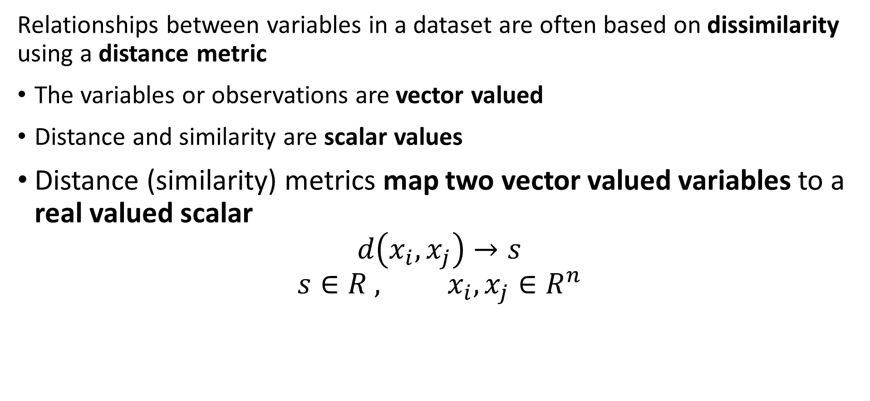
Measuring distance or dissimilarity
Relationships between variables in a dataset are often based on dissimilarity using a distance metric
The variables or observations are vector valued
Distance and similarity are scalar values
Distance (similarity) metrics map two vector valued variables to a real valued scalar
$$d\left(x_{i},x_{j}\right)→s$$
$$s∈R^{ }, x_{i},x_{j}∈R^{n}$$

Slide 7
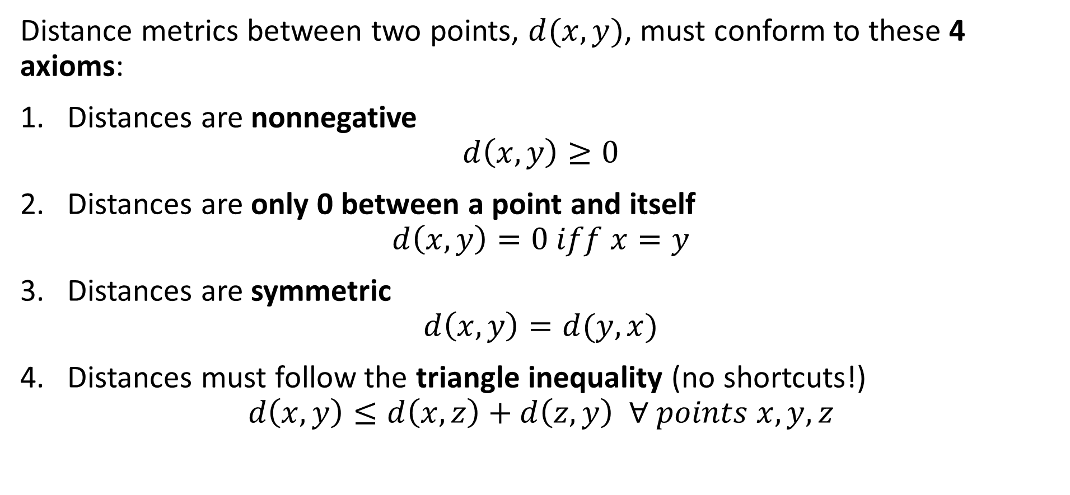
Measuring distance or dissimilarity
Distance metrics between two points, $d(x,y)$, must conform to these 4 axioms:
Distances are nonnegative
$$d\left(x,y\right)≥0$$
Distances are only 0 between a point and itself
$$d\left(x,y\right)=0 iff x=y$$
Distances are symmetric
$$d\left(x,y\right)=d(y,x)$$
Distances must follow the triangle inequality (no shortcuts!)
$$d\left(x,y\right)≤d\left(x,z\right)+d\left(z,y\right) ∀ points x,y,z$$

Slide 8
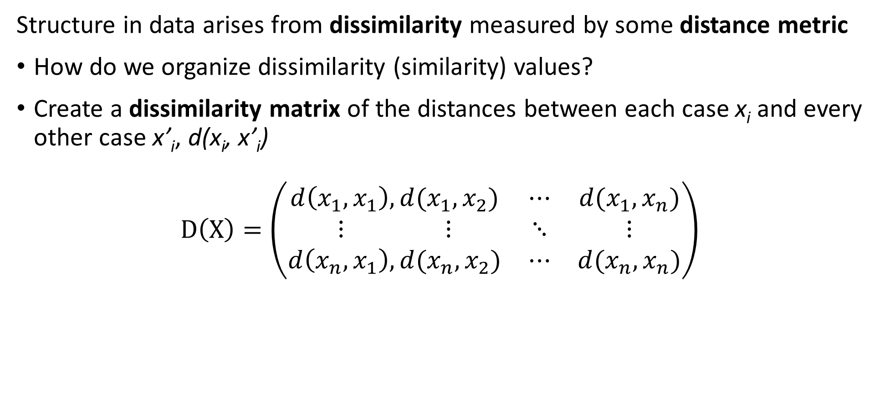
Measuring distance or dissimilarity
Structure in data arises from dissimilarity measured by some distance metric
How do we organize dissimilarity (similarity) values?
Create a dissimilarity matrix of the distances between each case x_{i} and every other case x’_{i}, d(x_{i}, x’_{i})
$$D\left(X\right)=\left(\begin{matrix}d\left(x_{1},x_{1}\right), d(x_{1},x_{2}) & ⋯ & d(x_{1},x_{n}) \\ ⋮ ⋮ & ⋱ & ⋮ \\ d\left(x_{n},x_{1}\right),d(x_{n},x_{2}) & ⋯ & d(x_{n},x_{n})\end{matrix}\right)$$

Slide 9
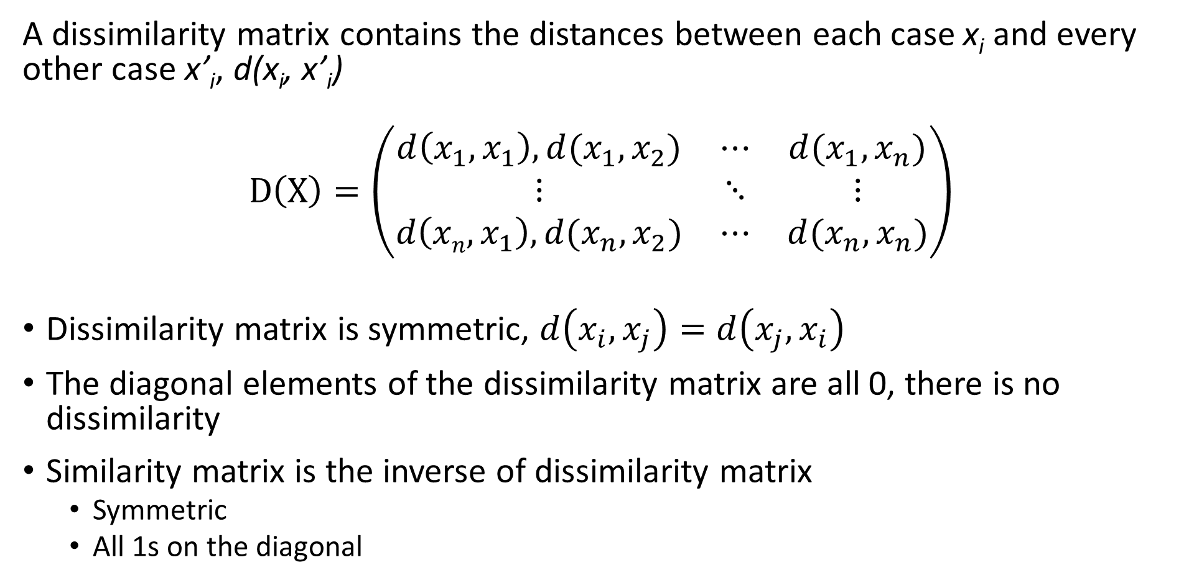
Measuring distance or dissimilarity
A dissimilarity matrix contains the distances between each case x_{i} and every other case x’_{i}, d(x_{i}, x’_{i})
$$D\left(X\right)=\left(\begin{matrix}d\left(x_{1},x_{1}\right), d(x_{1},x_{2}) & ⋯ & d(x_{1},x_{n}) \\ ⋮ & ⋱ & ⋮ \\ d\left(xn,x_{1}\right),d(x_{n},x_{2}) & ⋯ & d(x_{n},x_{n})\end{matrix}\right)$$
Dissimilarity matrix is symmetric, $d\left(x_{i},x_{j}\right)=d\left(x_{j},x_{i}\right)$
The diagonal elements of the dissimilarity matrix are all 0, there is no dissimilarity
Similarity matrix is the inverse of dissimilarity matrix
Symmetric
All 1s on the diagonal

Slide 10
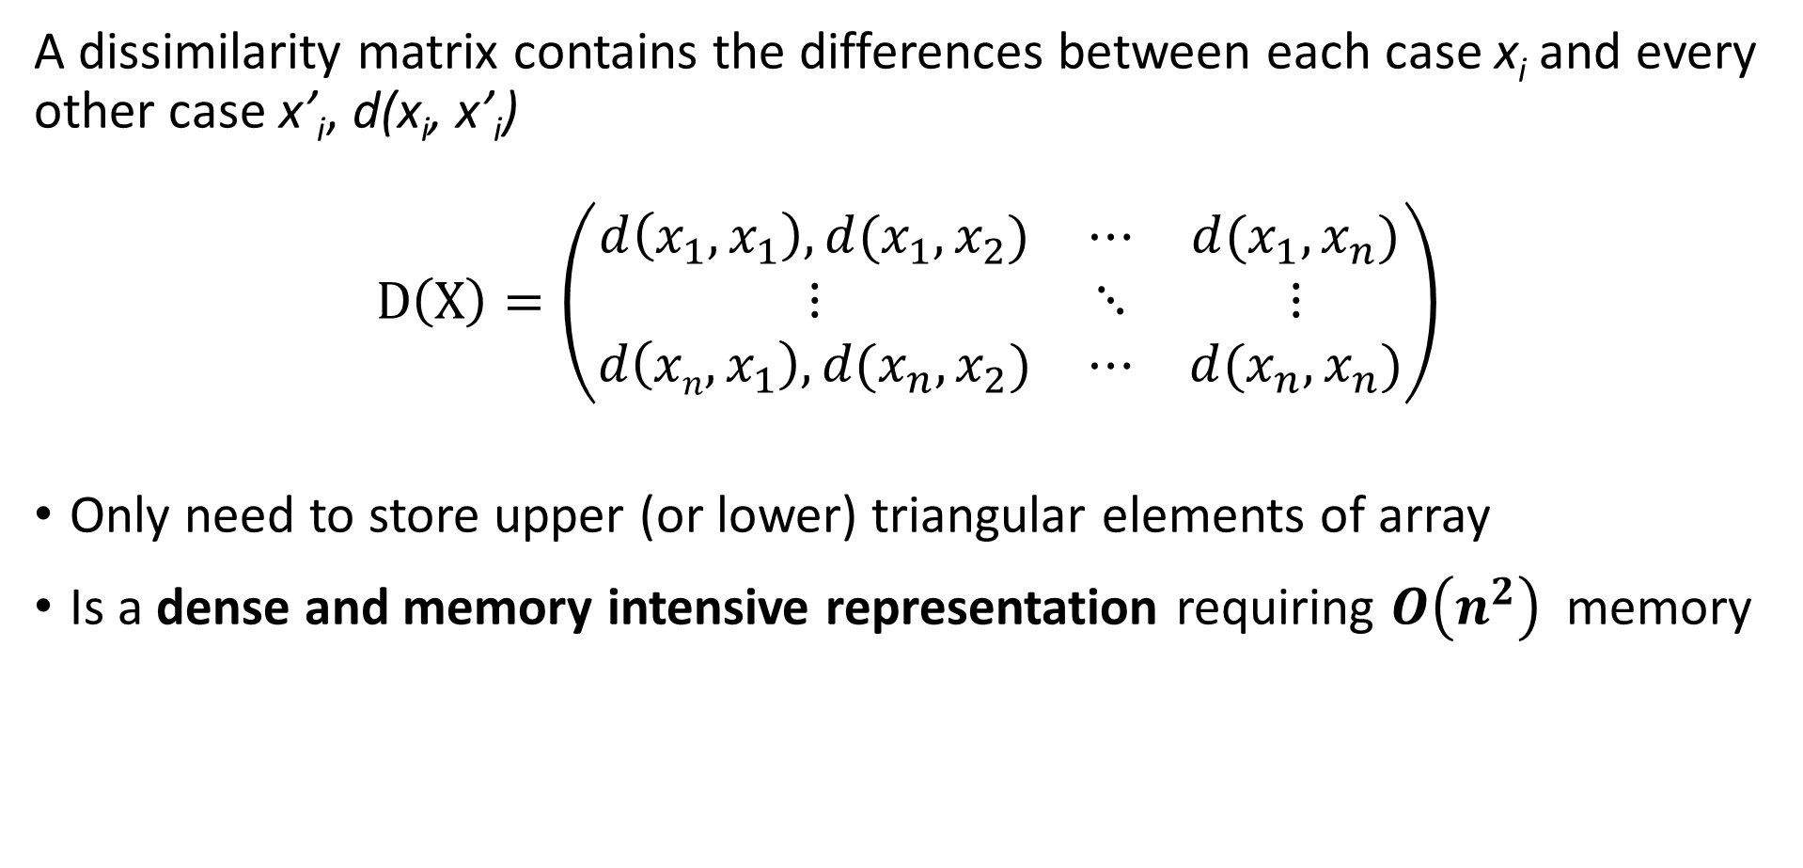
Measuring distance or dissimilarity
A dissimilarity matrix contains the differences between each case x_{i} and every other case x’_{i}, d(x_{i}, x’_{i})
$$D\left(X\right)=\left(\begin{matrix}d\left(x_{1},x_{1}\right), d(x_{1},x_{2}) & ⋯ & d(x_{1},x_{n}) \\ ⋮ & ⋱ & ⋮ \\ d\left(xn,x_{1}\right),d(x_{n},x_{2}) & ⋯ & d(x_{n},x_{n})\end{matrix}\right)$$
Only need to store upper (or lower) triangular elements of array
Is a dense and memory intensive representation requiring $O\left(n^{2}\right)$ memory

Slide 11
Basic Distance Metrics

Slide 12
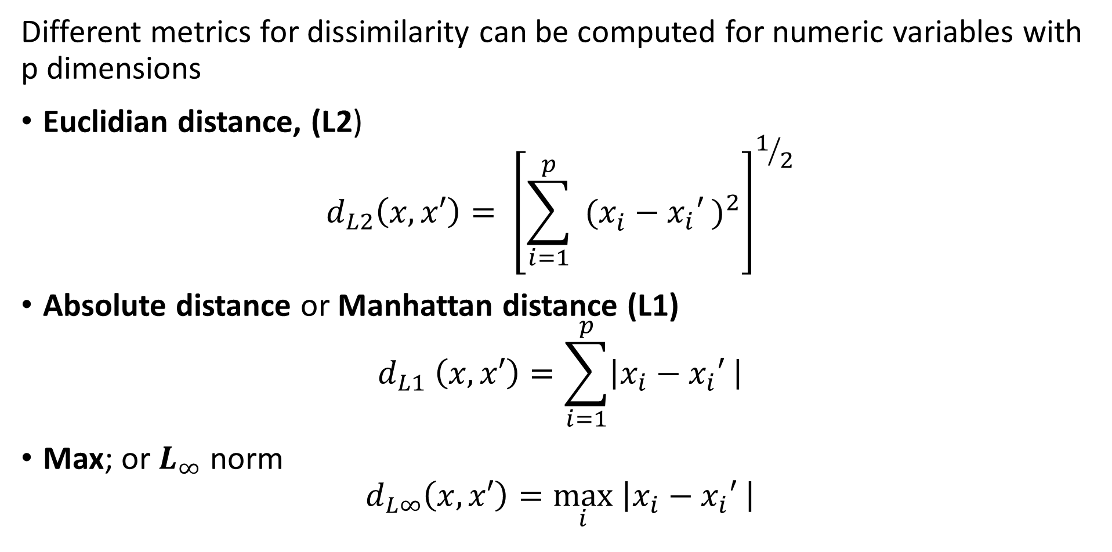
Measuring distance or dissimilarity
Different metrics for dissimilarity can be computed for numeric variables with p dimensions
Euclidian distance, (L2)
$$d_{L2}\left(x,x′\right)= {\left[\sum_{i=1}^{p}{ (x_{i}^{ }−{x_{i}′}_{ })^{2}}\right]}^{1/2}$$
Absolute distance or Manhattan distance (L1)
$$d_{L1} \left(x,x′\right)=\sum_{i=1}^{p}{\left|x_{i}−{x_{i}′}_{ }\right|}$$
Max; or $L_{∞}$ norm
$$d_{L∞}\left(x,x′\right)=\max_{i}\left|x_{i}−{x_{i}′}_{ }\right|$$

Slide 13
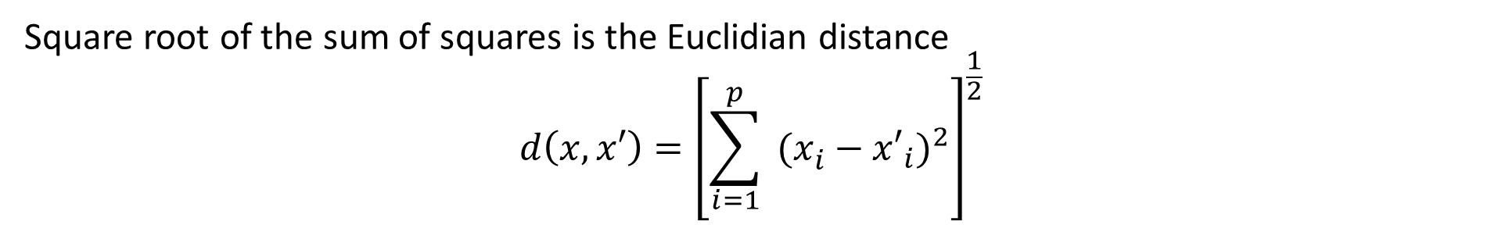
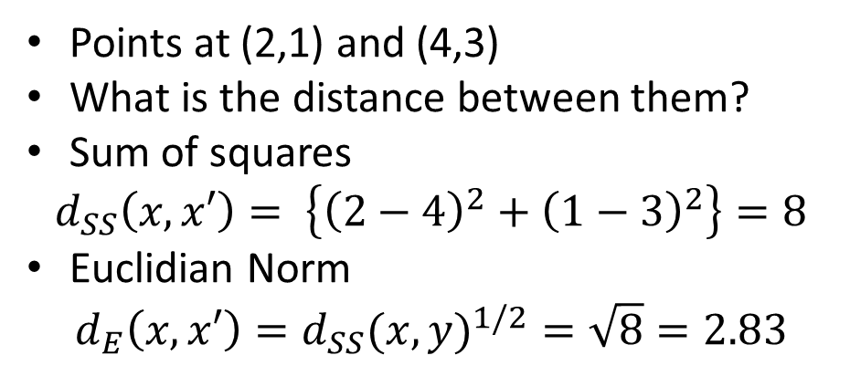
Measuring distance or dissimilarity
Square root of the sum of squares is the Euclidian distance
$$d\left(x,x′\right)={\left[\sum_{i=1}^{p}{ (x_{i}^{ }−{x′}_{i})^{2}}\right]}^{\frac{1}{2}}$$
Points at (2,1) and (4,3)
What is the distance between them?
Sum of squares
$$d_{SS}\left(x,x′\right)= \left\{{\left(2−4\right)}^{2}+{\left(1−3\right)}^{2}\right\}=8$$
Euclidian Norm
$$d_{E}\left(x,x′\right)={d_{SS}(x,y)}^{1/2}=\sqrt{8}=2.83$$
(4,3)
X₂
Euclidian Norm is ‘crow-flies’ distance
(2,1)
X₁

Slide 14

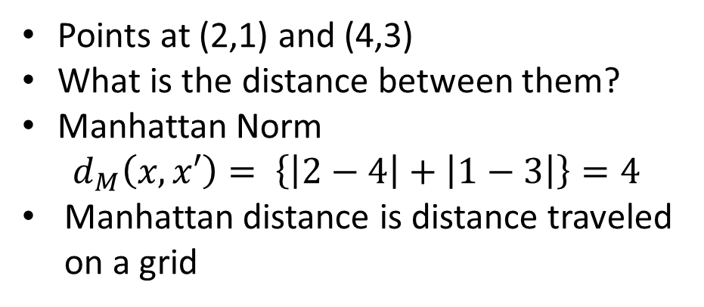
Measuring distance or dissimilarity
Manhattan Norm
$$d\left(x,x′\right)=\sum_{i=1}^{p}{\left|x_{i}−{x′}_{i}\right|}$$
Points at (2,1) and (4,3)
What is the distance between them?
Manhattan Norm
$$d_{M}\left(x,x′\right)= \left\{\left|2−4\right|+\left|1−3\right|\right\}=4$$
Manhattan distance is distance traveled on a grid
(4,3)
X₂
(2,1)
X₁

Slide 15
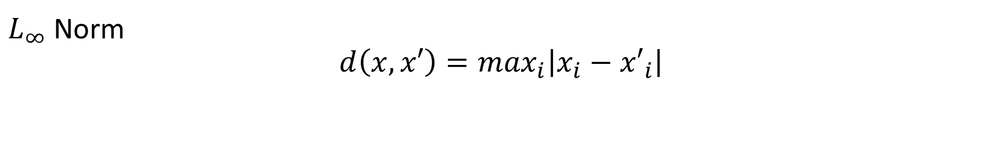
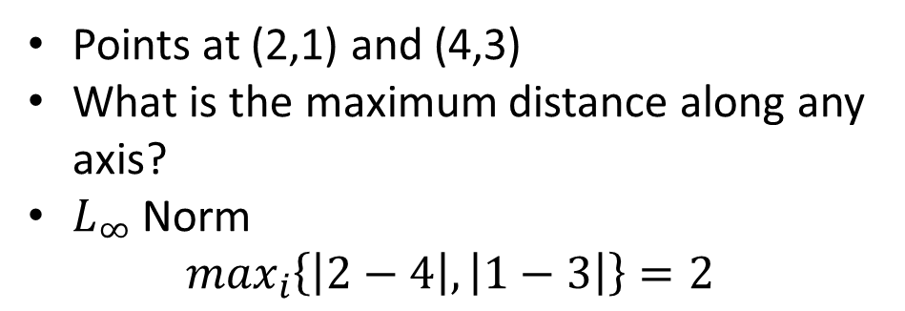
Measuring distance or dissimilarity
$L_{∞}$ Norm
$$d\left(x,x′\right)=\max_{i}\left|x_{i}−{x′}_{i}\right|$$
Points at (2,1) and (4,3)
What is the maximum distance along any axis?
$L_{∞}$ Norm
$$\max_{i}\left\{\left|2−4\right|,\left|1−3\right|\right\}=2$$
(4,3)
X₂
(2,1)
X₁

Slide 16
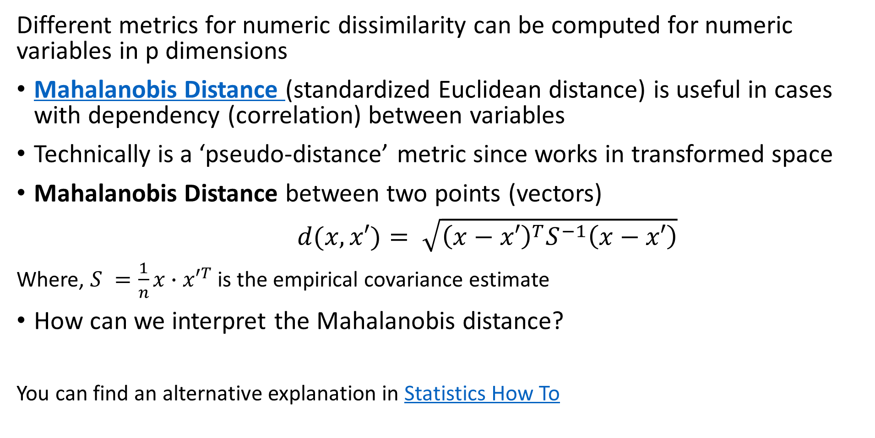
Measuring distance or dissimilarity
Different metrics for numeric dissimilarity can be computed for numeric variables in p dimensions
Mahalanobis Distance (standardized Euclidean distance) is useful in cases with dependency (correlation) between variables
Technically is a ‘pseudo-distance’ metric since works in transformed space
Mahalanobis Distance between two points (vectors)
$d(x,x′)= \sqrt{{\left(x−x′\right)}^{T}S^{−1}\left(x−x′\right)}$
Where, $S^{ }=\frac{1}{n}x∙{x′}^{T}$ is the empirical covariance estimate
How can we interpret the Mahalanobis distance?
You can find an alternative explanation in Statistics How To

Slide 17
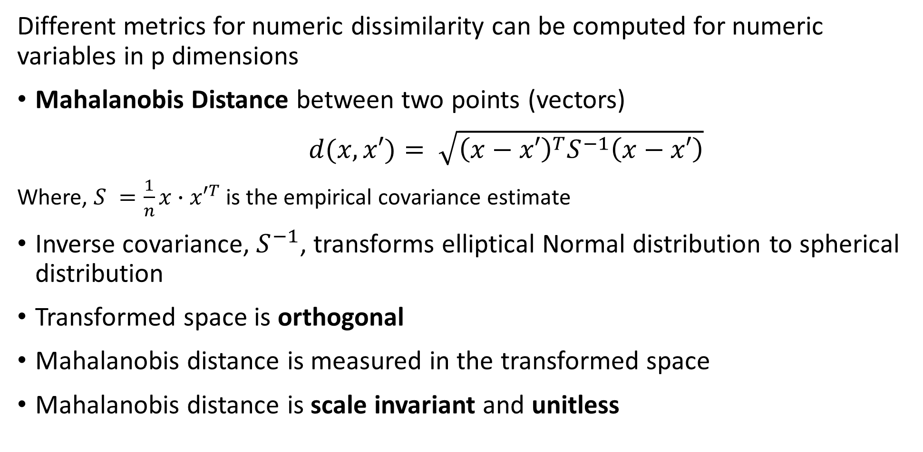
Measuring distance or dissimilarity
Different metrics for numeric dissimilarity can be computed for numeric variables in p dimensions
Mahalanobis Distance between two points (vectors)
$d(x,x′)= \sqrt{{\left(x−x′\right)}^{T}S^{−1}\left(x−x′\right)}$
Where, $S^{ }=\frac{1}{n}x∙{x′}^{T}$ is the empirical covariance estimate
Inverse covariance, $S^{−1}$, transforms elliptical Normal distribution to spherical distribution
Transformed space is orthogonal
Mahalanobis distance is measured in the transformed space
Mahalanobis distance is scale invariant and unitless

Slide 18
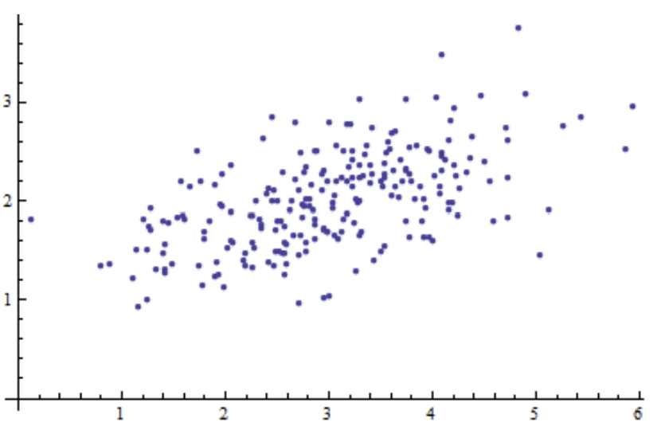
Measuring distance or dissimilarity
Different metrics for numeric dissimilarity can be computed for numeric variables in p dimensions
Example: start with some 2-dimensional observations
Variables are correlated
Source, lecture notes by Dr. Sunnie S. Chung

Slide 19
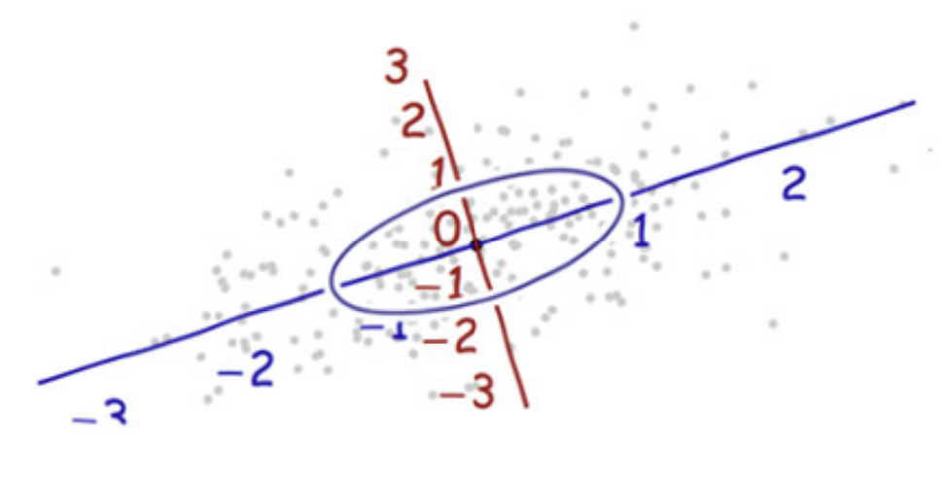
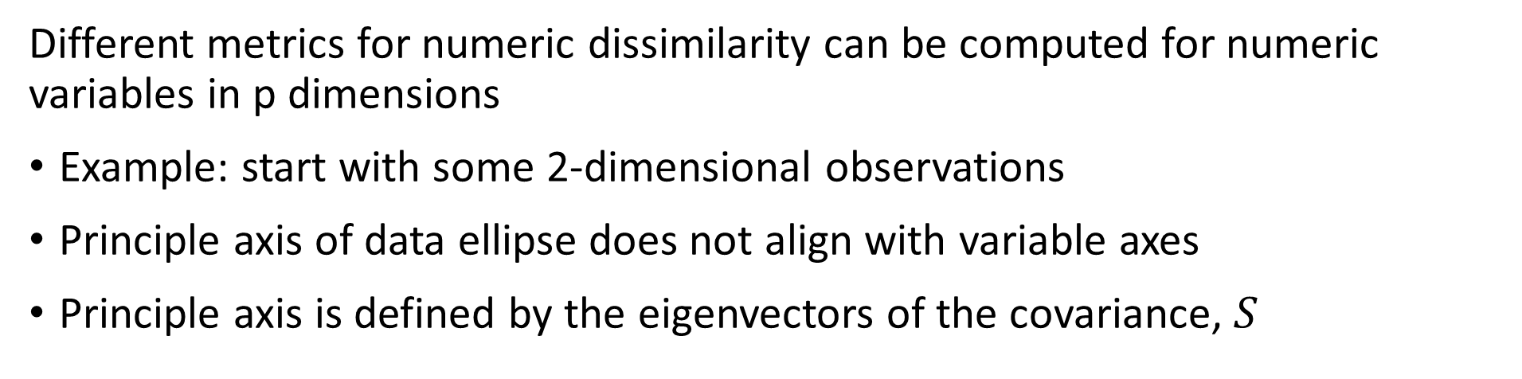
Measuring distance or dissimilarity
Different metrics for numeric dissimilarity can be computed for numeric variables in p dimensions
Example: start with some 2-dimensional observations
Principle axis of data ellipse does not align with variable axes
Principle axis is defined by the eigenvectors of the covariance, $S$
Source, lecture notes by Dr. Sunnie S. Chung

Slide 20
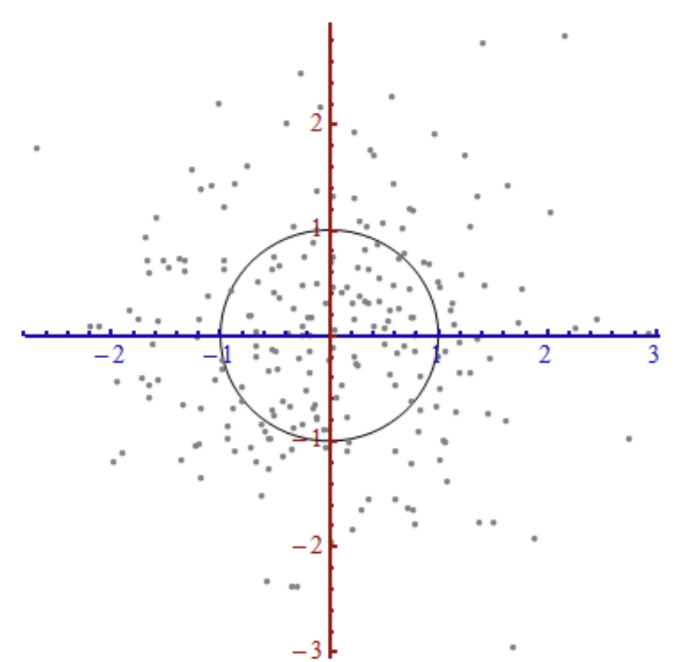
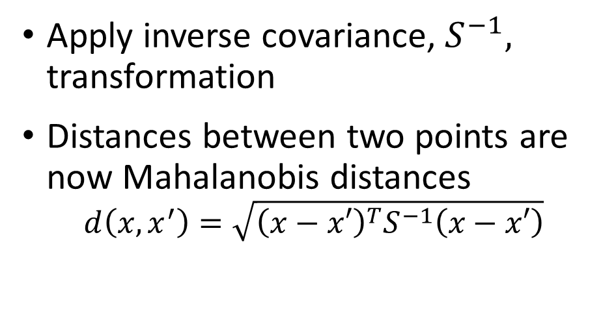
Measuring distance or dissimilarity
Different metrics for numeric dissimilarity can be computed for numeric variables in p dimensions
Apply inverse covariance, $S^{−1},$ transformation
Distances between two points are now Mahalanobis distances
$$d\left(x,x^{′}\right)=\sqrt{{\left(x−x′\right)}^{T}S^{−1}\left(x−x′\right)}$$
Source, lecture notes by Dr. Sunnie S. Chung

Slide 21
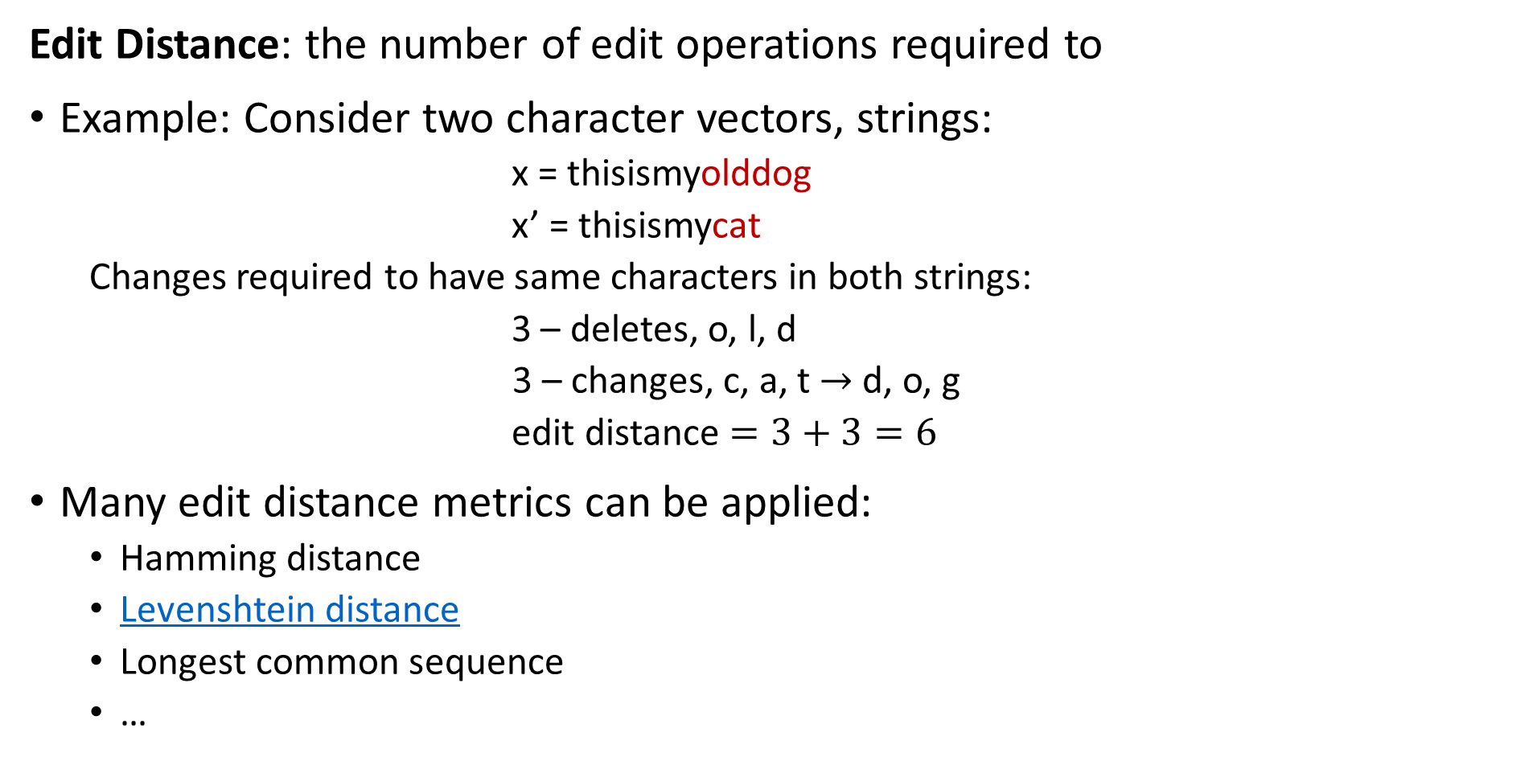
Measuring distance or dissimilarity
Edit Distance: the number of edit operations required to
Example: Consider two character vectors, strings:
x = thisismyolddog
x’ = thisismycat
Changes required to have same characters in both strings:
3 – deletes, o, l, d
3 – changes, c, a, t $→$ d, o, g
edit distance $=3+3=6$
Many edit distance metrics can be applied:
Hamming distance
Levenshtein distance
Longest common sequence
…

Slide 22
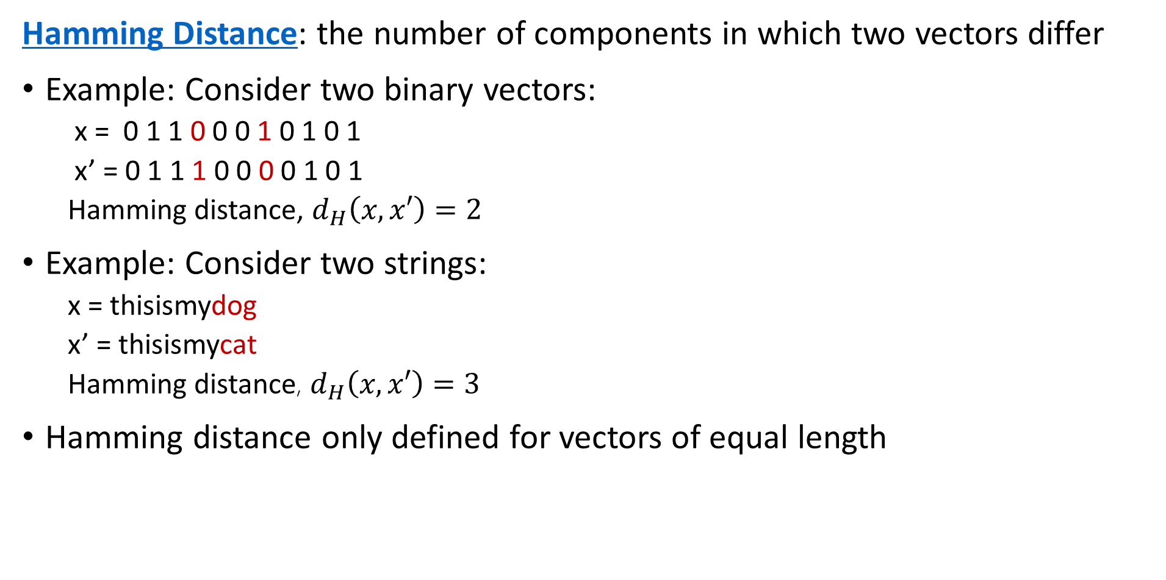
Measuring distance or dissimilarity
Hamming Distance: the number of components in which two vectors differ
Example: Consider two binary vectors:
x = 0 1 1 0 0 0 1 0 1 0 1
x’ = 0 1 1 1 0 0 0 0 1 0 1
Hamming distance, $d_{H}\left(x,x′\right)=2$
Example: Consider two strings:
x = thisismydog
x’ = thisismycat
Hamming distance, $d_{H}\left(x,x′\right)=3$
Hamming distance only defined for vectors of equal length

Slide 23
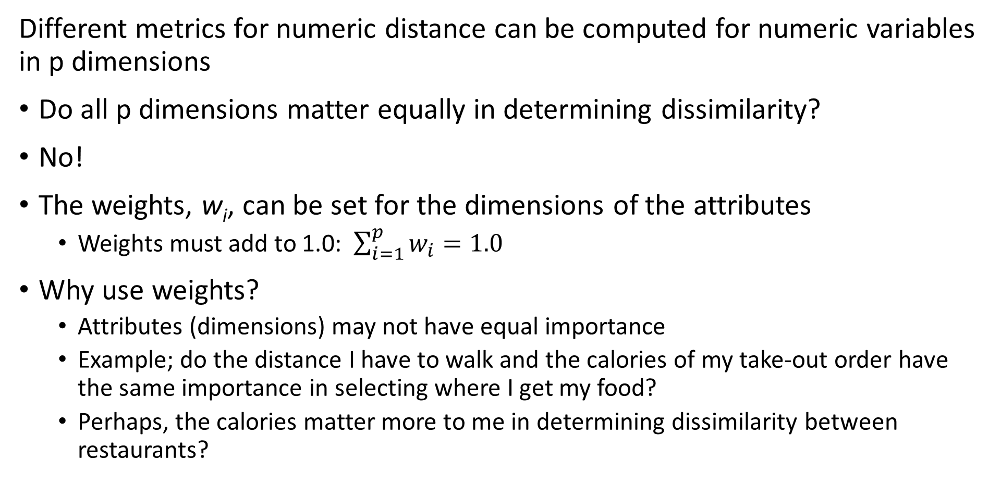
Measuring distance or dissimilarity
Different metrics for numeric distance can be computed for numeric variables in p dimensions
Do all p dimensions matter equally in determining dissimilarity?
No!
The weights, w_{i}, can be set for the dimensions of the attributes
Weights must add to 1.0: $\sum_{i=1}^{p}{w_{i}=1.0}$
Why use weights?
Attributes (dimensions) may not have equal importance
Example; do the distance I have to walk and the calories of my take-out order have the same importance in selecting where I get my food?
Perhaps, the calories matter more to me in determining dissimilarity between restaurants?

Slide 24
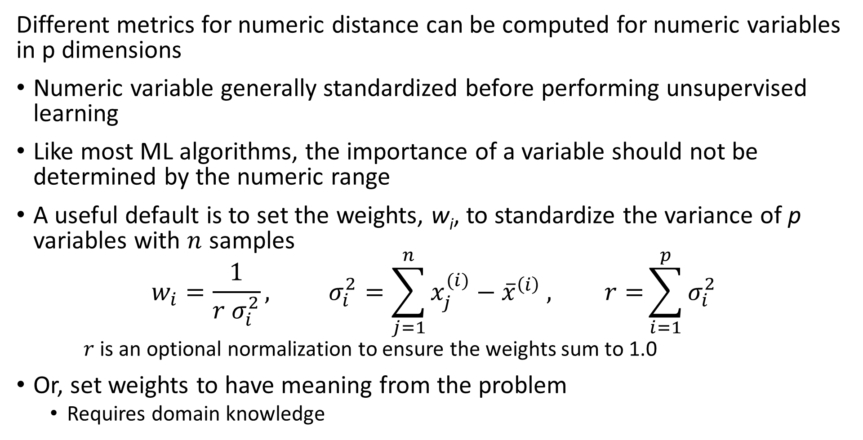
Measuring distance or dissimilarity
Different metrics for numeric distance can be computed for numeric variables in p dimensions
Numeric variable generally standardized before performing unsupervised learning
Like most ML algorithms, the importance of a variable should not be determined by the numeric range
A useful default is to set the weights, w_{i}, to standardize the variance of p variables with $n$ samples
$$w_{i}=\frac{1}{{r σ}_{i}^{2}}, σ_{i}^{2}=\sum_{j=1}^{n}{x_{j}^{(i)}−{{\overline{x}}^{\left(i\right)}}_{ }, r=}\sum_{i=1}^{p}{σ_{i}^{2}}$$
$r$ is an optional normalization to ensure the weights sum to 1.0
Or, set weights to have meaning from the problem
Requires domain knowledge

Slide 25
Distance Metrics with Mixed Variable Types

Slide 26
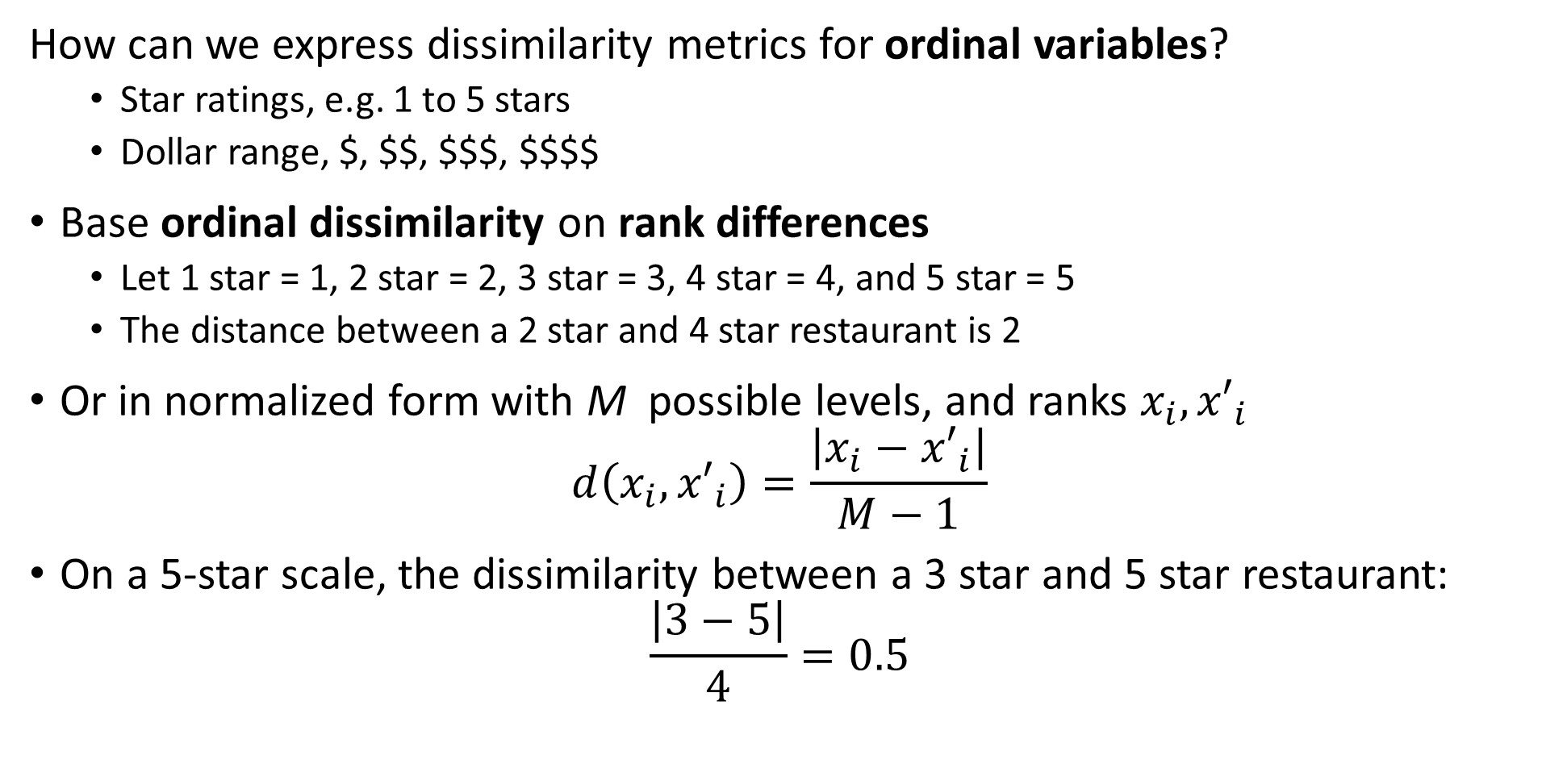
Measuring distance or dissimilarity
How can we express dissimilarity metrics for ordinal variables?
Star ratings, e.g. 1 to 5 stars
Dollar range, $, $$, $$$, $$$$
Base ordinal dissimilarity on rank differences
Let 1 star = 1, 2 star = 2, 3 star = 3, 4 star = 4, and 5 star = 5
The distance between a 2 star and 4 star restaurant is 2
Or in normalized form with M possible levels, and ranks $x_{i},{x′}_{i}$
$$d\left(x_{i},{x′}_{i}\right)=\frac{\left|x_{i}−{x′}_{i}\right|}{M−1}$$
On a 5-star scale, the dissimilarity between a 3 star and 5 star restaurant:
$$\frac{\left|3−5\right|}{4}=0.5$$

Slide 27
Measuring distance or dissimilarity
How can we express dissimilarity metrics for unordered categorical variables?
Use a coding scheme
e.g. a binary scheme, 1 if different categories, 0 if the same
Optionally, normalize
e.g., normalize by dividing by number of categories
Example; restaurant type with 5 choices:
Vegetarian, Thai, Mexican, Pizza, Burgers
Distance Vegetarian to Burgers = 1/5 = 0.2
Distance Burgers to Burgers = 0
Can have more complex scheme if required

Slide 28
Measuring distance or dissimilarity
Can we combine dissimilarities of different types of variables
Yes, but with carefully!
Scaling important, or some variable types dominate as a result of coding
The numeric range of values must be similar
e.g. We do not want ordinal variables to dominate numeric and categorical
But, weighting is problem dependent!
Unfortunately, no simple procedure for correct weighting
Do I care more about the (ordinal) star rating or calories of the meal (numeric) when choosing a restaurant?
Important Note: There is some controversy around methodology for combining distance metrics of different data types. Some textbooks and theoreticians say combining types should never be done. Pragmatists realize we must do something, even if questionable.

Slide 29
Measuring distance or dissimilarity
An example of computing dissimilarity between restaurants
Absolute dissimilarity between R1 and R4, a Mexican and vegetarian restaurant
[¼ + |0.8-0.3| + |0.7-0.1| + |3-1|/2 + |5-4|/4]/5 = [0.25 + 0.5 + 0.6 + 0.5 + 0.25]/5 = 0.42
Absolute dissimilarity between R2 and R3, two pizza places
[0 + |0.9-0.8| + |0.6-0.4| + |2-3|/2 + |4-3|/4]/5 = [0 + 0.1 + 0.2 + 0.5 + 0.25]/5 = 0.21
Restaurant | Type | Calories | Distance | Price Range | Stars
R1 | Mexican | 0.8 | 0.1 | $ | 4
R2 | Pizza | 0.9 | 0.4 | $$ | 3
R3 | Pizza | 0.8 | 0.6 | $$$ | 4
R4 | Vegetarian | 0.3 | 0.7 | $$$ | 5
R5 | Thai | 0.6 | 0.3 | $$ | 4

Slide 30
Measuring distance or dissimilarity
Another example of computing dissimilarity between restaurants
Squared dissimilarity between R1 and R4, a Mexican and vegetarian restaurant
[0.25² + 0.5² + 0.6² + 0.5² + 0.25²]/5 = [0.125 + 0.25 + 0.36 + 0.25+ 0.125]/5 = 0.22
Squared dissimilarity between R2 and R3, two pizza places
[0 + 0.1² + 0.2² + 0.5² + 0.25²]/5 = [0 + 0.01 + 0.04 + 0.25 + 0.125]/5 = 0.085
Restaurant | Type | Calories | Distance | Price Range | Stars
R1 | Mexican | 0.8 | 0.1 | $ | 4
R2 | Pizza | 0.9 | 0.4 | $$ | 3
R3 | Pizza | 0.8 | 0.6 | $$$ | 4
R4 | Vegetarian | 0.3 | 0.7 | $$$ | 5
R5 | Thai | 0.6 | 0.3 | $$ | 4

Slide 31
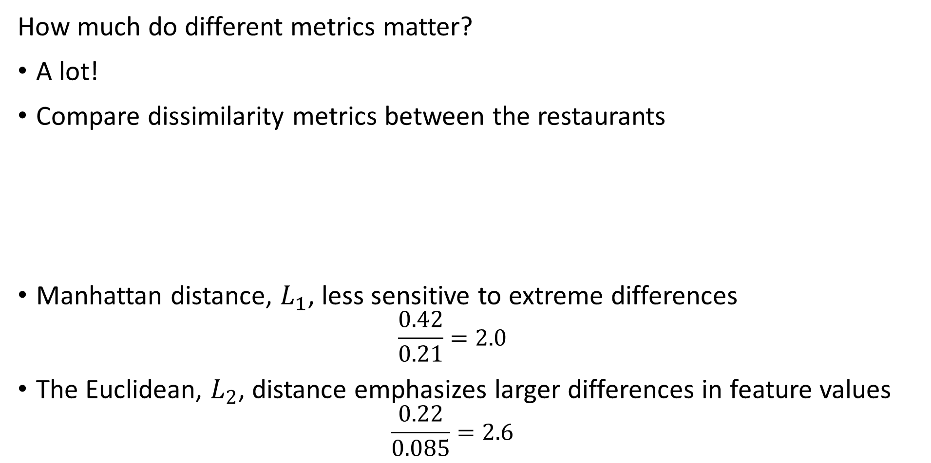
Measuring distance or dissimilarity
How much do different metrics matter?
A lot!
Compare dissimilarity metrics between the restaurants
Manhattan distance, $L_{1}$, less sensitive to extreme differences
$$\frac{0.42}{0.21}=2.0$$
The Euclidean, $L_{2}$, distance emphasizes larger differences in feature values
$$\frac{0.22}{0.085}=2.6$$
 | Mexican – Vegetarian | 2 Pizza Places
Absolute distance | 0.42 | 0.21
Euclidean distance | 0.22 | 0.085

Slide 32
Similarity Metrics

Slide 33
Measuring distance and similarity
Do we always work with dissimilarity?
No!
We often work with measures of similarity
The closer points are in a space (smaller distance) the more similar they are
In many cases, similarity measures can be transformed to dissimilarity
For data with positive and negative coding similarity must be in the range [-1,1]
Similarity = 1, maximum similarity, points are at the same location in the space
Similarity = 0, points are orthogonal in the space, no similarity
Similarity = -1, minimum similarity, points have completely opposite coding
For non-negative data similarity in range [0,1]
Example, binary data

Slide 34
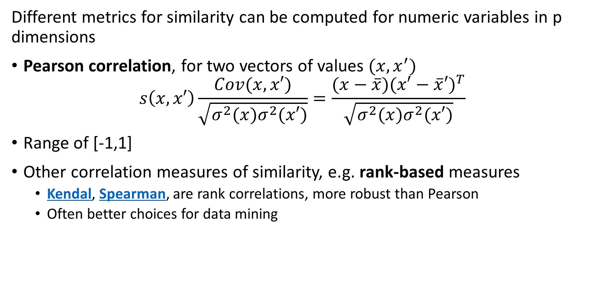
Measuring Similarity
Different metrics for similarity can be computed for numeric variables in p dimensions
Pearson correlation, for two vectors of values $(x,x^{′})$
$$s\left(x,x′\right)\frac{Cov(x,x′)}{\sqrt{σ^{2}(x)σ^{2}(x′)}}=\frac{(x−\overline{x}){(x′−\overline{x}′)}^{T}}{\sqrt{σ^{2}(x)σ^{2}(x′)}}$$
Range of [-1,1]
Other correlation measures of similarity, e.g. rank-based measures
Kendal, Spearman, are rank correlations, more robust than Pearson
Often better choices for data mining

Slide 35
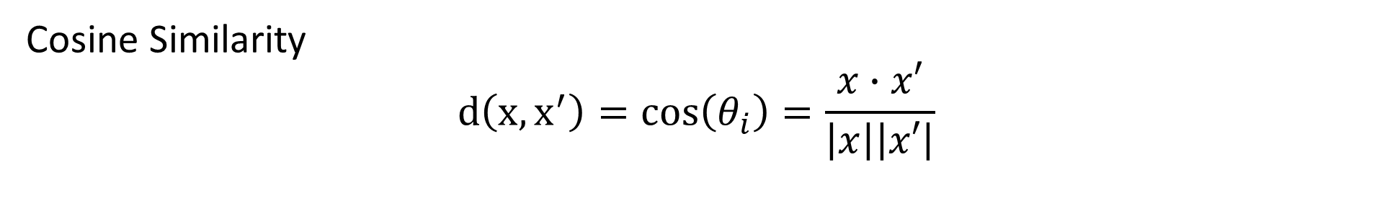
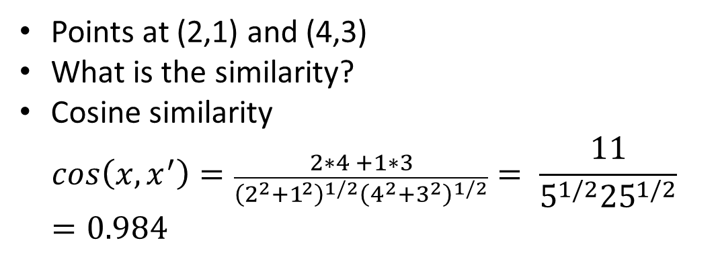
Measuring Similarity
Cosine Similarity
$$d\left(x,x^{′}\right)=cos\left(θ_{i}\right)=\frac{x∙x′}{\left|x\right|\left|x′\right|}$$
Points at (2,1) and (4,3)
What is the similarity?
Cosine similarity
$$cos\left(x,x^{′}\right)=\frac{2∗4 +1∗3}{{\left(2^{2}+1^{2}\right)}^{1/2}{\left(4^{2}+3^{2}\right)}^{1/2}}= \frac{11}{5^{1/2}{25}^{1/2}}=0.984$$
(4,3)
X₂
θ
(2,1)
X₁

Slide 36
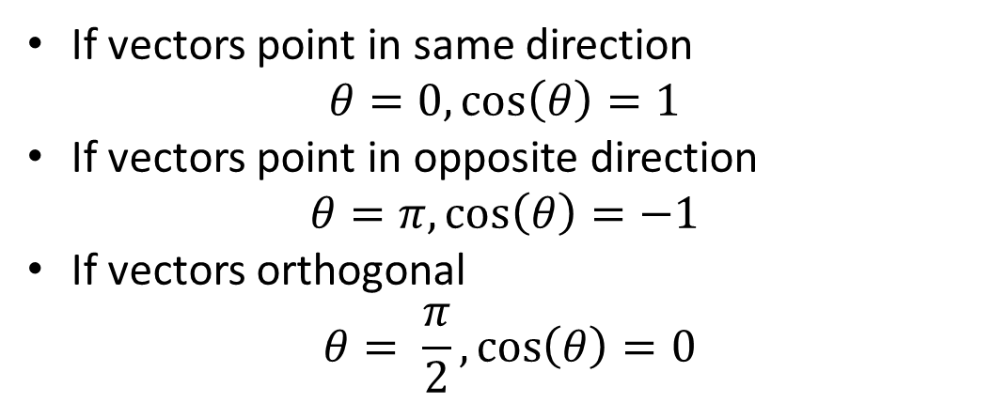
Measuring Similarity
Cosine Similarity
$$d\left(x,x^{′}\right)=cos\left(θ_{i}\right)=\frac{x∙x′}{\left|x\right|\left|x′\right|}$$
If vectors point in same direction
$$θ=0,\cos\left(θ\right)=1$$
If vectors point in opposite direction
$$θ=π,\cos\left(θ\right)=−1$$
If vectors orthogonal
$$θ= \frac{π}{2},\cos\left(θ\right)=0$$
(4,3)
X₂
θ
(2,1)
X₁

Slide 37
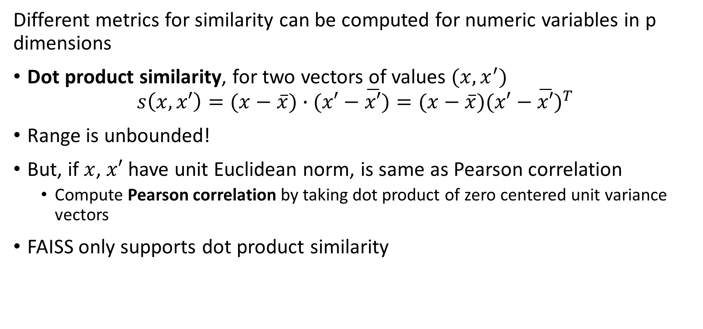
Measuring Similarity
Different metrics for similarity can be computed for numeric variables in p dimensions
Dot product similarity, for two vectors of values $(x,x^{′})$
$$s\left(x,x′\right)=(x−\overline{x})∙(x′−\overline{x′})=(x−\overline{x}){(x′−\overline{x′})}^{T}$$
Range is unbounded!
But, if $x$, $x′$ have unit Euclidean norm, is same as Pearson correlation
Compute Pearson correlation by taking dot product of zero centered unit variance vectors
FAISS only supports dot product similarity

Slide 38
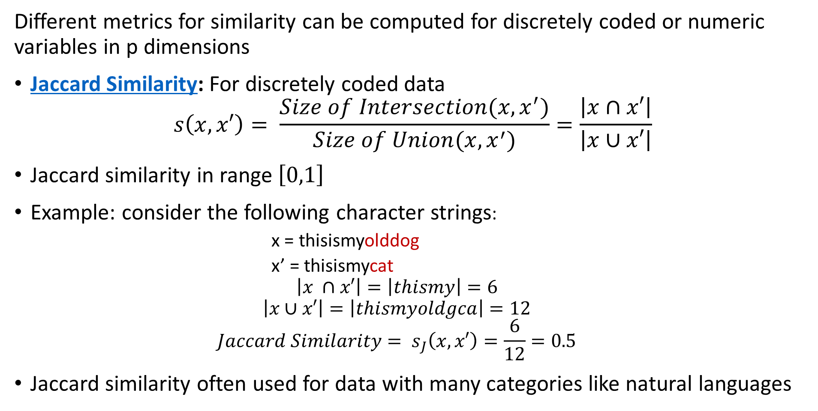
Measuring Similarity
Different metrics for similarity can be computed for discretely coded or numeric variables in p dimensions
Jaccard Similarity: For discretely coded data
$$s\left(x,x′\right)= \frac{Size of Intersection(x,x^{′})}{Size of Union(x,x^{′})}=\frac{\left|x∩x′\right|}{\left|x∪x′\right|}$$
Jaccard similarity in range $\left[0,1\right]$
Example: consider the following character strings:
x = thisismyolddog
x’ = thisismycat
$$\left|x ∩x′\right|=\left|thismy\right|=6$$
$$\left|x∪x′\right|=\left|thismyoldgca\right|=12$$
$${Jaccard Similarity= s}_{J}\left(x,x′\right)=\frac{6}{12}=0.5$$
Jaccard similarity often used for data with many categories like natural languages

Slide 39
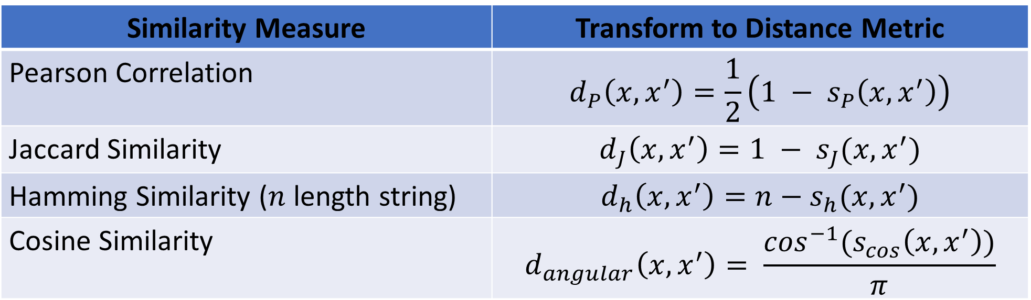
Relationship Between Similarity and Distance
Some similarity measures can be transformed to distance metrics
Transform is an inverse function
Resulting distance usually has limited range (limited support)
Examples:
Similarity Measure | Transform to Distance Metric
Pearson Correlation | $$d_{P}\left(x,x^{′}\right)=\frac{1}{2}\left(1 − s_{P}\left(x,x^{′}\right)\right)$$
Jaccard Similarity | $$d_{J}\left(x,x^{′}\right)=1 − s_{J}(x,x^{′})$$
Hamming Similarity ($n$ length string) | $$d_{h}\left(x,x^{′}\right)=n−s_{h}(x,x^{′})$$
Cosine Similarity | $$d_{angular}\left(x,x^{′}\right)= \frac{\cos^{−1}(s_{cos}\left(x,x^{′}\right))}{π}$$

Slide 40
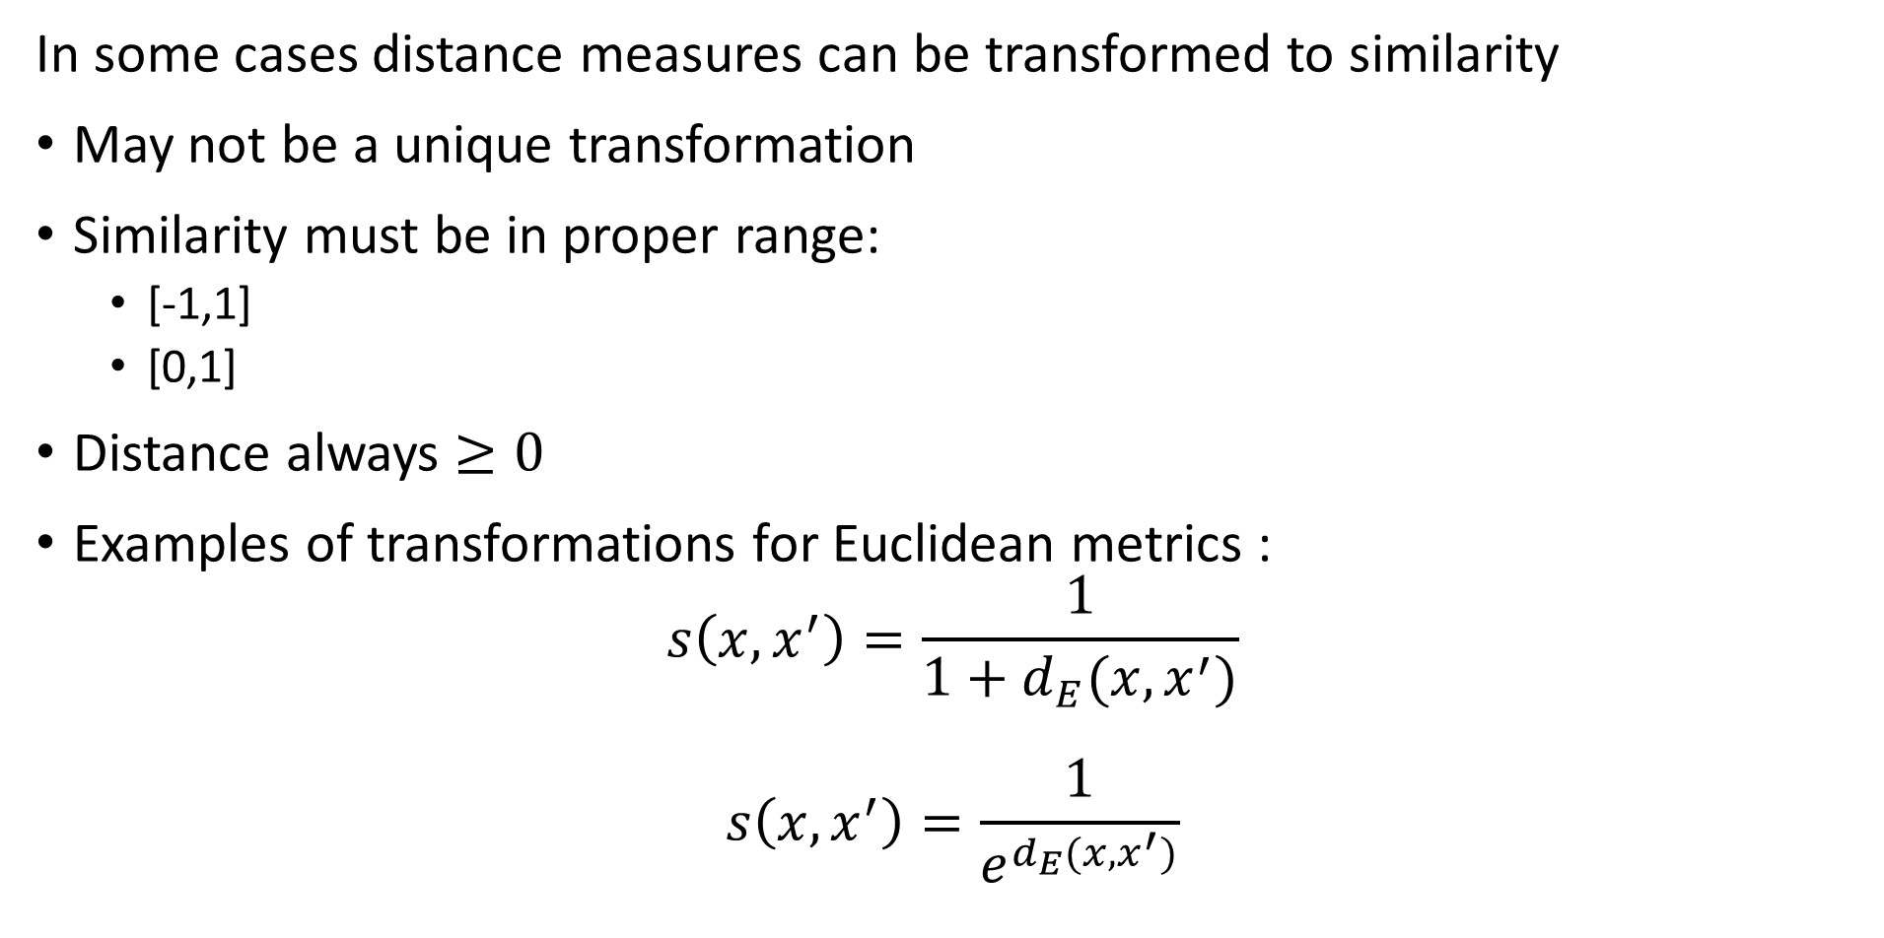
Relationship Between Distance and Similarity
In some cases distance measures can be transformed to similarity
May not be a unique transformation
Similarity must be in proper range:
[-1,1]
[0,1]
Distance always $≥0$
Examples of transformations for Euclidean metrics :
$$s\left(x,x^{′}\right)=\frac{1}{1+d_{E}(x,x^{′})}$$
$$s\left(x,x^{′}\right)=\frac{1}{e^{d_{E}(x,x^{′})}}$$

Slide 41
Scaling Distance and Similarity Metrics

Slide 42
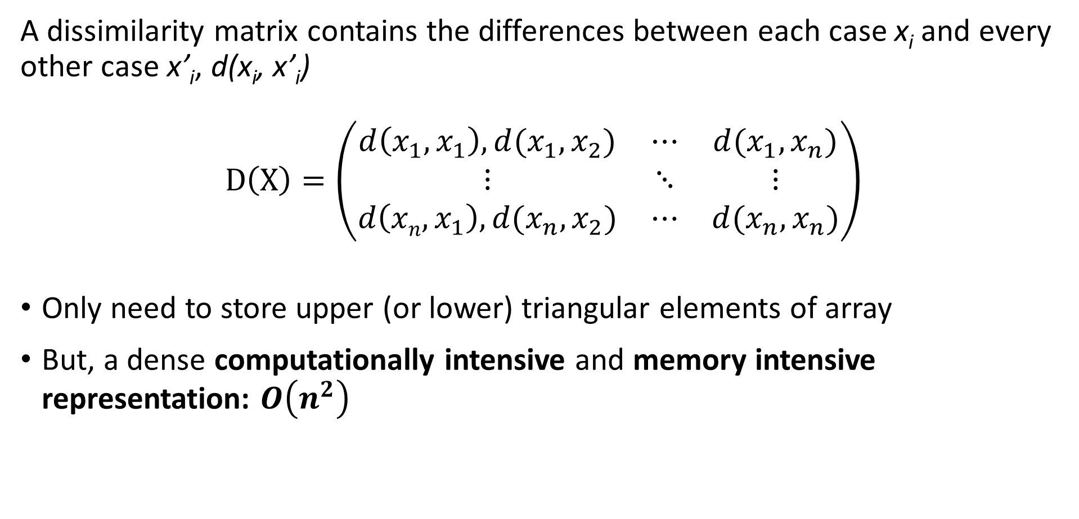
Scaling distance and similarity measures
A dissimilarity matrix contains the differences between each case x_{i} and every other case x’_{i}, d(x_{i}, x’_{i})
$$D\left(X\right)=\left(\begin{matrix}d\left(x_{1},x_{1}\right), d(x_{1},x_{2}) & ⋯ & d(x_{1},x_{n}) \\ ⋮ & ⋱ & ⋮ \\ d\left(xn,x_{1}\right),d(x_{n},x_{2}) & ⋯ & d(x_{n},x_{n})\end{matrix}\right)$$
Only need to store upper (or lower) triangular elements of array
But, a dense computationally intensive and memory intensive representation: $O\left(n^{2}\right)$

Slide 43
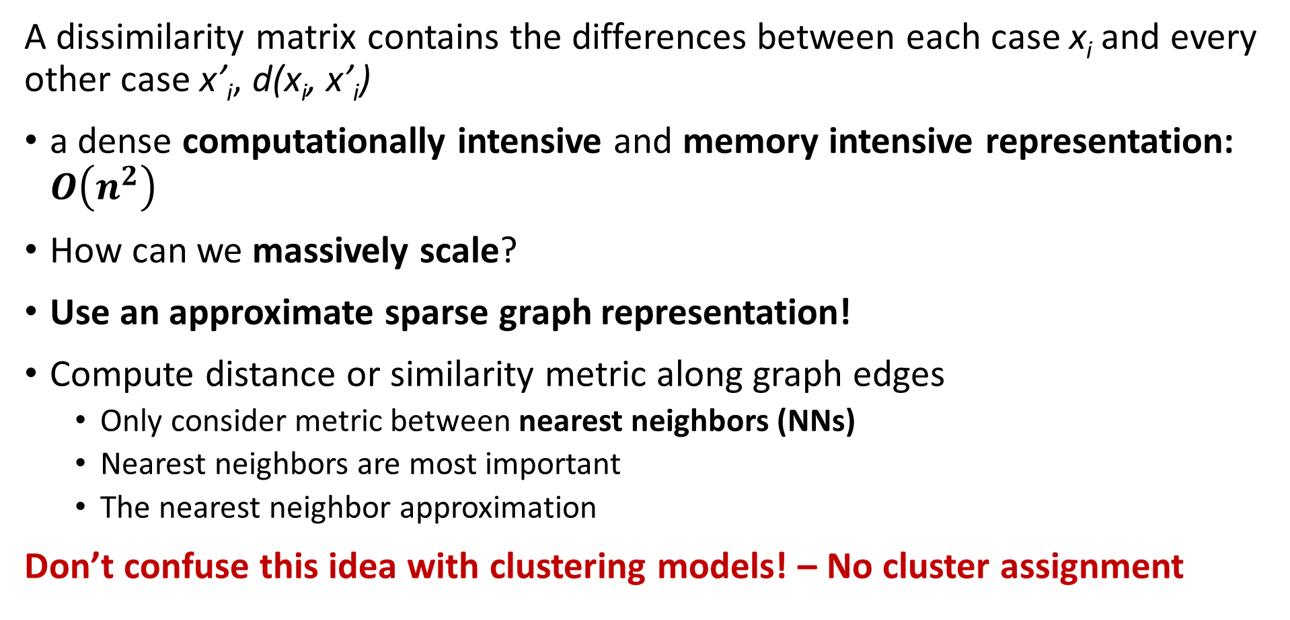
Massively scaling distance and similarity measures
A dissimilarity matrix contains the differences between each case x_{i} and every other case x’_{i}, d(x_{i}, x’_{i})
a dense computationally intensive and memory intensive representation: $O\left(n^{2}\right)$
How can we massively scale?
Use an approximate sparse graph representation!
Compute distance or similarity metric along graph edges
Only consider metric between nearest neighbors (NNs)
Nearest neighbors are most important
The nearest neighbor approximation
Don’t confuse this idea with clustering models! – No cluster assignment

Slide 44
Massively scaling distance and similarity measures
A dissimilarity matrix contains the differences between each case x_{i} and every other case x’_{i}, d(x_{i}, x’_{i})
Sparse graph representation reduces computation and memory use
In many practical situations only need measure for closest neighbors
Construct graph of nearest neighbors
Neglect metric for less important distant nodes
Ways to define nearest neighbor
Neighbors within radius r
Nearest k neighbors

Slide 45
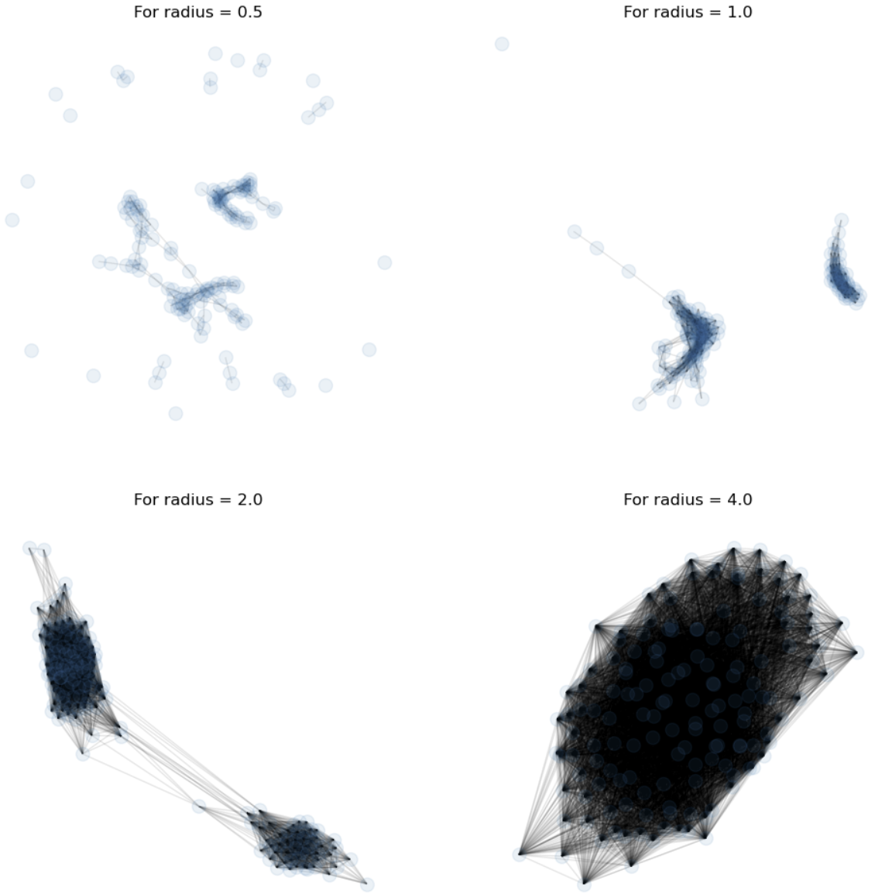
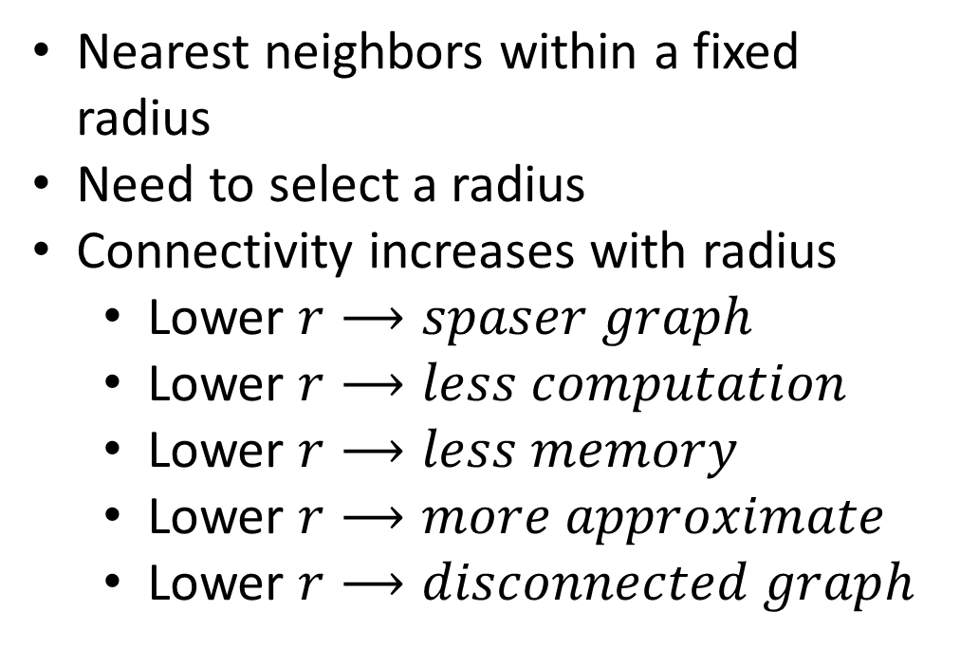
Scaling distance and similarity measures
Sparse graph representation reduces computation and memory use
Nearest neighbors within a fixed radius
Need to select a radius
Connectivity increases with radius
Lower $r⟶spaser graph$
Lower $r⟶less computation$
Lower $r⟶less memory$
Lower $r⟶more approximate$
Lower $r⟶disconnected graph$

Slide 46
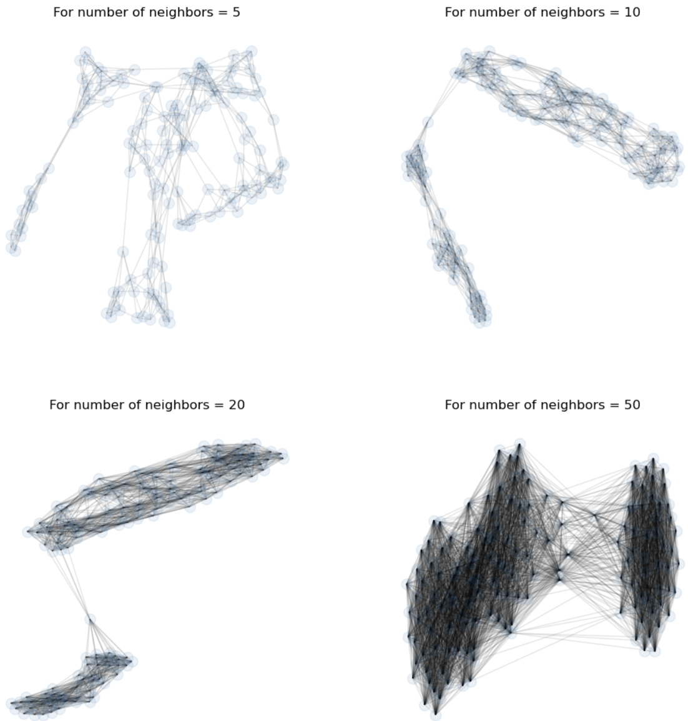
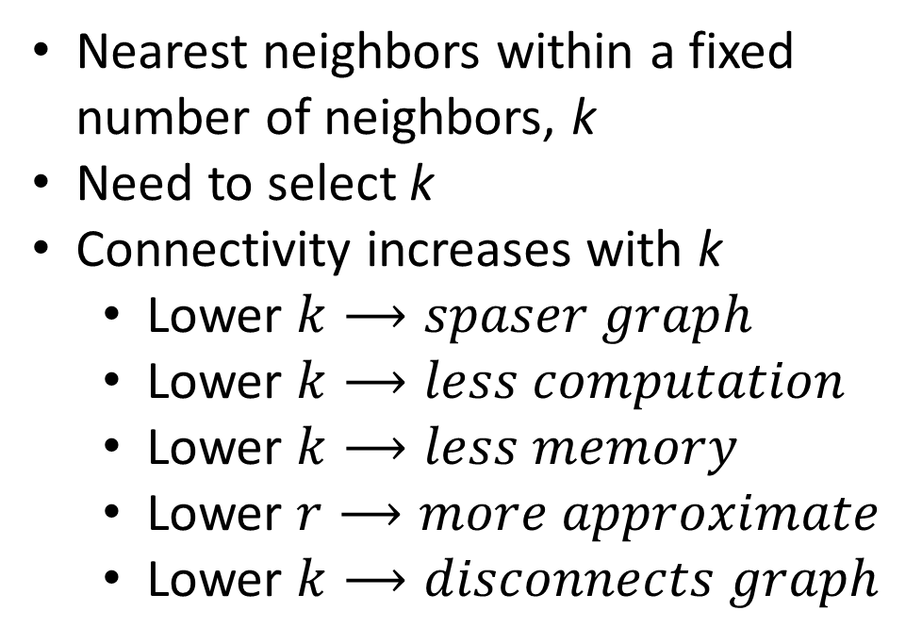
Scaling distance and similarity measures
Sparse graph representation reduces computation and memory use
Nearest neighbors within a fixed number of neighbors, k
Need to select k
Connectivity increases with k
Lower $k⟶spaser graph$
Lower $k⟶less computation$
Lower $k⟶less memory$
Lower $r⟶more approximate$
Lower $k⟶disconnects graph$

Slide 47
Summary
Key points for this lesson
Distance metrics and similarity metrics are foundational for unsupervised learning
Distance and similarity metrics map 2 multivariate (vector) values to a scalar
Distance metric must conform to the 4 axioms!
Different distance and similarity metrics find different relationships in data
There is no one best metric!
In practice, try several
Can transform from similarity to distance
Use sparse graph representation to massively improve scalability

