Slide 1
Information Retrieval
Project
By
Harel Moshayof & Saar Buium

Slide 2



IDEA

Slide 3








Main Search Engine Idea
Query
Doc2Title
800
Indexer
body RDD
BM25
Index
Merge Results
Get Title
Posting list
Result
W = 0.88392
title RDD
Indexer
BM25
W = 0.11607
Index
Posting list
Query

Slide 4







Initial design
Indexer
Small body RDD
Cosine Similarity
Index
Doc2Title.json
Posting list
Query
Small title RDD
Indexer
Binary Ranking
Index
Get Title
Posting list
Query
Result
Small anchor RDD
Indexer
Binary Ranking
Index
Posting list
Query
Page Ranker
Get page rank by doc
Doc IDs
Bucket
Page View Filter
Get page view by doc

Slide 5
Final design
Indexer
body RDD
Cosine Similarity
Index
Doc2Title
Posting list
Query
800
title RDD
Indexer
Binary Ranking
Index
Get Title
Query
Posting list
Result
anchor RDD
Indexer
Binary Ranking
Index
Posting list
Query
Page Ranker
Doc2Pr
Get page rank by doc
800
Doc IDs
Bucket
Page View Filter
Doc2Pv
Get page view by doc
800

Slide 6
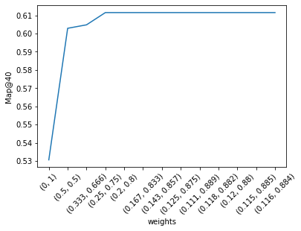
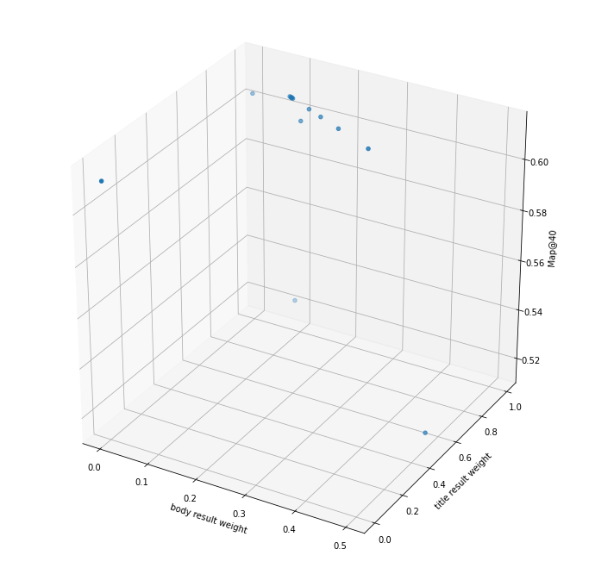
Statistics

