Slide 1
Text Genre Classification in the n << p Regime
Sam Anzaroot
David Belanger

Slide 2
Goal: Classify genre of “Documents”
Books
Research Papers
News articles
Conversation transcripts
Tweets

Slide 3
Document Features
Bag of words (1 feature for each word in vocab)
Ngrams
Capitalization, etc.

Slide 4
Feature Characteristics
High Dimensional
Sparse
Few training examples (n << p)

Slide 5
Example Dataset
Reuters newswire articles
Task = classify as “about corporate acquisitions” or not
Bag-of-words frequency features
17,000 dim features
1500 pos, 1500 neg training examples

Slide 6
Themes

Slide 7
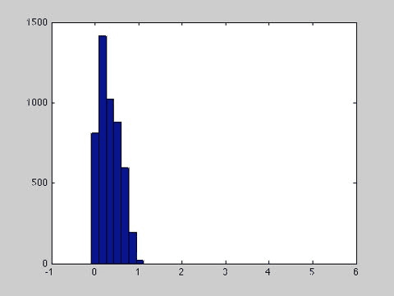
Curse of Dimensionality

Slide 8
Section I: Themes and Background
Curse of Dimensionality
Johnson-Lindenstrauss
Model Sparsity + why L1 yields it
Feature sparsity + how to handle it
Text tasks are often n << p
Model complexity in generative vs. discriminative models.

Slide 9
Techniques
L1/L2 Logistic Regression
Random projection + classifier/ KNN
SVM
Generative model
Naïve Bayes ( w/ smoothing).

Slide 10
Dataset
Freq. of word stems in text
Classes: Is Reuter’s article about ‘corporate acquisitions’ or not?
N = 2600
P = 20,000
Some algorithms can handle bigger p, but not all, and want to compare.

Slide 11
Experiments: Find subregimes of n << p
Fix test set
Vary training set size
Train/Test various algorithms
Plot time, accuracy vs. train set size.
Identify crossing points.

Slide 12
Hypotheses
For very small n, dimensionality reduction will be important to prevent overfitting.
L2 Logistic regression will be asymptotically worse, but better better for small n.
For small n generative techniques will be better.
For large n, discriminative techniques will be better.

Slide 13
Curse of Dimensionality
Vary RandProjection dimension and compute KNN accuracy.

Slide 14
Feature Selection
“Blow Up” dataset by adding random features.
See if you can recover original features by doing sparse logistic regression.

