Slide 1
Text Genre Classification in the n << p Regime
Sam Anzaroot
David Belanger

Slide 2
Goal: Classify genre of “Documents”
Books
Research Papers
News articles
Conversation transcripts
Tweets

Slide 3
Document Features
Bag of words (1 feature for each word in vocab)
Ngrams
Capitalization, etc.

Slide 4
Example Dataset
Reuters newswire articles
Task = classify as “about corporate acquisitions” or not
Bag-of-words frequency features
17,000 dim features
1500 pos, 1500 neg training examples

Slide 5
Data Characteristics
High Dimensional (17,000 dim)
Sparse (99.5%)
n << p (1,500 examples per class)

Slide 6
Themes in n << p

Slide 7
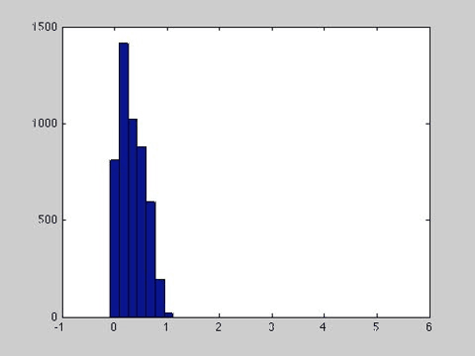
Curse of Dimensionality

Slide 8
Curse of Dimensionality
Linear vs. RBF Kernel

Slide 9
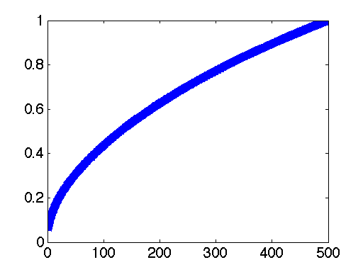
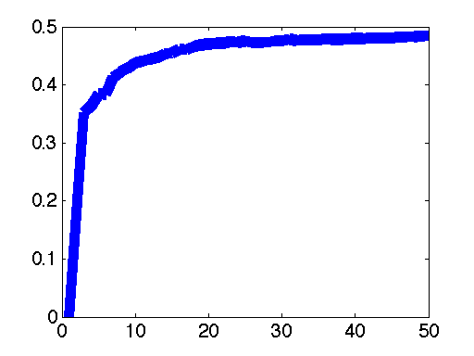
PCA
Cumulative Variance
Sparsity of Projected Data

Slide 10
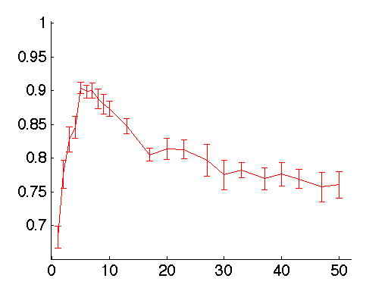
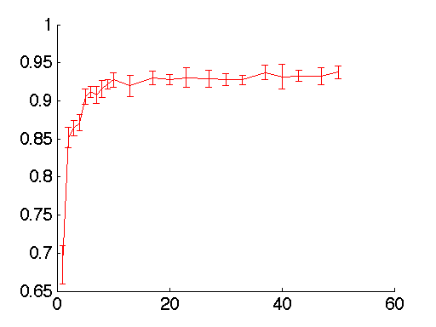
PCA
Naïve Bayes
SVM

Slide 11
PCA

Slide 12
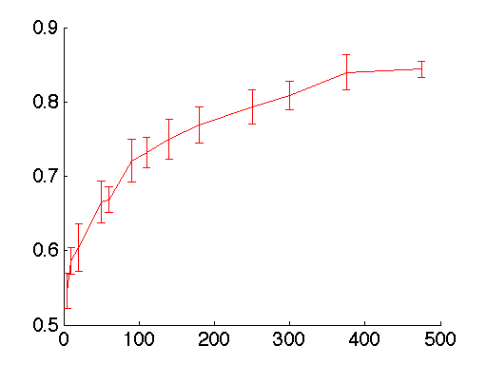
Random Projections
Surprisingly Effective!

Slide 13
Dimensionality Reduction Observations
Tradeoff between lossy compression and utility of small dimensionality
Necessary for extremely small training data.
PCA > Rand Proj., but expensive to compute

Slide 14
Feature Sparsity Observations
Dot products are extremely efficient.
Linear Kernel SVM fast
Need smoothing in Naïve Bayes

Slide 15
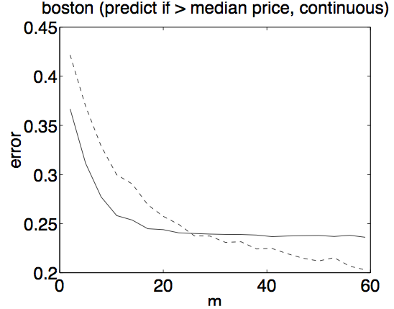
Subregimes of n << p
Ng. and Jordan 2002 :
Log. Regression is asymptotically better than naïve bayes, but requires more samples to reach this limit.

Slide 16
Subregimes of n << p
Anzaroot and Belanger 2011:
Log. Regression is always better than naïve Bayes.
Reason:
Very sparse data. Smoothing in Naïve Bayes sensitive

Slide 17
L1 Feature Selection
Goal of L1 model: find important/ relevant features and use them.
How robust is L1 logisitic regression to extra random features?

Slide 18
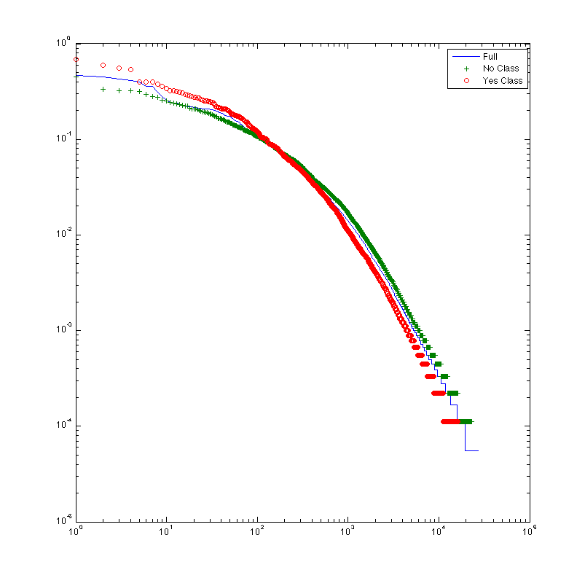
Feature Selection Exp.
Step 1: Generate random features using Zipf’s law.
Step 2: Train/ Test sparse Logistic Regression Model
Step 3: compare selected feature sets

Slide 19
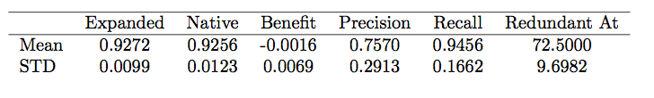
Feature Selection Results

Slide 20
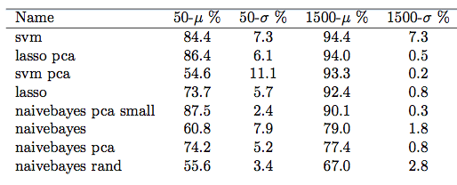
Overall Results

Slide 21
Lessons Learned
You can get surprisingly good results in n << p
100 examples, 17,000 dim.
86% acc. With log. Regression
Should have used harder dataset
Don’t standardize sparse data!
Dimensionality reduction (even random) helps!

