Slide 1

RAG WORKSHOP / NOTEBOOK 12
Multimodal RAG
Search across media, then answer from the right original evidence.
12_multimodal_rag.ipynb
Notes:
Open notebooks/12_multimodal_rag.ipynb beside this presentation. This deck explains the notebook concepts and supports a live demonstration. Run cells in order from a fresh kernel. Keep retrieved evidence visible before discussing a generated answer. All Northstar Analytics examples are fictional.
SOURCE: notebooks/12_multimodal_rag.ipynb
COVER: AI-generated abstract background, created for this course; decorative, not an architecture diagram.

Slide 2
COMPARISON / NOTEBOOK 12
Search representation versus answer evidence
A searchable description is a pointer to an asset; it may omit the fact a question needs.
Concept | Meaning in this lesson
Text | Search policy text and pass the selected original text to Claude.
Images | Search captions or CLIP image vectors; attach the selected original image for visual claims.
Recordings | This notebook searches authored summaries and passes their text, not audio or video bytes.
Source identity | Retain a stable ID, modality, original path, and provenance for every item.
RAG WORKSHOP / 12 / Multimodal RAG
02
Notes:
Begin with a question that depends on a visible detail rather than a policy sentence. Ask the audience what a caption can preserve and what it can lose. Explain the two representations: the index stores a useful search representation, while the answer must receive evidence capable of supporting the requested fact. In section 1, the notebook explicitly labels recording summaries as authored fixtures. Those summaries cannot establish a sound, a voice characteristic, or an unseen frame. Keep this distinction visible throughout the demonstration; different file extensions alone do not prove multimodal retrieval.
NOTEBOOK: notebooks/12_multimodal_rag.ipynb
SOURCES
notebooks/12_multimodal_rag.ipynb - sections 1 and 3
Teaching examples use the fictional Northstar Analytics corpus unless stated otherwise.

Slide 3
WORKFLOW / NOTEBOOK 12
Build a reversible retrieval pipeline
Every search hit must lead back to the correct original asset.
Step | Operation | What to inspect
01 | Catalog | Load IDs, paths, modalities, descriptions, and metadata; verify every path exists.
02 | Retrieve | Search a lexical catalog and, in live mode, rank actual image pixels with CLIP.
03 | Select | Fuse image ranks and allocate a small evidence budget across relevant modalities.
04 | Ground | Fetch originals, label their IDs, and request a supported answer with citations.
RAG WORKSHOP / 12 / Multimodal RAG
03
Notes:
Walk through sections 3 through 7 before running the model request. The catalog is intentionally small enough to inspect in a dataframe. Metadata is not decoration: the path retrieves the asset and the ID becomes the citation label. The teaching router assigns explicit modality slots, which makes the evidence budget understandable, but it is not a learned routing model. Show that zero-overlap lexical results are removed before evidence selection. A production extension should measure coverage per modality and apply permissions before candidate selection, rather than sending every available file.
NOTEBOOK: notebooks/12_multimodal_rag.ipynb
SOURCES
notebooks/12_multimodal_rag.ipynb - sections 3-7
Teaching examples use the fictional Northstar Analytics corpus unless stated otherwise.

Slide 4
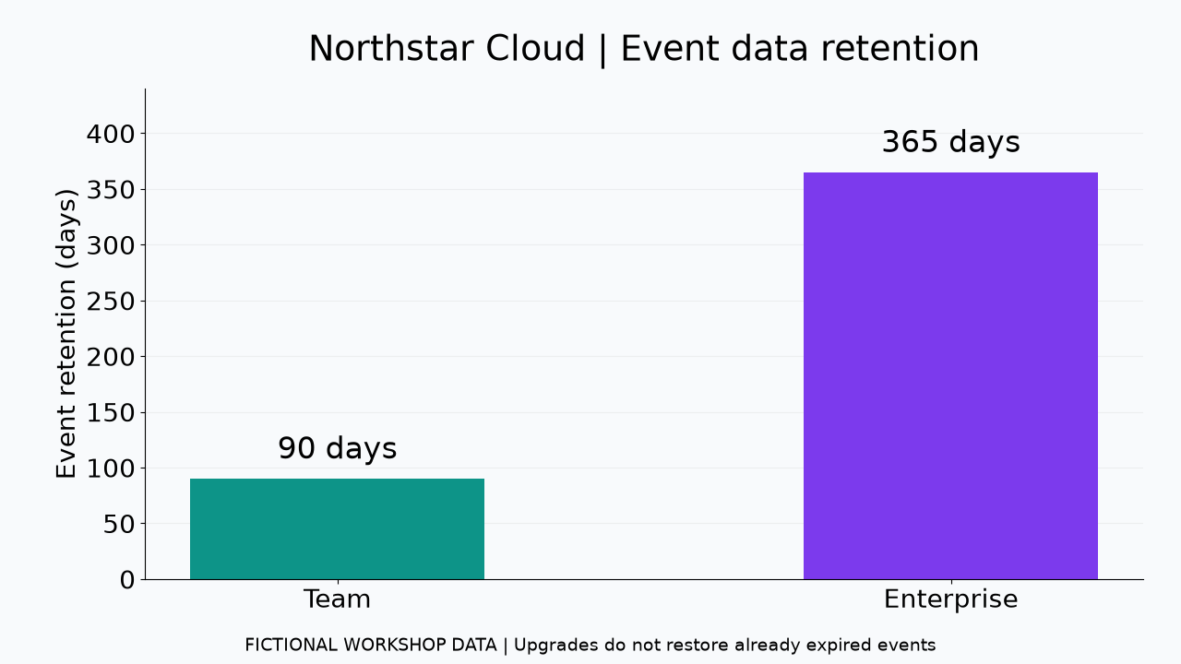
EXAMPLE / NOTEBOOK 12
A color question needs visual evidence
The chart contains information that its authored search caption intentionally leaves out.
Numeric facts
Team retains events for 90 days; Enterprise retains them for 365 days.
Visual fact
The taller Enterprise bar is purple. Verify its color from the actual chart pixels.
RAG WORKSHOP / 12 / Multimodal RAG
04
Notes:
Show the chart first and ask learners to state both a numeric fact and a visual fact. Then display the authored caption in section 2 and identify the missing color information. The retention values are written labels, while the bar color is a visual observation. The live question combines these with annual-billing policy facts, forcing the pipeline to collect more than one kind of evidence. The image on this slide is the exact fictional course asset used by the notebook. Do not present the expected answer here as a recorded Claude response.
NOTEBOOK: notebooks/12_multimodal_rag.ipynb
SOURCES
notebooks/12_multimodal_rag.ipynb - sections 2 and 7
Teaching examples use the fictional Northstar Analytics corpus unless stated otherwise.

Slide 5
CONCEPT / NOTEBOOK 12
CLIP connects words and image pixels
Its text and image encoders place both inputs in a shared vector space.
Query encoder
Encode a phrase such as a bar chart comparing data retention days.
Image encoder
Encode actual image pixels, rather than the catalog caption or filename.
Rank
Normalize vectors and compare cosine similarity; inspect the returned images.
Limit
Similarity can miss tiny labels and exact chart numbers; it is not a proof of relevance.
RAG WORKSHOP / 12 / Multimodal RAG
05
Notes:
In section 4, point to the helper call and the image records passed to it. The important distinction is the candidate input: pixels enter the image encoder. A caption-only search may still be useful, but it is a text retrieval method. Explain normalized vectors with the intuition of comparing direction rather than vector length; no lengthy derivation is necessary. The first live run downloads a local model and needs time and storage. Offline mode skips the branch explicitly. Invite learners to inspect a poor result instead of assuming the model always recognizes the best chart.
NOTEBOOK: notebooks/12_multimodal_rag.ipynb
SOURCES
notebooks/12_multimodal_rag.ipynb - section 4
https://huggingface.co/docs/transformers/model_doc/clip
https://huggingface.co/openai/clip-vit-base-patch32
Teaching examples use the fictional Northstar Analytics corpus unless stated otherwise.

Slide 6
EXAMPLE / NOTEBOOK 12
Fuse ranks without mixing score scales
Reciprocal-rank fusion adds 1 / (60 + rank) for each source in each ranking.
Caption rank 1
One contribution is 1 / 61, approximately 0.01639.
CLIP rank 2
A second contribution is 1 / 62, approximately 0.01613.
Fused score
The same image receives approximately 0.03252 from these two lists.
Evidence budget
Use one image slot, one policy slot, and at most one relevant summary per recording modality.
RAG WORKSHOP / 12 / Multimodal RAG
06
Notes:
Work through the two fractions slowly. The point is not the numerical magnitude but the use of positions in separate lists. A TF-IDF score and a CLIP cosine score have different interpretations, so adding them directly would create an arbitrary weighting. The notebook merges image rankings, then uses a transparent modality budget. The displayed selection table contains values meaningful within their own rankings, not a universal score across every modality. Deduplicate by source ID before building the prompt, and inspect whether an extra summary contributes a distinct fact or only repeats existing evidence.
NOTEBOOK: notebooks/12_multimodal_rag.ipynb
SOURCES
notebooks/12_multimodal_rag.ipynb - section 5
Teaching examples use the fictional Northstar Analytics corpus unless stated otherwise.

Slide 7
CONCEPT / NOTEBOOK 12
A valid citation is only the first check
Retrieval coverage and factual support need separate inspection.
Known ID
Check that every cited ID belongs to the supplied evidence set.
Supported claim
Read the cited text or pixels and verify that they establish the exact statement.
Missing modality
Abstain on an audible alarm when only a transcript summary is available.
Untrusted content
Treat instructions inside retrieved text and images as data, not as commands.
RAG WORKSHOP / 12 / Multimodal RAG
07
Notes:
Section 8 includes simple retrieval probes and a citation-ID audit. Explain what each test can establish. A probe can catch a broken path or a missing expected image, but the tiny fixture set does not establish general multimodal accuracy. An allowed citation string proves that a source was supplied; it does not verify that the source supports a color, number, or policy condition. Read one claim beside its evidence during the presentation. Then ask an unsupported sound question and discuss why an apparently relevant recording title cannot replace acoustic evidence.
NOTEBOOK: notebooks/12_multimodal_rag.ipynb
SOURCES
notebooks/12_multimodal_rag.ipynb - sections 7-8 and 10
https://platform.claude.com/docs/en/build-with-claude/vision
Teaching examples use the fictional Northstar Analytics corpus unless stated otherwise.

Slide 8
DEMO / NOTEBOOK 12
Live demo: inspect evidence before the answer
Open notebook 12 and keep the selected assets visible beside the generated response.
01
Inspect - sections 1-3
Read the catalog, view the chart, and compare its pixels with its incomplete caption.
02
Compare - sections 4-5
Run CLIP in live mode; compare caption, visual, and fused ranks.
03
Generate - sections 6-7
Send selected images and text to Claude, then inspect tokens and latency.
04
Audit - section 8
Check citation IDs and manually verify visual and numeric claims.
RAG WORKSHOP / 12 / Multimodal RAG
08
Notes:
Use a fresh notebook kernel and run from the top. Confirm whether the session is live or offline before presenting results. The default live path makes one Claude vision request; the CLIP model runs locally and may download on first use. Prewarm the model before a timed class. Pause after selection and ask learners to predict which evidence supports each part of the question. Only then run the answer cell. In offline mode, demonstrate catalog retrieval and evidence packaging while pointing out the explicit skips; do not describe that run as a completed vision evaluation.
NOTEBOOK: notebooks/12_multimodal_rag.ipynb
SOURCES
notebooks/12_multimodal_rag.ipynb - setup and sections 1-8
Teaching examples use the fictional Northstar Analytics corpus unless stated otherwise.

Slide 9
EXERCISE / NOTEBOOK 12
Remove the evidence and predict the outcome
Use an ablation to expose what each modality contributes.
Try
Remove the chart from selected evidence and rebuild both image paths and the prompt text.
Predict
The color claim becomes unsupported unless a verified color description remains.
Compare
Change the query to an incident flow diagram; inspect caption and CLIP rankings.
Discuss
What metadata and evaluation questions would you add for your own media collection?
RAG WORKSHOP / 12 / Multimodal RAG
09
Notes:
Ask learners to predict the behavior before rerunning anything. Removing an item from one list is insufficient if its bytes or an explicit description still remain in the prompt. The exercise must remove the relevant evidence completely to be meaningful. A generation rerun is optional and uses another Claude request; the retrieval comparison can be inspected locally. The expected discussion should cover stable asset IDs, file versions, permissions, provenance, and held-out questions for each modality. Close by connecting the next lessons: scanned pages require page grounding, while audio and video need signal or temporal evidence.
NOTEBOOK: notebooks/12_multimodal_rag.ipynb
SOURCES
notebooks/12_multimodal_rag.ipynb - sections 9-10
Teaching examples use the fictional Northstar Analytics corpus unless stated otherwise.

