Slide 1

RAG WORKSHOP / NOTEBOOK 13
Image and Document RAG
Retrieve scanned pages and answer from their original visual evidence.
13_image_document_rag.ipynb
Notes:
Open notebooks/13_image_document_rag.ipynb beside this presentation. This deck explains the notebook concepts and supports a live demonstration. Run cells in order from a fresh kernel. Keep retrieved evidence visible before discussing a generated answer. All Northstar Analytics examples are fictional.
SOURCE: notebooks/13_image_document_rag.ipynb
COVER: AI-generated abstract background, created for this course; decorative, not an architecture diagram.

Slide 2
COMPARISON / NOTEBOOK 13
A PDF is not always searchable text
The document can contain a text layer, page images, or a mixture of both.
Concept | Meaning in this lesson
Text extraction | Reads existing PDF text. Empty output does not mean that the page is blank.
Rendering | Converts the original page to visible pixels; it does not create searchable words.
OCR or vision | Reads lettering and layout from pixels, with possible recognition errors.
This fixture | Three image-only pages: a chart, an incident diagram, and a refund-policy scan.
RAG WORKSHOP / 13 / Image and Document RAG
02
Notes:
Start by asking whether a PDF file extension guarantees extractable text. Run section 1 and show the extracted-character counts for all three fixture pages. Their empty text layer is the trigger for a different ingestion path, not a reason to discard them. Rendering with pypdfium2 makes the page visible but still does not create an index. The notebook uses Claude vision to create page descriptions in live mode. A traditional OCR engine is another possible reading method, but it is not a hidden dependency in this lesson.
NOTEBOOK: notebooks/13_image_document_rag.ipynb
SOURCES
notebooks/13_image_document_rag.ipynb - sections 1-3
https://pypdf.readthedocs.io/en/stable/user/extract-text.html
https://pypdfium2.readthedocs.io/en/stable/python_api.html
Teaching examples use the fictional Northstar Analytics corpus unless stated otherwise.

Slide 3
WORKFLOW / NOTEBOOK 13
Separate ingestion from question answering
Read once for search; retrieve and supply selected originals for each question.
Step | Operation | What to inspect
01 | Render | Create one image per original PDF page and retain the page mapping.
02 | Describe | Create searchable page text; validate complete, unique page numbers and nonempty descriptions.
03 | Retrieve | Index descriptions and rank pages for the current question.
04 | Answer | Send only selected original images or a selected-page PDF, with original-page citation IDs.
RAG WORKSHOP / 13 / Image and Document RAG
03
Notes:
Explain the two-stage cost model without making claims about current pricing. The ingestion request reads all three rendered fixture pages and produces descriptions that can be reused for questions. The answer request receives only the selected originals. In offline mode, clearly labelled authored descriptions replace live ingestion; they are not presented as simulated model output. If live extraction is malformed or truncated, the notebook stops rather than silently substituting a different provenance. This separation helps learners see why retrieving a description and answering from the original page are complementary tasks.
NOTEBOOK: notebooks/13_image_document_rag.ipynb
SOURCES
notebooks/13_image_document_rag.ipynb - sections 2-4 and 6-7
Teaching examples use the fictional Northstar Analytics corpus unless stated otherwise.

Slide 4
CONCEPT / NOTEBOOK 13
Preserve page identity through every transform
A source citation must still identify the original page after a subset PDF is created.
Stable evidence ID
visual-guide:p3 identifies original page 3 of the source guide.
Original location
Store source filename, one-based page number, rendered image path, and provenance.
Subset mapping
Local page 1 in a selected PDF can still be original page 3.
Scaling up
Long reports may need figure, table, or region chunks with page numbers and bounding boxes.
RAG WORKSHOP / 13 / Image and Document RAG
04
Notes:
Use the refund question to illustrate the page-number trap. The original policy scan is on page 3, but a one-page subset containing only that scan starts at local page 1. The notebook builds an explicit mapping so the citation still points to the original document location. Show the metadata stored in each Document and then the page_map string used in the answer prompt. One chunk per page works for this short fixture; it is a teaching decision, not a universal recommendation for long or densely structured reports.
NOTEBOOK: notebooks/13_image_document_rag.ipynb
SOURCES
notebooks/13_image_document_rag.ipynb - sections 4 and 6
Teaching examples use the fictional Northstar Analytics corpus unless stated otherwise.

Slide 5
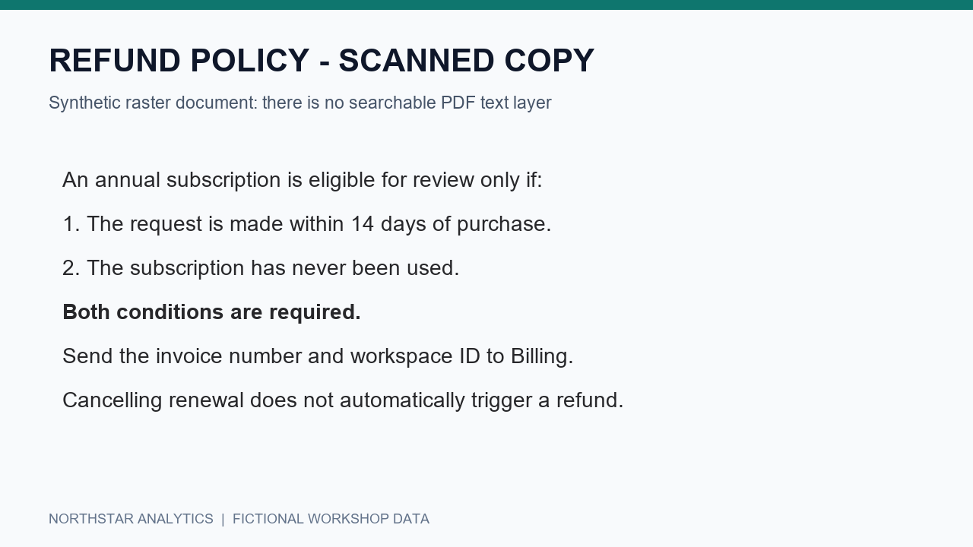
EXAMPLE / NOTEBOOK 13
Retrieve both refund conditions
The original scan supports a deadline and an eligibility condition.
Deadline
The request must be within 14 days of purchasing an annual subscription.
Eligibility
The subscription must be unused. The deadline alone is not the complete policy.
RAG WORKSHOP / 13 / Image and Document RAG
05
Notes:
Display the scan and ask learners to identify the two conditions before reading any model answer. An incomplete answer that repeats only fourteen days is not faithful to the source. In section 4 the query retrieves the relevant page description; section 6 packages the corresponding original page. The answer stage reads that original, rather than treating the generated description as authoritative policy. The asset on this slide is the same synthetic scan used by the course. Discuss how a faint or clipped word such as unused could change the business meaning.
NOTEBOOK: notebooks/13_image_document_rag.ipynb
SOURCES
notebooks/13_image_document_rag.ipynb - sections 4, 6-8
Teaching examples use the fictional Northstar Analytics corpus unless stated otherwise.

Slide 6
COMPARISON / NOTEBOOK 13
Rendered images and native PDF input
Both answer paths use the same selected evidence, with different request packaging.
Concept | Meaning in this lesson
Image path | ANSWER_INPUT="images" sends selected rendered page images.
PDF path | ANSWER_INPUT="pdf" sends a newly assembled PDF containing those selected original pages.
Same grounding rule | Cite original-page IDs and preserve numbers, units, deadlines, and conditions.
Same uncertainty rule | Report unclear pixels or missing evidence rather than filling gaps with assumptions.
RAG WORKSHOP / 13 / Image and Document RAG
06
Notes:
Section 7 offers two answer-input choices. Avoid implying that one automatically improves accuracy; the fixture uses the same retrieved pages in both paths. Switching the option and rerunning makes another request, so use it deliberately during a live demonstration. The central RAG distinction appears in section 6: the system first retrieves a subset, then sends that subset to the model. Passing the whole document every time would skip this retrieval step. Provider request limits can change, so larger experiments should consult the linked documentation rather than reuse a hard-coded capacity claim.
NOTEBOOK: notebooks/13_image_document_rag.ipynb
SOURCES
notebooks/13_image_document_rag.ipynb - sections 6-7
https://platform.claude.com/docs/en/build-with-claude/vision
https://platform.claude.com/docs/en/build-with-claude/pdf-support
Teaching examples use the fictional Northstar Analytics corpus unless stated otherwise.

Slide 7
CONCEPT / NOTEBOOK 13
Evaluate reading, retrieval, and support separately
A polished answer can conceal a missing phrase or incorrect page mapping.
Extraction fidelity
Compare descriptions with originals: values, labels, arrow order, and policy exceptions.
Retrieval check
Run three labelled page probes and inspect recall@1 for this small fixture.
Citation audit
Reject unknown page IDs, then manually check the cited page supports the claim.
Unsupported query
An international-return fee is absent; a search hit does not establish a fee.
RAG WORKSHOP / 13 / Image and Document RAG
07
Notes:
Use section 5 before running generation. Its three probes can expose missing searchable words or a swapped page number, but they are too small to be a production benchmark. Then distinguish structural citation checking from support verification. A citation might be syntactically valid and still point to a page that does not establish the answer. Section 8 includes an unsupported shipping-fee query to make that failure concrete. Ask learners whether a positive retrieval score is sufficient evidence, and have them inspect the actual page before responding.
NOTEBOOK: notebooks/13_image_document_rag.ipynb
SOURCES
notebooks/13_image_document_rag.ipynb - sections 5 and 8-10
Teaching examples use the fictional Northstar Analytics corpus unless stated otherwise.

Slide 8
DEMO / NOTEBOOK 13
Live demo: from empty extraction to a cited page
Open notebook 13 and stop at each intermediate representation.
01
Inspect - sections 1-2
Show empty extracted text, then render and display all three actual pages.
02
Index - sections 3-5
Read the provenance, inspect descriptions, and run the labelled retrieval probes.
03
Package - sections 6-7
Print the subset mapping and answer from selected images or PDF pages.
04
Verify - section 8
Check the cited page, the 14-day deadline, and the unused-subscription condition.
RAG WORKSHOP / 13 / Image and Document RAG
08
Notes:
Prepare the live budget before class: the default path makes one ingestion request and one answer request. The authored-description option enables an answer-only demonstration with explicit provenance, while offline mode skips both calls. Do not confuse these modes when describing what was verified. Run the notebook independently from the top so the page paths and metadata belong to the current source. Before generating an answer, open the selected original page and ask the audience to predict the citation and required conditions. That pause makes the retrieval boundary visible.
NOTEBOOK: notebooks/13_image_document_rag.ipynb
SOURCES
notebooks/13_image_document_rag.ipynb - setup and sections 1-8
Teaching examples use the fictional Northstar Analytics corpus unless stated otherwise.

Slide 9
EXERCISE / NOTEBOOK 13
Change the question without losing page identity
Rerun retrieval and evidence packaging before rerunning generation.
Incident question
Expected: original page 2; acknowledge within 15 minutes and update every 30 minutes.
Retention question
Expected: original page 1; Team 90 days and Enterprise 365 days.
Ablation
Remove a key phrase from a copied description and observe whether page retrieval changes.
Your own PDF
Inspect text layers, remove three-page assumptions, and review recognition errors.
RAG WORKSHOP / 13 / Image and Document RAG
09
Notes:
The most common practical mistake is changing the question but reusing stale page hits or a stale subset PDF. Have learners identify the dependent cells and rerun them in order. Retrieval and local packaging can be tested without another paid answer request. In the ablation, modify a copy of the description rather than the original fixture. Expected discussion: the original can contain the answer while a lossy search description prevents retrieval. Extensions should preserve layout locations, cache ingestion by content hash, apply permissions before search, and keep original pages available for verification.
NOTEBOOK: notebooks/13_image_document_rag.ipynb
SOURCES
notebooks/13_image_document_rag.ipynb - sections 9-10
Teaching examples use the fictional Northstar Analytics corpus unless stated otherwise.

