Slide 1
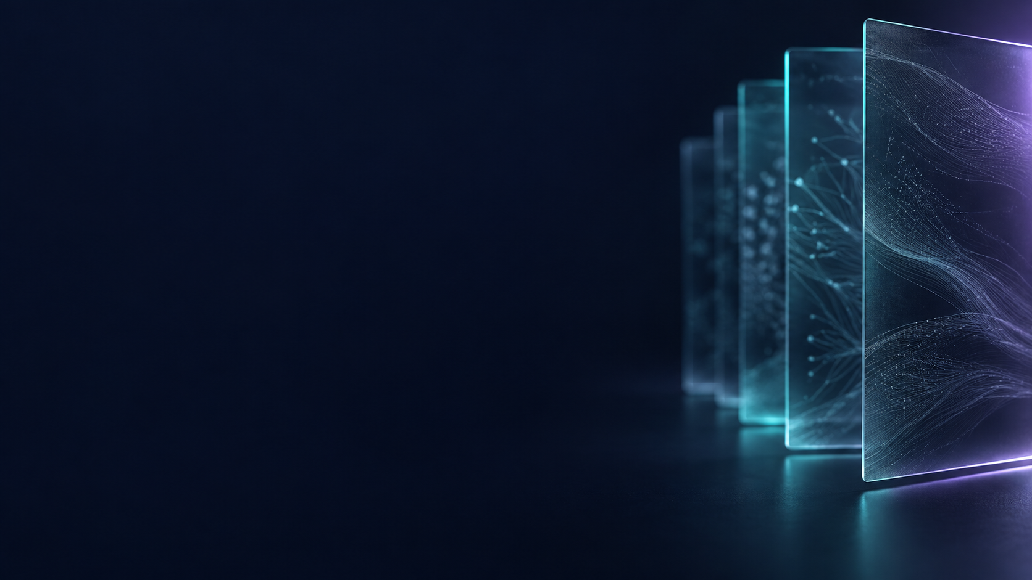
RAG WORKSHOP / NOTEBOOK 15
Video RAG
Align speech and sampled frames, then retrieve evidence on one timeline.
15_video_rag.ipynb
Notes:
Open notebooks/15_video_rag.ipynb beside this presentation. This deck explains the notebook concepts and supports a live demonstration. Run cells in order from a fresh kernel. Keep retrieved evidence visible before discussing a generated answer. All Northstar Analytics examples are fictional.
SOURCE: notebooks/15_video_rag.ipynb
COVER: AI-generated abstract background, created for this course; decorative, not an architecture diagram.

Slide 2
CONCEPT / NOTEBOOK 15
A video has visual and spoken timelines
Visible scenes and narration can change at different moments.
Visual window
The retention slide is visible from 11.9 to 24.7 seconds in this fixture.
Speech interval
Its narration spans approximately 11.82 to 24.22 seconds.
Provenance
The scene manifest is authored during asset creation; it is not a scene detector result.
Evidence limit
Temporal overlap alone does not prove that a spoken statement describes a visible object.
RAG WORKSHOP / 15 / Video RAG
02
Notes:
Open the source video and compare a visual cut with the narration boundary. The sample is a real synthetic narrated MP4, but its scene labels were authored and quantized to the ten-frame-per-second video. They are not automatically discovered labels. The small difference between speech and slide timing is intentional and becomes important when assigning segments to windows. Explain that a speaker can refer to an earlier image, so temporal alignment is a practical association rather than proof of semantic agreement. The source must still be replayed when claims appear to conflict.
NOTEBOOK: notebooks/15_video_rag.ipynb
SOURCES
notebooks/15_video_rag.ipynb — section 1; data/media/video/scenes.json
Teaching examples use the fictional Northstar Analytics corpus unless stated otherwise.

Slide 3
WORKFLOW / NOTEBOOK 15
Decode, align, retrieve, and ground
The default pipeline processes real media while keeping learned branches optional.
Step | Operation | What to inspect
01 | Decode | FFmpeg extracts the MP4 audio track; OpenCV samples actual frames every two seconds.
02 | Align | Attach transcript segments and sampled frames to shared temporal window IDs.
03 | Retrieve | Rank speech text; optionally rank frame pixels with CLIP, then fuse window ranks.
04 | Answer | Replay the chosen time range and send selected frames plus timestamped text to Claude.
RAG WORKSHOP / 15 / Video RAG
03
Notes:
Walk through sections 2 through 8 as an evidence pipeline. The frame source matters: OpenCV decodes the actual MP4 rather than opening the original slide image files. Regular two-second sampling is inexpensive for this short fixture but can miss brief scenes. Audio extraction and frame decoding do not call a language model. Optional faster-whisper recognition and CLIP retrieval are separate learned steps. The final request contains selected images and text, with a small frame budget. Claude is not given the video file or raw audio in this notebook.
NOTEBOOK: notebooks/15_video_rag.ipynb
SOURCES
notebooks/15_video_rag.ipynb — sections 2–8
https://docs.opencv.org/4.x/dd/d43/tutorial_py_video_display.html
https://ffmpeg.org/ffmpeg.html
Teaching examples use the fictional Northstar Analytics corpus unless stated otherwise.

Slide 4
EXAMPLE / NOTEBOOK 15
Handle a boundary-crossing utterance
Shared window IDs make fusion possible, but alignment rules must prevent duplicate evidence.
Half-open windows
A frame belongs when start <= time < end; a frame at end belongs to the next window.
Small overlap
Retention speech begins at 11.82 seconds, only 0.08 seconds before the 11.9-second visual cut.
Assignment rule
For retrieval, assign a crossing utterance to the window with greatest overlap duration.
Keep provenance
Retain all overlaps for inspection and keep the utterance's own timestamps.
RAG WORKSHOP / 15 / Video RAG
04
Notes:
Work through the 0.08-second overlap at the first visual boundary. If a full retention utterance were copied into every overlapping window, the previous billing scene could rank highly for retention despite containing almost none of that speech. The notebook therefore chooses the window with the largest overlap duration for transcript retrieval. It still records overlaps for inspection and preserves the speech segment range. This is a teaching alignment policy, not a claim that every word falls inside the selected visual window. Show why frame assignment and utterance assignment use related but different rules.
NOTEBOOK: notebooks/15_video_rag.ipynb
SOURCES
notebooks/15_video_rag.ipynb — section 4; data/media/video/scenes.json
Teaching examples use the fictional Northstar Analytics corpus unless stated otherwise.

Slide 5
COMPARISON / NOTEBOOK 15
Compare speech retrieval with frame retrieval
Ask the same question before comparing or fusing the two rankings.
Concept | Meaning in this lesson
Transcript branch | Searches only spoken words; authored scene labels are excluded from retrieval text.
Frame branch | CLIP compares the query with actual decoded frame pixels when RUN_CLIP=True.
Fusion | Deduplicate window IDs within each list, then add 1 / (60 + rank).
Disabled branch | Without CLIP, the ranking is transcript-only followed by frame selection by time.
RAG WORKSHOP / 15 / Video RAG
05
Notes:
Section 5 uses a common question for both branches so the rankings are comparable. Explain why independent frame IDs must map to shared window IDs before fusion. A long scene can have many sampled frames; without per-list deduplication, it receives an unfair number of votes. Section 6 makes reciprocal-rank fusion explicit. When CLIP is disabled, describe the result accurately as transcript retrieval with visual evidence lookup. Selecting a midpoint frame is useful, but it is not learned image retrieval. Query wording can also change the simple lexical ranking because this baseline does not stem every word form.
NOTEBOOK: notebooks/15_video_rag.ipynb
SOURCES
notebooks/15_video_rag.ipynb — sections 5–6
https://huggingface.co/docs/transformers/en/model_doc/clip
Teaching examples use the fictional Northstar Analytics corpus unless stated otherwise.

Slide 6
CONCEPT / NOTEBOOK 15
Selected still frames cannot establish motion
The answer must reflect what the supplied frames and text actually show.
Image selection
Use the best CLIP frame per chosen window, or the sampled frame nearest its midpoint.
Traceability
Map image order to the window ID and the exact sampled-frame timestamp.
Conflict handling
Report disagreements between spoken and visible values instead of silently choosing one.
Scope
This lesson does not implement native video embeddings, action recognition, or speaker diarization.
RAG WORKSHOP / 15 / Video RAG
06
Notes:
Before generation, inspect the image-to-window mapping in section 8. At most two original decoded frame images enter the answer request, together with timestamped transcript text. This supports visible labels and spoken facts, but a still image cannot establish the direction or duration of an action. The source MP4 is available for human playback if more context is needed. Make the limitation concrete by asking whether two distant stills prove a smooth transition or its speed. For conflicts, the correct behavior is to preserve the disagreement rather than invent a reconciled fact.
NOTEBOOK: notebooks/15_video_rag.ipynb
SOURCES
notebooks/15_video_rag.ipynb — sections 7–8 and 11
Teaching examples use the fictional Northstar Analytics corpus unless stated otherwise.

Slide 7
EXAMPLE / NOTEBOOK 15
Evaluate where the answer was found
Temporal intersection-over-union rewards accurate localization.
Definition
Temporal IoU = overlap duration / union duration.
Reference interval
The authored retention window is [11.9, 24.7), a duration of 12.8 seconds.
Whole-video retrieval
Returning [0, 38.6) gives IoU = 12.8 / 38.6, approximately 0.33.
Separate label
The relevant interval is a human fixture label; change it when you change the question.
RAG WORKSHOP / 15 / Video RAG
07
Notes:
Use the whole-video example to show why merely containing the answer is not enough for precise retrieval. The source duration is 38.6 seconds and the retention slide window is 12.8 seconds, so retrieving the complete clip earns only about one third temporal IoU against that interval. This calculation is illustrative and derives from the authored fixture boundaries, not a broad retrieval benchmark. Section 9 keeps localization evaluation separate from the generated answer. A real evaluation should label several relevant intervals and compare methods under the same returned-duration budget.
NOTEBOOK: notebooks/15_video_rag.ipynb
SOURCES
notebooks/15_video_rag.ipynb — section 9; data/media/video/scenes.json
Teaching examples use the fictional Northstar Analytics corpus unless stated otherwise.

Slide 8
DEMO / NOTEBOOK 15
Live demo: retrieve and replay a window
Open notebook 15 and inspect both frame times and speech times.
01
Decode · sections 1–3
Watch the MP4, extract audio, sample frames, and identify authored versus ASR text.
02
Align · sections 4–6
Inspect overlap assignments and compare transcript, optional CLIP, and fused ranks.
03
Ground · sections 7–8
Replay the selected range and inspect the exact images sent to Claude.
04
Measure · section 9
Compute temporal IoU and verify unique frame assignment at boundaries.
RAG WORKSHOP / 15 / Video RAG
08
Notes:
Prepare FFmpeg and any optional local model downloads before the workshop. Default Run All uses authored transcript retrieval and time-based frame selection, then makes one Claude request with at most two images. Enable ASR or CLIP only when demonstrating those actual learned paths. The browser player uses a start/end media fragment; support can vary, so the notebook also prints exact intervals for manual checking. Pause after alignment to inspect the small cross-boundary overlap. Then ask learners to predict the relevant window before seeing the ranking or generated answer.
NOTEBOOK: notebooks/15_video_rag.ipynb
SOURCES
notebooks/15_video_rag.ipynb — setup and sections 1–9
Teaching examples use the fictional Northstar Analytics corpus unless stated otherwise.

Slide 9
EXERCISE / NOTEBOOK 15
Replace scene windows with five-second windows
Compare evidence precision under a different temporal segmentation policy.
Build
Create consecutive five-second windows over the decoded recording duration.
Attach
Assign sampled frames and overlapping transcript segments while preserving original timestamps.
Inspect
Find a scene that straddles a boundary; compare duplicated context and missed visual evidence.
Evaluate
Try 1-, 2-, and 5-second frame sampling with fixed queries and a fixed duration budget.
RAG WORKSHOP / 15 / Video RAG
09
Notes:
Use section 10 to connect chunking concepts from text RAG with temporal segmentation. Five-second windows are easy to create but need not follow semantic scene changes. The expected discussion should identify both extra context and split evidence at boundaries, along with the possibility of missing a short visual scene when sampling is sparse. Keep the question set and model fixed while comparing window or sampling policies. For new videos, regenerate transcripts and windows from those files rather than reusing this fixture manifest. Long recordings also need explicit decode, frame, and context budgets.
NOTEBOOK: notebooks/15_video_rag.ipynb
SOURCES
notebooks/15_video_rag.ipynb — sections 10–11
https://github.com/SYSTRAN/faster-whisper
Teaching examples use the fictional Northstar Analytics corpus unless stated otherwise.

