Slide 1
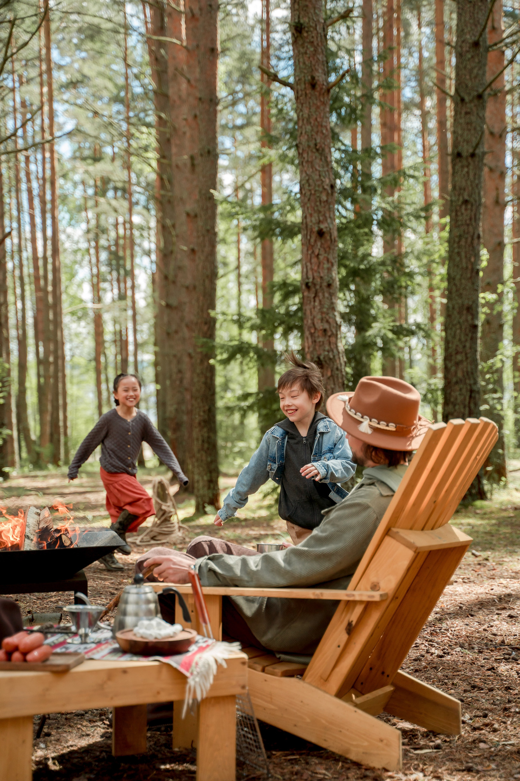

WELCOME
PLEASE MAKE YOURSELF AT HOME
TO THE
Apartment
name

Slide 2
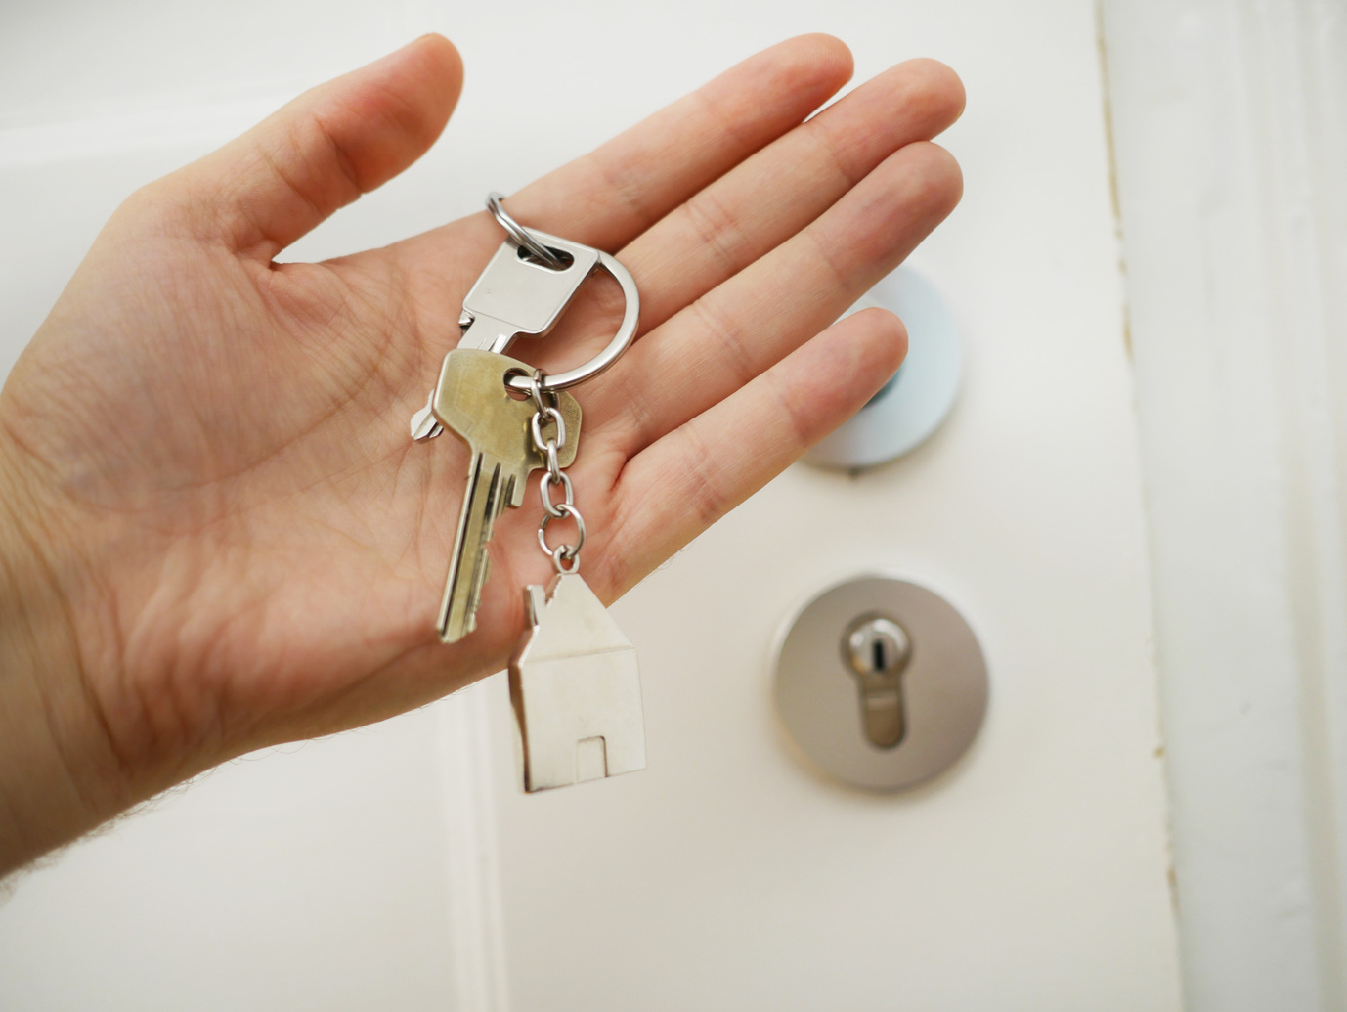
CHECK-IN | CHECK-OUT
4PM | 10AM
Please let us know if you need somewhere to store your
luggage on check-in | check-out days.
Address
Phone number

Slide 3
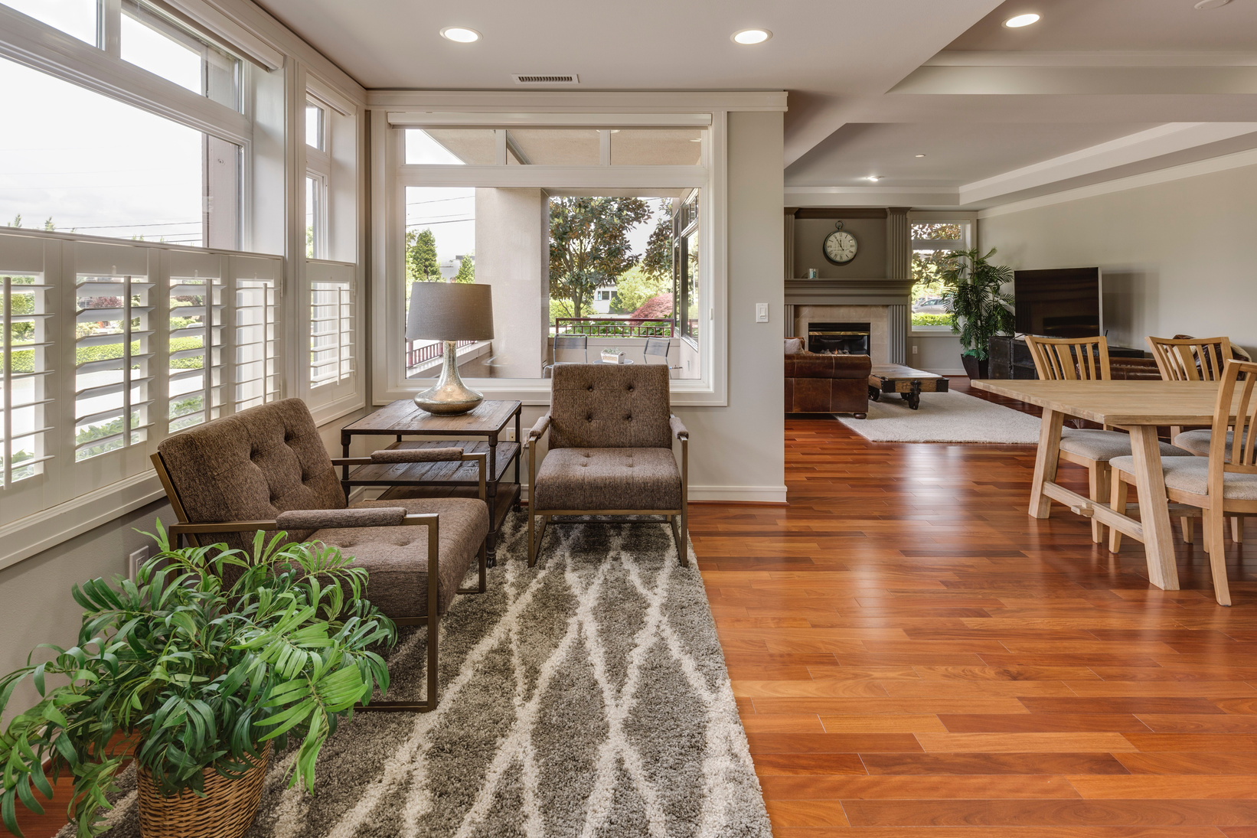








HOUSE RULES
NO SMOKING
Except in designated
area outside
NO LOUD NOISE
Especially after
10pm
NO PETS ALLOWED
No
Exceptions
NO EXTRA GUESTS
Except people named
on the booking
CHECKOUT 10AM
We need to get the house
ready for the next guests
NO SHOES
Please remove all
footwear at the door

Slide 4

ENJOY FREE WIFI
NETWORK
WoodlandRetreatGuests116
PASSWORD
WoodlandRetreat

Slide 5



LEAVE A REVIEW
Dear valued guest,
We hope you enjoyed your stay with us and had a wonderful experience. We strive to provide our guests with the best possible service and accommodations, and we are always looking for ways to improve.
If you have a few moments to spare, we would greatly appreciate it if you could leave us a review on our website or social media channels.
Your feedback is extremely important to us and helps us to continue to provide exceptional service to future guests.
Thank you again for choosing to stay with us, and we look forward to hosting you again in the future.

Slide 6

CHECK-OUT DAY
Strip the beds of linens and pillowcases that have been used during their stay.
Collect all the used towels and place them in a designated area.
Take out any garbage and recyclables to the proper bins outside.
Clean and put away any dishes that were used during their stay.
Wipe down and clean the kitchen counters, stovetop, and sink.
Remove any food from the refrigerator and cabinets that they brought in.
Turn off any lights and electrical appliances that are not needed.
Lock all doors and windows (including the patio doors) before leaving the Airbnb.
Leave the key(s) in the designated spot and make sure it is secure.
Leave a note or message for the host if they have any concerns or feedback about their stay.

Slide 7
NO SMOKING
Except in designated
area outside
THANK YOU

Slide 8
NO LOUD NOISE
AFTER 10PM
Please be courteous to
our neighbours
THANK YOU

Slide 9
NO PETS ALLOWED
Strictly no exceptions - we
are sorry for any
inconvenience caused
THANK YOU

Slide 10
PET FRIENDLY
Cats and dogs welcome
in our home
THANK YOU

Slide 11

SAVE ENERGY
Please turn off the lights
when not in use
THANK YOU

Slide 12

TOWELS
Please leave dirty towels
in the bath or shower
THANK YOU

Slide 13
NO SHOES INSIDE
Please remove all footwear
at the front door
THANK YOU

Slide 14

TOILET PAPER ONLY
Please do not flush anything
other than toilet paper down
the toilet - please use
bin provided
THANK YOU

